Slide 1
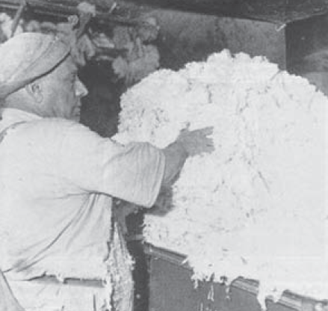
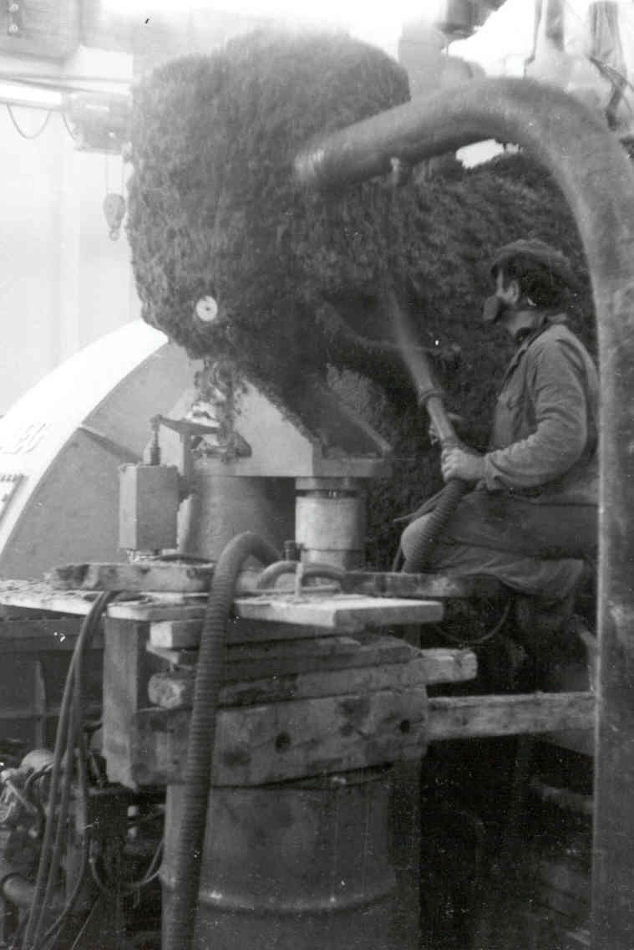
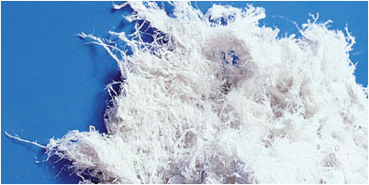
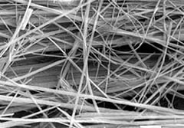


The Role of the Occupational/Environmental History with a focus on chrysotile exposure for lung, laryngeal, ovarian cancer
Xaver Baur
Institute for Occupational Medicine, Charité University Medicine Berlin, Germany
European Society for Environmental and Occupational Medicine, EOM

Slide 2
The Role of the Occupational/Environmental History Why is occupational/environmental history of diseased former asbestos- exposed workers needed? - estimation of likelihood of asbestos causation - national regulatory thresholds for acceptance of an ARD, e.g. 25 fiber-years for lung cancer in Germany - identification of additional risk factors and differential diagnostic aspects
Xaver Baur-Ramazzini Days 2016

Slide 3
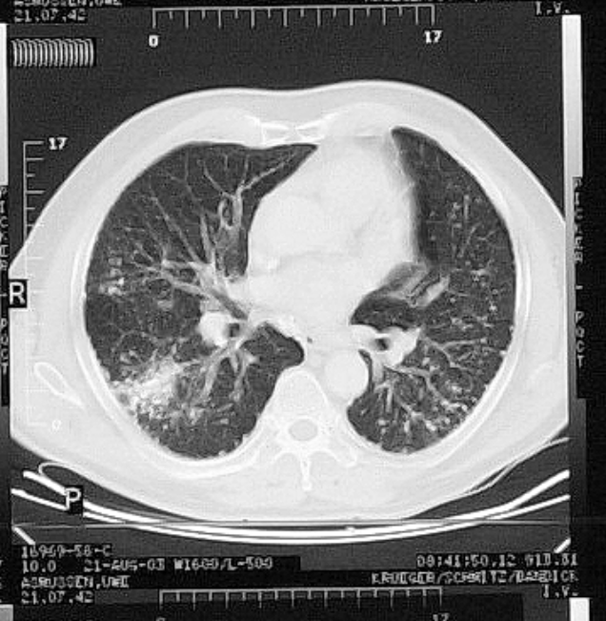
Social Court Cologne lawsuit:
W.H., m., 72 yrs
Lung cancer
Cause?

Slide 4
Social Court Cologne lawsuit: W.H., m., 72 yrs Diagnosis: lung cancer
Occupational history:
1959-1984 brewer, preparing 4 times a day huge filters for filtering beer by use of 25-40 kg kieselguhr (diatomite) +
1-2.5 kg chrysotile
Confounder: 10 Packyears
Cumulative asbestos estimates by industrial hygienists:
23 fiber-years (based on personal interview + Fiber-years Report*
4 fiber-years*
2.6 fiber-years*
21.6 fiber-years
*industrial hygienists from insurance
Xaver Baur-Ramazzini Days 2016

Slide 5
Social Court Cologne litigation case: W.H., m., 72 yrs Diagnosis: lung cancer
Occupational history:
1959-1984 Brewer, preparing 4 times a day huge filters for filtering beer by use of 25-40 kg kieselguhr (diatomite) +
1-2.5 kg chrysotile
Confounder: 10 Packyears
Cumulative asbestos estimates by industrial hygienists:
23 fiber-years (based on occup. history + Fiber-years Report*
4 fiber-years*
2.6 fiber-years*
21.6 fiber-years
*industrial hygienists from insurance
Expert opinion: Accept lung cancer as an occupational disease due to syncancerogenicity of asbestos and quartz
Xaver Baur-Ramazzini Days 2016

Slide 6
Radiology
Lung function testing, exercise test, biopsy + histology in case of suspected malignancy
Differential diagnosis
Xaver Baur-Ramazzini Days 2016

Slide 7
Asbestos exposure
assessment in a personal interview (questionnaire)
Plants/jobs
Hrs per day
per week
per month
Asbestos type
http://gvs.bgetem.de/formulare/
formulare-fuer-den-arzt

Slide 8
Questionnaire
Asbestos Exposure Assessment
Asbestos products used
http://gvs.bgetem.de/formulare/
formulare-fuer-den-arzt

Slide 9
Questionnaire
Asbestos Exposure Assessment
How did you handle these
asbestos materials?
Hygiene conditions
ventilation, exhaust
PPE, mask
http://gvs.bgetem.de/formulare/
formulare-fuer-den-arzt
Xaver Baur-Ramazzini Days 2016

Slide 10
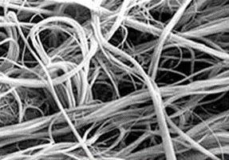
Chrysotile covers c. 95 % of asbestos applied in most countries; it has been utilized in c. 3,000 of products, e.g.
Cement
Insulation
Joint compound
Roofing materials
Brake pads and linings
Gaskets
Textiles
Filters
Xaver Baur-Ramazzini Days 2016

Slide 11
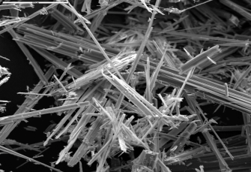
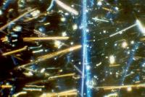
Leading uses of crocidolite asbestos
Fire protection, thermal insulation
Spray-on insulation, e.g. in power plants
Chemical insulation
Electrical or telecommunication wires
Leading uses of other amphibole asbestos types
Anthophyllit: Chemical insulation
Amosit: Thermal/chemical insulation, tiles
Tremolite: Paints, sealants, plumbing materials
Xaver Baur-Ramazzini Days 2016

Slide 12
How to assess the cumulative asbestos dose?
Use of exposure matrices and databases from previous measurements
(NIOSH) (OSHA)
Dement et al. 1983, 2015 https://www.ncbi.nlm.nih.gov/pubmed/6846339; http://oem.bmj.com/content/early/2007/11/05/oem.2007.033712.full.pdf+html
Kauppinen et al. 1998 http://onlinelibrary.wiley.com/doi/10.1002/(SICI)1097-0274(199804)33:4%3C409::AID-AJIM12%3E3.0.CO;2-2/abstract
Swuste et al. 2008 http://annhyg.oxfordjournals.org/content/52/5/397.full.pdf
van Oyen et al. 2015 http://annhyg.oxfordjournals.org/content/59/6/737.long
[Faserjahr Report] (Fiber-Years Report) http://publikationen.dguv.de/dguv/pdf/10002/bk_rep0113.pdf
Xaver Baur-Ramazzini Days 2016

Slide 13
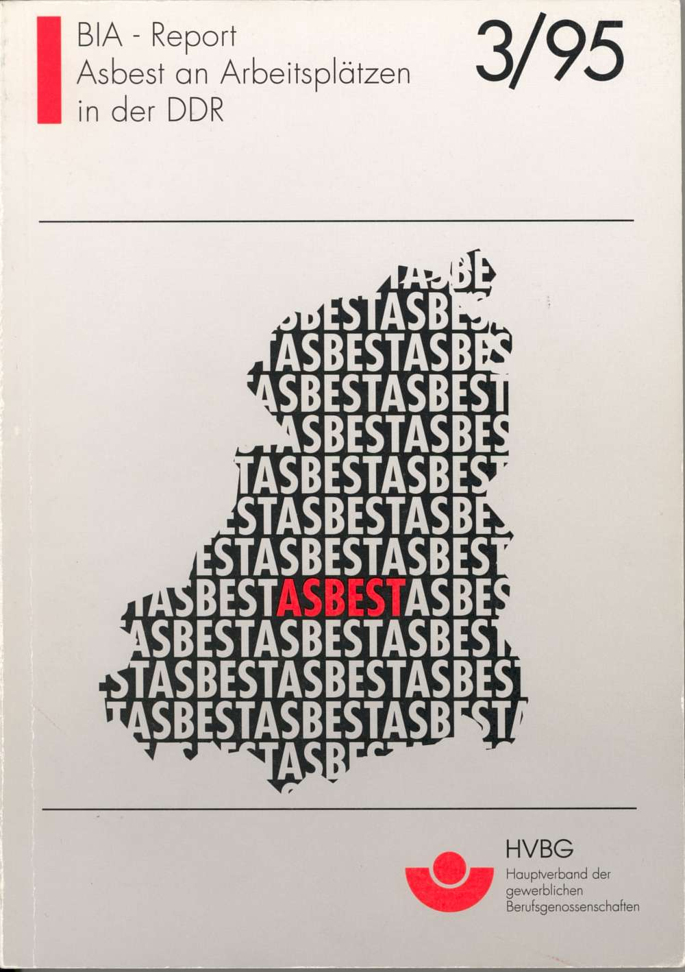


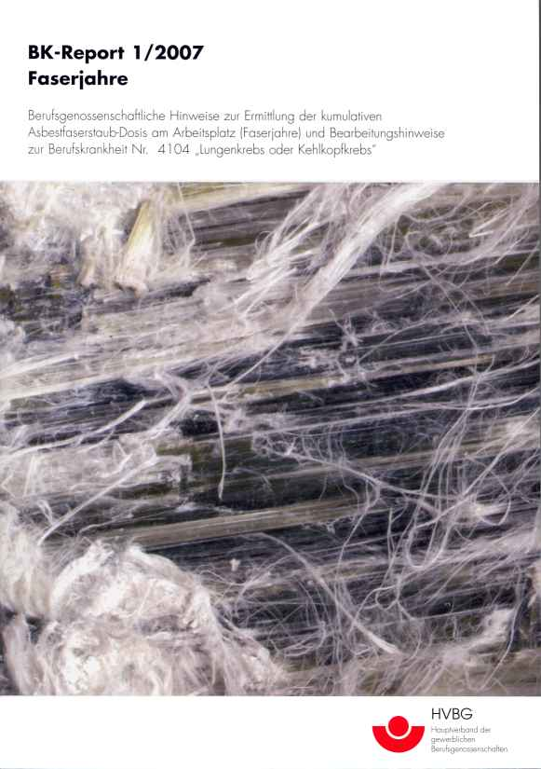

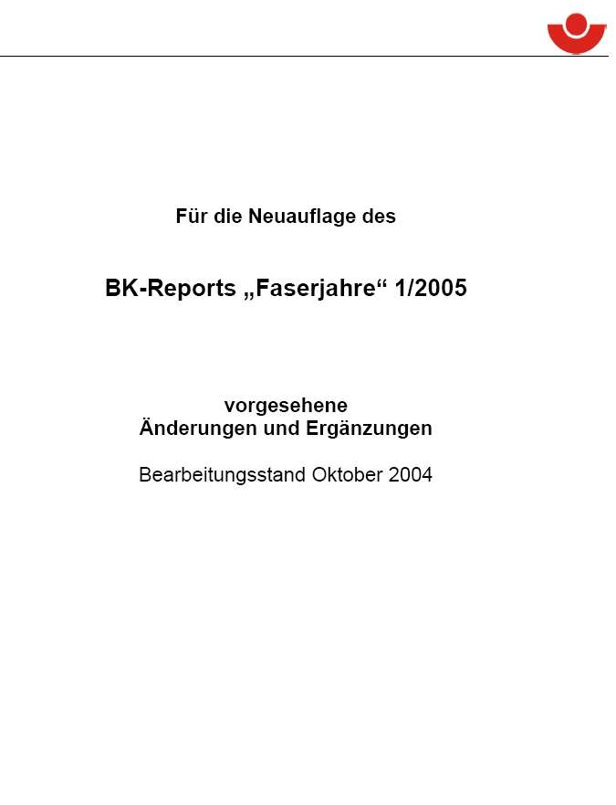
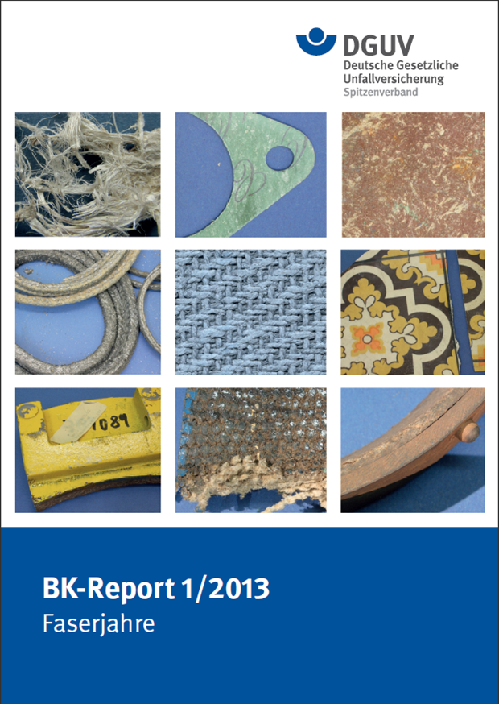
Fiber-years Report (Faserjahre) 2013
http://publikationen.dguv.de/dguv/pdf/10002/bk_rep0113.pdf

Slide 14
Fiber-years Report (Faserjahre)
till 1972: estimates and literature
1972-1991: c. 25,000 measurements by membrane filter and IR spectrometry
means and 90% upper CI for 60 different occupations with various tasks
Xaver Baur-Ramazzini Days 2016

Slide 15
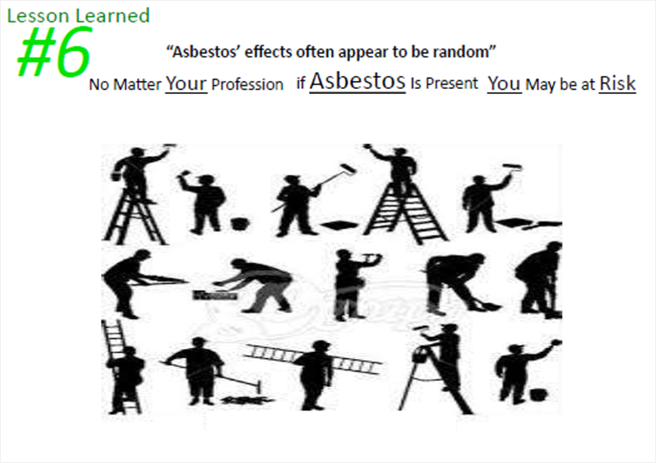


start exposure assessment
Case history
Assessment of
fiber-years in the
individual case
with suspected ARD
exposure
data available?
applicable?
check databases
- means/ 90% upper CI
- set order of data
Yes
No
data
obtained
from the plant?
(or from a comparable plant?)
apply
Fiber-years Report
yes
Yes
Estimate/calculate fiber-years
Xaver Baur-Ramazzini Days 2016

Slide 16
Fiber conc.
90 % CI
F/cm³
% exposure per shift
Calculation:
time-related or
shift (mean)
Type of work
up CI
Examples: roofers
working on
asbestos
corrugated
sheets
Cutting with a hand-hold angle grinder
6% cutting < 1981
1% cutting >1981
6% cutting< 1981
94% trilling+
displacing
1% cutting >1981
99% trilling+
displacing
Disclacement
on a roof
+ bystander of 6% cutting< 1981
+ bystander of 1% cutting >1981
exposure
Xaver Baur-Ramazzini Days 2016

Slide 17
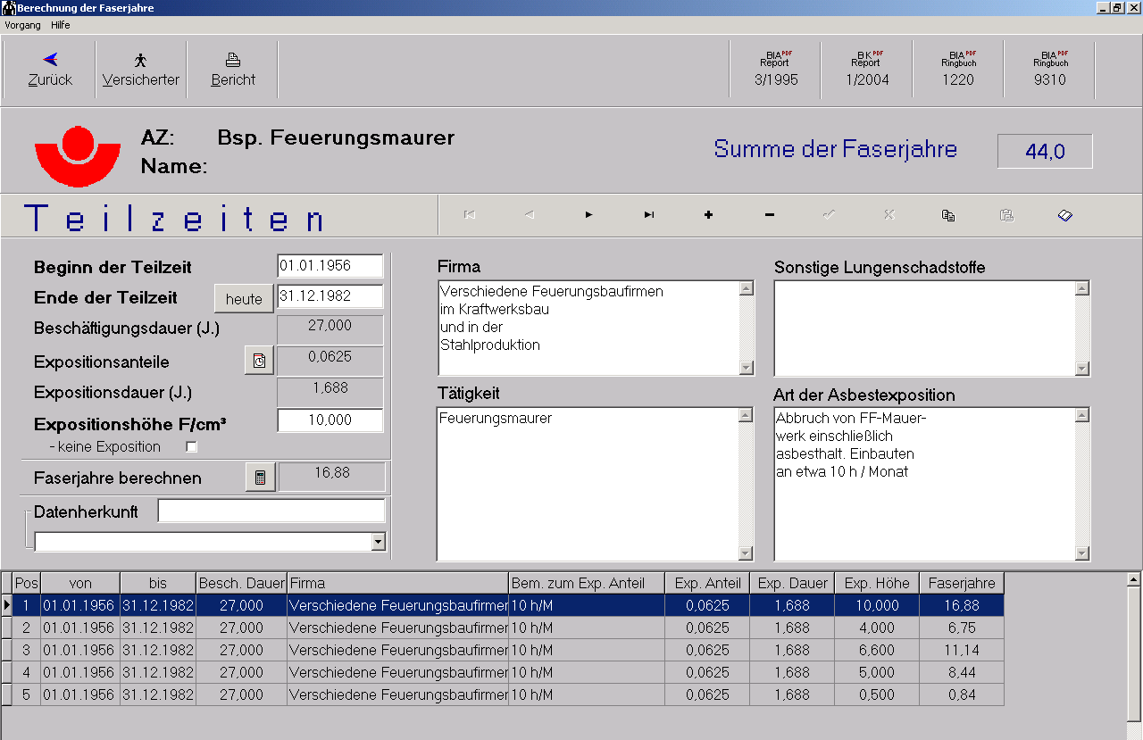
Assessment of fiber-years by IFA occupational history software
Entry screen mask „Calculation of fiber-years“ (Version 5.0 11/2013)
CAVE:
Gospel In ->
Gospel Out!
Garbage In ->
Garbage Out!
plant
Date: start
end
exp. proportion
exp. level F/cm3
job
exp. details
Xaver Baur-Ramazzini Days 2016

Slide 18
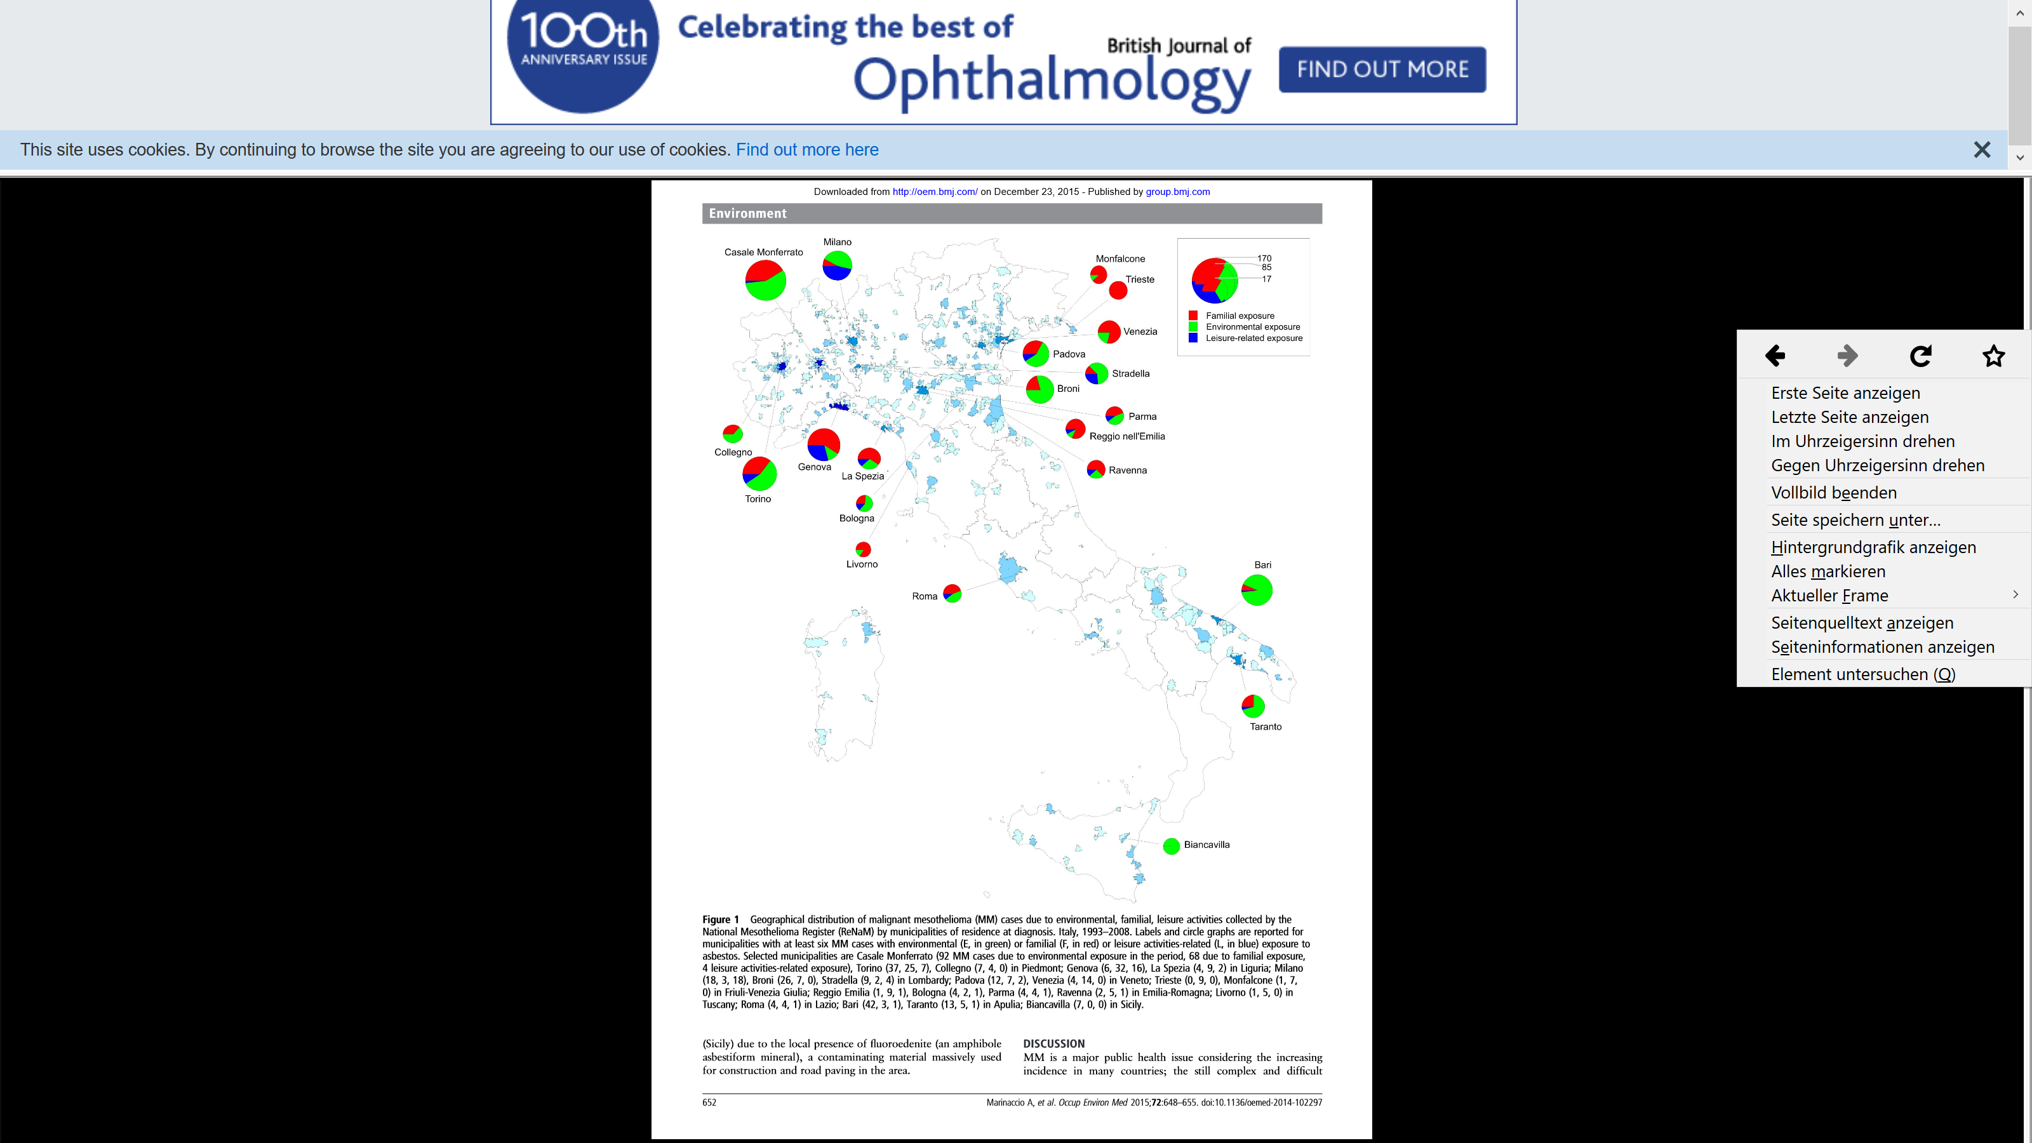
Non-occupational asbestos-induced mesothelioma in Italy
Environmental
history
Risk related to distance
to asbestos plant, wind,
concentration,
frequencies and
duration of exposures
530
514
188
Marinaccio et al. 2014: Italian ReNaM: Among the 15 845 mesothelioma cases registered between 1993 and 2008, exposure to asbestos fibres was investigated for 12 065 individuals (76.1%), identifying 530 (4.4%) with familial exposure (they lived with an occupationally exposed cohabitant), 514 (4.3%) with environmental exposure to asbestos (they lived near sources of asbestos pollution and were never occupationally exposed) and 188 (1.6%) exposed through hobby-related or other leisure activities.

Slide 19
The Role of the Occupational/Environmental History Additional risk factors due to co-exposures and differential diagnosis
AR lung cancer: smoking, PAH, quartz, radon (syncancerogenicity)
Larynx cancer: smoking, alcohol abuse
Ovarian cancer: genetics, fertility drug clomiphene citrate (Clomid®), hormon therapy
AR COPD: smoking, other dusts
Differential diagnosis of asbestosis: other pneumoconioses, IPF, collagenoses
Xaver Baur-Ramazzini Days 2016

Slide 20
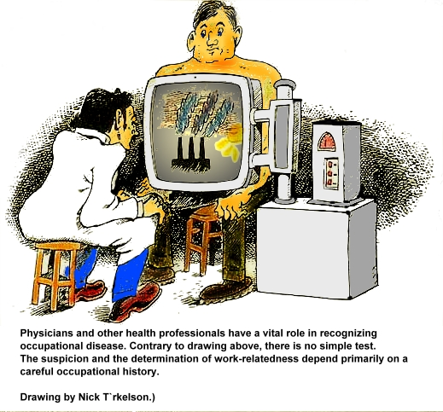
Take home message:
A qualified occupational history is a prerequisite of diagnosis and exclusion of ARD. It is a time-consuming hard work, requiring extensive training and experience.
A good questionnaire is helpful
Thanks for your
attention
Xaver Baur-Ramazzini Days 2016

