Slide 1

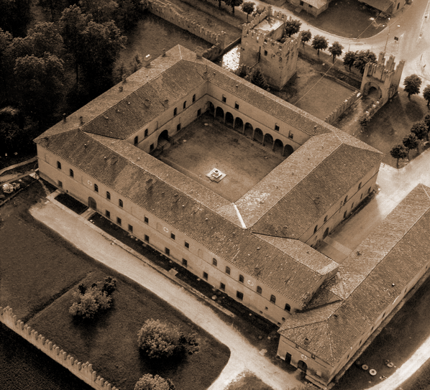

Comparison between the NTP carcinogenesis studies on RF with the RF carcinogenesis study performed by the RI on the same strain of rats
Dr. Fiorella Belpoggi
Director
Cancer Research Center
Cesare Maltoni
Annual Ramazzini Days
Carpi, October 28th , 2016

Slide 2
Radio Frequencies in vivo studies
Observational data collected in earlier, large-scale population-based studies, have found limited evidence of an increased risk for developing cancer from cell phone use
From early 2000, both NTP and RI started a program to perform an experimental study on radiofrequency (RF)

Slide 3




Radio Frequencies in vivo studies
AIM OF THE STUDY
The nomination for NTP to study cell phone RF radiation was made by the U.S. Food and Drug Administration
Animals were exposed to frequencies and modulations currently used in cellular communications in the United States
The nomination for the RI study was performed on the basis of the number of people exposed and the inadequacy of information on the possible hazards
Animals were exposed to frequencies and modulations that mimic the commonly human population exposure to radiobase-station antennas in the world

Slide 4


Radio Frequencies in vivo studies
GSM (Global System for Mobile Communication)
CDMA (Code Division Multiple Access)
Near Field
GSM (Global System for Mobile Communication)
Far Field

Slide 5
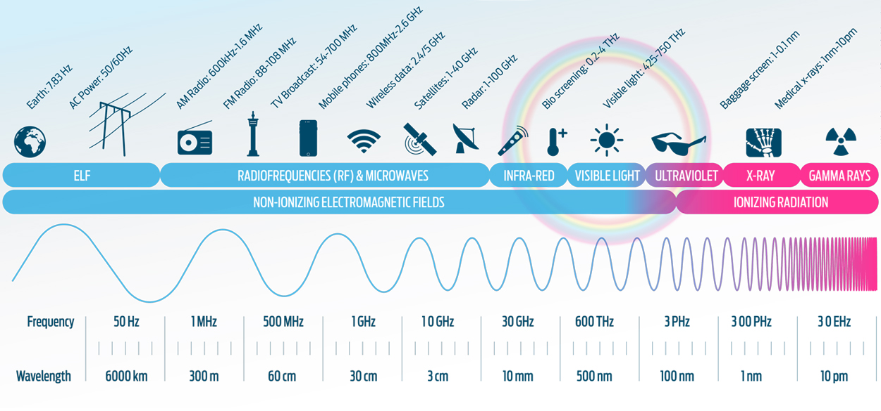

Radio Frequencies in vivo studies

Slide 6
Radio Frequencies in vivo studies
SAR values (W/Kg)
(base-10 log scale)
0.001 0.01 0.1 1 10
≈0.001 ≈0.025 ≈0.1
1.5 3 6
RI study
NTP study

Slide 7
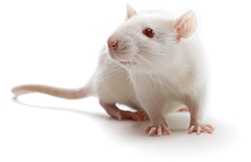
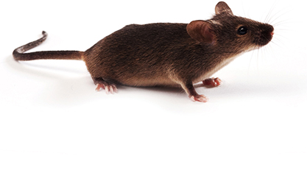
Radio Frequencies in vivo studies
ANIMAL MODELS
Sprague-Dawley rats
B6C3F₁ mice
Sprague-Dawley rats
FREQUENCY OF SIGNAL MODULATION
1900 MHz
900 MHz
1800 MHz
I group: 6 W/Kg (90 F, 90 M)
II group: 3 W/Kg (90 F, 90 M)
III group: 1.5 W/Kg (90 F, 90 M)
IV group: 0 W/Kg (90 F, 90 M)
I group: 50 V/m (202 F, 207 M)
II group: 25 V/m (202 F, 209 M)
III group: 5 V/m (410 F, 401 M)
IV group: 0 V/m (405 F, 412 M)
STUDY GROUPS AND EXPOSURE
FREQUENCY OF SIGNAL MODULATION
TIME OF EXPOSURE
10-min on, 10-min off increments
9 hours/day, 7 days/week
continuous exposure
19 hours/day, 7 days/week

Slide 8


Radio Frequencies in vivo studies
Prenatal
Postnatal
Total animals: 720
Sacrifice
(106 weeks)
start of treatment
Prenatal
Postnatal
Total animals: 2448
Lifespan
start of treatment

Slide 9
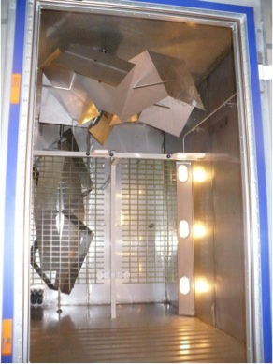
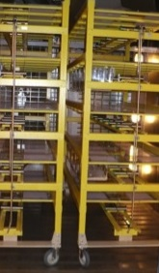
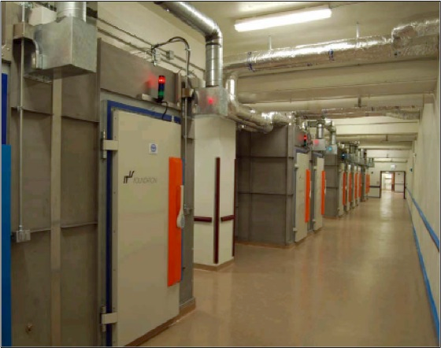
NTP Exposure System

Slide 10
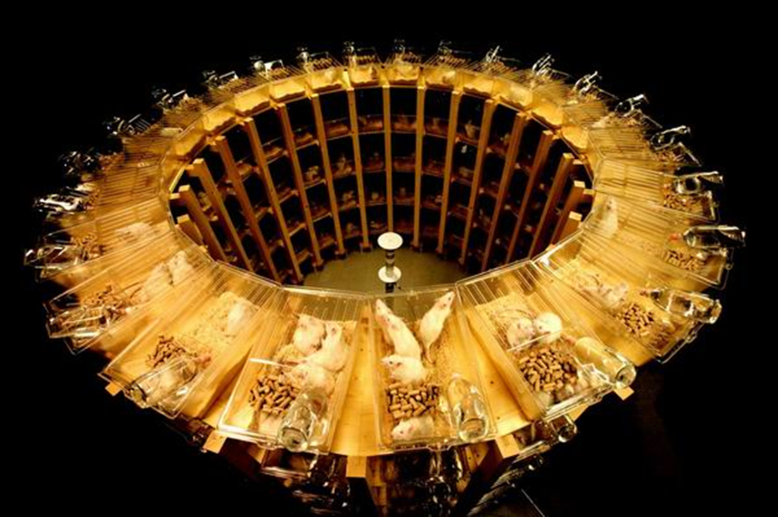
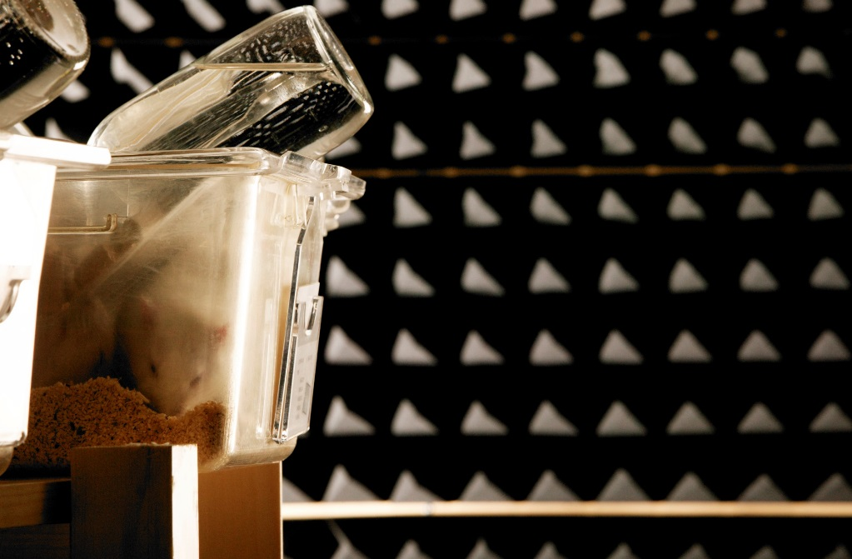
Ramazzini Institute Exposure System

Slide 11

Radio Frequencies in vivo studies – Results
BRAIN
MALIGNANT GLIOMA:
Low incidences occurred in GSM and CDMA exposed male rats, none were observed in controls.
GLIAL CELL HYPERPLASIA:
Low incidences occurred in GSM and CDMA exposed male rats, none were observed in controls.

Slide 12
Radio Frequencies in vivo studies – Results
HEART
SCHWANNOMA:
Statistically significant positive trend in male rats exposed to GSM- and CDMA-modulation (p<0.05).
SCHWANN CELL HYPERPLASIA:
Not statistically significant increased incidence in male rats exposed to either GSM- or CDMA-modulation, and in female rats exposed to CDMA-modulation.

Slide 13

Radio Frequencies in vivo studies – Results
IN ADDITION..
Litter weights tended to be lower in GSM and CDMA RFR-exposed groups compared to controls
Early in the lactation phase, body weights of pups were lower in GSM-and CDMA-modulated RFR groups at 6 W/kg compared to controls
The complete results from all the rat and mice studies will be available for peer review and public comment by the end of 2017
The evaluation of data are now ongoing and the results of the study will be available by the end of 2017

Slide 14
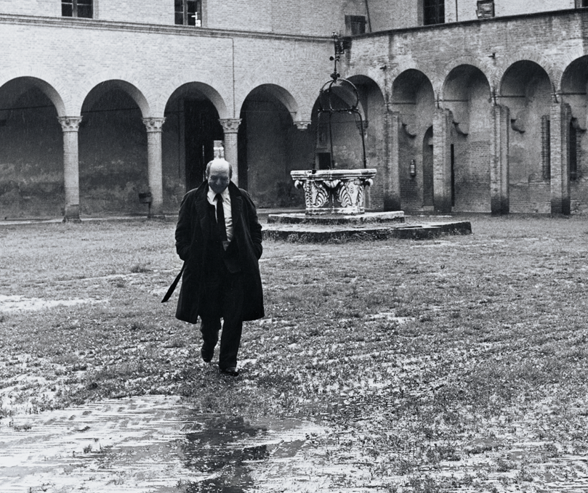
In memoriam of our Founder, 15 years on
From:
Maltoni, C., Lefemine, G., Ciliberti, A.
Carcinogenicity bioassays of vinyl chloride monomer: A model of risk assessment on an experimental basis(1981) Environmental Health Perspectives, Vol. 41, pp. 3-29.

