Slide 1
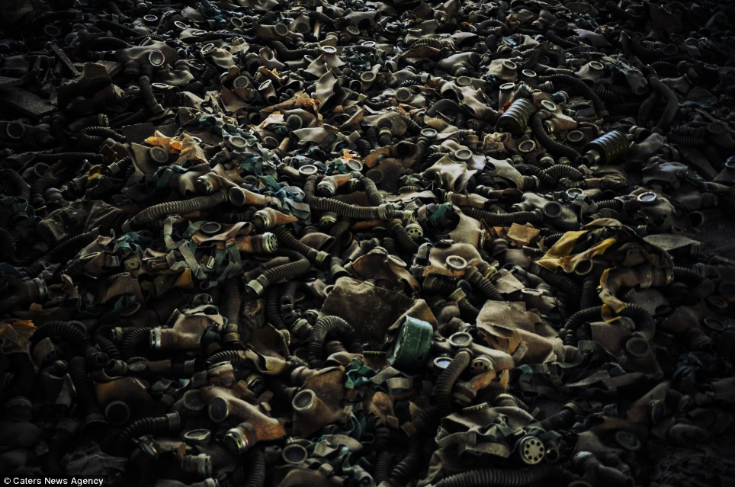
Liquidators of Chernobyl nuclear plant accident: 30 years after extreme occupational exposure to ionizing radiation Aleksandra Fucic¹,Elizaveta Neronova ² ¹Institute for Medical Research and Occupational Health, Zagreb, Croatia ²Nikiforov Russian Center Emergency and Radiation Medicine EMERCOM of Russia, St Petersburg, Russian Federation

Slide 2
Signal about the fire at the NPP was received in fire station on April 26, 1986 at 1 a.m. 28 min
uncontroled nuclear reaction and tempreture increased up to 2500 C
One of the first who took part in the liquidation of the accident, were firemen, who worked in total dark and connected water pipes while walking in radioactive water
240 firemen extinguished fire within 6 hours.
They were exposed to doses of up to 16 Gy. Almost all of them died within 3 months.

Slide 3
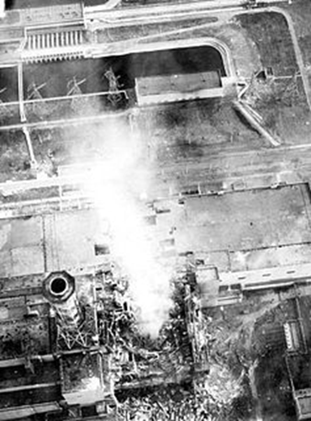

Slide 4
in the first week there were serious shortcomings in the organization of individual monitoring (lack of personal dosimeters as nobody expected such large doses)
In most cases biological dosimetry showed that military dosimeters underestimated received doses. This is why doses were later estimated based on clinical symptoms and biodosimetry but generaly as it was combined internal and external radiation exposure, thus calculation of doses was very complex with questionable accuracy

Slide 5
An estimated 350 000 emergency and recovery operation workers (liquidators), including army (from almost all regions of Soviet Union), power plant staff, local police and fire services, were initially involved in cleaning up.
Among them, about 240 000 recovery operation workers took part in major mitigation activities at the reactor and within the 30-km zone surrounding the reactor. Later, the number of registered "liquidators" rose to 600 000 (this includes number of civilans who joined willingly)
Military nuclear accident experts 1960-1992 were referred as "Chemical Troops”, after 1992 these forces were renamed as 'Radiation, Chemical, and Biological Defense Troops". Soldiers were in the disaster area in the most acute period from April to November-December 1986
In 1986 the upper permissible dose was 250 mSv, in 1987 100 mSv and further 50 mSv

Slide 6
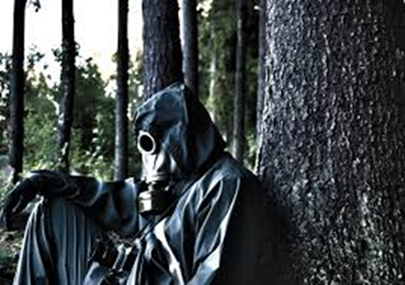
Due to high temperatures of air it was almost impossible to work in rubber suits so some liquidators fainted after an hour of work
Due to hot weather, liquidators who wore respirators experienced face exfoliation
Liquidators worked 12 h per day

Slide 7
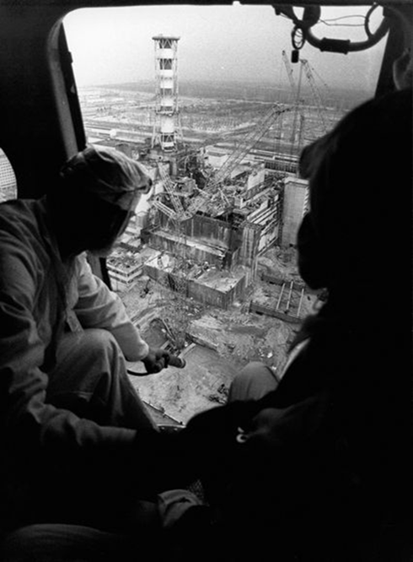
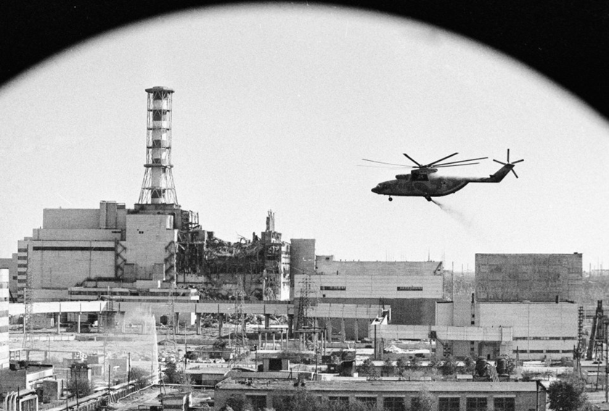
In order to lower the temperature helicopters were throwing lead panels, bohr (neutrolizing element for neutrons),sand, dolomite and clay
60 t of material was thrown in three days
Pilots during the first fligths received doses of approximatelly 6 Sv

Slide 8
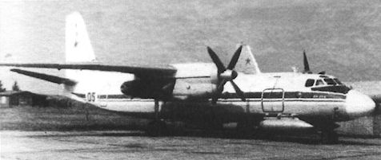
During operation "cross",70 aircraft-flights were performed for estimation of radionuclides fallout at a distance from nuclear power from 3 to 13 km at altitudes from 25 m to 2 km. During the first days people worked in shifts in the danger zone just a few minutes During the period from april 1986 to November 1990 radiology experts monitored radiation contamination over an area of ​​3500 km² During decontamination it 2.2 million m³. of radioactive soil was moved
Laboratory airplan An 24 RR was used for air analysis

Slide 9
As they commented later on, there was no educational program which could prepare them for the situation and conditions in which they worked

Slide 10
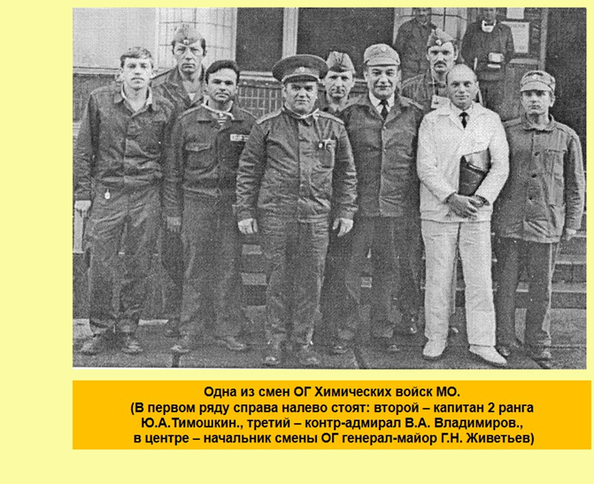
May 3rd, 1986 Task Force was organized with a plan to
explore routes for evacuation
the point of measuring radiation levels and sampling of air, soil, water and vegetation
organize information collection
organize analysis of samples
collect radioactive waste and the removal of the upper layers of soil, loading them into the metal containers
select temporary burial of radioactive waste containers and equipment
organize decontamination of engineering and construction machinery
organize preventive health measures to reduce the effects of radiation exposure of people.

Slide 11
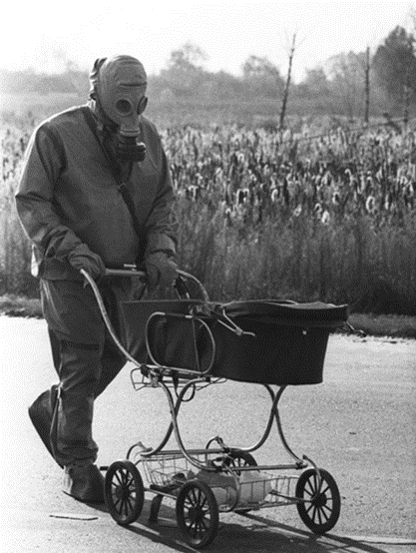
On May 2nd the evacuation of 9864 residents of all settlements from the 10-kilometer zone around the plant started, and later on a total of 99,195 citizens were evaucuated in May (30 km zone), followed by additional 200,000 during the next few years.
Police handled 600 drunk people during the first few days
Additional problem was that people who were evacuated were returning as they wanted to take more things but this would cause transfer of contamination on clear regions, so police was returning same subjects for several times.
Evacuation was additionally slow, as number of subjects were old and hardly walking
As it was a rural environment with large namber of animals
75 000 of cattle was evacuated

Slide 12
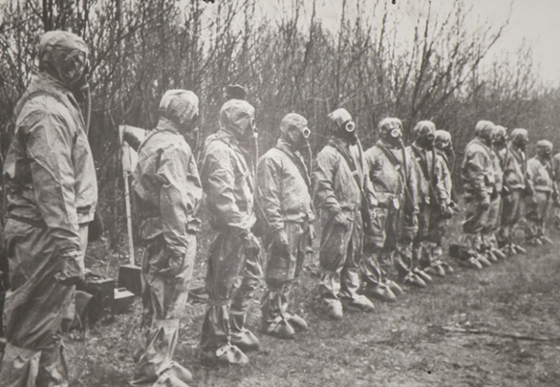
Empty villiges, without a single sound, except hens on trees afraid of hungry dogs, and here and there a horse or cow
Liquidators fed hungry dogs which were left, lost horses….

Slide 13
After the first, most acute phase, all efforts to localize the accident were focused on creating a special protective structure called a sarcophagus ( "Shelter" object).
At the end of May 1986 a special organization, consisting of several construction and installation units, concrete plants, mechanization administrations, transport, energy and other started with work.
Basement of Sarcophagus was built by companies who build metro
With the completion of this unique building in November 1986, the main focus of contamination was localized.

Slide 14
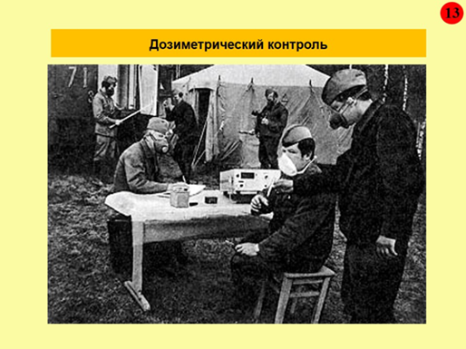
There was no cell phones, laptops or printers, dose certificates were written by hand

Slide 15
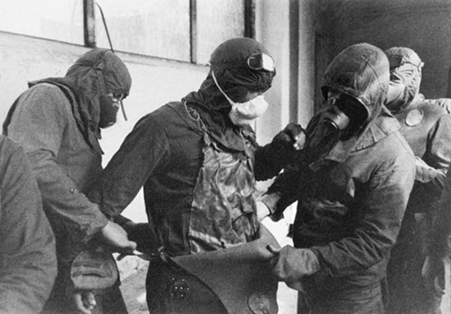
All liquidators willingly took part in clean up tasks
Nobody rejected to take part. It was way how people were raised, loving their country and feeling duty to sacrifice their life for general cause
Dedication was the most important feature of liquidators

Slide 16
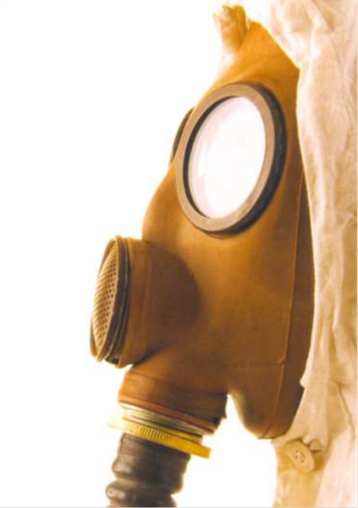
HEALTH CONSEQUENCIES IN LIQUIDATORS

Slide 17
according to the UNSCEAR 2008 Report, the majority of the 530,000 registered recovery operation workers received doses of between 0.02 Gy and 0.5 Gy between 1986 and 1990
The examination of liquidators of the accident either shortly after accident or many years following their irradiation, revealed increased levels of chromosome aberrations, genome instability and, methylation disturbances as compared to unirradiated individuals (Sevankaev et al. 1995;Snigiryova et al. 1997; Neronova et al. 2003; Kuzmina et al 2014)
liquidators who worked within the first year after this accident receiving the mean external whole body dose of 0.2 Gy, have increased incidence of cerebrovascular diseases (Katscheev et al., 2016)

Slide 18
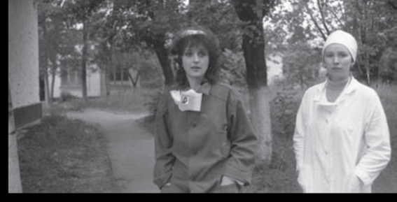

In liquidators, a significant increase in incidence of leukimia and solid cancers (Kashcheev et al. 2015) with a latent period between 4 and 15 years is described (Ivanov et al. 2009).
Significantly increased increased thyroid cancer rates among Chornobyl liquidators (Ostroumova et al., 2014), using polymorphysims of DNA damage response gense it is possible to make difference between sporadic and radiogenic thyroid carcinoma ( Akulevich et al., 2009)
In liquidators convulsive epileptic seizures are significantly increased by 33.3 times (p<0.001) mainly during the first 10 years after exposure (Podsonnaya et al., 2015)
Increased cardiovascular diseases (Liubchenko et al.,2004)
Increased cataract (Hamer et al., 2013)
Signficantly increased suicide rate (Rahu et al., 1997) death is less problem than waiting to die
Increase of breast cancer in female recovery workers (Prysyazhnyuk et al., 2007)
Currently, the health status of liquidators and their families are regularly monitored. Thus, for example, the information about exposed persons from Russia and their health are continuously collected in the National Radiation Epidemiological Registry

Slide 19
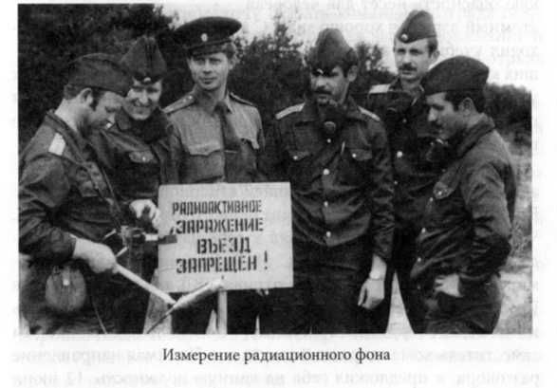
Health consequencies of liquidator children

Slide 20
Children of liquidators, who lived in the St Petersburg region showed a significant increase in genome damage in comparison with control subjects (Vorobtsova et al. 1995;Stepanova et al. 2006), lower DNA repair capacity (Suskov et al. 2006), increased markers of apoptosis, transgeneretional genome instability and radiosensitivity (Suskov et al. 2008; Shevchenko et al 2006, Kovalenko , 2012)
Birth anomalies have been found to be significantly increased in the children of liquidators. Minor malformations were diagnosed in 88 % of the children of persons who were exposed to radiation as children during the ChNPP accident. The highest incidence of birth defects was detected 2–3 years after exposure of fathers, and this decreased over the course of 6–7 subsequent years (Lyaginskaja et al. 2009).
In liquidators’ families, there is a dose-related increase in children with intrauterine growth retardation (Ermalitskiy et al. 2013).
Immunodeficiency (Baleva et al., 2015)
In children who were conceived either while their fathers were working at the facility or up to 2 months later, the frequencies of genome damage was higher than in children who were conceived at least 4 months after their fathers had stopped working at the Chernobyl site. (Livshits et al. 2001).

Slide 21
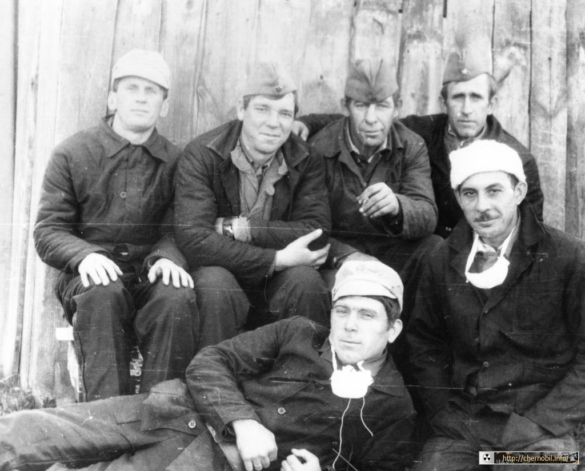
We are alive as long as you remember us

