Slide 1

THE IMPACT OF POLLUTION ON GLOBAL HEALTH: Emergence of an Underappreciated Risk Factor
Philip J. Landrigan, M.D., M.Sc., F.A.A.P. Dean for Global Health Professor of Preventive Medicine and Pediatrics Icahn School of Medicine at Mount Sinai

Slide 2
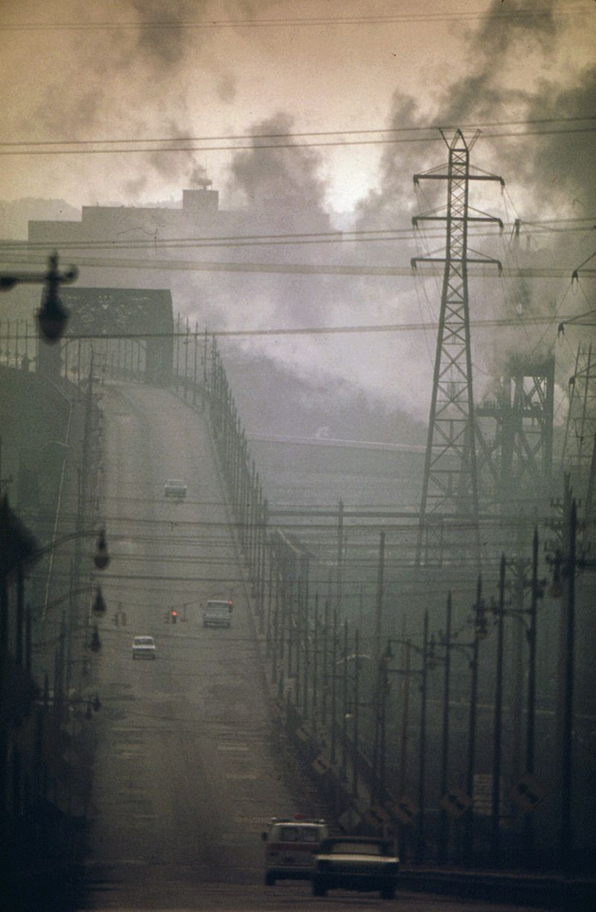
Pollution and Global Health
Definition of Pollution
…unwanted, dangerous materials discharged into air, water and onto the earth that harm directly human health and degrade the environment
The externalized, uncounted
by-products of production

Slide 3
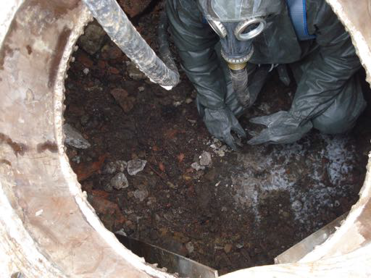
Pollution is a Major Cause of Disease and Premature Death

Slide 4
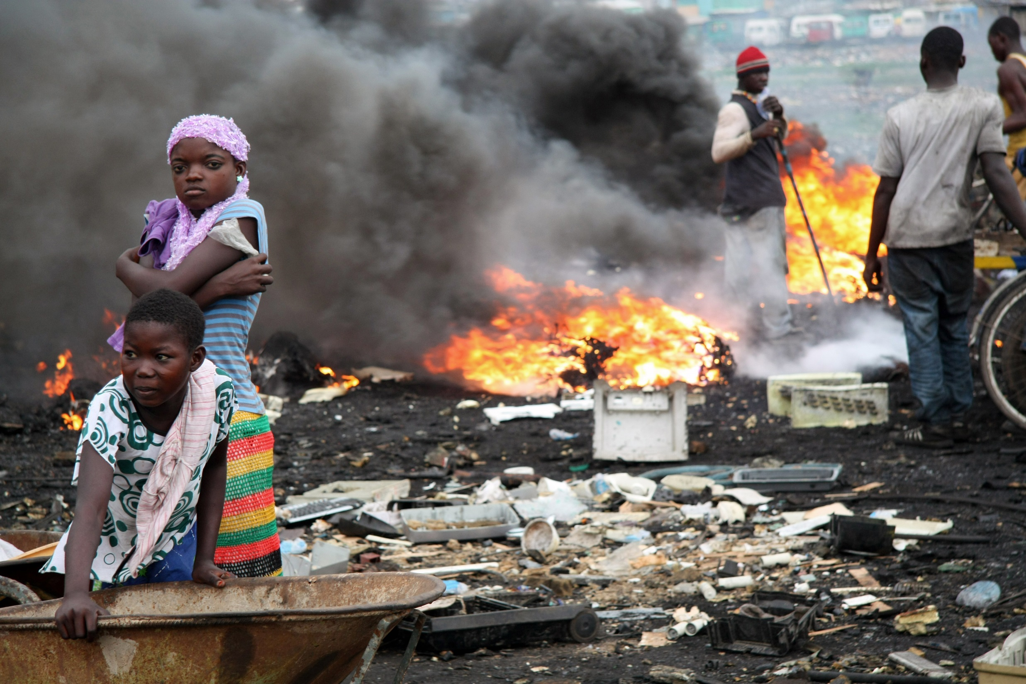
A toxic cocktail of air and soil pollution from e-waste recycling in Ghana

Slide 5
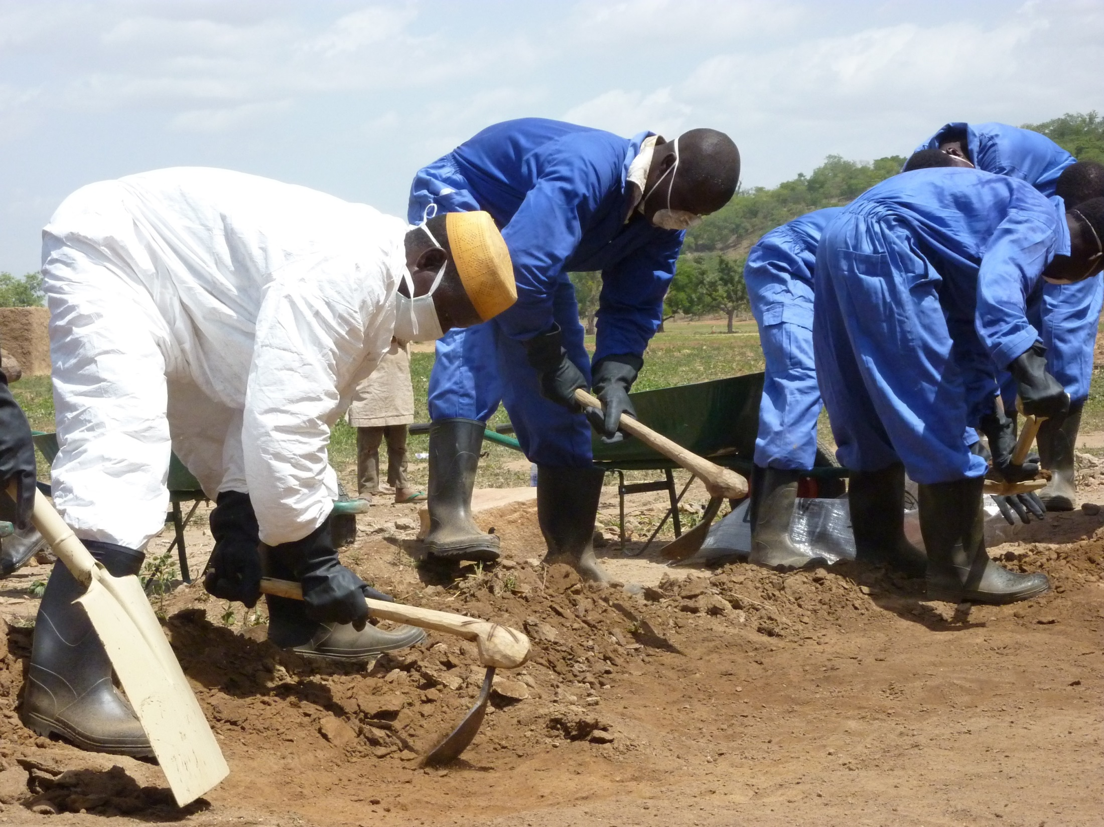
Villagers in northern Nigeria cleaning up lead pollution that killed more than 400 children in one year

Slide 6
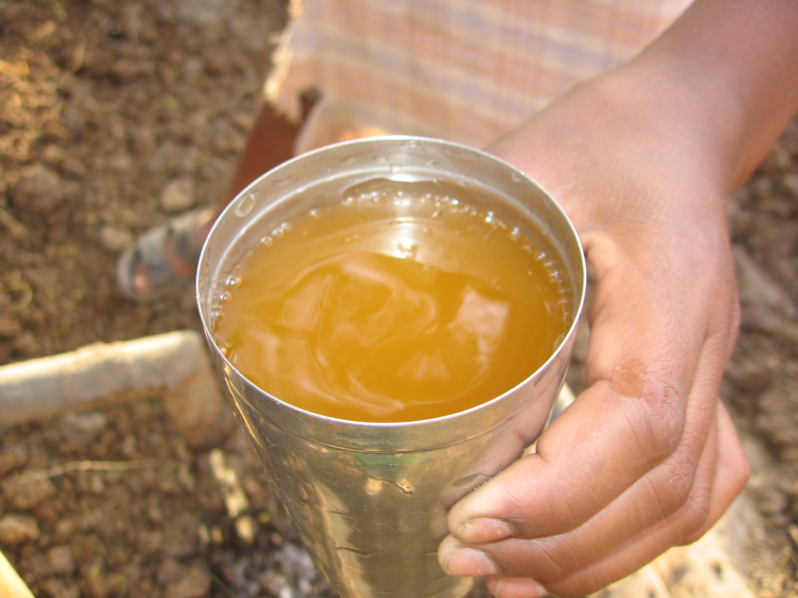
Groundwater contaminated with hexavalent chromium from leather tanning in India

Slide 7
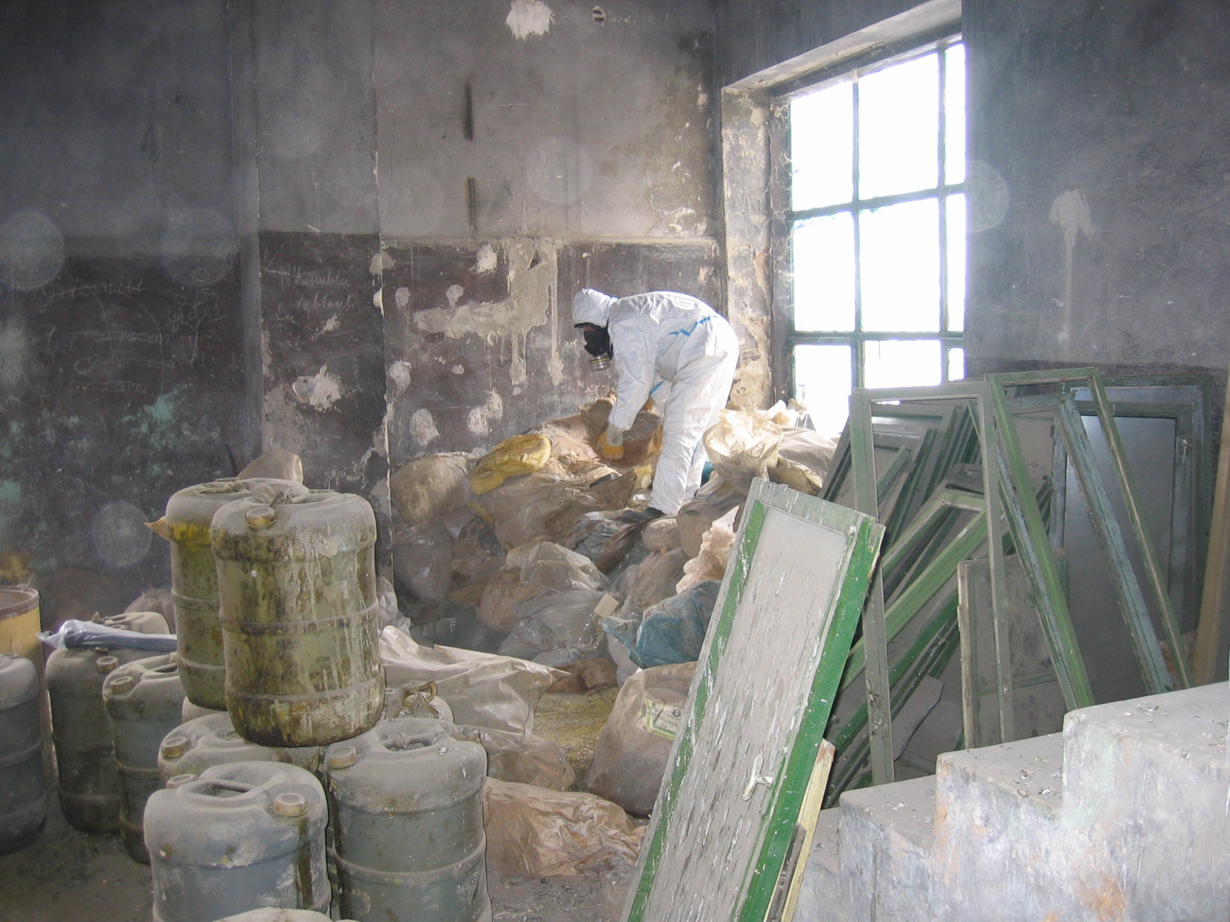
Banned and obsolete pesticides left in crumbing buildings in
Eastern Europe

Slide 8
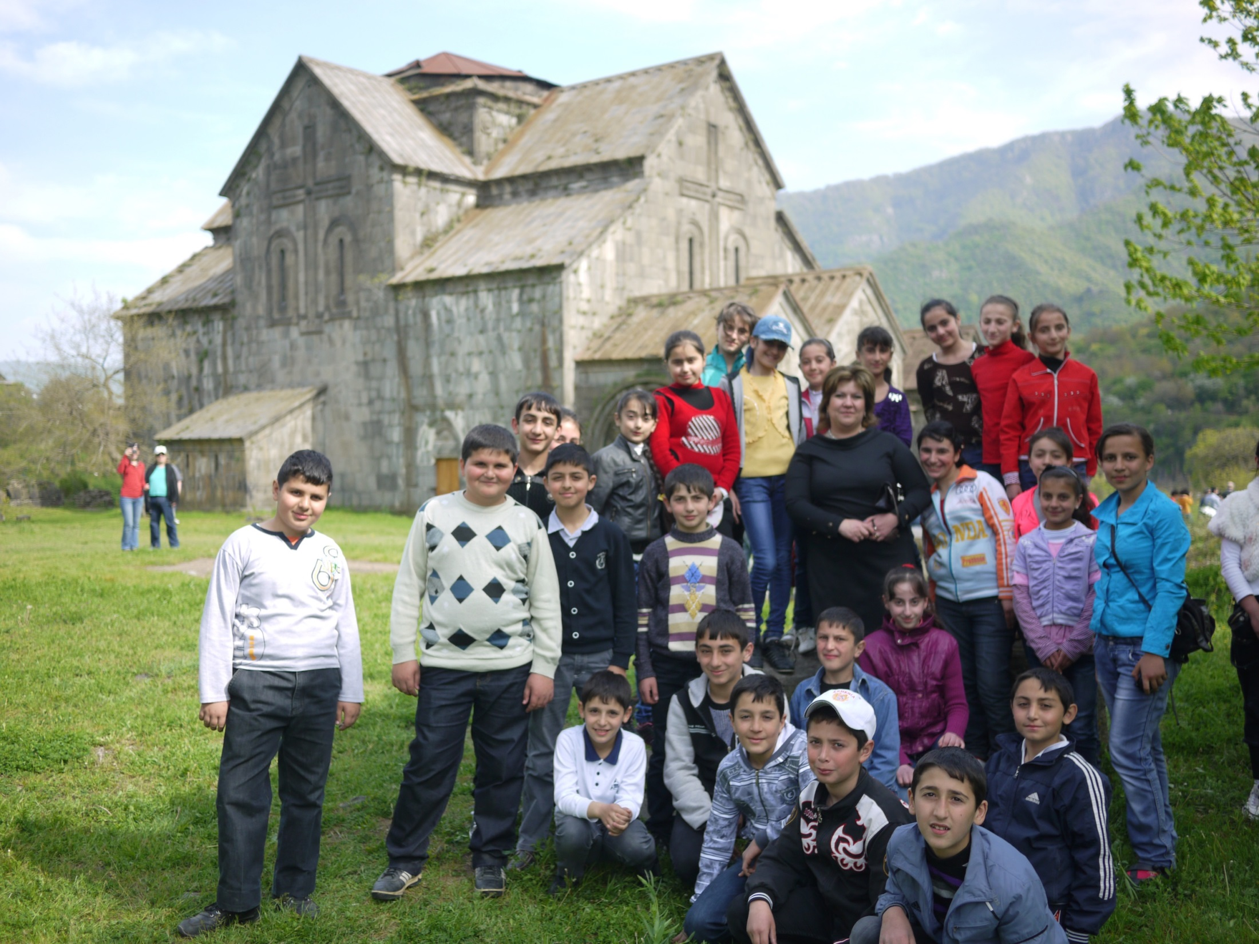
A community in Armenia where half of the children have lead poisoning

Slide 9
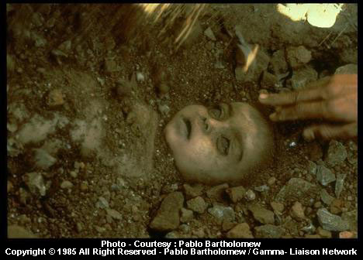
Bhopal, India

Slide 10
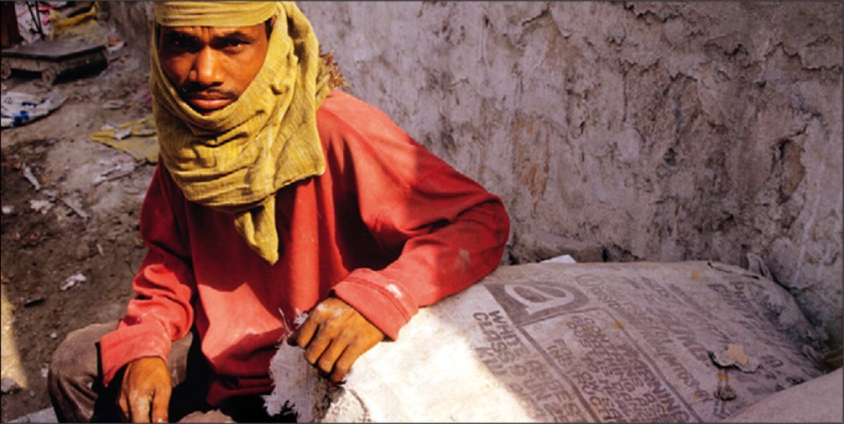
Asbestos Export to Developing Countries
Two million tons of new asbestos are produced each year
Most is exported to the world’s poorest countries
In south Asia, asbestos consumption is increasing at >10 % per year
Used mainly in construction
5-10 million total deaths from asbestos cancers projected by 2030

Slide 11
E-Waste - A Growing Global Problem
E-waste is that it is the fastest-growing component of the municipal waste stream worldwide
In 20 years, developing nations will be discarding 400-700 million personal computers annually
Developed nations will be throwing out 200-300 million a year

Slide 12
Deaths Due to Pollution are Increasing
Major drivers:
Urbanization – over 50% of global population now resides in cities. Populations are exploding in third world mega-cities
Increasing use of motor vehicles
Industrialization
Globalization. Relocation of hazardous industries to developing countries – steelmaking, chemical and pesticide production, shipbreaking, waste recycling
Global spread of toxic chemicals
Notes:
I would include that industrialization includes industrialization of agricultural and livestock production

Slide 13
Patterns of Pollution and Disease Change as Countries Develop
Least developed countries:
Indoor air pollution causes respiratory disease
Contaminated drinking water causes dysentery
Industrializing countries:
Toxic chemicals, ambient air pollution and other modern pollutants become increasingly important and cause a suite of non-communicable diseases:
Children: asthma, neurodevelopmental disorders and sudden infant death syndrome
Adults - asthma, chronic bronchitis, COPD, atherosclerosis, ischemic heart disease, stroke, renal disease, lung cancer, accelerated neurological degeneration and premature death
Developed countries:
- Air pollution levels are falling but only slowly

Slide 14
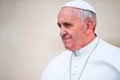
Pollution is a Human Rights Issue
94% of deaths from pollution-related disease occur in low- and middle-income countries
In countries at all income levels, pollution disproportionately affects the poor and marginalized
Women, children, the elderly and minorities are the main victims
Contrast these sad realities with Pope Francis’ social and environmental teaching in Laudato Si’

Slide 15
Pollution is Extremely Costly
Costs of pollution related disease include:
Medical care costs
Opportunity costs from the diminished productivity of people who die prematurely or are damaged by pollution
Annual cost of diseases in American children caused by pollution was estimated to be $76.6 billion in 2008 – main component is the diminished lifelong productivity of children damaged by lead and other neurotoxins
Lead poisoning in Flint, MI will result in estimated lifetime costs of $400 million - the consequence of a short-sighted attempt to save $5 million in the cost of drinking water

Slide 16
Pollution’s Costs are Uncounted and Largely Invisible
The costs of pollution control are tangible and relatively easy to compute
By contrast, the costs of pollution and pollution-related disease are not easily discerned.
These costs are spread out across large populations over many years, do not affect environmental budgets, and are buried deep in health care costs and in lost productivity
They are externalized and not captured in standard accounting
But these costs are so great that they can undermine national growth trajectories, distort health system spending and truncate the growth and development of entire societies.

Slide 17
Pollution Control is Highly Cost-Effective
Control of air pollution in the US yields a return of $30 for every dollar invested
Control of childhood lead poisoning in the US yields a return of between $17 and 221 for every dollar invested

Slide 18
Pollution and its Diseases have been Neglected
Despite it great and growing magnitude, pollution and its diseases are not high priorities in the global health agenda
Despite the proven feasibility of pollution control, less than 5% of international development assistant goes to prevent and clean up global pollution and prevent pollution-related disease
Barriers to pollution control:
Lack of knowledge of pollution’s health effects
Separation of environmental protection from public health
Fragmentation of the pollution agenda
Powerful vested interests

Slide 19



The Global Commission on
Pollution & Health
Launched in summer 2015

Slide 20
The Global Commission on Pollution & Health
Goals
1. To inform key decision makers globally about pollution’s severe and underrecognized contribution to the global burden of disease and its enormous economic costs; and
2. To present these leaders actionable, data-driven strategies for pollution control and disease prevention

Slide 21
The Global Commission on Pollution & Health
Anticipated Work Products
First-ever analysis of the global burden of disease attributable to all types of pollution
First-ever analysis of PRD’s global economic costs
Actionable strategies based on case studies for pollution control and disease prevention
Evidence-based recommendations for pollution control and prevention of pollution-related disease
Notes:
I would steer clear of overpromising. The report is not analyzing GBD/economic costs of ALL types of pollution

Slide 22
The Global Commission on Pollution & Health
Three Key Audiences
Heads of government – Presidents, Governors and Mayors
International development organizations - United Nations agencies, multilateral development banks, bilateral funding agencies, private foundations and NGOs
Health professionals
The Commission’s intent is to dispel the myth that pollution is unavoidable, to overcome apathy and entrenched vested interests, and to mobilize the political will, the leadership and the resources that will be needed to control pollution and prevent PRD worldwide

Slide 23
The Global Commission on Pollution & Health
The Team:
Global Alliance on Health and Pollution
UN Environment Programme
World Bank
Pure Earth
Institute for Health Metrics and Evaluation
Co-Chairs:
Philip Landrigan - Dean for Global Health, Professor of Preventive Medicine and Pediatrics, Icahn School of Medicine at Mount Sinai
Richard Fuller – Executive Director, Pure Earth

Slide 24
The Global Commission on Pollution & Health
Commissioners:
Neric Acosta - Presidential Adviser for Environmental Protection, Government of the Philippines
Robert Arnold – Professor of Chemical and Environmental Engineering, University of Arizona
Kenneth Arrow, Nobel Laureate in Economics; Professor of Economics at Stanford University
Siti Nurbaya Bakar, Minister of Environment and Forestry for the Government of Indonesia; Secretary General of the Regional Representatives Council for the Government of Indonesia (2004-2013); Secretary General of the Ministry of Home Affairs for the Government of Indonesia (2001-2005)
Abdoulaye Bibi Baldé – Minister of Environment and Sustainable Development, Republic of Senegal
Ralava Beboarimisa – Minister of the Environment, Ecology, Sea and Forestry, Madagascar
Roberto Bertollini – Chief Scientist and WHO Representative to the EU World Health Organization, Office at the European Union
Li Bingbing - Actress; singer; environmental protection advocate; UNEP Goodwill Ambassador
Jo Ivey Boufford – President, New York Academy of Medicine
Patrick Breysse - Director, National Center for Environmental Health/Agency for Toxic Substances and Disease Registry, U.S. Centers for Disease Control and Prevention
Paula Caballero – Senior Director, Environment and Natural Resources, World Bank Group
Palaniappan Chidambaram, Union Minister of Finance for the Government of India (2004-2008, 2012-2014); Minister of Home Affairs for the Government of India (2008-2012)

Slide 25
The Global Commission on Pollution & Health
Thomas Chiles - DeLuca Chair of Biology and Vice Provost for Research, Boston College
Her Royal Highness Princess Chulabhorn - Princess of Thailand; President, Professor, Chulabhorn Research Institute
Johanita Dahimananjara – Minister of the Environment, Ecology, Sea and Forestry, Madagascar
Valentin Fuster - Professor of Internal Medicine and Cardiology, Physician in Chief and Director, Zena and Michael A. Wiener Cardiovascular Institute, Mount Sinai Medical Center, New York, NY; General Director, Centro Nacional de Investigaciones Cardiovasculares Carlos III (CNIC), Madrid, Spain; President, World Heart Federation (2005-2006)
Michael Greenstone, Director of the Energy Policy Institute at Chicago (EPIC); Milton Friedman Professor in Economics at the University of ChicagoDevelopment Council
David Hunter, Associate Dean, Harvard T. H. Chan School of Public Health
Bruce Lanphear – Clinician Scientist, Child and Family Research Institute, BC Children’s Hospital; Professor, Faculty of Health Sciences, Simon Fraser University
Bindu Lohani, Vice President for Knowledge Management and Sustainable Development for the Asian Development Bank (ADB); Vice President for Finance and Administration for the Asian Development Bank (2007-2011)
Keith Martin – Executive Director, Consortium of Universities for Global Health; Member of Parliament, Canada (1993-2011)
Karen Mathiasen, Senior Advisor, Office of the U.S. Executive Director, World Bank Group; Director, Multilateral Development Banks, U.S. Dept. of Treasury
Maureen McTeer - Canadian Lawyer, Author, Women's Rights and Health Advocate, and Adjunct Professor of Health Law at the University of Ottawa

Slide 26
The Global Commission on Pollution & Health
Christopher Murray - Professor of Global Health, University of Washington; Director, Institute for Health Metrics and Evaluation
Ramon Paje, 19th Secretary of the Philippine Department of Environment and Natural Resources (DENR); former DENR Undersecretary for Field Operations; former DENR Executive Director of the Minerals Frederica Perera - Professor of Environmental Health Sciences, Director of the Columbia Center for Children's Environmental Health, Mailman School of Public Health, Columbia University
Janez Potocnik, European Commissioner for the Environment (2010-2014); European Commissioner for Science and Research (2004-2010); Minister for European Affairs for Government of Slovenia (2002-2004)
Alexander Preker - Executive Scholar & Adjunct Associate Professor, Columbia University, Mt. Sinai and NYU; President and CEO of the Health Investment & Financing Corporation; former Head of Health Industry Group & Chief Economist for Health, World Bank/IFC (1991-2013)
Jairam Ramesh, Member of the Indian Parliament; Minister of Rural Development for the Government of India (2011-2014); Minister of State at the Ministry of Environment and Forests for the Government of India (2009-2011)
Johan Rockström - Professor of Environmental Science, Director of Stockholm Resilience Centre, Stockholm University
Carlos Salinas, former President, Mexico
Aitkul Samakova, Member of Parliament, Kazakhstan; Minister of Environment, Kazakhstan (2002-2006)
Leona Samson, Professor of Biology and Biological Engineering, Massachusetts Institute of Technology (MIT); Director of the MIT Center for Environmental Health Sciences (2001-2012)
Karti Sandilya - Senior Advisor, Pure Earth; U.S. Resident Director, Asian Development Bank (2002-2004); Joint Secretary, Ministry of Finance, India (1983-1986)

Slide 27
The Global Commission on Pollution & Health
Onno van Schayck – Scientific Director of the Netherlands School of Primary Care Research, Professor of preventative medicine, Maastricht University
Awa Marie-Coll Seck – Minister of Health, Republic of Senegal; Director, Department of Policy, Strategy and Research and Department of Country and Regional Support, UNAIDS (1996-2001)
Peter Sly - Professor of Faculty of Medicine and Biomedical Sciences, Senior Clinical Research Fellow, the University of Queensland
Achim Steiner, Executive Director of the United Nations Environment Programme (UNEP); Director General of the International Union for Conservation of Nature (IUCN) (2001-2006)
Kirk Smith, Professor of Global Environmental Health, Director of the Global Health and Environment Program at the School of Public Health, University of California, Berkeley
Richard Stewart - Professor of Law, Director of the Frank J. Guarini Center on Environmental, Energy, and Land Use Law, New York University School of Law
William Suk, Director, Center for Risk and Integrated Sciences, the Superfund Research Program and the Hazardous Substances Research Branch, US National Institute of Environmental Health
Gautam Yadama, Dean and Professor, Boston College School of Social Work
Kandeh Yumkella - Former Director-General of the United Nations Industrial Development Organization (UNIDO), Founder - Sustainable Energy for All
Ma Zhong - Professor and Dean, School of Environment and Natural Resources, Renmin University of China; Senior Advisor, Ministry of Environmental Protection; Council Member, China Council for International Cooperation of Environment and Development Sciences

Slide 28
The Global Commission on Pollution & Health
Report structure:
Executive Summary with recommendations
Introduction and Overview
Chapter 1. Global burden of disease due to pollution
Chapter 2. Economic costs of pollution-related disease
Chapter 3. Pollution and social justice
Chapter 4. Solutions
To be published in The Lancet in early 2017

Slide 29
Beyond the Commission
The Commission’s work will not end with publication of its report in The Lancet in early 2017
We are mapping intervention programs to continue the Commission's work globally and in countries worldwide. The Global Alliance on Health and Pollution (GAHP) will coordinate
We call for research to correlate pollution exposures with health outcomes. Far too little is known about too many polutants
Sustainability of these programs will require the creation of a new Global Fund for Prevention of Pollution and Disease. This will be a key recommendation of the Commission

Slide 30
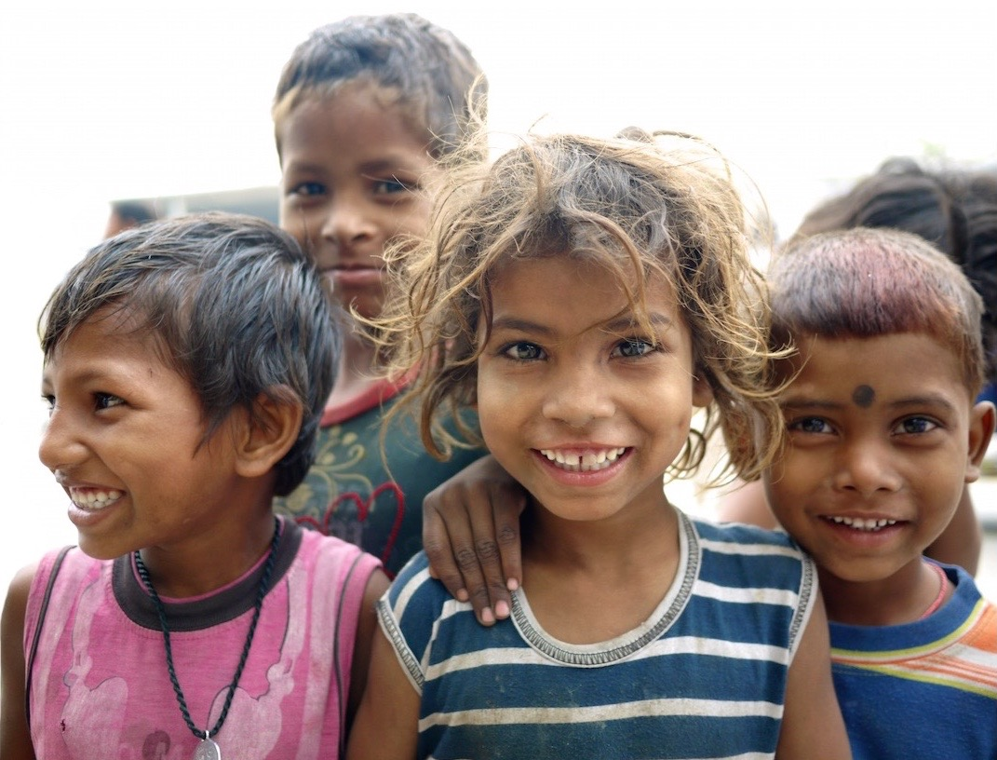
Thank you

