Slide 1
Drinking water and manganese neurotoxicity: re-establishing the guidelines
Donna Mergler
Université du Québec à Montréal
Notes:
two distinct manganese
oxides and pigment preparations were used in painting
the Great Bull of Lascaux.

Slide 2
Manganese in drinking water
Natural manganese:
  Manganese is the the 12th most abundant of the crust's elements
  Manganese in soil varies between 7–9000 ppm.
  In some areas with very high manganese, it is mined.
Manganese from anthropogenic sources
  Contamination of water delivery systems from industrial pollution, toxic dump sites, irrigation sewage, manganese-based pesticides (maneb, mancozeb), others….

Slide 3
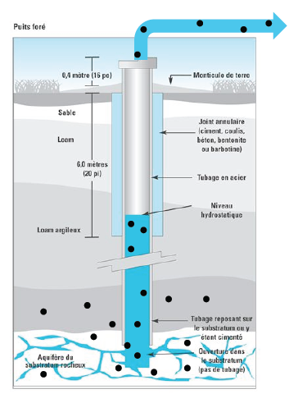
Natural manganese in drinking water
Manganese can be present in drinking water systems supplied by groundwater due to the favourable redox conditions prevailing in many aquifers.
Brochure to explain to Quebec study participates how natural Mn gets into their municipal and domestic wells (2009)

Slide 4
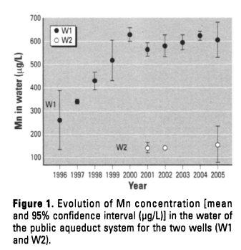
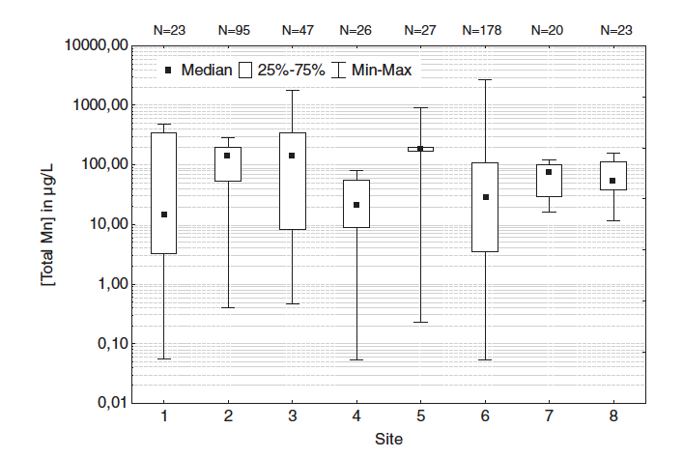
Natural manganese in drinking water
Municipal and domestic artesian wells
Municipal well monitoring data over time
Tap water from municipal and domestic wells
Bouchard et al. 2007
Barbeau et al. 2011

Slide 5
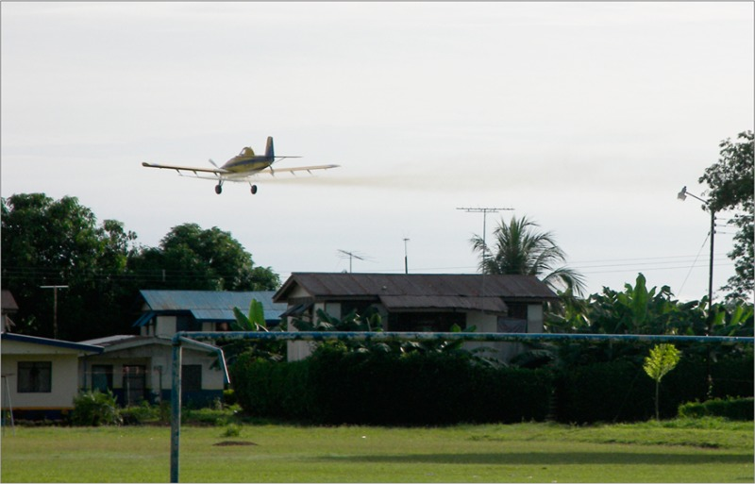
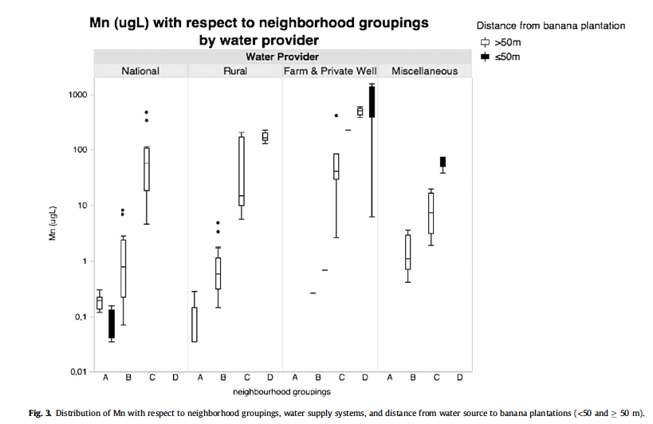
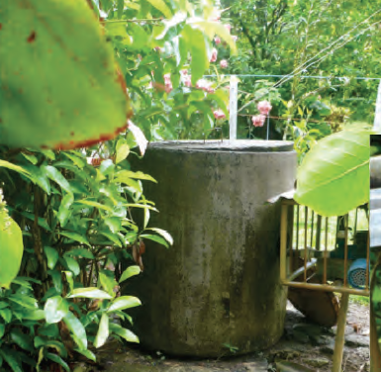
Aerial spraying of mancozeb
ISA birth cohort study
Costa Rica
Private well; picture taken by A. Skytt (2011)
Van Wendel de Joode et al, 2016

Slide 6
World Health Guidelines on Manganese on Drinking Water
Year | Concentration | Reason
1958 | 500 µg/L | health
1983 | 100 µg/L | esthetic
1993 | 500 µg/L | health
2006 | 400 µg/L | Health
2011 | No guideline because “this health-based value is well above concentrations of manganese normally found in drinking water, it is not considered necessary to derive a formal guideline value.”
Time to Re-evaluate the Guideline Value for Manganese in Drinking Water? (Ljung and Vahter, 2007)
World Health Organization Discontinues Its Drinking-Water Guideline for Manganese (Frisbie et al, 2012)
Urgent need to reevaluate the latest World Health Organization guidelines for toxic inorganic substances in drinking water (Frisbie et al, 2015)
Notes:
Both in Environmental Health Perspectives and 3rd Environmental Health

Slide 7
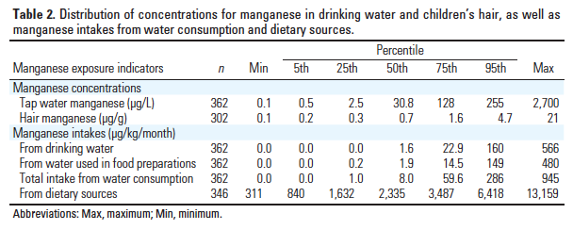
Manganese intake from food and water
Manganese is an essential nutrient that is common and necessary in the diet.
The estimated daily exposure to Mn from drinking water systems is far below the expected daily intake from the diet
In a study of school-age Quebec children, Mn was measured at the tap, a water and food frequency questionnaire was applied. Total Mn intake from water consumption (including food preparations) and from food (using portion size and Canadian Nutrient File) were calculated.
Even considering that approximately 5% of food intake is absorbed food Mn intake is considerably higher than Mn intake through water.
From Bouchard et al, 2011
Notes:
When average daily intakes from drinking water are compared with intakes from food, air and soil, drinking water accounts for a relatively small proportion of Mn intake. On the basis of these observations, the impact of regulating Mn concentrations in drinking water on health risk reduction is likely to be small.

Slide 8
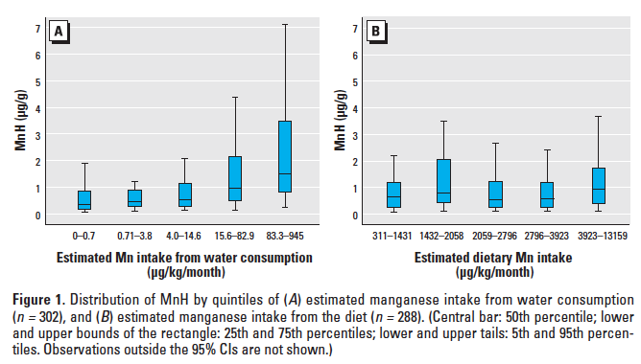
Drinking water, food and hair manganese
Drinking water intake, not food intake, is correlated to hair Mn concentration
Bouchard et al, 2011
Notes:
This is from our study in Quebec, but there are many others that show strong correlations between Mn in drinking water and hair Mn

Slide 9
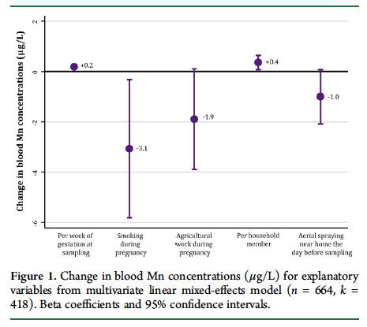
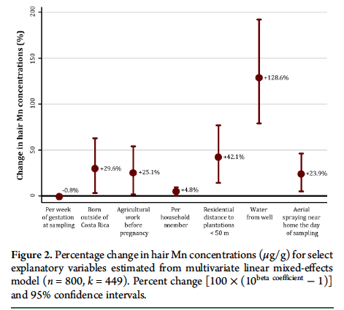
Drinking water and hair manganese
Drinking water Mn predicts hair Mn concentration, but not blood.
Mora et al, 2014
Mn concentration during pregnancy (ISA study, Costa Rica)
Notes:
In the ISA study of pregnant women, extensive information was taken of socio-demographic variables, geolocation, working and home caring habits (like washing work clothes).

Slide 10
Kondakis et al. 1989
*
Hair Mn
(µg/g)
Significant differences between areas for for men and women separately
Significant difference between sexes in region C
*
Blood Mn
(µg/L)
No differences between regions
No difference between sexes
No correlation with hair Mn
(3.6 - 14.6)
(81 – 225)
(1800 - 2300)
Mn in drinking water (µg/L)

Slide 11
Drinking water and biomarkers of exposure
p < 0.001 R² = 0.37
nails
a
p < 0.001
R² = 0.14
hair
a
ab
LLMnN
bc
LLMnH
b
b
c
c
c
c
p=0.011 R²=0.04
a
total saliva
a
p= 0.015 R²= 0.03
Saliva surnatant
ab
ab
ab
ab
ab
ab
LLMnS
b
LMnT
b
Quintile median (µg/L) : G1: 0.26 µg/L; G2 1.50; G3: 5.8; G4:34; G5: 265
Ntihabose et al, submitted

Slide 12
Some key studies of Mn neurotoxicity
country | age | population | source | MnW concentration (µg/L) | reference
Greece | 50 + | M:96 F:92 | Natural |  | Kondakis et al 1989
China | 11-13 | M + F: 90 | Sewage irrigation | 100 300 | He et al, 1994
Bangladesh | 9.5 – 10.5 | M:70 F: 721 | Natural | 795 ± 755 ¹ (4 – 3908) | Wasserman, 2006
Quebec | 6 -15 | M:24 F:22 | Natural | 610 160 | Bouchard et al, 2007
Quebec | 6 - 13 | M:168 F:194 | Natural | 34² (1 – 2700) | Bouchard et al, 2011
Bangladesh | 8 - 11 | M:396 F:444 | Natural | 1302² (10 -5710) | Khan et al, 2011
Bangladesh | 10 | M:656 F:609 | Prenatal natural | 200² (1 – 6600) | Rahman et al 2016
 |  |  | Postnatal natural | 340² (1 -8700)
(3.6 - 14.6)
(81 – 225)
(1800 - 2300)
~
~
1 = arithmetic mean 2 = median

Slide 13
Kondakis et al. 1989
*
Neurologic Score
Significant differences between areas for each sex separately.
In region B, women’s scores were significantly higher than men’s
*
*
Hair Mn
(µg/g)
Significant differences between areas for each sex separately
Significant difference between sexes in region C
*
Blood Mn
(µg/L)
No differences between regions
No difference between sexes
No correlation with hair Mn
(3.6 - 14.6)
(81 – 225)
(1800 - 2300)
Mn in drinking water (µg/L)
Notes:
Everyone in this well water Mn category has less than 300 µg/L although one can argue that we do not know whether previous consentrations were higher

Slide 14
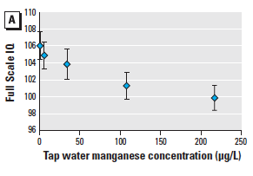
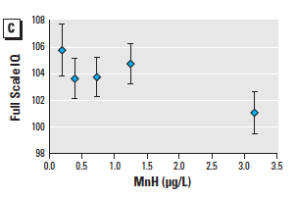
Drinking water Mn and IQ score
Quebec children (n = 362)
Only 4% of children were exposed to Water Mn > 400 µg/L
Wechsler Abbreviated Scale of Intelligence (WASI)
Loss of 6.2 points between highest and lowest quintile
Bouchard et al. 2011
Notes:
Performance IQ showed the strongest relation

Slide 15
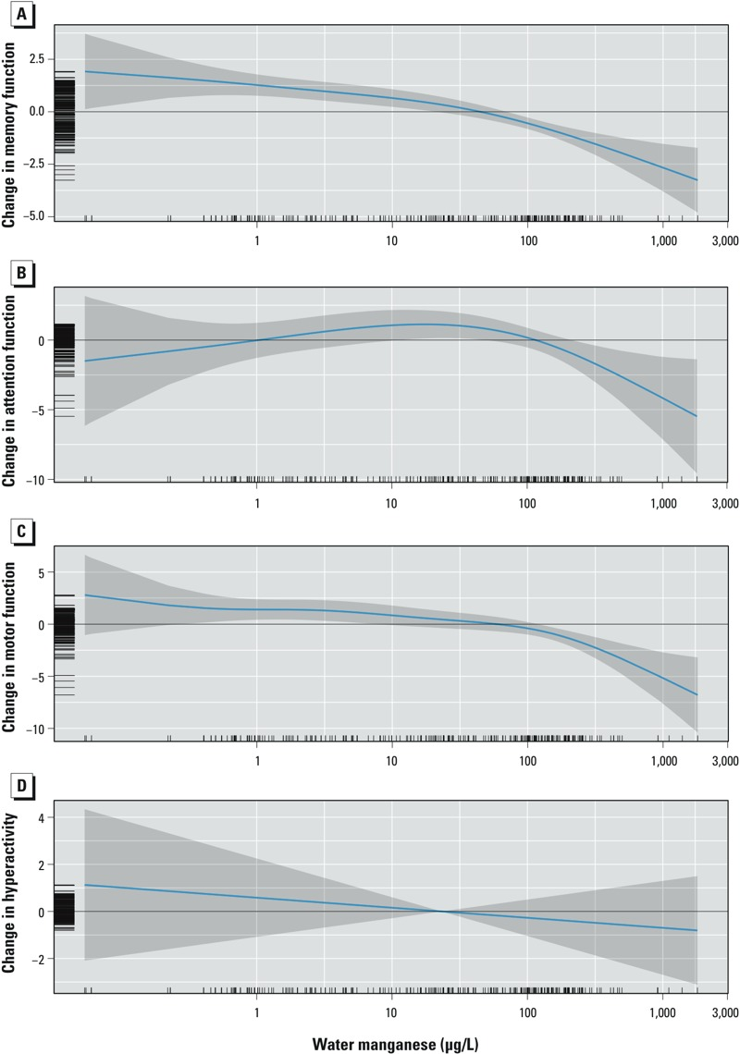
Drinking water Mn and cognition
Quebec children (n = 362)
Memory
p < 0.001
Attention
p < 0.1
Drinking water Mn (μg/L)
Oulhote et al. 2015

Slide 16
Drinking water Mn, motor functions and and hyperactivity
Quebec children (n = 362)
Motor
p < 0.001
Hyperactivity
p > 0.2
Drinking water Mn (μg/L)
Oulhote et al. 2015

Slide 17
Summary of neurotoxicity of Mn from drinking water
Few studies have been done on adults; older adults exposed to drinking water Mn show higher prevalence of neurologic signs and symptoms
Cross-sectional studies of school children show loss of IQ and cognitive ability, even at low Mn drinking water concentration
Behavioral difficulties are associated with drinking water Mn at higher concentrations
The effects of prenatal exposure through mother’s drinking water suggest that there may be positive as well as negative effects
Animal studies confirm manganese neurotoxicity from Mn in drinking water

Slide 18
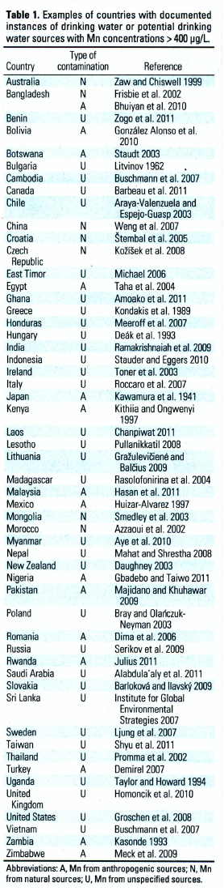
N
Frisbie et al, 2012

Slide 19
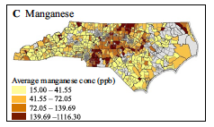
Further reports of high manganese in drinking water
Frisbie et al, 2012 source estimates :
  8 natural; 11 anthropogenic; 31 unknown
Since their publication:
  Brazil (unknown) Nascimento et al, 2016;
  Costa Rica (natural & anthropogenic) van Wendel de Joode et al, 2016;
  USA (North Carolina) (unkown) Sanders et al. 2014
  Nigeria (unknown) Etchie et al, 2013
  Cambodia (unknown) Phan et al, 2013
  Ethiopia (unknown) Amenu et al, 2013
Sanders et al 2014

Slide 20
Current guidelines
Manganese was removed from the World Health Organization guidelines for drinking water
Manganese is not included in the US National Primary Drinking Water Regulations, but in the secondary standards with an aesthetic guideline of 50 µg/L¹
In Canada, the Federal-Provincial-Territorial Committee on Drinking Water produced a consultation document which proposes a maximal acceptable concentration of 100µg/L and an aesthetic guideline of 20 µg/L²
https://www.epa.gov/dwstandardsregulations (accessed 09/2016)
http://healthycanadians.gc.ca/health-system-systeme-sante/consultations/manganese/alt/manganese-eng.pdf (accessed 09/2016)

Slide 21
What needs to be done
We need more studies on neurotoxic effects of Mn in drinking water for males and females throughout the lifespan.
We should join the other voices to urge regulatory agencies to revisit their guidelines (or absence of) on manganese in drinking water.

