Slide 1
DETERMINING RISK FOR ASBESTOS-RELATED MALIGNANCY: LUNG CANCER
L. CHRISTINE OLIVER, MD, MPH, MS
COLLEGIUM RAMAZZINI
OCTOBER 28, 2016

Slide 2
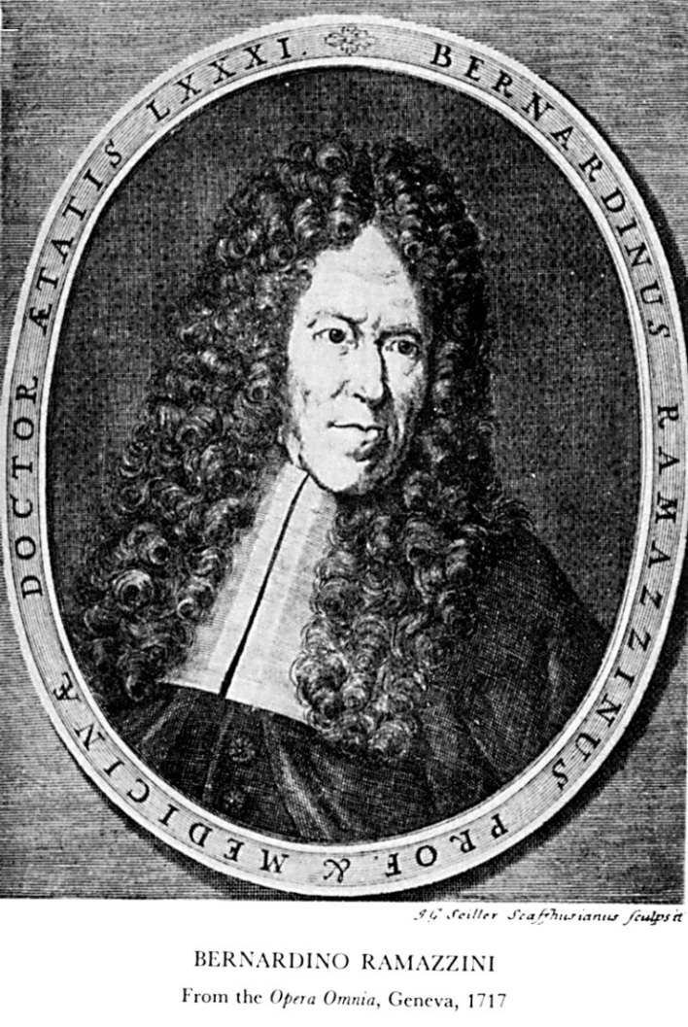
BERNARDINO RAMAZZINI 1713

Slide 3
DR. RAMAZZINI 1713
QUOTED HIPPOCRATES FROM AFFECTIONS:
“WHEN YOU COME TO A PATIENT’S HOUSE, YOU SHOULD ASK HIM WHAT SORT OF PAINS HE HAS, WHAT CAUSED THEM, HOW MANY DAYS HE HAS BEEN ILL.”
RAMAZZINI FROM DE MORBIS ARTIFICUM:
“I MAY VENTURE TO ADD ONE MORE QUESTION: WHAT OCCUPATION DOES HE FOLLOW?”

Slide 4
DR. RAMAZZINI 1713
TAUGHT US
TO OBSERVE
TO TAKE A DETAILED OCCUPATIONAL HISTORY
IN ORDER TO DETERMINE DIAGNOSIS AND CAUSAL ATTRIBUTION FOR WORK-RELATED DISEASE.

Slide 5
ASBESTOS-RELATED LUNG CANCER: DETERMINATION OF RISK
LUNG FIBER BURDEN 2015
GILHAM ET AL (OEM 2015): EXAMINED RELATIONSHIPS BETWEEN ASBESTOS LFB AND MPM CASES, USING LUNG CANCER CONTROLS.
RESULTS INDICATED A LINEAR DOSE-RESPONSE FOR MALIGNANT MESOTHELIOMA.
BOFETTA AND LA VECCHIA (OEM 2016): FINDINGS “SET A NEW STANDARD” FOR EPIDEMIOLOGIC RESEARCH ON ASBESTOS AND MESOTHELIOMA.

Slide 6
TWO QUESTIONS BEFORE US TODAY
IS LFB AN ACCEPTABLE “NEW STANDARD” FOR ASSESSMENT OF RISK FOR ASBESTOS-RELATED LUNG CANCER?
DOES METHOD OF ASBESTOS-RELATED LUNG CANCER RISK ASSESSMENT MATTER?

Slide 7
ASBESTOS-RELATED LUNG CANCER: RISK FACTORS
ASBESTOS DOSE
OCCUPATIONAL HISTORY
AIR SAMPLING DATA
LUNG FIBER BURDEN
LATENCY
AGE
CIGARETTE SMOKING
COPD
FAMILY HISTORY

Slide 8
ASBESTOS-RELATED LUNG CANCER: DETERMINATION OF RISK
ASBESTOS DOSE

Slide 9
HELSINKI CRITERIA 2014

Slide 10
HELSINKI CRITERIA 2014: DOSE ASSESSMENT
RELY UPON:
AIR SAMPLING DATA/DURATION OF EXPOSURE
FIBER YEARS CUMULATIVE DOSE
FIBER BURDEN ANALYSIS

Slide 11
ASBESTOS-RELATED LUNG CANCER: DOSE
HELSINKI CRITERIA 2014
2-FOLD INCREASE IN LUNG CANCER RISK:
CUMULATIVE ASBESTOS DOSE 25 F-YRS
AND/OR
2 MILLION AMPHIBOLE FIBERS > 5 µM/GM DRY LUNG
= 5K-15K AB/GM DRY LUNG
= 5-15 AB/ML BAL

Slide 12
ASBESTOS-RELATED LUNG CANCER: DETERMINATION OF RISK
VALUE ADDED BY LFB DEPENDS UPON
VALIDITY OF THE RESEARCH
BIOPERSISTENCE OF CHRYSOTILE IN THE LUNGS
PREVALENCE OF CHRYSOTILE USE WORLDWIDE
DOSE-RESPONSE RELATIONSHIPS DETERMINED BY OTHER VARIABLES.

Slide 13
ASBESTOS-RELATED LUNG CANCER: DETERMINATION OF RISK
LFB: VALIDITY OF THE STUDY
LUNG CANCER CASES WERE USED AS CONTROLS
BASED UPON PREMISE THAT NUMBER OF LUNG CANCERS CAUSED BY ASBESTOS IS SMALL,
CITING A RATIO OF LUNG CANCERS TO MALIGNANT MESOTHELIOMAS < 1.

Slide 14
ASBESTOS-RELATED LUNG CANCER: DETERMINATION OF RISK
LFB: VALIDITY OF THE STUDY
ASBESTOS-RELATED LUNG CANCER: MALIGNANT MESOTHELIOMA RATIO > 2:1*
*BARROETAVENA MC ET AL. AM J IND MED. 1995
MCCORMACK V ET AL. BRIT J CANCER 2012

Slide 15
ASBESTOS-RELATED LUNG CANCER: DETERMINATION OF RISK
LFB: CHRYSOTILE
BIOPERSISTENCE: IS NOT BIOPERSISTENT IN THE LUNG.
PREVALENCE OF USE: ACCOUNTS FOR > 95% OF ASBESTOS PRODUCED AND USED WORLDWIDE.

Slide 16
ASBESTOS-RELATED LUNG CANCER: DETERMINATION OF RISK
LFB: DOSE-RESPONSE RELATIONSHIP
DETERMINED BY OCCUPATIONAL HISTORY
INDUSTRIAL HYGIENE (AIR SAMPLING) DATA
COMBINATION OF THE TWO
IS LINEAR WITHOUT EVIDENCE OF THRESHOLD.

Slide 17
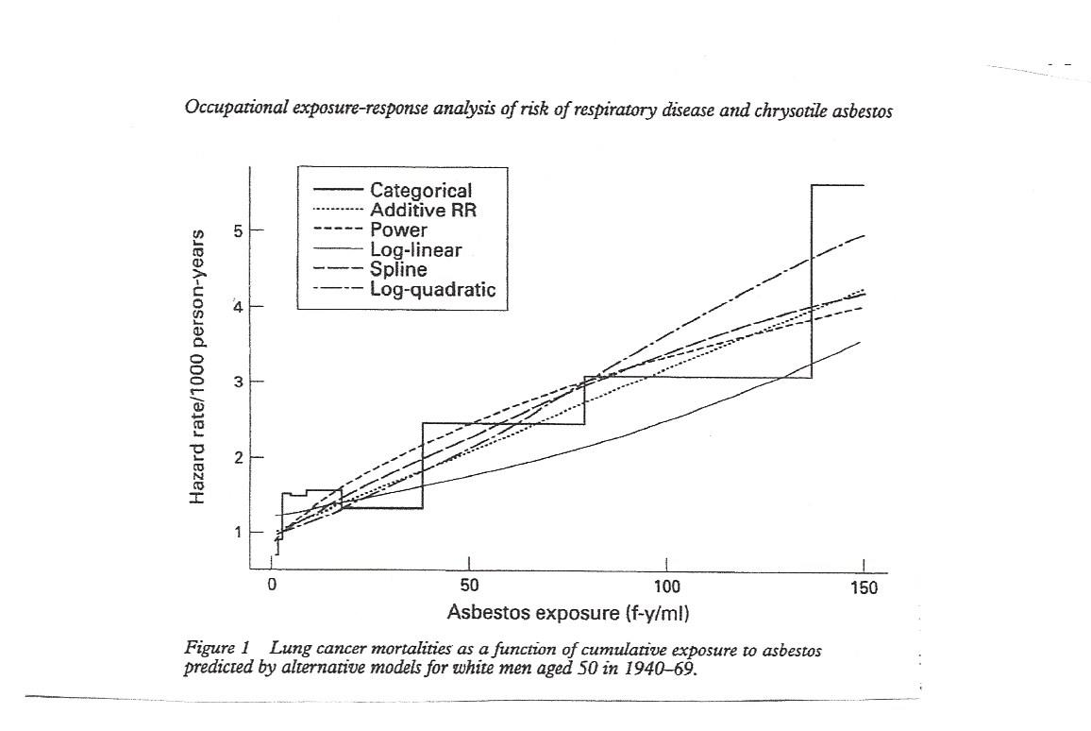
ASBESTOS-RELATED LUNG CANCER: DOSE-RESPONSE RELATIONSHIP
STAYNER 1997

Slide 18
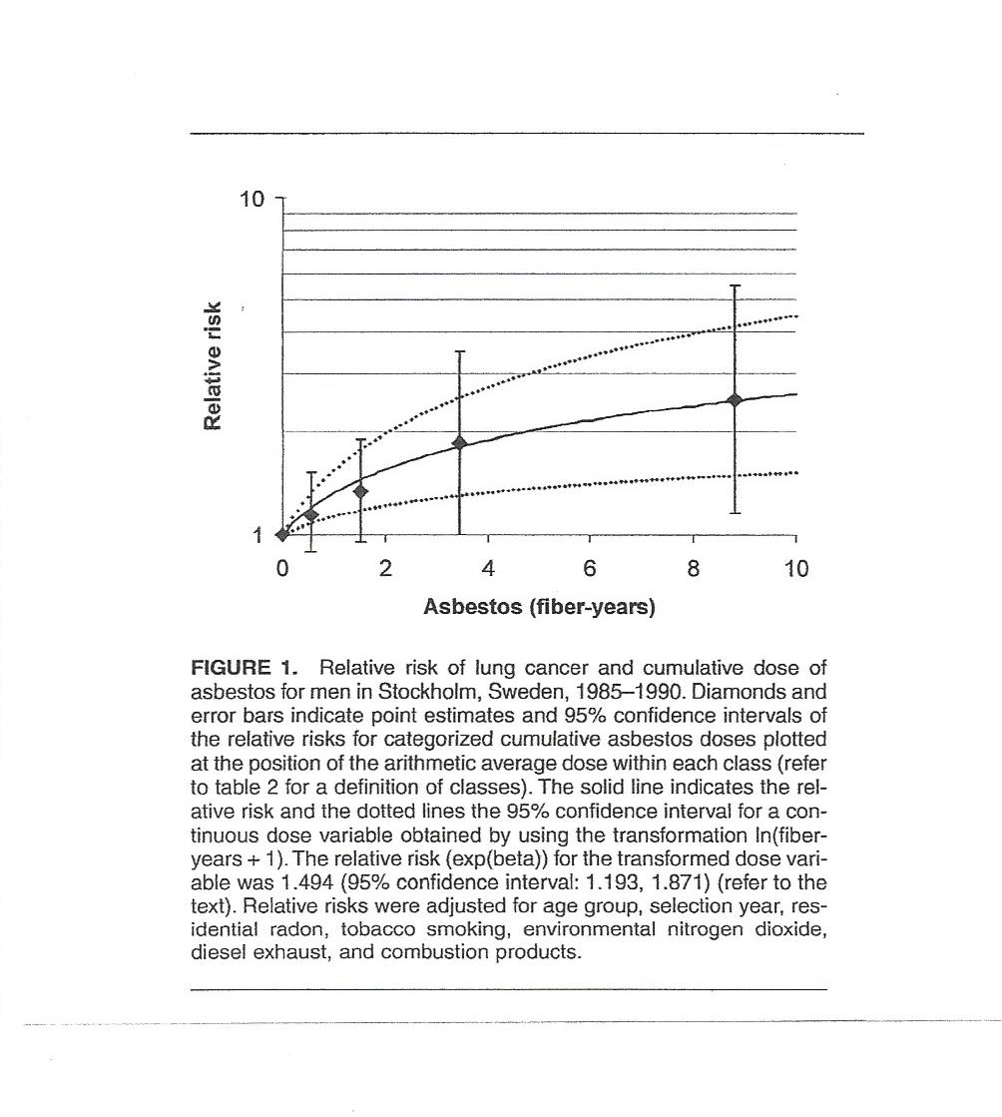
ASBESTOS-RELATED LUNG CANCER: DOSE-RESPONSE RELATIONSHIP
GUSTAVSSON 2002

Slide 19
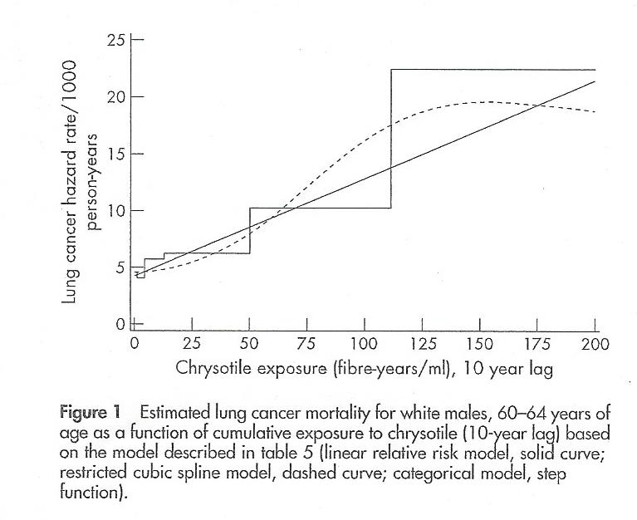
ASBESTOS-RELATED LUNG CANCER: DOSE RESPONSE RELATIONSHIP
HEIN 2007

Slide 20
ASBESTOS-RELATED LUNG CANCER: LUNG FIBER BURDEN
PROBLEMS:
FOCUSES SINGULARLY ON LUNG FIBER BURDEN
UNDERESTIMATES THE ROLE OF CHRYSOTILE IN CAUSATION
IGNORES FIBERS < 5 µm
UNWORKABLE IN THE DIAGNOSTIC SETTING

Slide 21
ASBESTOS-RELATED LUNG CANCER: DETERMINATION OF RISK
DOES METHOD OF ASBESTOS-RELATED LUNG CANCER RISK ASSESSMENT MATTER?

Slide 22
ASBESTOS-RELATED LUNG CANCER: DETERMINATION OF RISK
FROM A PUBLIC HEALTH PERSPECTIVE*
LUNG CANCER IS THE MOST COMMON OCCUPATIONAL MALIGNANCY.
ASBESTOS IS THE MOST COMMON CAUSE OF OCCUPATIONAL LUNG CANCER.
LUNG CANCER IS THE MOST COMMON ASBESTOS-RELATED MALIGNANCY.
TAKALA J. ELIMINATING OCCUPATIONAL CANCER. EDITORIAL. INDUSTR HEALTH, 2015.

Slide 23
ASBESTOS-RELATED LUNG CANCER: DETERMINATION OF RISK
FROM THE INDIVIDUAL PERSPECTIVE
MAGNITUDE OF THE RISK
ASBESTOS-RELATED LUNG CANCER IS CURABLE.

Slide 24
NATIONAL LUNG SCREENING TRIAL – NIH/USA

Slide 25
ASBESTOS-RELATED LUNG CANCER: DETERMINATION OF RISK
LDCT SCREENING FOR LUNG CANCER
NLST
> 20% REDUCTION IN LUNG CANCER MORTALITY
LDCT VS. CHEST X-RAY SCREENING.
RISK BASED ON SMOKING AND AGE

Slide 26
ASBESTOS-RELATED LUNG CANCER: DETERMINATION OF RISK
IN CONCLUSION
FOR THOSE WITH PREDOMINANTLY CHRYSOTILE EXPOSURE
LFB UNDERESTIMATES RISK FOR LUNG CANCER.
LFB MAY PRECLUDE ELIGIBILITY FOR LDCT LUNG CANCER SCREENING, WHICH MAY BE CURATIVE.
LFB MAY PRECLUDE JUST COMPENSATION FOR ASBESTOS-RELATED LUNG CANCER.
LFB MAY REDUCE INCENTIVE FOR PREVENTION.

