Slide 1
What Is Known About the Exposure and Endocrine Disrupting Properties of Neonicotinoid Pesticides?
Melissa Perry, ScD, MHS
Department of Environmental and Occupational Health
Milken Institute School of Public Health
The George Washington University

Slide 2
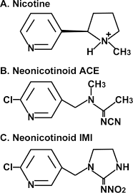
What are neonics?
Entirely new type of insecticide: systemic
Developed mid-90s to replace organophosphates/carbamates
High potency at low concentrations
Chemically similar to nicotine
Bind to nicotinic acetylcholine receptor (nAChR)
Acetimiprid (ACE), Imidacloprid (IMI), thiamethoxam (THO), clothianidin (CLO)
Persist in crops and soil
Kimura-Kuroda et al. 2012
Notes:
New type of pesticide, systemic so perfuse all the tissues of a treated plant: roots, nectar, pollen, guttation fluids, and the fruit/vegetable/grain. Makes them highly effective against broad spectrum of insects.
Developed mid-90s to replace older pesticides that were more toxic to humans and more persistent in the environment.
Neonics act like nicotine in the brain, binding to the nAChr, one of the most common neuroreceptors in the animal kingdom. In insects, neonics can pass through the blood-brain barrier, where they bind irreversibly to their nAChRs, causing a break in nerve transmission, resulting in almost instant paralysis and death.
Three most common neonics in the U.S. are IMI, which was approved by EPA in 1994, THO approved in 1999, and CLO, conditionally approved in 2003 (meaning at least one tox test was missing).

Slide 3
Sources of Exposure

Slide 4
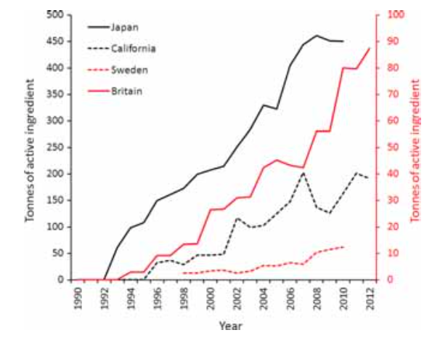
Trend in Neonicotinoid Sales and Use through 2012
Japan Domestic Shipment
California Total Use
Sweden Sales
Britain Agricultural Use
Simon Delso et al., 2015
Notes:
Trend in the sales (Sweden), domestic shipment (Japan), use (California) and agricultural use (Britain) of all neonicotinoid insecticides and fipronil.
Note the separate vertical axes for California// Japan, and Britain//Sweden

Slide 5
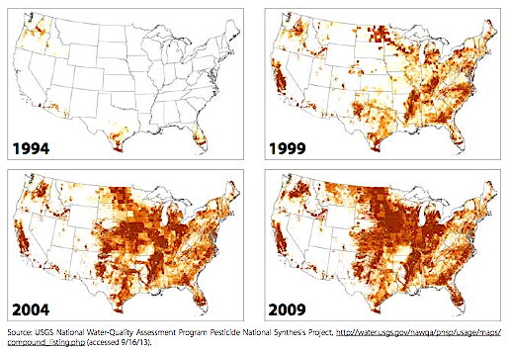
How are neonics used?
Use of IMI has grown exponentially since its approval in 1994
Notes:
Unsurprisingly, have rapidly become most widely used class of insecticide in the US, registered for some 500 products, including not just crops, but also for lawns, gardens, pets, golf courses, timber tracts, and turf.

Slide 6
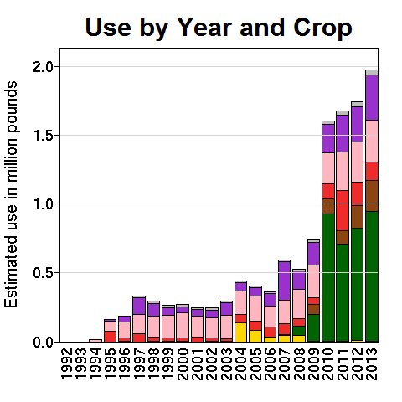
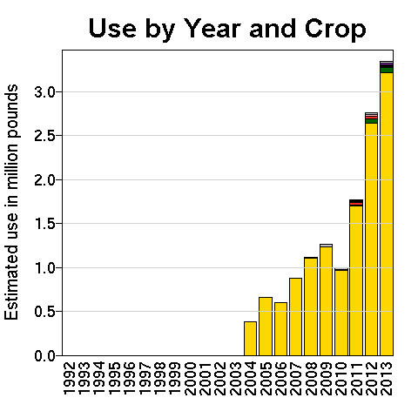
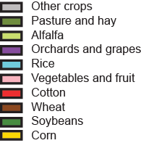
US Agricultural Use
Imidicloprid
Clothianidin
Data retrieved from: Pesticide National Synthesis Project of National Water-Quality Assessment Program (USGS)

Slide 7
Routes of Exposure

Slide 8
Chemical Properties of Neonicotinoids
Highly water soluble
Highly volatile in air
Half-lives > 1,000 days in soil
Persistence in woody plants for > 1 year
Pass the placenta and the blood brain barrier
Reference: Bonmatin 2013

Slide 9
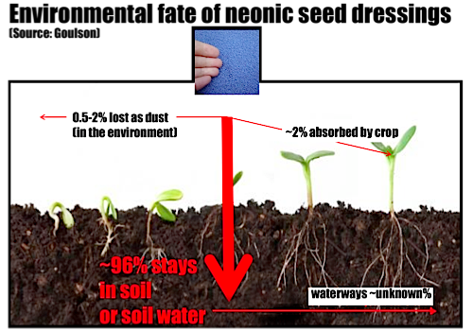
Notes:
Reference: Goulson D. 2013. An overview of the environmental risks posed by neonicotinoid insecticides. J Appl Ecol. 50(4). DOI: 10.1111/1365-2664.12111.
From Andi’s Paper:
Recent studies show neonics are concentrating in the environment (Anderson et al. 2015, Hladick et al. 2014, Main et al. 2014, Simon-Delso 2015), Persistent in the environment and mobile, neonics have been found in soil, dust, wetland, surface and ground water, non-target plants and vertebrate prey, and foods common to the American diet, including wild and aqua cultured marine species (Bonmatin et al. 2015, Chagnon et al. 2015, Chen et al. 2014, Cycoń and Piotrowska-Seget 2014, Huseth and Groves 2014, Hladick et al. 2014, Huseth and Groves 2014, Koshlukova 2006, Krupke et al. 2012, USDA 2014, FDA 2014). The U.S. Department of Agriculture’s (USDA) most recent2014 pesticide monitoring report found neonics in 12 of the 197 different foods fruits and vegetables sampled, with 11 of these containing multiple neonics, a dramatic increase compared to the previous USDA PDP report, which reported neonics were detected in 11 of 17 fruits and vegetables, with only two containing multiple neonics (USDA 2016, USDA 2014). The USDA also reported levels in one food (summer squash) exceededing the MRL for thiamethoxam (THX) (USDA 20144). Multiple neonics were detected in some foods (e.g., celery and peaches) (USDA 2014). A study using more sensitive analytical techniques than those used by the USDA prior to 2013 also reported finding multiple neonics in several foods fruits and vegetables common to the American diet (seven apple varieties, oranges, cantaloupe, and spinach), and as well as in five organic honey samples) (Chen et al. 2014). In its 2012 Total Diet Study, the FDA reported neonics were among the most frequently found pesticide residues in infant and toddler foods (occurrence ranging from 6% to 31%) (FDA 2012). Unlike most other pesticides, neonics cannot be washed off of food prior to consumption (Chen et al. 2014).

Slide 10
79 Water Samples taken from
9 Iowa Streams over 2013 Growing
Season
Hladick et al. 2014
Notes:
Neonics are also being detected in surface and ground water. The figureon the right shows the detection frequencies and concentrations for IMI, CLO, and THO based on 79 water samples taken from 9 Iowa streams over the 2013 growing season. Most samples contained multiple neonics, with CLO the most frequent, which makes sense given it has the longest half life and is a breakdown product for THO. It is also the most common seed dressing.

Slide 11
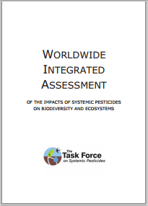
Worldwide Assessment of Impact of Systemic Pesticides on Biodiversity and Ecosystems (WIA) 2015
A synthesis of 1,121 published peer-reviewed studies spanning last five years
Including industry-sponsored studies
The single most comprehensive study of neonics
Peer reviewed
Published as open access

Slide 12
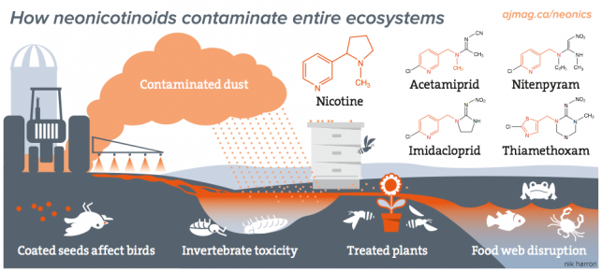
Neonics in the environment
Neonics can be highly persistent and transport via soil, water, dust, air, pollen, leaching, & accumulation in non-target species
Half-life soil:
  THX: 25-100 days
  IMI: 40-997 days
  CLO: 148-1,155 days
Half-life water:
  THX: 8.5 days
  IMI: 30 days
  CLO: 40.3 days
Notes:
Ecosystem contamination by neonics is occurring via several routes: sediment loading; leaching and run-off into surface and ground water; uptake by nontarget plants followed by translocation via pollen, nectar, guttation fluids, and seeds; plantar exhaust dust; and spray drift.
Field studies show neonics are highly mobile, persist for months to years in the environment, and are causing harm, even at sublethal low-dose concentrations, to many important soil, natural pest control, food chain, and pollinating animals, both vertebrates and invertebrates. They have been linked to CCD as well as the outbreak of White Nose Syndrome in bats.
The overall effect of the current level of neonic use is thought to pose a serious threat to food production in the U.S., ranging from a reduction in the availability, variety, and nutritional quality of certain crops to a crisis in which all pollinated crop yields begin to fall.

Slide 13

Pets and In-Home Use
Residue detected in dog’s blood for up to 72 h after application
Transferrable residue detected on coat for up to 4 weeks
Reference: Craig 2005
Notes:
Two Papers on Dogs:
http://www.ncbi.nlm.nih.gov/pubmed/20021094
http://www.ncbi.nlm.nih.gov/pubmed/25365583

Slide 14
Neonics in food
Common foods contain multiple neonics, some at levels >MRLs
Chen et al. 2014
Notes:
As shown in table, neonics frequently detected in many foods common to the American diet. A 2014 study found 72% of fruits, 45% of veggies, and 50% of honey samples contained at least two neonics; some contained as many as three. Unlike previous pesticides, neonics cannot be washed off of food prior to consumption. Important to note EPA’s risk assessment process does not screen for effects of mixtures, such as the additive/synergistic effects of neonics with other neonics and/or other pesticides. This is concerning because some fungicides and herbicides are known to increase toxicity of neonics from 200 to 1000 times.
Neonics are also being detected in surface and ground water. The figureon the right shows the detection frequencies and concentrations for IMI, CLO, and THO based on 79 water samples taken from 9 Iowa streams over the 2013 growing season. Most samples contained multiple neonics, with CLO the most frequent, which makes sense given it has the longest half life and is a breakdown product for THO. It is also the most common seed dressing.

Slide 15
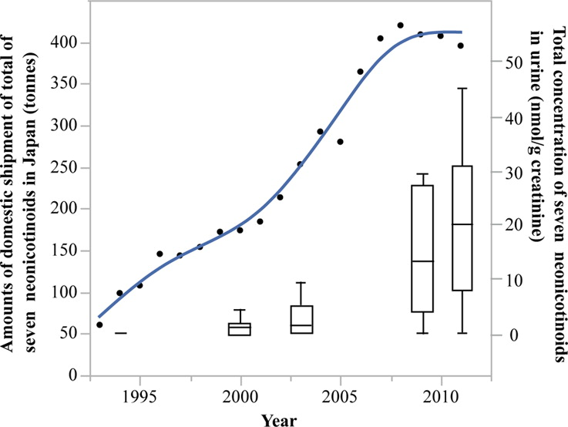
Temporal Levels of Urinary Neonicotinoid Concentrations in Japanese Women
Reference: Ueyama 2015
Notes:
Reference: http://www.ncbi.nlm.nih.gov/pubmed/26556224

Slide 16
Review of Literature
Are Neonicotinoids Reproductive Toxicants?

Slide 17
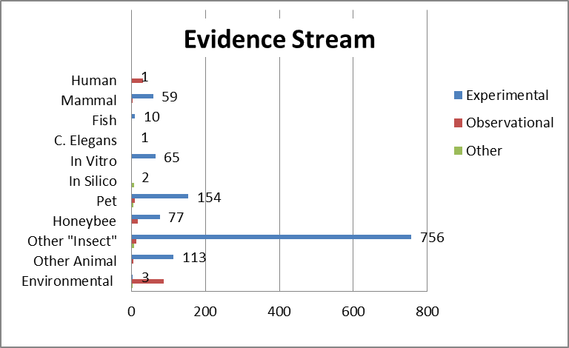
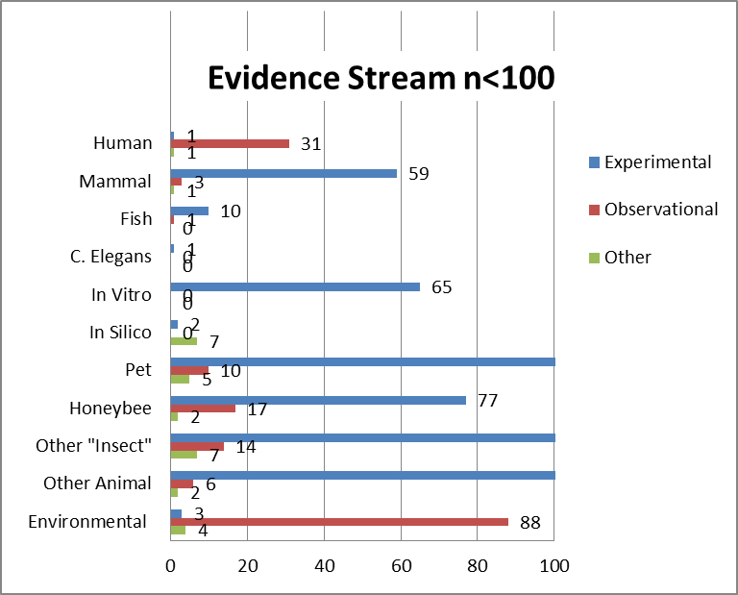
Title/Abstract Screen
English (n=1471)
Systematic Reviews (n=3)
Narrative Reviews (n=34)
Original (n=1406)
Other/Unclear (n=28)
Experimental (n=1221)
(zoomed in graph)
Observational (n=159)
Other (n=26)

Slide 18
Neonics in mammals
Simon-Delso et al. 2015
Neonics & byproducts can cross the mammalian blood-brain barrier
Some neonic metabolites more toxic than parent compound
Adverse even at sublethal doses, affinity for α4β2 subtype of nAChRs
Reproductive, genotoxic, cytotoxic, neurobehavioral effects
Notes:
When neonics were approved for commercial use, they were considered less toxic to humans because of their inability to cross the mammalian blood-brain barrier. We have since learned that neonics and certain of their metabolites can cross this barrier and show a high affinity for mammal nAChRs. Also learned that some neonic metabolites are more toxic than parent compound.
Growing # in vitro and in vivo studies have found neonics are not benign once in mammal brains, but exert adverse effects even at sublethal doses. For instance, a 2012 study found IMI and acetamiprid (ACE) can impair mammalian nAChRs. These receptors are of critical importance to human brain functions such as memory, cognition, and behavior.
Neonics are also capable of activating or modulating the most prominent subtype of nAChRs in mammals, the α4β2. The highest density of this subtype is located in the thalamus. Alteration of the density of this subtype has been found to play a role in several central nervous system disorders (Alzheimer’s disease, Parkinson’s disease, schizophrenia, and depression). In the developing brain, this subtype is involved in neural proliferation, apoptosis, migration, differentiation, synapse formation, and neural circuit formation.
Neonics are also linked to adverse reproductive effects in mammals, including reduced sperm production, reduced rates of pregnancy, and higher rates of embryo death, stillbirth, premature birth, and reduced weight offspring.
Sublethal doses of neonics on mammals, principally rats/mice, have also been reported to produce genotoxic and cytotoxic effects, neurobehavioral disorders in offspring, thyroid lesions, retinal atrophy, reduced movement, and increased measures of anxiety/fear.

Slide 19
Neonicotinoid Tox21/ToxCast Results ER related assays
Cluster | Chemical Name | ER Agonist Area Under Curve (AUC) | ER Antagonist AUC | ER Bioactivity
Parent | Imidacloprid | 0 | 0 | 0
Parent | Thiamethoxam | 0 | 0 | 0
Parent | Clothianidin | 0 | 0 | 0
Parent | Acetamiprid | 0 | 0 | 0
Parent | Thiacloprid | 0 | 0 | 0
Parent | Dinotefuran | 0 | 0 | 0
Parent | (E)-Nitenpyram | not tested | not tested | not tested
Metabolite | 2-Pyridone | not tested | not tested | not tested
Base | Nicotine | 0 | 0 | 0
Base | Nicotine sulfate | not tested | not tested | not tested
Base | D-Nicotine | not tested | not tested | not tested
*Judson et al., Toxicol. Sci. 148:137–154;

Slide 20
Green Screen Evidence Review 2014
Target | Reproductive Toxicity | Endocrine Disruption
Imidicloprid | Moderate | Moderate
Clothianidin | Moderate | Moderate
Thiamethoxam | Moderate | Data Gap

Slide 21
Results: 8 Papers on Reproductive Toxicity/Endocrine Disruption
Animals
  Rats (Najafi 2010) (Bal 2012a, b, c) (Rasgele 2014) (Kapoor 2011)
  Mice (Hirano 2015) (Tanaka 2012) (Gu 2013)
Neonicotinoid
  Imidacloprid: (Najafi 2010) (Bal 2012b, c) (Kapoor 2011)
  Clothianidin (Bal 2012a) (Hirano 2015) (Tanaka 2012)
  Acetamiprid (Rasgele 2014)
  Mixture: (Gu 2013)

Slide 22
 | Objective | Neonicitinoid | Animal | Findings *Indicates Statistically significant result
Najafi (2010) | Evaluate chronic effect of IM exposure on testicular tissue, sperm morphology, and testerone in serum | Imidacloprid | Male rats | Testicles decreased in size and weight* Severe hypertrophy and cytoplasmic granulation in Leydig cells Difference in Repopulation Index* Decrease in normal sperm content, viability of content, and motile sperm content* Reduced testosterone *
Kapoor (2011) | Evaulate effect of IM exposure on ovarian morphology, hormones, and antioxidant enzymes | Imidacloprid | Female rats | Decrease in ovary weight at IMI 20 Serum FSH was increased*; LH and progesterone decreased in IMI 20 LPO and decrease in GSH content, SOD, CAT and GPX activity in IMI 20
Bal (2012a) | Investigate effect of low does of CTD exposure on reproductive system | Clothianidin | Male rats (developing) | Epididymal sperm concentration decreased in CTD 32 group* Abnormal sperm rates increased in CTD 8 and 32 Testosterone level decreased in CTD 32 * Decrease in GSH in all groups* TUNEL positive cells increased in CTD 32
Bal (2012b) | Investigate effect of low doses of IM exposure on reproductive system | Imidacloprid | Male rats | Deterioration in sperm motility in IMI 8* Decrease in epididymal sperm concentration in IMI 2 and 8* Increase in sperm morphology in IMI 8* Decrease in testosterone and GSH in 8* Apoptotic index increase only in germ cells of seminiferous tubules of IMI 8* Fragmentation in DNA of IMI8 Elevation in fatty acids (stearic, oleic, linoleic and arachidonic acids)*
Bal (2012c) | Investigate effect of IM exposure on DNA fragmentation, antioxidant imbalance, and apoptosis | Imidacloprid | Male rats (developing) | Weight of epididymis, vesicular seminalis, epididymal sperm concentration, body weight gain, testosterone and reduced glutathione values lower in IMI groups; Increased peroxidation, fatty acid concentrations and Higher rates of abnormal sperm in IMI 8* Apoptosis and fragmentation of seminal DNA higher in IMI 2 and 8
Gu (2013) | Compare in vitro effects of IM and ACE on reproduction | Imidacloprid, Acetamidprid | Male and female mice | Decrease in motility of spermatozoa Minor increase in avg. percentage of DNA fragmented spermatozoa Among exposed sperm, 2 Cell embryo, morula, blastocyst formation decreased * With consecutive exposure from fertilization to blastocyst formation, decrease in morulae and blastocysts for IMI and ACE
Rasgele (2014) | Investigate genotoxic effects of ACE on mouse germ cells | Acetamiprid | Male mice | Acm “induced different types of sperm abnormalities e.g., “hookless, banana, amorphous and folded sperms at all concentrations” Acm slightly increased the percentage of abnormal sperm in mouse germ cells.
Hirano (2015) | Investigate effect of CTD and environmental stress on reproductive function | Clothianidin | Male mice | GPx4 immunoreactivity was detected in sperm and diffuse Gpx4 immunoreactivity was seen in permatid cytoplasm; intensity of Gpx4 immunioreactivity was decreased by stress, and the cytoplasmic immune reactivity in the spermatids was dose-dependently decreased by CTD Abnormal immunoreactivity for GPx4 in Sertoli cells was detected in the combined exposure groups

Slide 23
Human Acute exposure findings
Total neonic poisoning exposures n=1280 (698 ingestions, 582 other pathways)
Mortality n=2
IMI most common neonic used in self-poisonings (ACE n=8, THO n=6, CLO n=5)
Traditional pesticide treatments may worsen outcomes for neonic poisonings
Notes:
This excerpt from my Results table displays 4 the 7 studies grouped by acute exposure. All of the studies are recent, the oldest published just in 2009, the latest in 2014, so represents very new data. I will quickly review the key findings.
The sole occupational study, conducted in Sweden, reported no adverse human health effects associated with a week of acute exposure to IMI.
The other three studies comprised two retrospective analyses of poison control center data, one in China, the other in Texas, and a prospective observational cohort following hospital patients with confirmed IMI poisoning in Sri Lanka. Together they examined a total of 1280 neonic exposures. Of these, 698 were oral ingestions, with 582 exposed via other pathways. Only 2 fatalities were reported.
IMI was reported as the most common neonic used in self-poisonings. Cases of self-poisoning with ACE (n=8), THO (n=6), and CLO (n=5) were few in comparison.
All of the poisoning studies found acute neonic exposure produced less serious clinical symptoms than older pesticides. However, the Chinese and Sri Lankan studies both noted neonic poisoning can present with symptoms similar to acute organophosphate or carbamate, but should not be treated with their antidotes as they seem to worsen outcomes.
The Sri Lankan study also addressed the toxicokinetics of IMI poisoning, reporting that concentrations remained elevated for up to 10-15 hours post-ingestion, suggesting humans have a saturable (zero order) absorption and/or elimination ability for high doses of IMI.

Slide 24
Author (Year) | Study Population | Country of Study | Results
Carmichael (2014) | 101 heart defect cases recruited from mothers who participated in a pop-based case control study in San Joaquin valley; 9 exposed/92 not exposed | USA | Significant association between residential proximity to agricultural use of IMI and tetralogy of Fallot (AOR 2.4, 95% CI: 1.1-5.4)
Keil (2014) | 407 children with autism spectrum disorder (ASD) recruited from Childhood Autism Risk from Genetics and Environment (CHARGE) Stuyd/ 206 controls | USA | Weak association between prenatal exposure to IMI and ASD (AOR 1.3, 95% CrI: 0.78, 2.2); OR increased to 2.0 (95% CrI: 1.0, 3.9) when limiting study population to those who self- identified as “frequent users” of flea and tick medicines containing IMI
Marfo (2015) | 35 symptomatic cases in Gunma prefecture/ 50 controls | Japan | Significant association between urinary DMAP and increased prevalence of memory loss, finger tremor, and other symptoms of unknown origin (OR 14, 95% CI: 3.5-57)
Yang (2014) | 73 anencephaly cases in San Joaquin valley; 6 exposed/67 not exposed | USA | Suggestive association between residential proximity to agricultural use of IMI and anencephaly (AOR 2.9, 95% CI: 1.0-8.2)

Slide 25
Source to Effect Framework
Sources of stressors
Environmental
Intensity
Stressors
Exposure
Dose
Receptors
Effect or
Outcomes
Upstream
Human
and Natural Factors
Time Activity
and
Behavior
Notes:
Use this slide to emphasize what is known (in dark green) and (not – in red) regarding the exposure and effects.
Some of what is known – in light green.

Slide 26
  How much neonic is translocated from coated seeds to food, including processed products?
  What is the effect of consuming multiple neonics along with other pesticides, some of which are known to increase neonic toxicity?
  Are we consuming a hazardous level of neonics & metabolites on a cumulative basis, even at levels <MRLs?
  Are certain populations at higher risk due to multiple exposure pathways (e.g., air, water, dust + food) or vulnerable windows of development?
  When neonics cross the human placenta are they eliminated or do they bind with nAChR receptors in the fetal brain?
Notes:
In conclusion, although there is scant evidence of harm in the literature, this should not be misinterpreted as evidence of no effect rather than the absence of exceedingly difficult-to-gather data. Studies have documented concerning levels of neonics in the environment, adverse effects of neonics in mammals, and multiple pathways by which human exposure to neonics could occur, yet little is known about the potential human health effects of neonic exposure.
This slide captures several critical public health concerns that have not been adequately addressed by the literature to date and that warrant additional study:

Slide 27

Take Away Points
Emerging evidence base for ecological impacts and damage to beneficial insects
Suggestion of reproductive toxicity in vetebrates; sparse mammalian data
Extremely limited epidemiologic studies
No human biomonitoring data

Slide 28
Consumer Use
Examples of Neonicotinoid Garden Products Used in the United States
Neonicotinoid | Garden and ornamental uses | Garden Product Trademark names
Imidacloprid | Seed dressing, soil drench, granules, injection, or spray to a wide range of ornamental plants, trees, and turf. | Bayer Advanced 3-in-1 Insect, Disease, & Mite Control Bayer Advanced 12 Month Tree & Shrub Insect Control
Clothianidin | Seed treatment, foliar spray or soil drench for turf, a variety of ornamental trees, and flowers. | Bayer Advanced All-in-One Rose & Flower Care granules Green Light Grub Control with Arena
Acetamiprid | Foliar spray for fruits, vegetables, ornamental plants, and flowers. | Ortho Flower, Fruit and Vegetable Insect Killer Ortho Rose and Flower Insect Killer
Example of Neonicitinoid Animal Care Products Used in the United States
Neonicotinoid | Animal Care Use | Trademark Name
Imidacloprid | Broad spectrum protection against fleas, heartworms, parasites | Advantage
Info retrieved from: http://www.xerces.org/neonicotinoids-and-bees/
Notes:
Maryland is the 1st State to ban neonicitinoids for consumer use.
http://mgaleg.maryland.gov/Pubs/LegisLegal/2015-Pollinator-Health.pdf

Slide 29
Seeds, not pounds
4 million pounds of neonics are applied to between 140 and 200 million acres of cropland annually in US
BUT
“From 2000-2012, virtually all neonics applied to corn, soybeans and wheat were applied as seed treatments” (in US)
  Neonic seed treatments accounted for approx.
    43% of insecticide mass applied to maize by 2010;
    21-23% of insecticide mass applied to soybeans by 2011/2;
    25-29% of insecticide mass applied to wheat by 2011/2
AND
Approx. 60% of all neonic application is via seed treatments
Reference: Douglas 2015; Jeschke 2011
Notes:
Currently more than 90% of all corn and 44-50% of soybeans are grown from seeds coated with neonics,
It is estimated that approximately 60% of all neonicotinoid applications globally are delivered as seed/soil treatments (Jeschke et al. 2011).

Slide 30
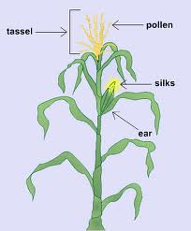
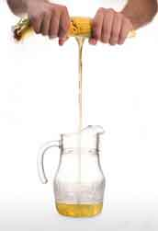


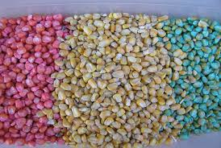
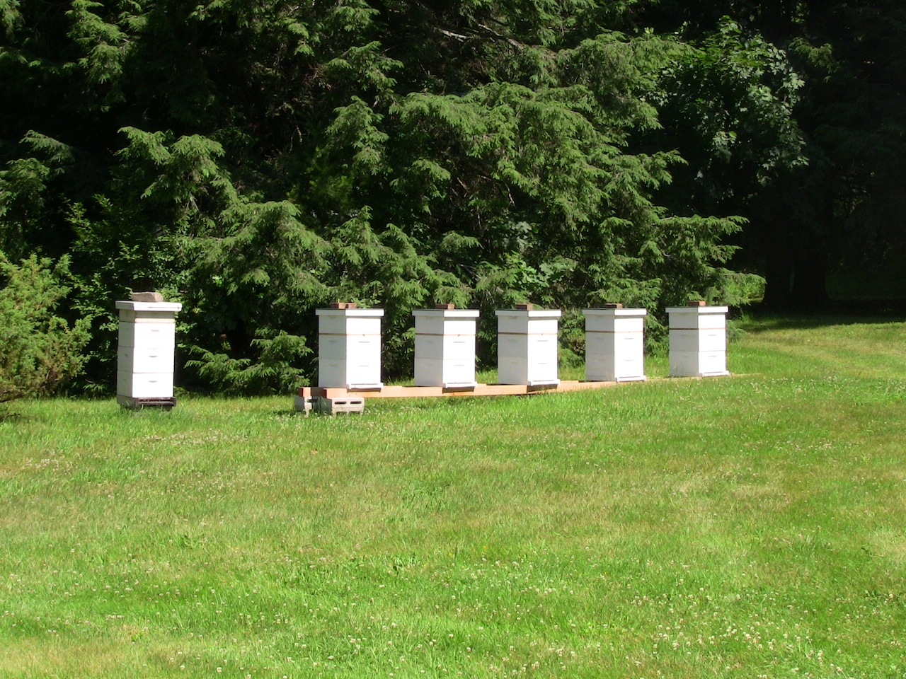
From GMO to HFCS to CCD

Slide 31
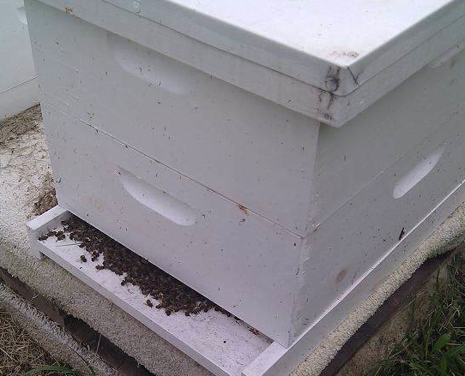
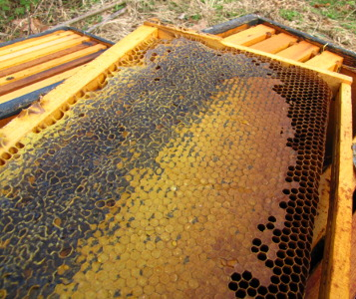
Dead Bees at the Entrance to a Healthy Hive
Colony collapse disorder hive—with capped honey, an absence of worker bees, but no dead bees

Slide 32
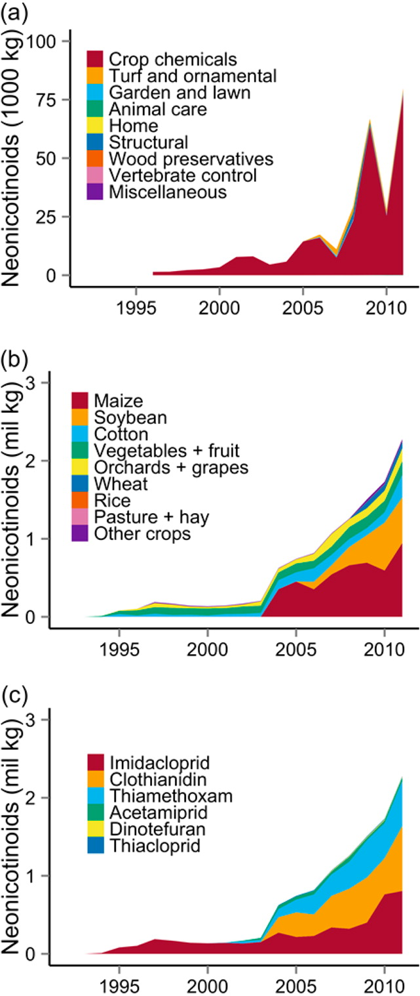
Neonicotinoid sales by product type
Primarily crop chemicals
Neonicotinoid use by crop
Primarily corn and soybeans
Neonicotinoid use by active ingredient
Primarily Imidacloprid, Clothianidin, Thiamethoxam
Reference: Douglas 2015
Notes:
May want to mention/speak to difficulty of quantifying use of neonics in US since treated seeds are currently not considered an “application of pesticide” by EPA and not currently assessed by USDA in pesticide use surveys.

Slide 33
Author (Year) | Study Population | Country of Study | Results
Elfman (2009) | 19 conifer seedling planters: 17 men, 2 women | Sweden | No clear acute adverse effects reported after 1 week of exposure to IMI-treated seedlings.
Forrester (2014) | 1142 exposure cases reported to a TX poison control network from 2000-2012 | USA | Of the 1142, 77% were identified as IMI alone or in combination with other neonics. 32 neonic exposures (2.9%) resulted in “serious medical outcomes” including ocular irritation/pain, dermal irritation/pain, nausea, vomiting, oral irritation, red eye, erythema, rash, numbness, and dizziness. Chest pain (2 exposures; 0.2%), hypertension (0.2%), and tachycardia (0.2%) were the most frequently reported serious cardiovascular effects. No deaths reported.
Mohamed (2009) | 68 hospital patients: 61 ingestion, 7 dermal exposures | Sri Lanka | Of the 56 patients with acute IMI poisoning (versus mixtures), only 2 developed severe symptoms. The majority had mild symptoms including nausea, vomiting, headache, dizziness, abdominal pain, and diarrhea. IMI exposure confirmed in 28 cases, with a median plasma concentration of 10.58 ng/L (IQR: 3.84-15.58 ng/L; range: 0.02-51.25 ng/L) on admission. Concentrations for 7 patients remained elevated for 10-15 hours post-ingestion, suggesting absorption and/or elimination may be saturable or prolonged at high doses. No deaths reported.
Phua (2009) | 70 exposure cases reported to Taiwan National Poison Center | China | Of the 57 cases of ingested neonics, the majority were of IMI (n=53), followed by ACE (n=2) and CLO (n=2). The 10 most severe cases were from IMI alone. Two deaths reported (mortality rate 2.9%).

