Slide 1
THE ONGOING CORRUPTION OF THE SCIENTIFIC BASIS FOR ATTRIBUTION IN ASBESTOS-RELATED DISEASE: How did we get here and what can we do?
Colin L. Soskolne, PhD
Professor emeritus, University of Alberta, Canada
Adjunct Professor, Health Research Institute,
University of Canberra, Australia
Immediate Past-Chair, International Joint Policy Committee of the Societies of Epidemiology (IJPC-SE)
www.colinsoskolne.com │ www.ijpc-se.org
SYMPOSIUM: ASBESTOS LUNG FIBER BURDEN: THE NEW GOLD STANDARD FOR DETERMINING ASBESTOS EXPOSURE AND ATTENDANT HEALTH RISKS?
RAMAZZINI days 2016, ANNUAL CONFERENCE, CARPI, ITALY - October 27-30, 2016
Notes:
This template can be used as a starter file to give updates for project milestones.
Sections
Right-click on a slide to add sections. Sections can help to organize your slides or facilitate collaboration between multiple authors.
Notes
Use the Notes section for delivery notes or to provide additional details for the audience. View these notes in Presentation View during your presentation.
Keep in mind the font size (important for accessibility, visibility, videotaping, and online production)
Coordinated colors
Pay particular attention to the graphs, charts, and text boxes.
Consider that attendees will print in black and white or grayscale. Run a test print to make sure your colors work when printed in pure black and white and grayscale.
Graphics, tables, and graphs
Keep it simple: If possible, use consistent, non-distracting styles and colors.
Label all graphs and tables.

Slide 2
DISCLOSURE
I have served as an expert witness in litigation on behalf of plaintiffs in the past, monies from which generally went into a University-managed research account; and
As a professional legacy, I have been bankrolling the IJPC-SE as a voluntary professional society for the past four years, hoping that it will become self-sustaining and enduring into the future.

Slide 3
Epidemiology as an applied science
Because it is possible to manipulate experimental and control groups in ways that introduce bias and thus fail to serve the public interest through the pursuit of truth (as expected of scientists), it is more and more recognized that ethical training and oversight are crucial.
Our ethics and values determine in large part our behaviours and the choices that we make.

Slide 4
First,
A reality check about science and scientists …

Slide 5

In 1982 … examples … From Galileo and many more

Slide 6
The book argues that the conventional wisdom of science being a strictly logical process, with objectivity the essence of scientists’ attitudes, errors being speedily corrected by rigorous peer scrutiny and replication, is a mythical ideal.

Slide 7
Daniele Fanelli , 2009
How Many Scientists Fabricate and Falsify Research? A Systematic Review and Meta-Analysis of Survey Data
This is the first meta-analysis of surveys asking scientists about their experiences of misconduct. It found that, on average, about 2% of scientists admitted to have fabricated, falsified or modified data or results at least once … and up to one-third admitted a variety of other questionable research practices including “dropping data points based on a gut feeling”, and “changing the design, methodology or results of a study in response to pressures from a funding source”.
In surveys on the behaviour of colleagues, questionable practices were reported in up to 72%.

Slide 8
Pervasive influences and pressures on scientists
From funding sources to peer review
From the questions we ask through access to data
From study design to data analysis and interpretation
From dissemination to job security

Slide 9
The FUNDAMENTAL PRINCIPLES of BIOETHICS include
RESPECT FOR AUTONOMY
- Requires respect for individual rights and freedoms (Also: Veracity & Fidelity)
BENEFICENCE
- Requires doing good / Consider consequences of interventions in people’s lives
NON-MALEFICENCE
- Requires doing no harm
SOCIAL AND DISTRIBUTIVE JUSTICE
- Requires fair and equitable allocation (of risks & benefits) to all without discrimination

Slide 10
Primary principles in public health
Protect the most vulnerable in society (e.g., unborn, children, Inuit, frail elderly) - beneficence
Involve communities in our research (ensure community relevance of our work) - autonomy
Integrity in Public Health (serve the public health interest above any other interest) - beneficence and non-maleficence

Slide 11
Now, in practice …
TEMPTATION LURKS to derail us from these principles …

Slide 12
“Industry’s offensive against the regulation of health and safety hazards uses academics to downplay or deny the seriousness of the hazards...”
Clayson and Halpern
J. of Public Health Policy
September, 1983

Slide 13
Tobacco Example is best known
Full circle – ~50-year story now told
Disinformation campaigns
Lies, manipulation, deceit
Co-option or appropriation of scientists to lie. Is this bad in itself?
  The real tragedy is that scientists accept these monies and then proceed to please their sponsor.

Slide 14
Manufacturing Doubt
► Samuel Epstein.
The Politics of Cancer, 1978
► Devra Davis.
When Smoke Ran Like Water: Tales of Environ Deception …, 2002
The Secret History of the War on Cancer, 2007
Disconnect: The Truth About Cell Phone Radiation …, 2010
► David Michaels.
Doubt is their Product: How Industry's Assault on Science…, 2008
► McCulloch & Tweedale.
Defending the Indefensible: The Global Asbestos Industry …, 2008
The policy-maker’s conundrum ► the fomentation of uncertainty by vested interests. By increasing uncertainty, the policy-maker’s ability to implement health policy is made all the more difficult.

Slide 15
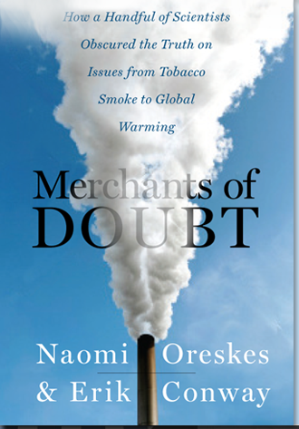
Merchants of Doubt: How a Handful of “Scientists” Obscured the Truth on Issues from Tobacco Smoke to Global Warming
Also made into a movie...
Released in 2015

Slide 16
Relentless PrEssure from vested INterests
Manoeuver their way onto review panels, influence Boards of our professional associations, and infiltrate the literature with junk science
Expert witness tensions arise between the plaintiff and defence sides of the argument in tort actions where the rubber hits the road concerning policy decisions
David vs Goliath?

Slide 17
We must not be naïve
Be aware of forces at play that influence both science and policy.
… Great vigilance and personal integrity are required to counter the influence of financially interested parties and corrupt / morally bankrupt governments.

Slide 18
Virtue ethics
Character vs. Actions
Virtues do not replace ethical rules or principles. Rather, an account of professional ethics is more complete if virtuous traits of character are identified, such as:

Slide 19
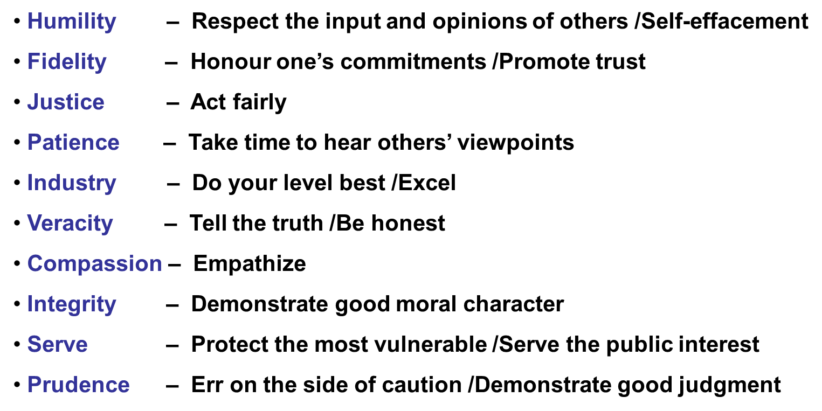
Epidemiology and virtue ethics (weed DL, McKeown RE. Int J Epidemiol.; 1998 - adapted)

Slide 20
International joint policy committee of the societies of epidemiology
IJPC-SE

Slide 21
IJPC-SE VISION statement
We strive to bring clarity to the science of epidemiology, paving the way to rational evidence-based policy. We work to promote and protect public health by serving as an ethical and effective counterweight to the misuse of epidemiology.

Slide 22
IJPC-SE MISSION statement
We promote the ethical and unbiased application of epidemiology.
We use epidemiological evidence to inform rational policy development for government and other policy-making organizations.
When special interests misuse or create scientific evidence to manufacture doubt, our goal is to provide independent evidence and bring clarity to correct what is scientifically flawed.
…
We volunteer our expertise to protect the public and to promote health and well-being ...

Slide 23
The IJPC-SE 2012 Position Statement on Asbestos
This has resulted in major antagonism from defence attorneys and their hired guns.
Why?
Because it brought together, for the first time, epidemiologists agreeing that all forms of asbestos are harmful and should be banned.
Until this time, defence attorneys could claim that the jury was still out among epidemiologists because of hired guns (usually) who would deny such harms.

Slide 24
Superior court of
California, January 2016
Defendant AMCORD submitted a motion … on behalf of all defendants, for an Order excluding the introduction at trial of any reference - testimonial or otherwise - relating to "Position Statement on Asbestos“ from the Joint Policy Committee of the Societies of Epidemiology.
Complaint Filed: January 7, 2016

Slide 25
On technical, legal grounds or, spurious and mischievous?
ARGUMENTS:
The PS is inadmissible hearsay
The PS cannot be properly relied upon by experts
The PS is irrelevant, will confuse and mislead the jury, necessitate undue consumption of time, is more prejudicial than probative and should be excluded under evidence code §§350 and §§352
CLAIM:
… there is no CA authority for use of the PS to prove defect.

Slide 26
They claim that the PS was not published in the peer reviewed literature
IT WAS NEVER INTENDED TO BE PUBLISHED IN THE PEER REVIEWED LITERATURE.
INSTEAD, AND EQUIVALENTLY, IT WAS BROUGHT TO ATTENTION THROUGH TWO EDITORIALS IN THE PEER REVIEWED LITERATURE (IJOEH AND EHP). THE EPIDEMIOLOGY MONITOR SENT IT TO ITS WORLD-WIDE READERSHIP.
NO NEGATIVE FEEDBACK IS ON RECORD …

Slide 27
Ruff’s view of this and one that I endorse
Promoting independent, ethical, transparent, scientific evidence, without fear or favour and free of the influence of vested interests, is to be applauded not denounced.
The role of the IJPC-SE is in keeping with the role of the courts, which is to uphold the evidence in an independent, ethical, transparent manner, free of the influence of vested interests.
Those who do not wish the independent, ethical, transparent, scientific evidence to be put forward will endeavour to create slurs with which to discredit and denounce it.

Slide 28
We have yet to be advised of the CA court’s decision …

Slide 29
Ch. 7 Serving Industry, Promoting Skepticism, Discrediting Epidemiology
BY Kathleen Ruff
In : Corporate Ties that Bind: An Examination of Corporate Manipulation and Vested Interest in Public Health
EdITORS: Hardell and Walker
Expected early 2017

Slide 30
Ruff demonstrates
through real-world examples
– including asbestos –
how epidemiologists
go to the dark side
in return for lucrative contracts and proceed to foment uncertainty and cast doubt

Slide 31
The way forward
Ruff concludes
The evidence is overwhelming and urgent that the scientific community, and, in particular, scientific journals and universities, must end their silence and collusion in the face of epidemics of industry-created harm. They must find the courage to be true to their mission, to practice what they preach, and defend the integrity of science and public health against documented subversion of public health policy by powerful industry interests.

Slide 32
The Way Forward
Soskolne concludes
True democracy through a well-informed public, underscored by an improved government science, technology and innovation strategy that should:
  Offer incentives to non-profit professional organizations in support of capacity-building to expose junk science, particularly where applied science works at the nexus of policy; and
  Introduce disincentives (i.e., regulatory penalties) for those engaging in producing junk science.

Slide 33
THANK YOU
www.ijpc-se.org
www.colinsoskolne.com

