Slide 1
Emerging exposures to developmental toxicants
Mary Wolff, Stephanie Engel, Jessie Buckley, Rob McConnell, Dana Barr
Icahn School of Medicine at Mount Sinai, NY
University of North Carolina
Johns Hopkins University
University of Southern California
Emory University
CHEAR: Children’s Health Exposure Analysis Resource
Established by the National Institute of Environmental Health Sciences, 2015

Slide 2

What exposures are we missing because they are not measured?
Many exposures have become reported often during the past 10 years but are not being measured in people
Some existing methods could be used to measure exposure biomarkers – before health effects are evident
Agents with NHANES biomonitoring data get more attention

Slide 3
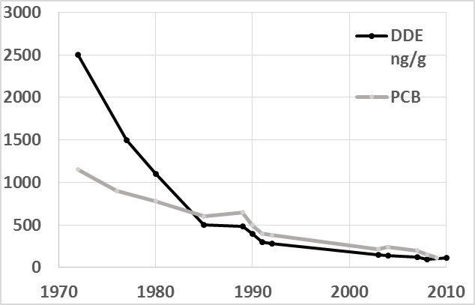
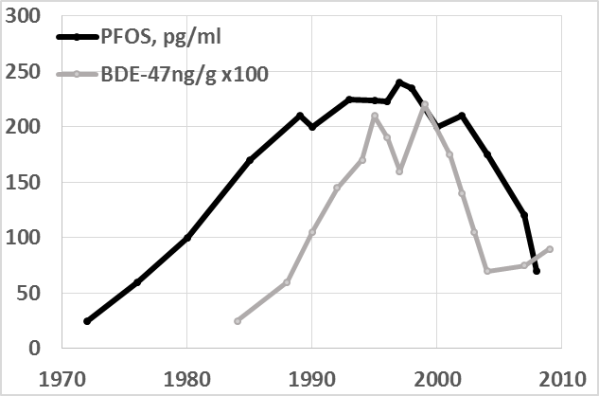
Major exposures related to child development - POPs
15 years
*1970 – Swedish breast milk monitoring
*1972-76 – US ban on production and use
*1984-86 – Rogan and Jacobson: PCBs and child neurodevelopment
*2013 – IARC PCBs upgraded by IARC to Group 1, known carcinogen
*2014 – IARC DDT probably carcinogenic Group 2A
*
*
*
*
10 years
Less persistent HHCs:
1970 – Swedish breast milk monitoring
1985 -
2004 – PBDE_{5,10} banned in US
2005 – PFOA voluntary reduction
2014 - PFOA possibly carcinogenic IARC Group 2B*
Notes:
Halogenated hydrocarbons: pk exposure to HEs
15 years, 10 years, 1998 workers BMI pfoa

Slide 4
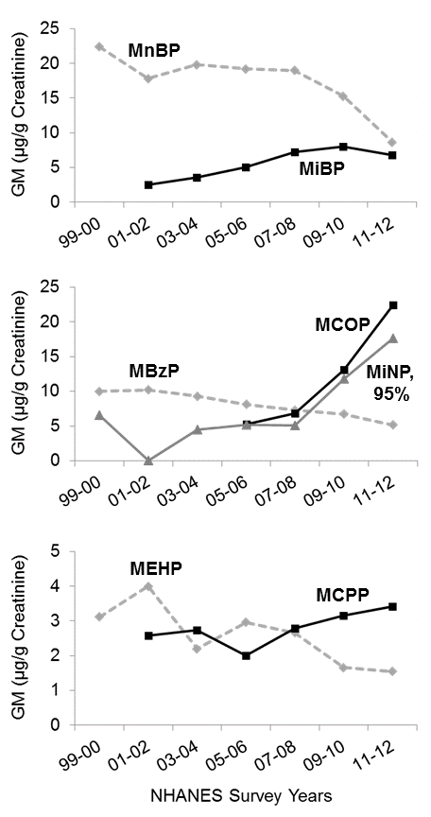
Major exposures related to child development – nonpersistent chemicals – phthalate metabolites
1976 - Rodent data on male reproduction
1982 – EHP monograph, focus on cance(r
1985 – rat toxicokinetics – polar metabolites
1982, 2000 IARC possibly --> unevaluable
2000 – NHANES monitoring
2004 – male reproductive function
GM, all NHANES 1999-2012

Slide 5
Major exposures now recognized, were little studied in the 20th century, still few or no human exposure data
Number of indexed publications on selected suspect chemicals
>Tenfold rise during the past 10 years, compared to 1990-2000
Child health associations now being reported for some phthalates and phenols – mainly those cited before 2000
Notes:
Emerging list.xlsx

Slide 6
Major exposures now recognized, were little studied in the 20th century, still few or no human exposure data
SUNSCREENS, PESTICIDES, NEONICOTINOIDS, NANOS, E-CIGS
Number of indexed publications on selected suspect chemicals that have risen >tenfold during the past 10 years, compared to 1990-2000
(Human, exposure, urine)
Notes:
Emerging list.xlsx

Slide 7
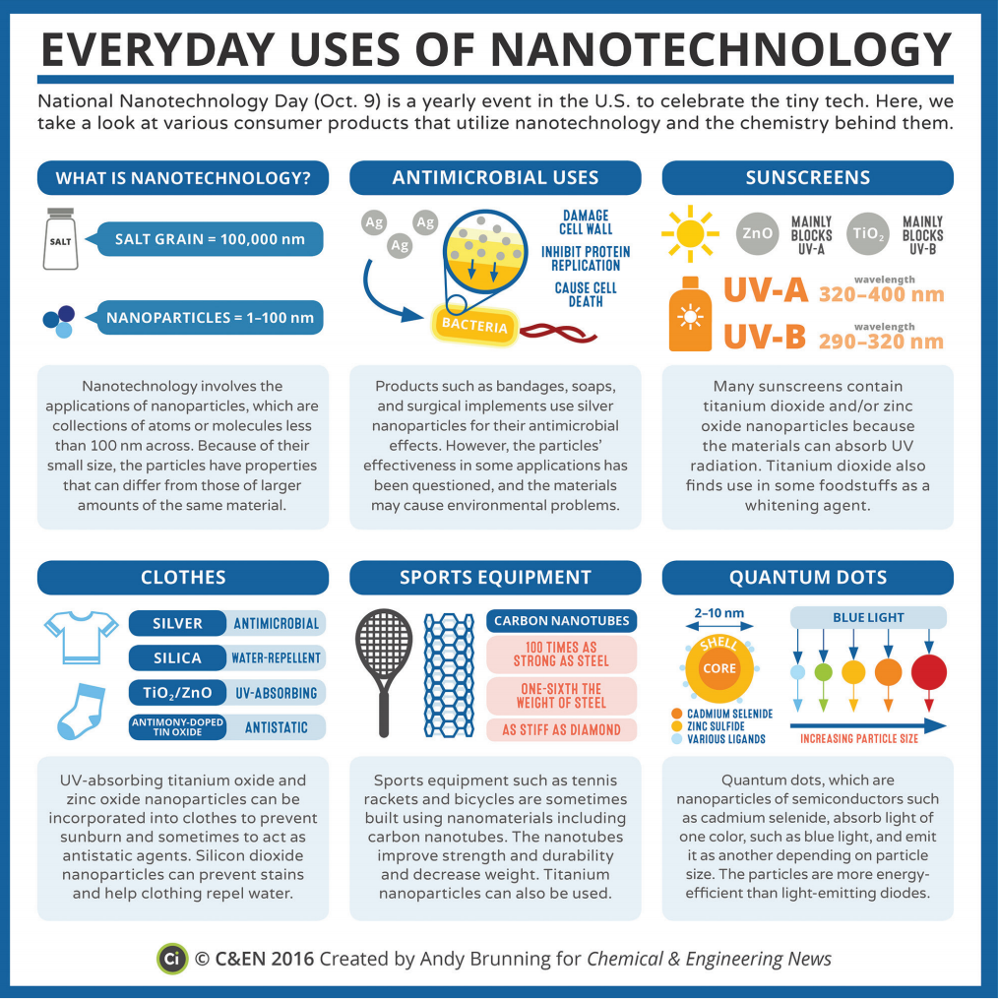
http://cen.acs.org/periodicgraphics.html

Slide 8
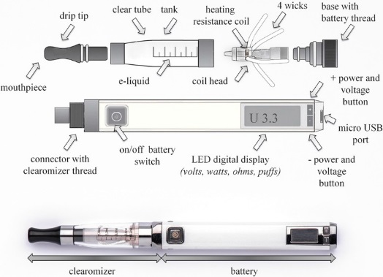
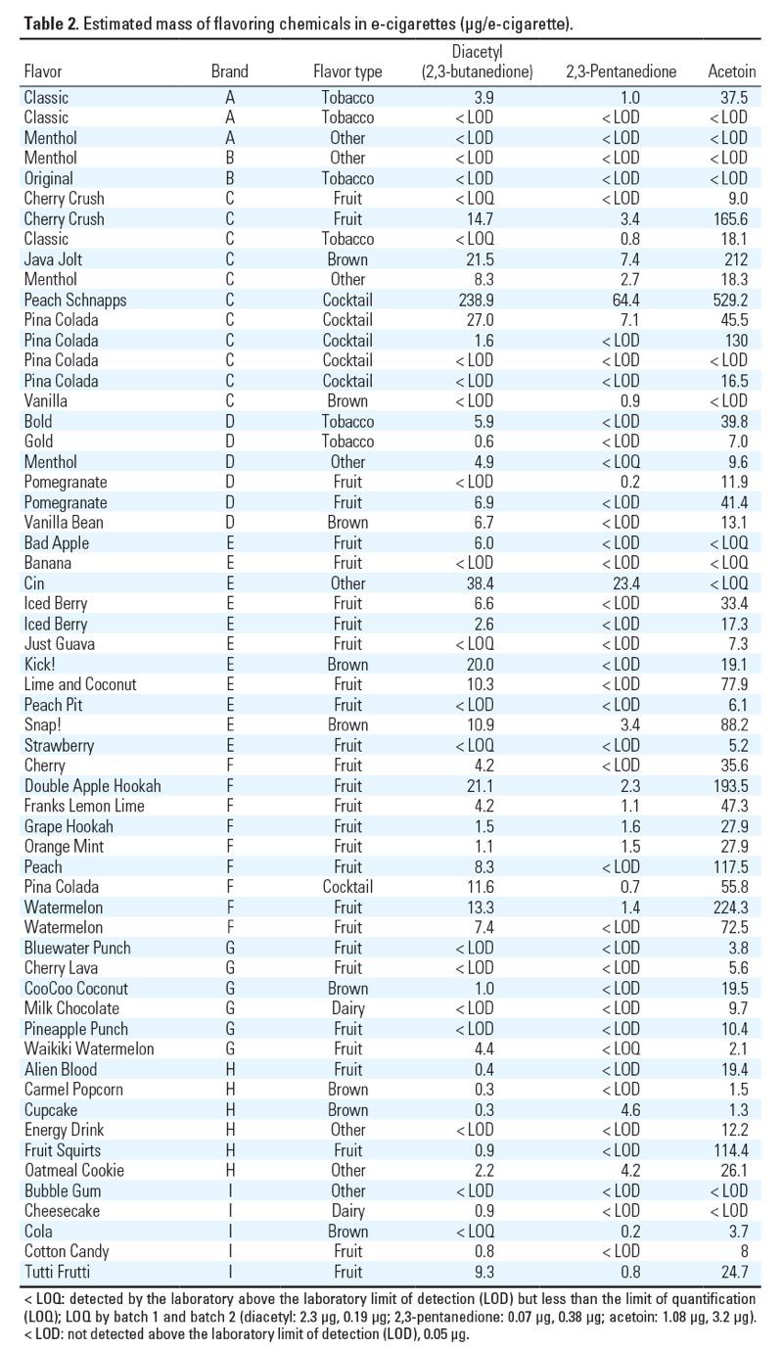
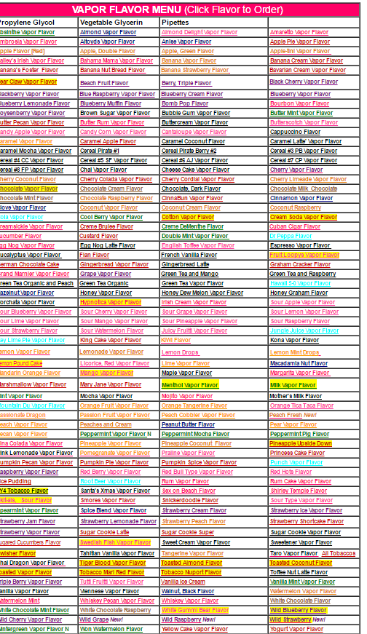
e-juice
Table 2 – Estimated mass of flavoring chemicals in e-cigarettes (μg/e-cigarette).
VAPOR FLAVOR MENU (Click Flavor to Order)
nicotine
propylene glycol
diacetyl
2,3-pentanedione=acetyl propionyl
acetoin (ug)
vegetable glycerin
Sweeteners - Ethyl maltol
Flavoring - cherry, cheesecake, cinnamon, tobacco, fruit-, candy, cocktail, menthol
..”1.78 million children tried e-cigarettes as of 2012..”
Allen et al., & Christiani, EHP, PMID: 26642857
Notes:
Allen et al., & Christiani, EHP, PMID: 26642857
Acetoin ch3chohcoch3
propylene glycol HOCH2CHOHCH3
acetyl propionyl, 2,3-pentanedione ch3COCOch2ch3
Glycerin HOch2chohCH2OH

Slide 9
Methods already exist to determine biomarkers for some but not all toxicants. Most of the nonpersistent chemicals have urinary metabolites
 | Toxico-kinetics | IS, standards etc | GC/LCMS etc methods
Long-chain phthalates etc (DINCH) | ✓ | ✓ | ✓
BPA,F,S; TCS,TCb; Cl-PhOHs, parabens | ✓ | ✓ | ✓
Nonyl phenol | x
Avobenzene, octisalate, etc (sunscreen) | x
Br/Cl-fire retardants PBDE | ✓ | ✓ | ✓
other Br/CL FRs | ?
Perfluoroalkyl acid replacements (long chain)
e-cigarette flavorings & additives | x
Neonicotinoid pesticides | ✓ | ✓ | ✓
Nanoparticles | x

Slide 10
How can we anticipate exposures related to child development
Agents without exposure data also lack studies of health effects
Existing analytic methods can be used or minimally modified to measure some exposures
Valid methods can be developed based on toxicokinetics, requiring research on metabolism and analytic approaches
Replacement chemicals are not tested, but can exposure principles be suggested by homology with the suspect agent? Can pretesting be implemented?
CHEAR – NIEHS funding: U2CES026555 U2CES026561 U2CES026560
NIEHS Core grants - P30ES023515 P30ES019776 P30ES010126 R01ES021777

Slide 12
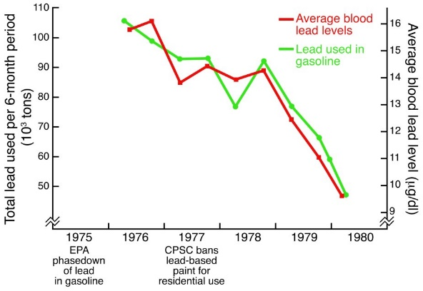
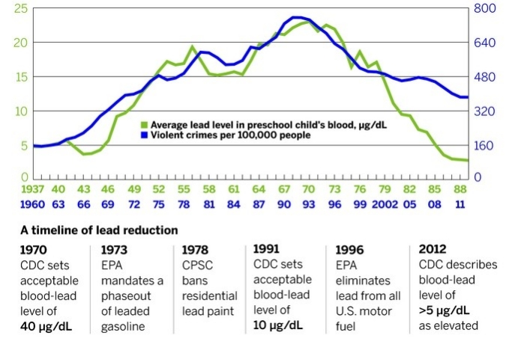
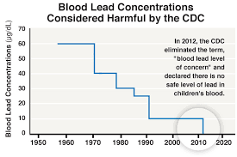
Ignoring putative toxins leads to unreasonable delay
1940 1970 1985

