Slide 1

Collegiality at work: occupational safety and health around the world Ramazzini lecture – carpi, Italy 2016
Arthur L. Frank, MD, PhD, CR Fellow

Slide 2
Thank you, Joanne!

Slide 3
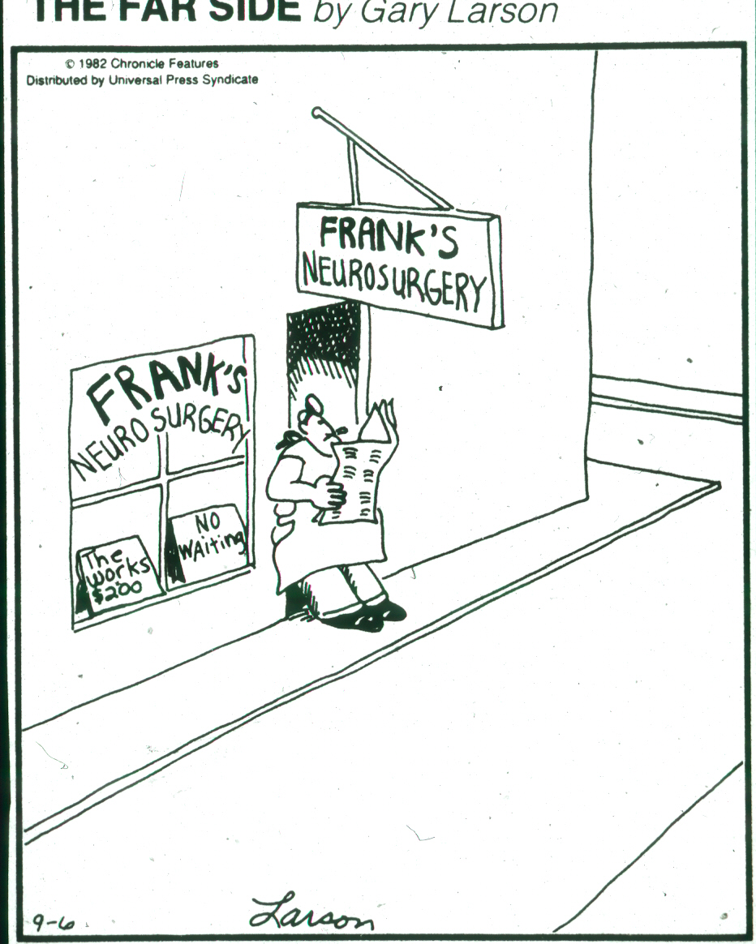

Slide 4
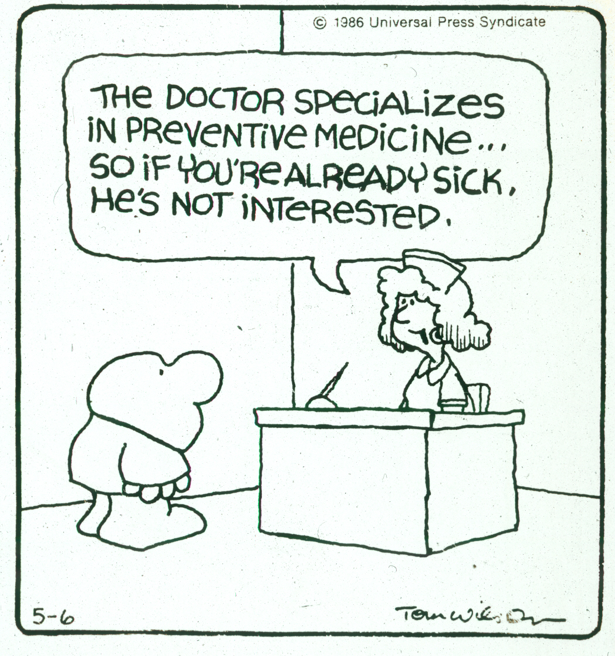

Slide 5
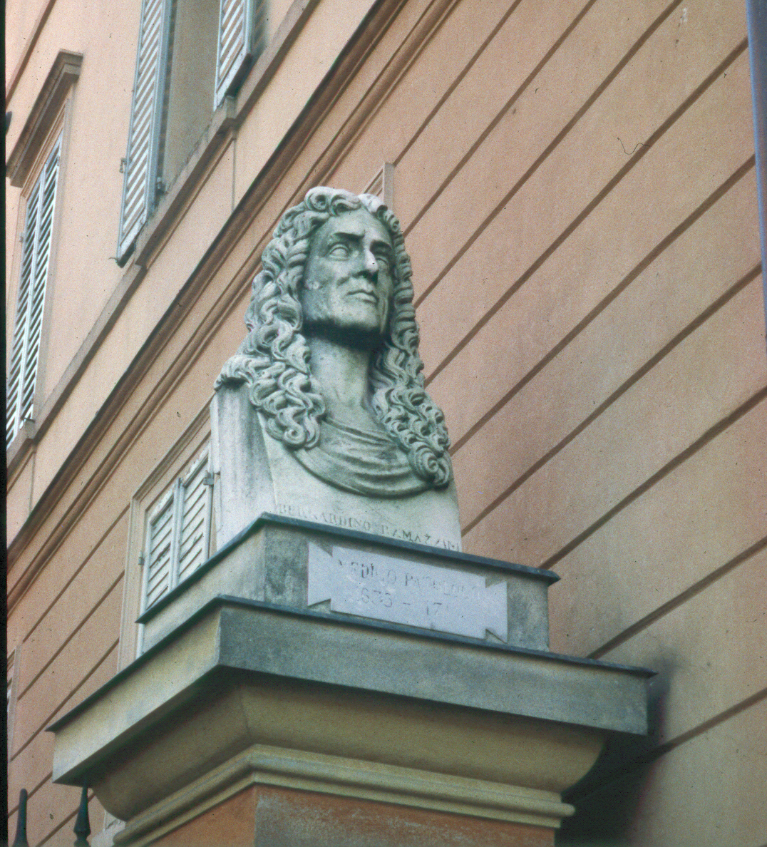

Slide 6
Clearly, much of my work has dealt with asbestos, and this and other exposures have given me an interesting career around the world.

Slide 7
It is astonishing that in 2016 we must still deal with the hazards of asbestos, especially in the developing world, but also in the USA.

Slide 8
My own work has involved:
Cell and organ culture
Animal studies
Case reports
Epidemiologic studies
Education of workers, companies, governments, medical/legal work

Slide 9
A Brief History of Asbestos Disease Knowledge:
Romans
1898 – HMIF Report
1924 – Cooke
1930 – Merewether and Price
1942 – Hueper
1955 – Doll
1960 – Wagner
Thereafter, Selikoff and many others

Slide 10
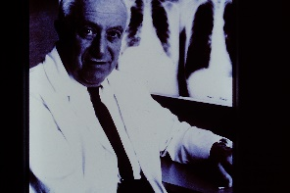

Slide 11
Collegium Fellows do not need to be educated about asbestos:
Multiple CR documents
Scientific presentations
Former award winners

Slide 12
There are some simple truths about asbestos:
All fiber types
All products, both common and unusual

Slide 13
Legitimate questions:
Fiber potency
Fiber size
Issues of translocation
Genetic interactions

Slide 14
“Science for Sale”
Wagner
Bernstein
Exponent and CardnoChemrisk
Many others…

Slide 15
Why do we still have a problem with asbestos?
Greed
Lack of morals
Lack of worker and physician education
Government complicity

Slide 16
50+ Countries Have Banned Asbestos!
ADAO, IBAN, Japan, India, Canada

Slide 17
Education has been an important part of my life.

Slide 18
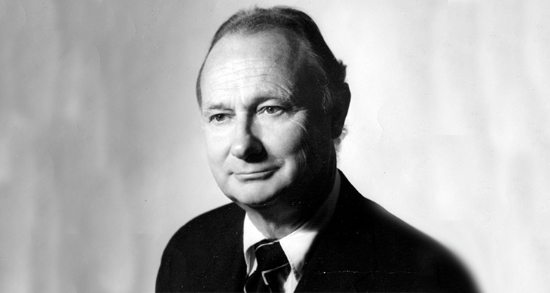

Slide 19
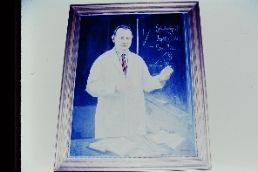

Slide 20
Better Education of Physicians:
Basic knowledge
History taking – The “Ramazzini” question
Involvement in compensation

Slide 21
Governments Need to Keep Better Records:
India
Russia
Data of Takahashi

Slide 22
International agencies need to be more involved and avoid poor science.

Slide 23
Through my work I have been fortunate to see much of the world including all of the United States, Canada, South America, much of Europe, Egypt, Israel, and much of Asia.

Slide 24
To properly do occupational medicine, one needs to examine workplaces.

Slide 25
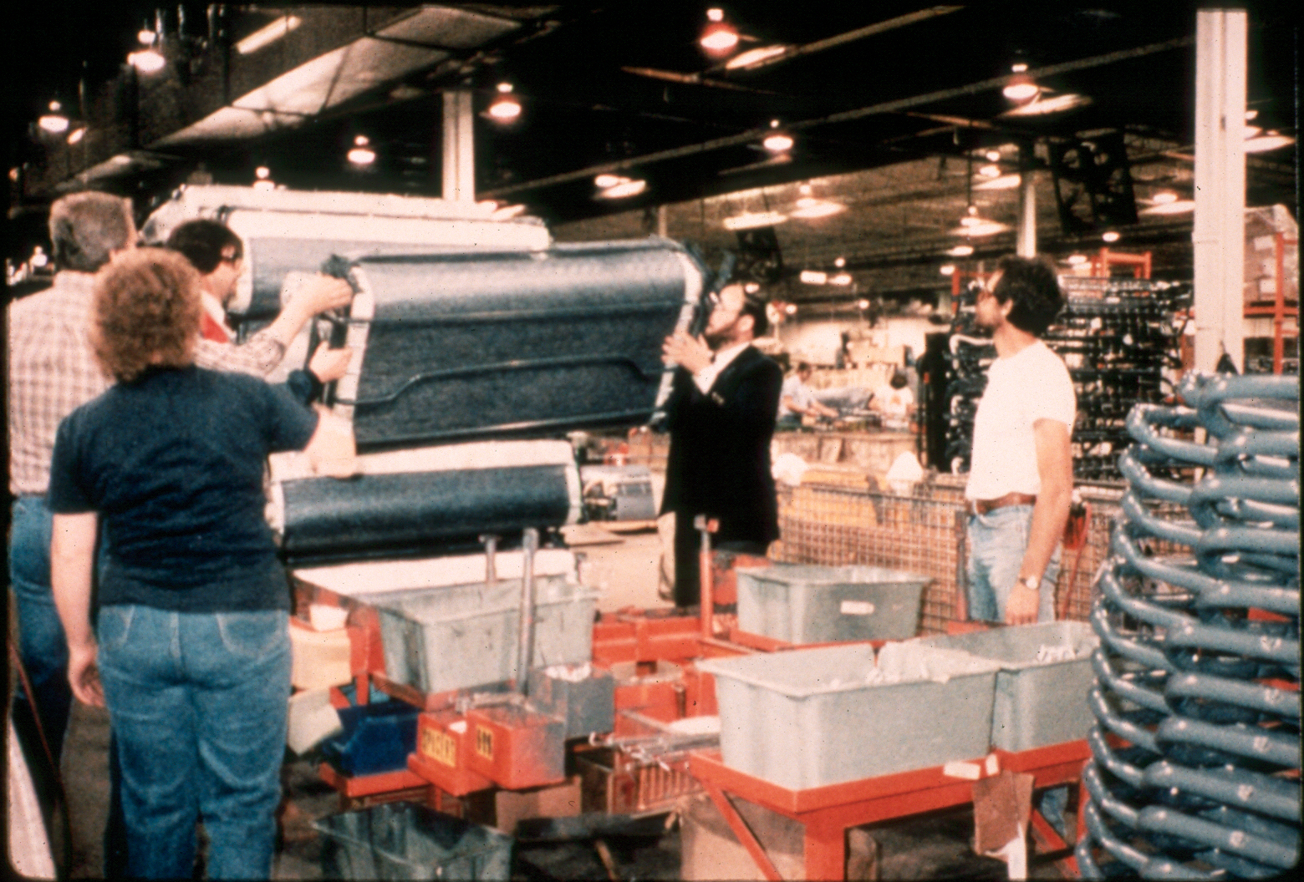

Slide 26
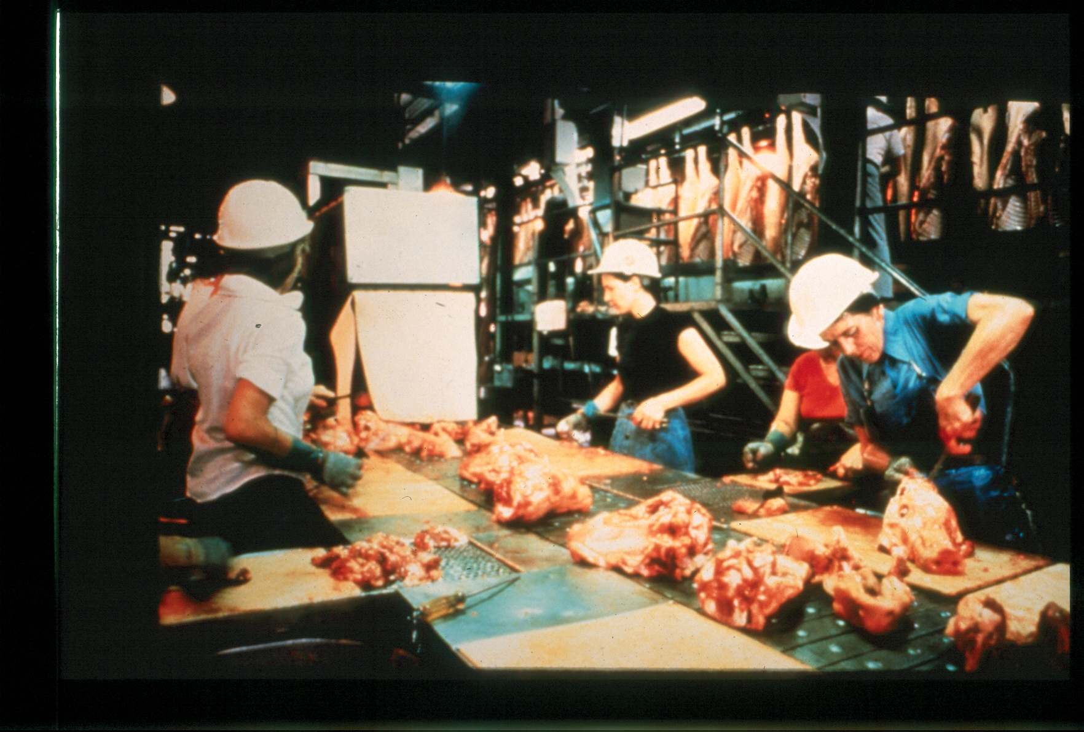

Slide 27
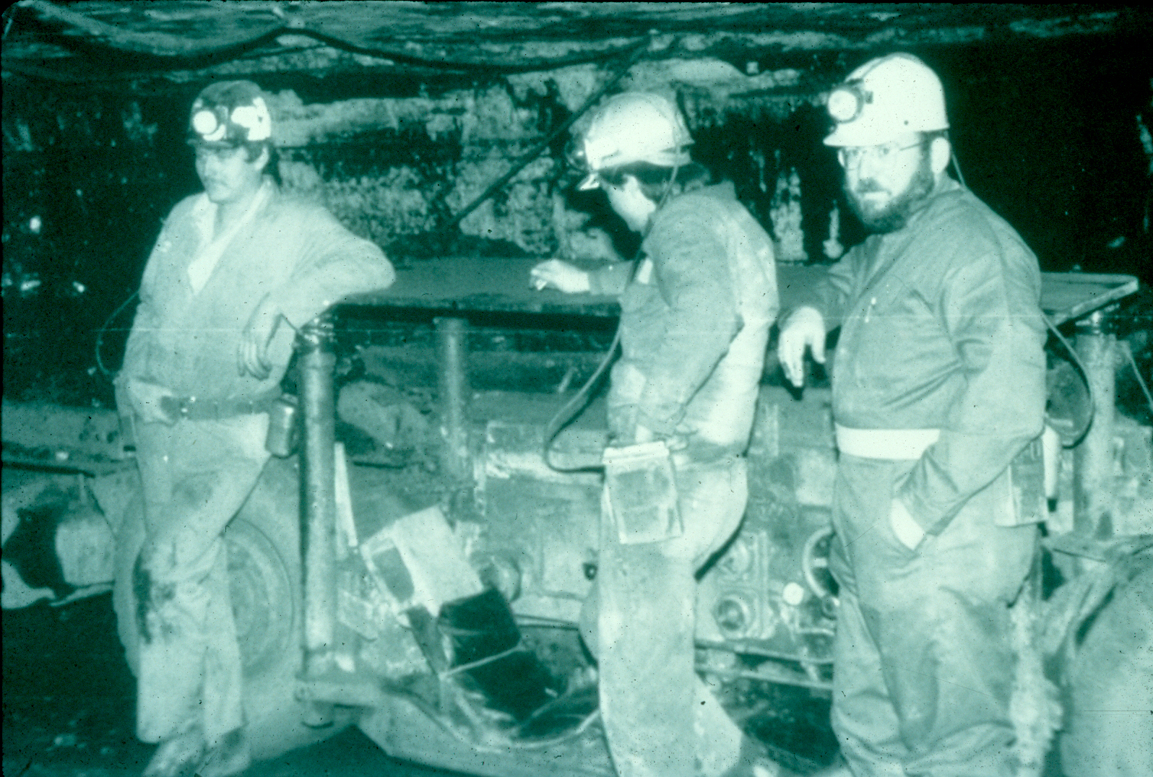

Slide 28
Worksites in the United States:
Shipyards
Steel mills
Garages
Construction sites
Farms
And, more…

Slide 29
Work in Agricultural Safety and Health

Slide 30
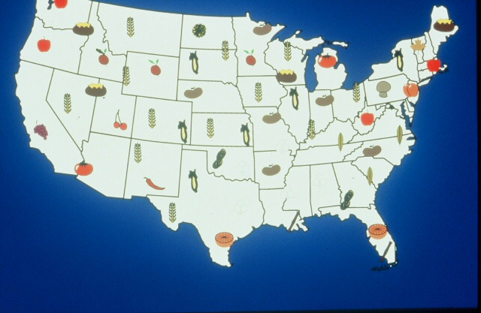

Slide 31
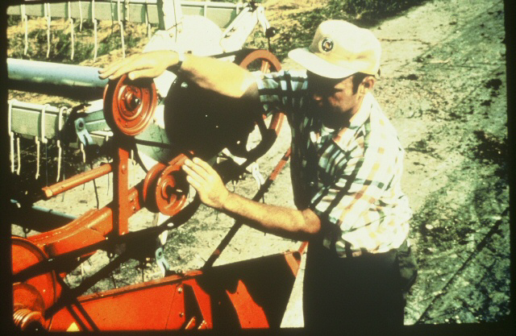

Slide 32
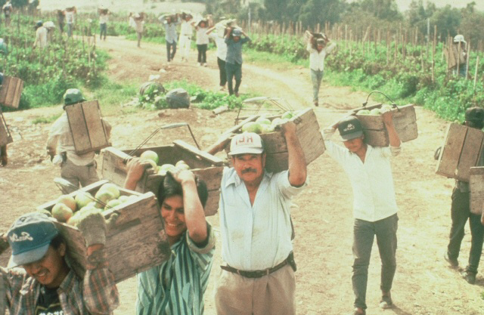

Slide 33
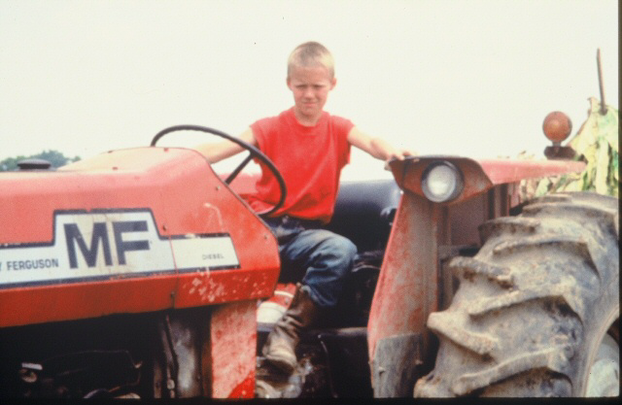

Slide 34
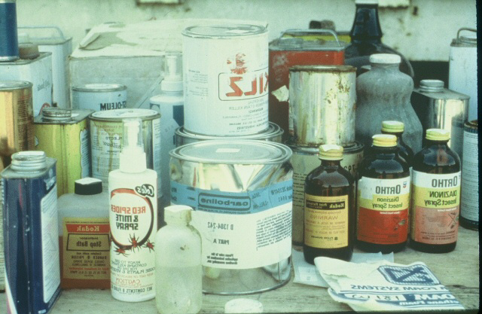

Slide 35
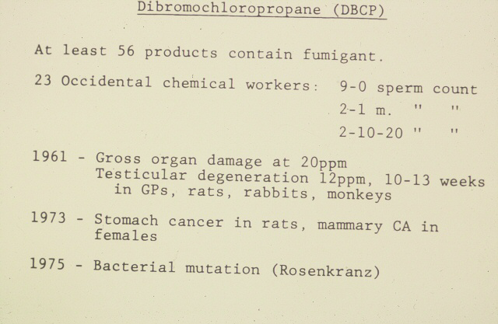

Slide 36
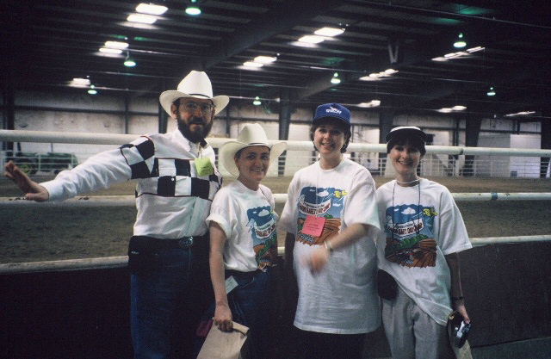

Slide 37
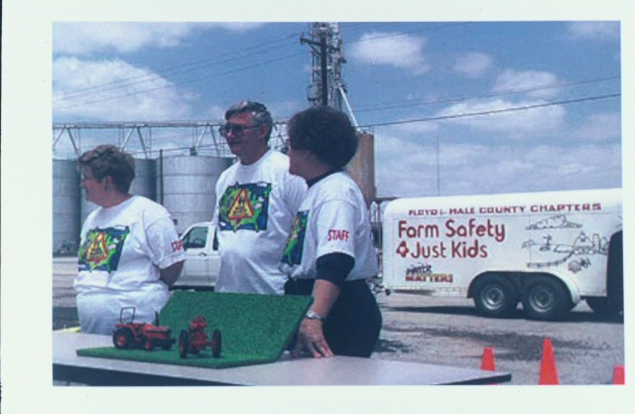

Slide 38
Mining Activities
Coal in the USA
Silica in the USA and elsewhere

Slide 39
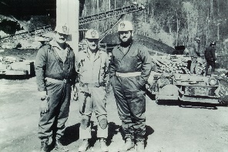

Slide 40
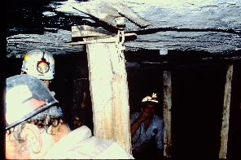

Slide 41
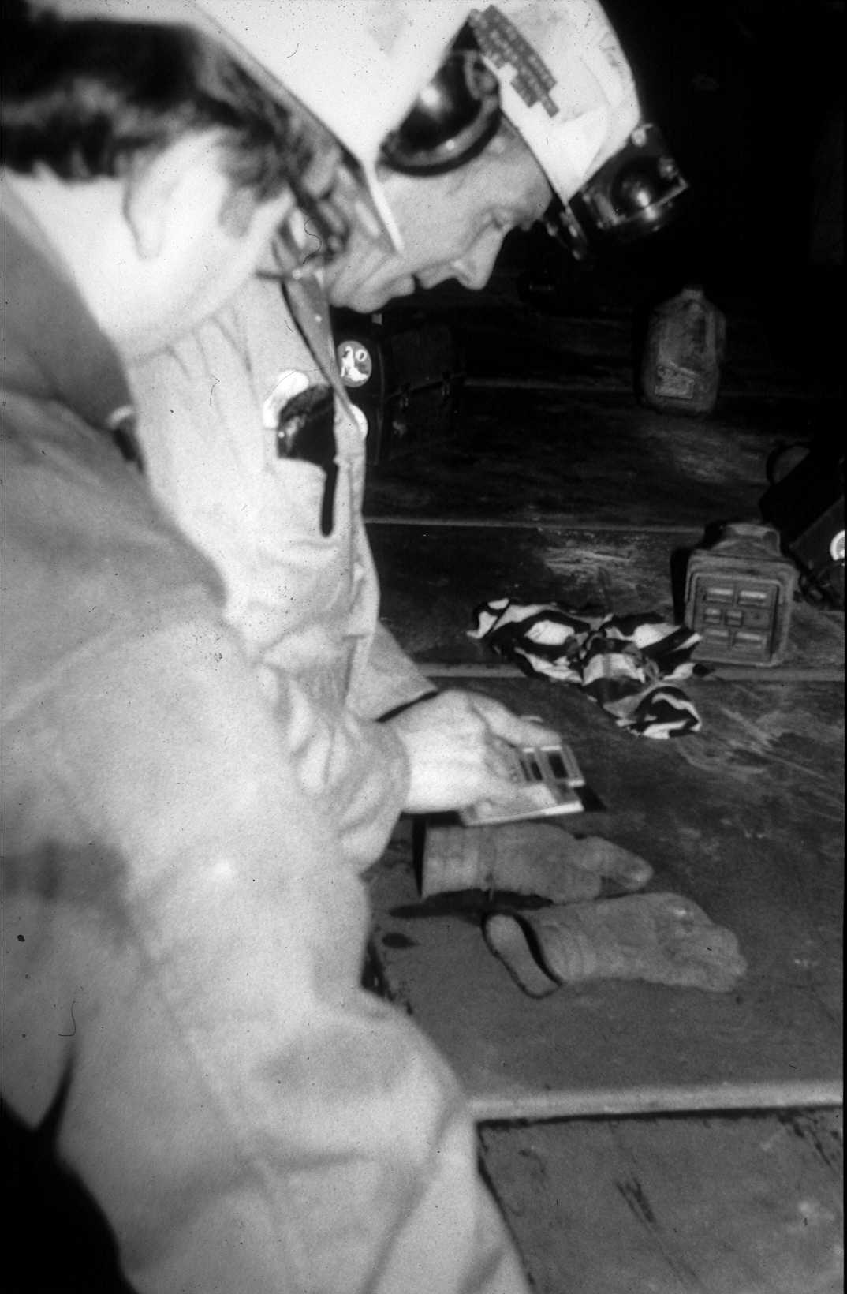

Slide 42
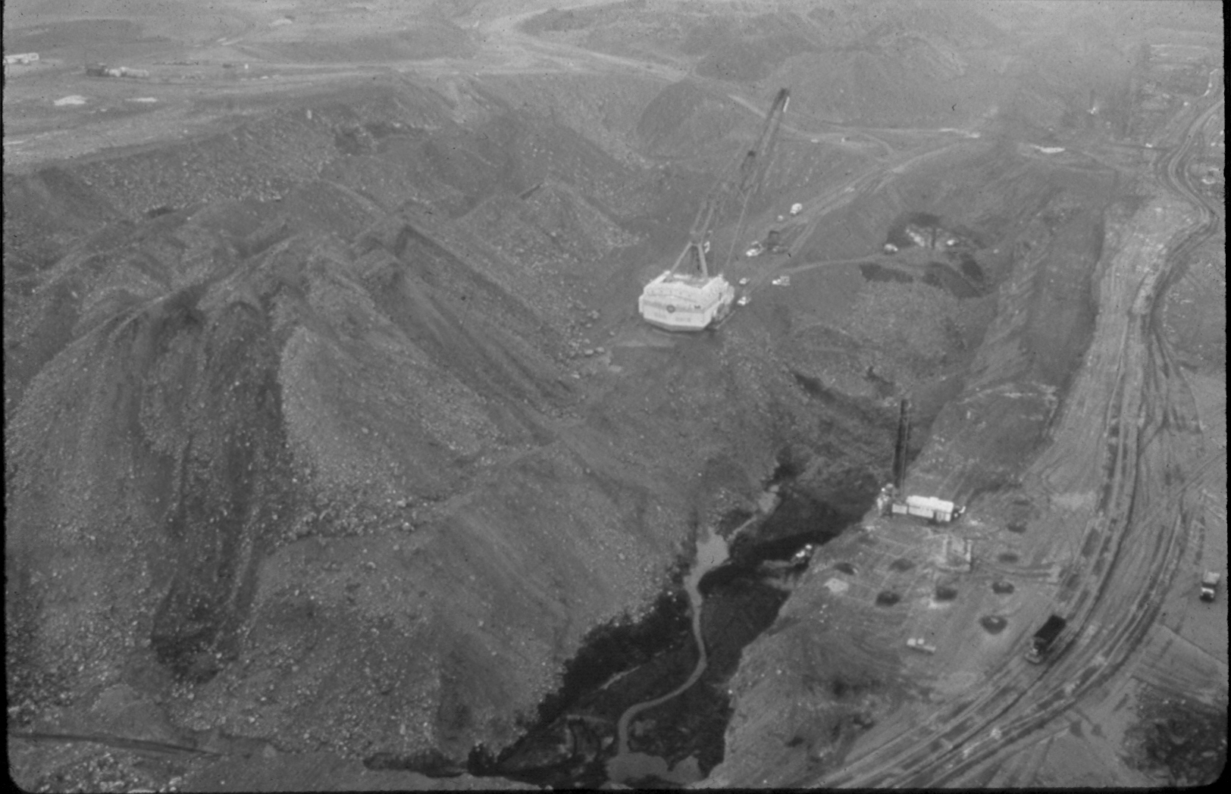

Slide 43
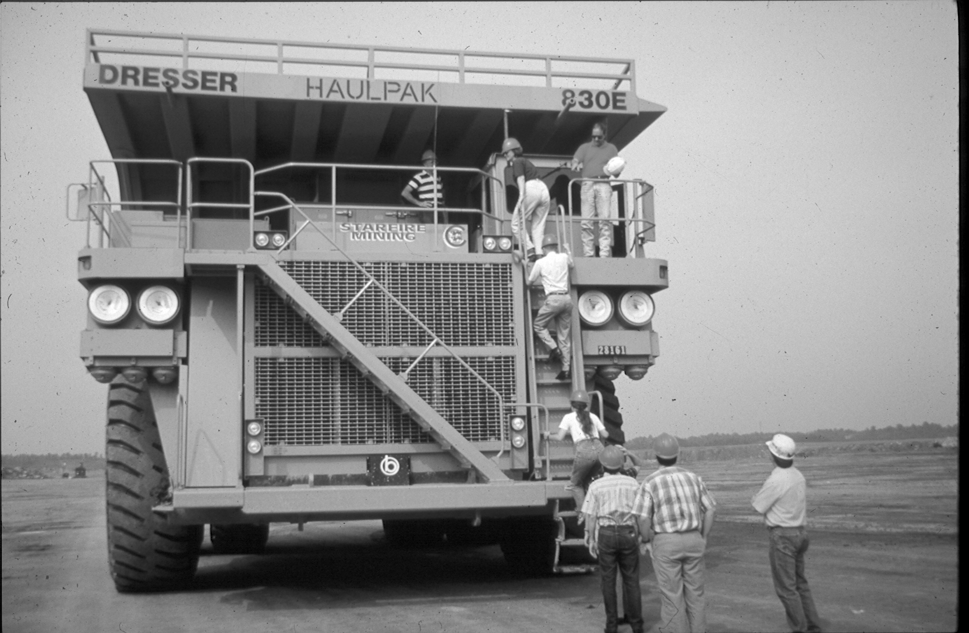

Slide 44
Silica and Gauley Bridge

Slide 45
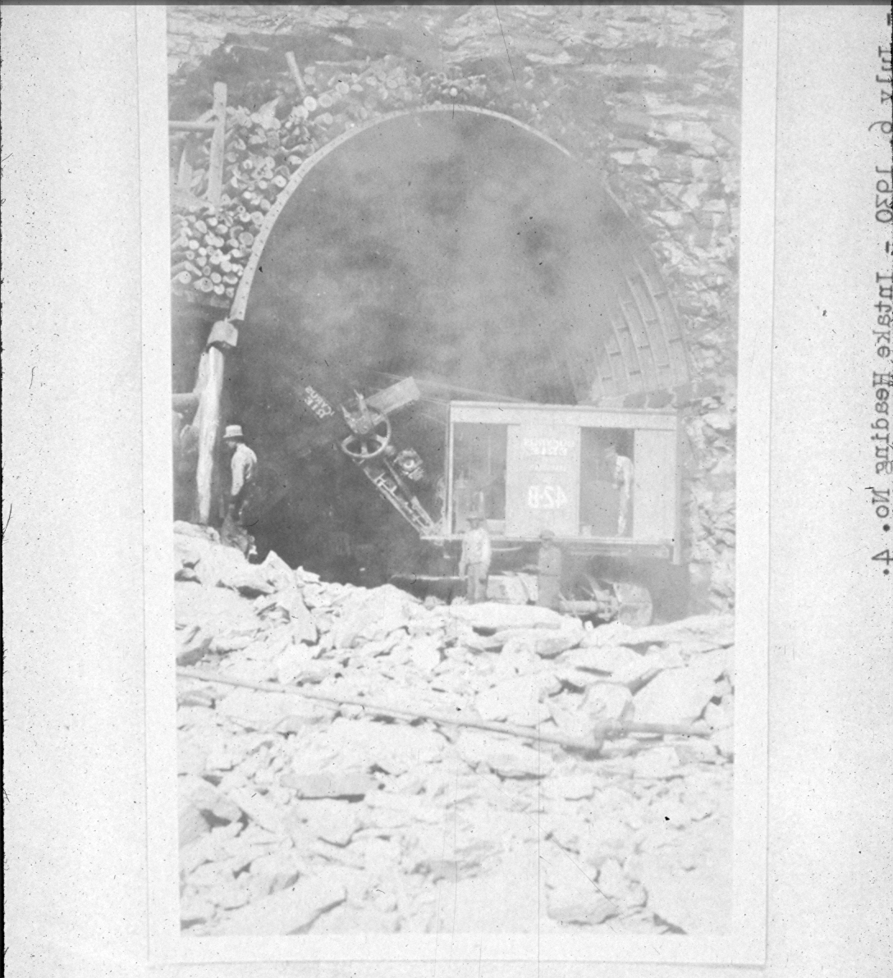

Slide 46
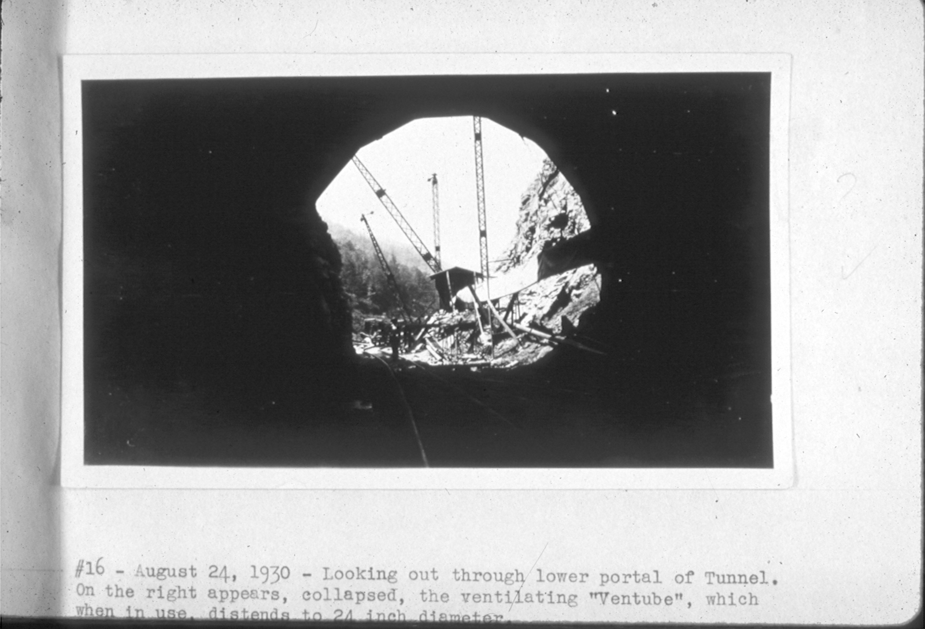

Slide 47
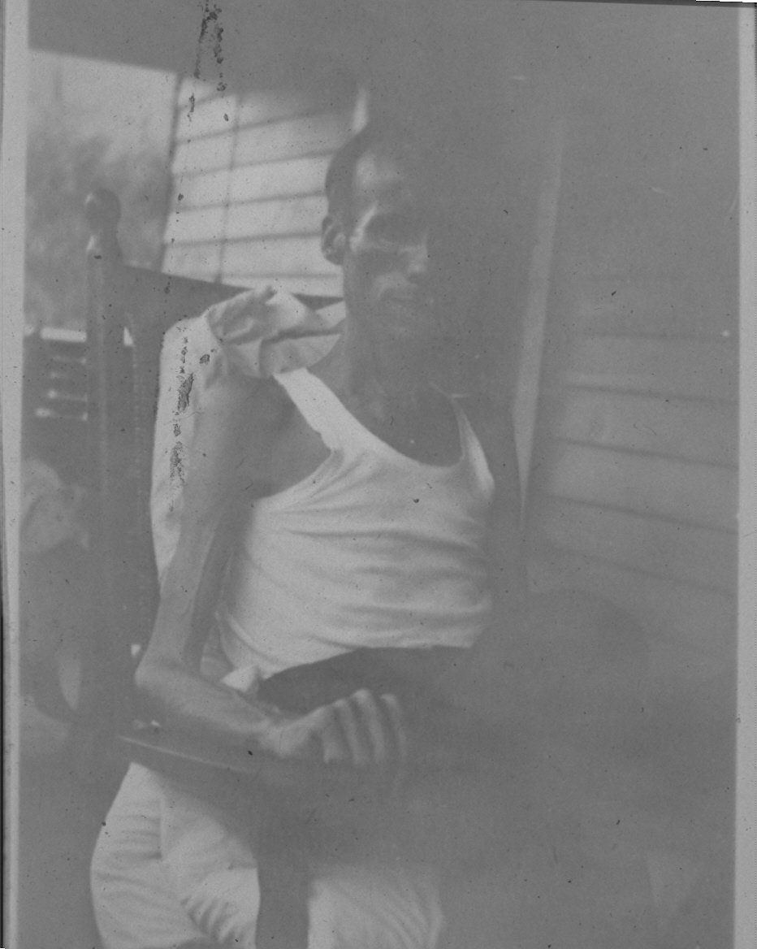

Slide 48
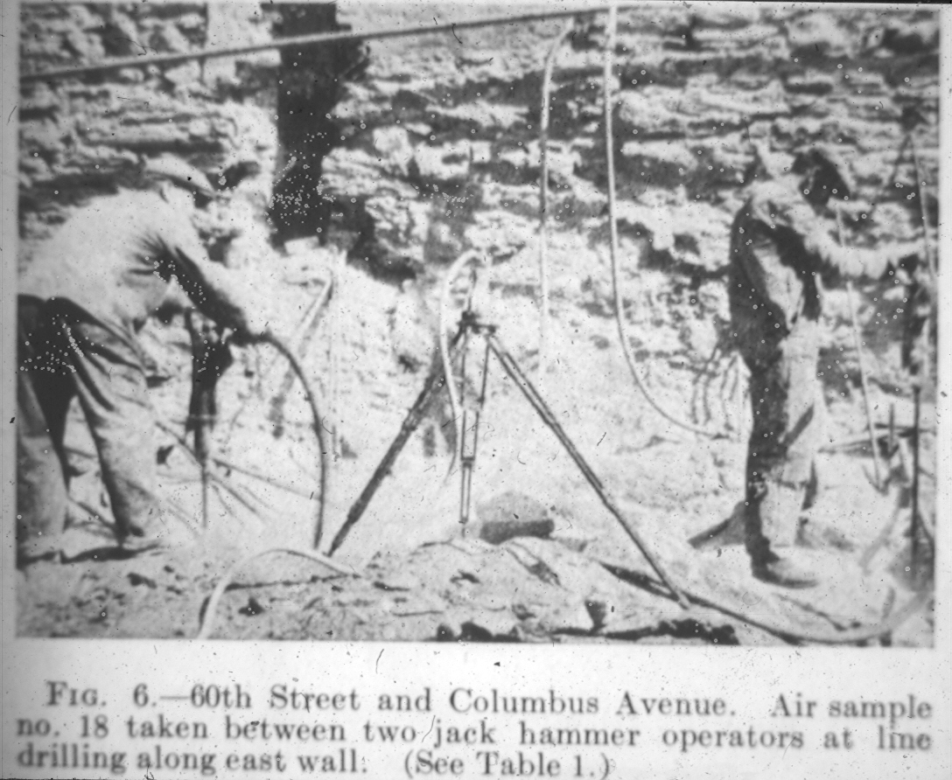

Slide 49
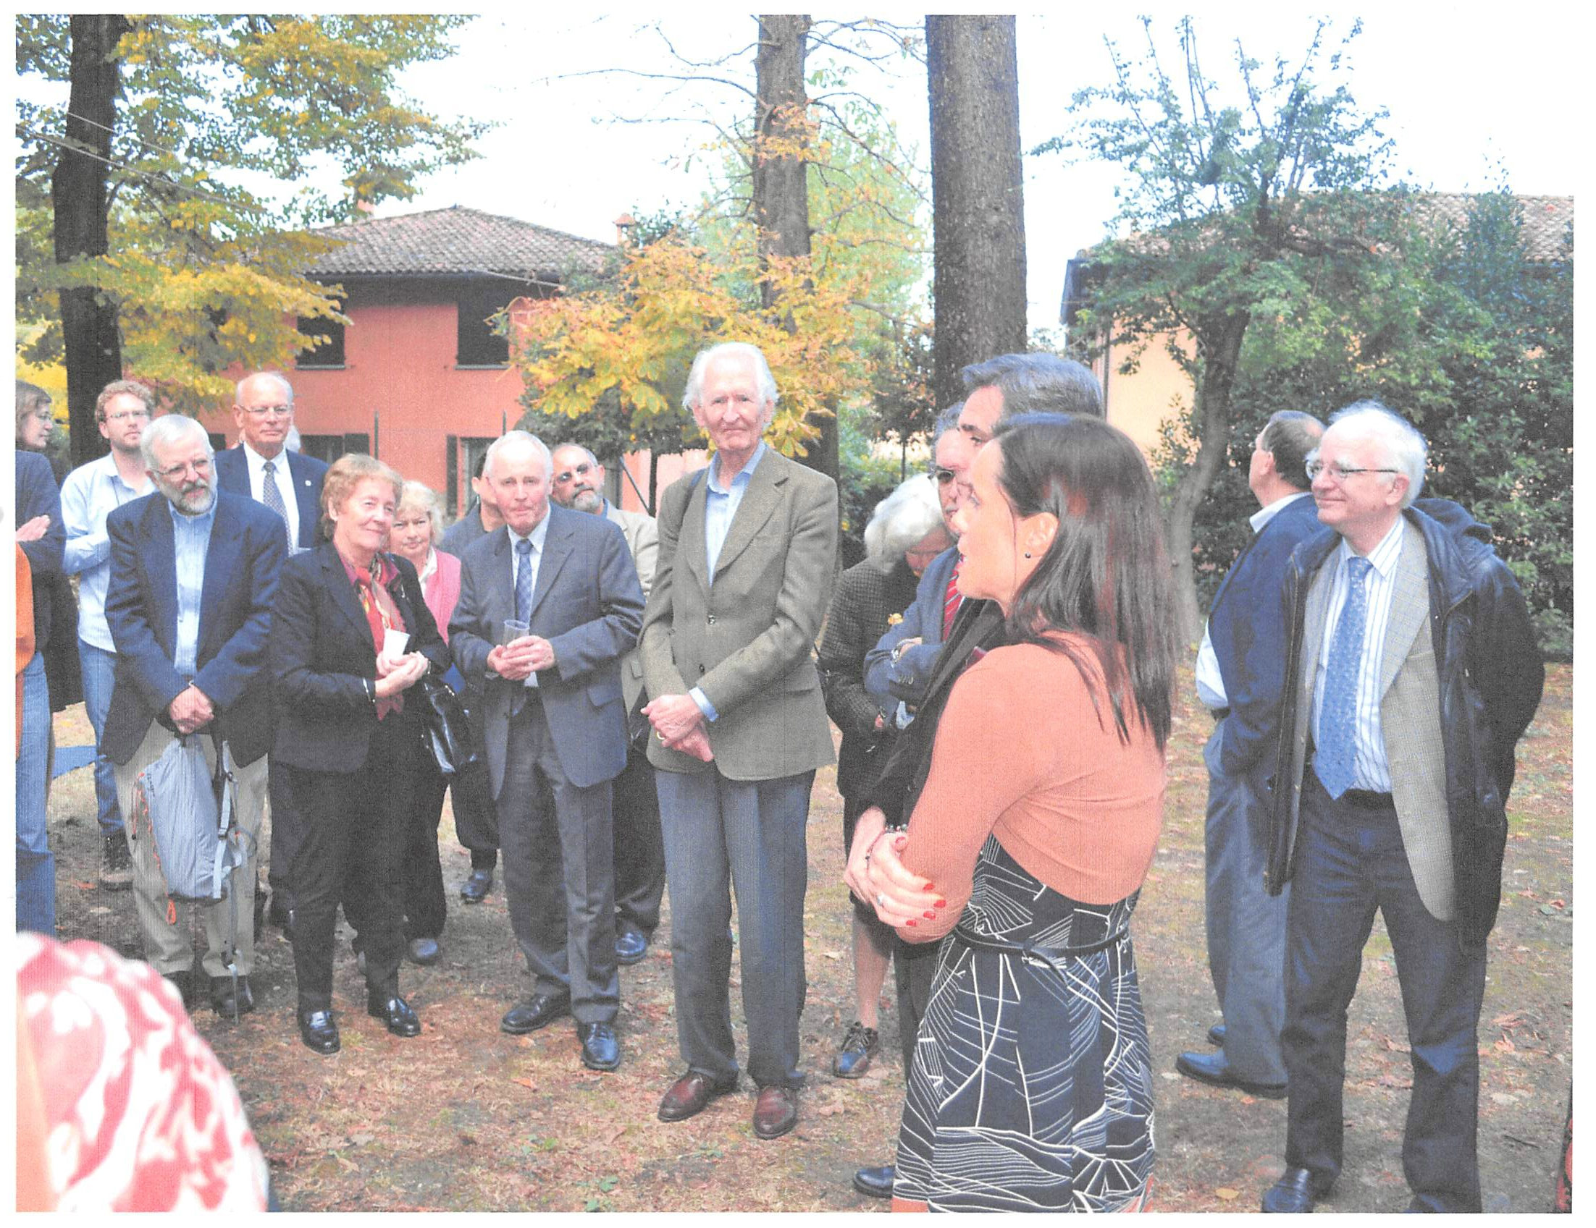

Slide 50
Mines in Canada

Slide 51
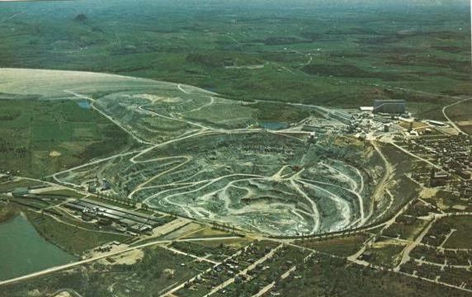
The town of Asbestos, Quebec, surrounds the huge open pit of an asbestos mine just a little more than 100 miles east of Montreal.

Slide 52
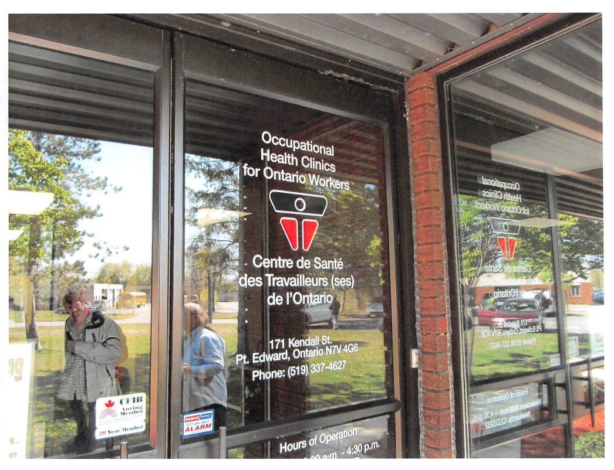

Slide 53
Israel Interactions

Slide 54
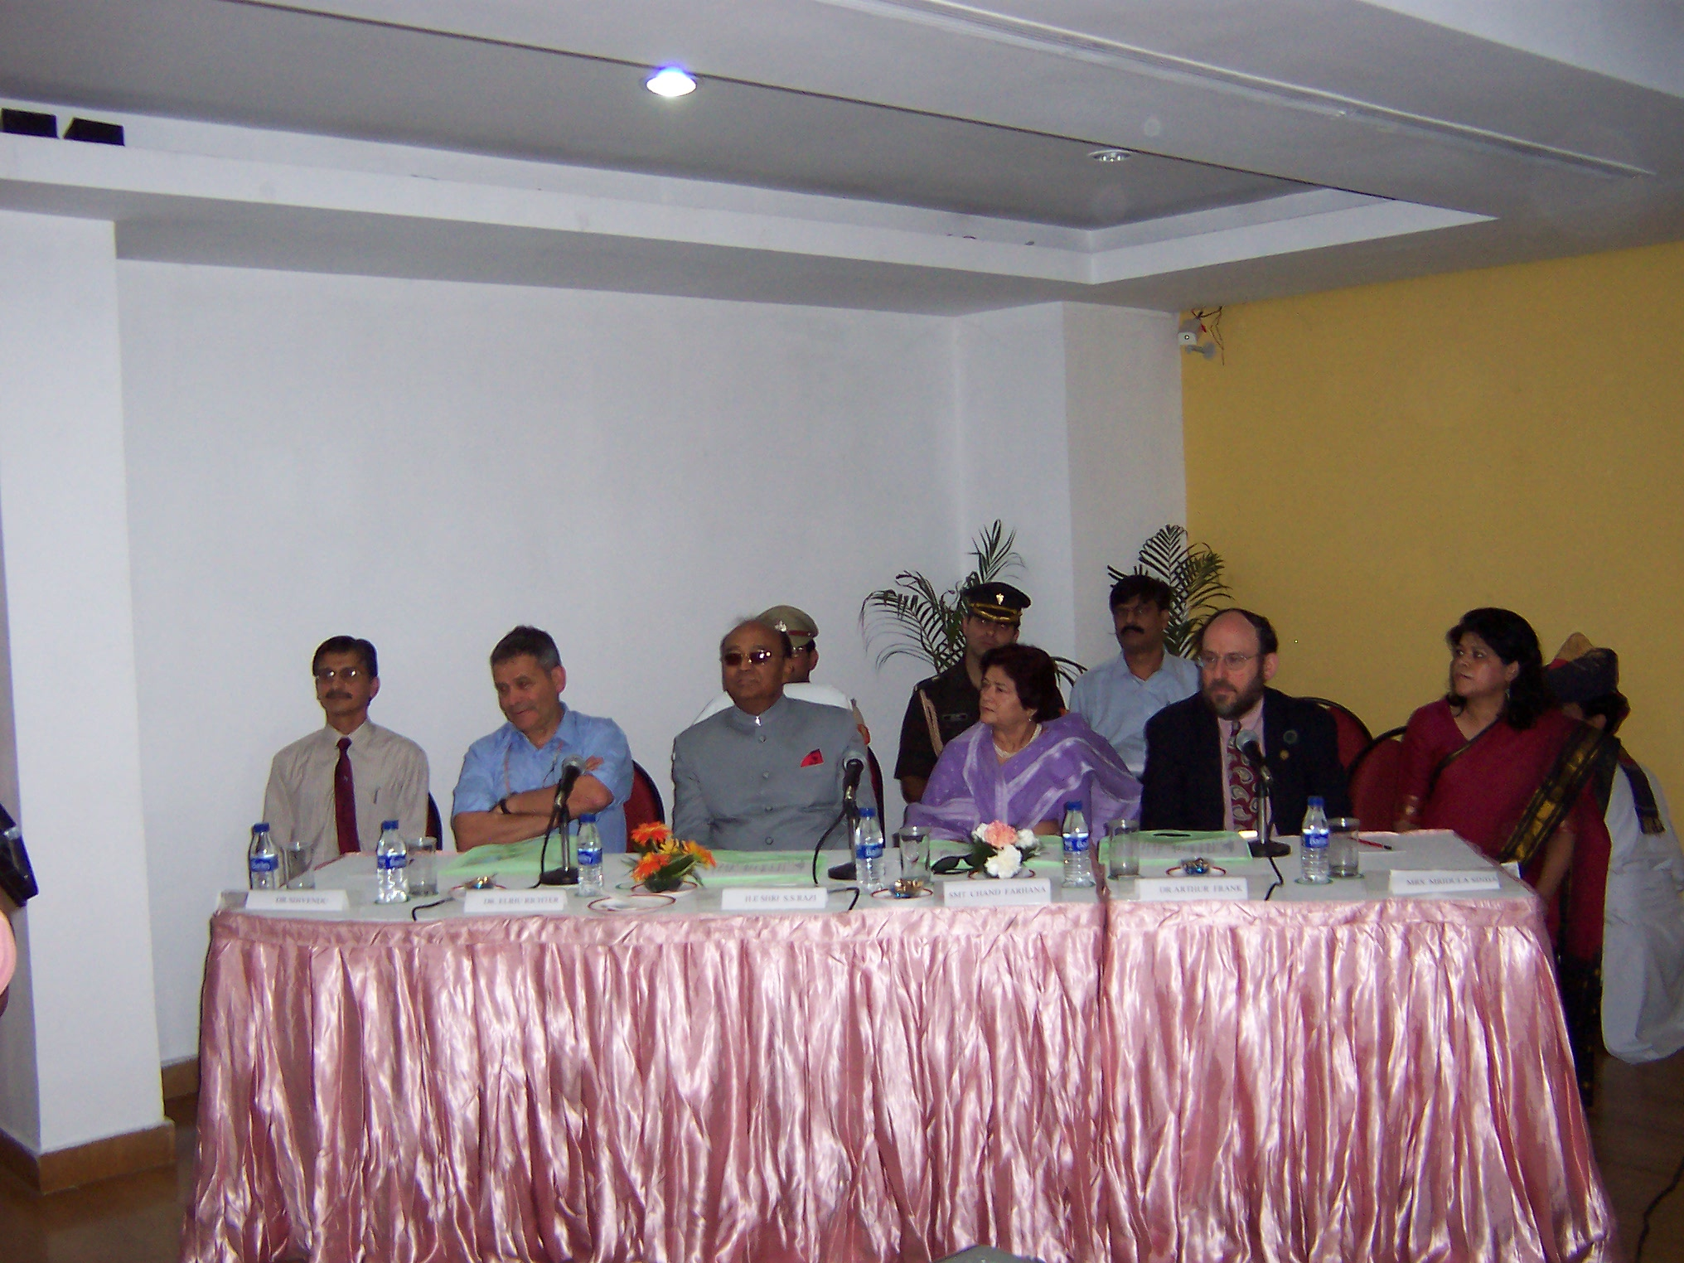

Slide 55
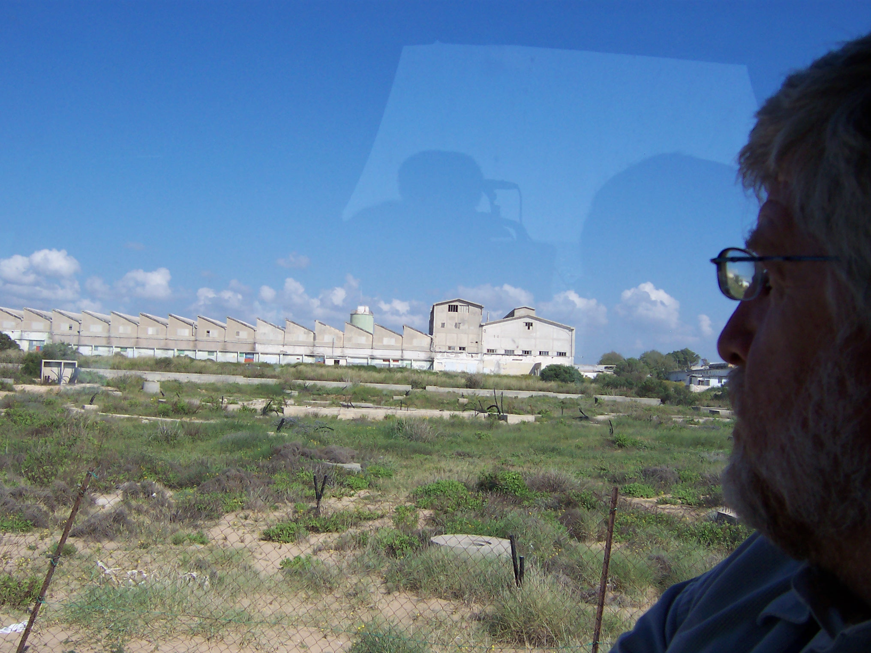

Slide 56
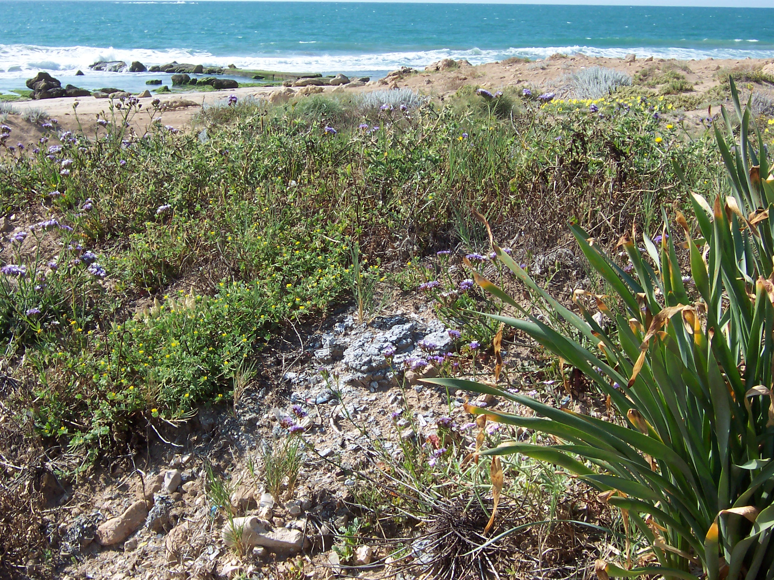

Slide 57
China has been a major area of my work.

Slide 58
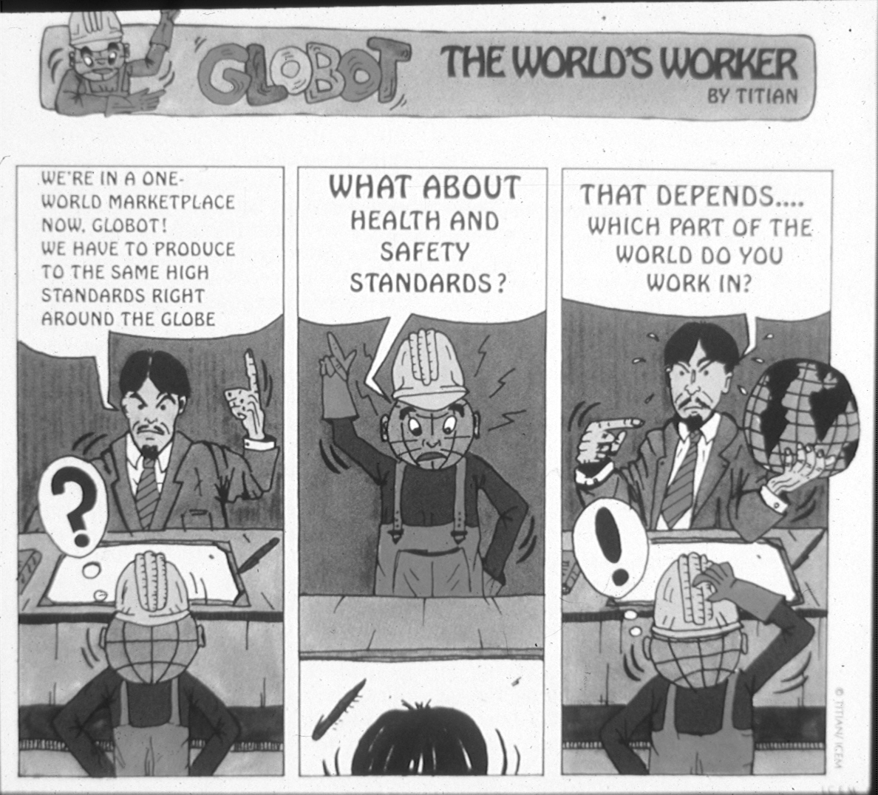

Slide 59
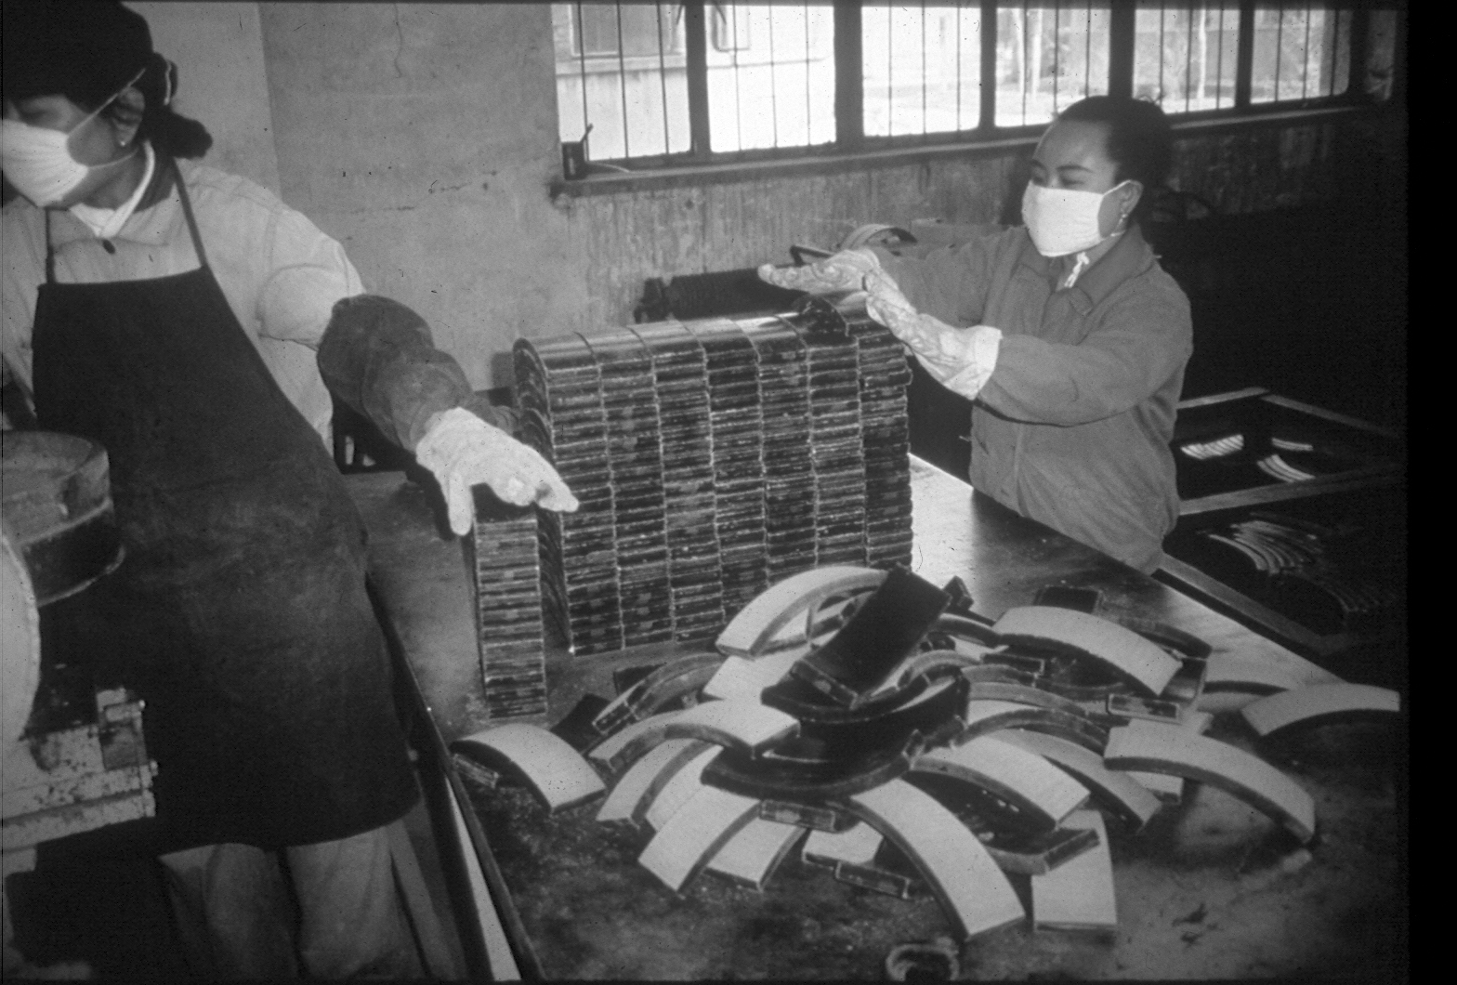

Slide 60
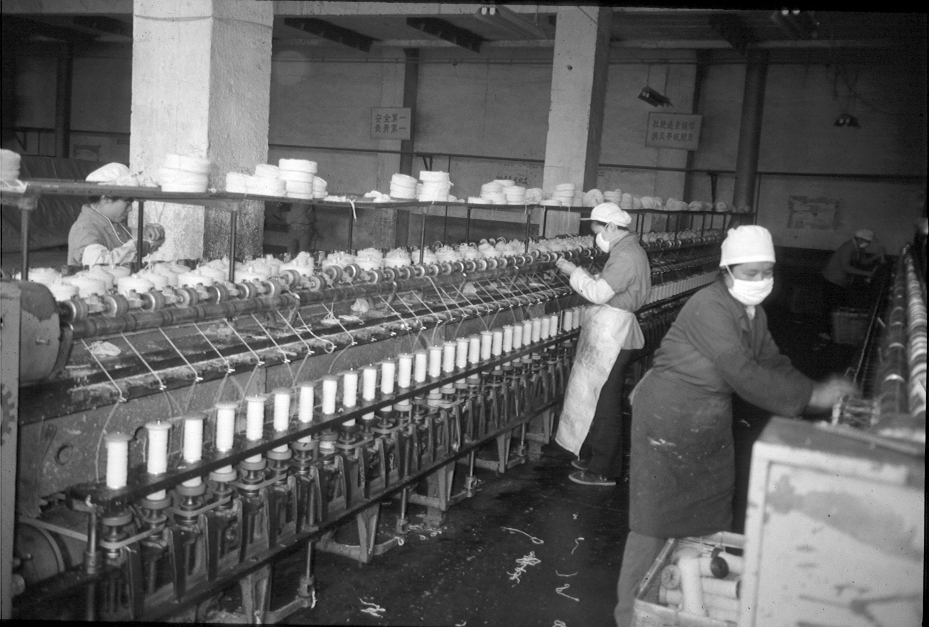

Slide 61
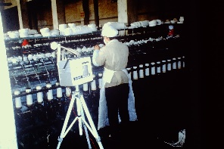

Slide 62
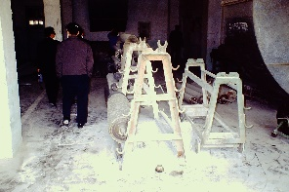

Slide 63
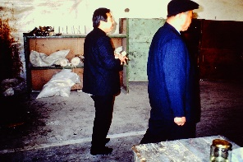

Slide 64
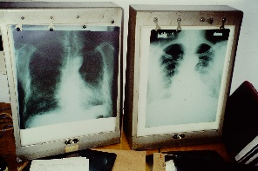

Slide 65
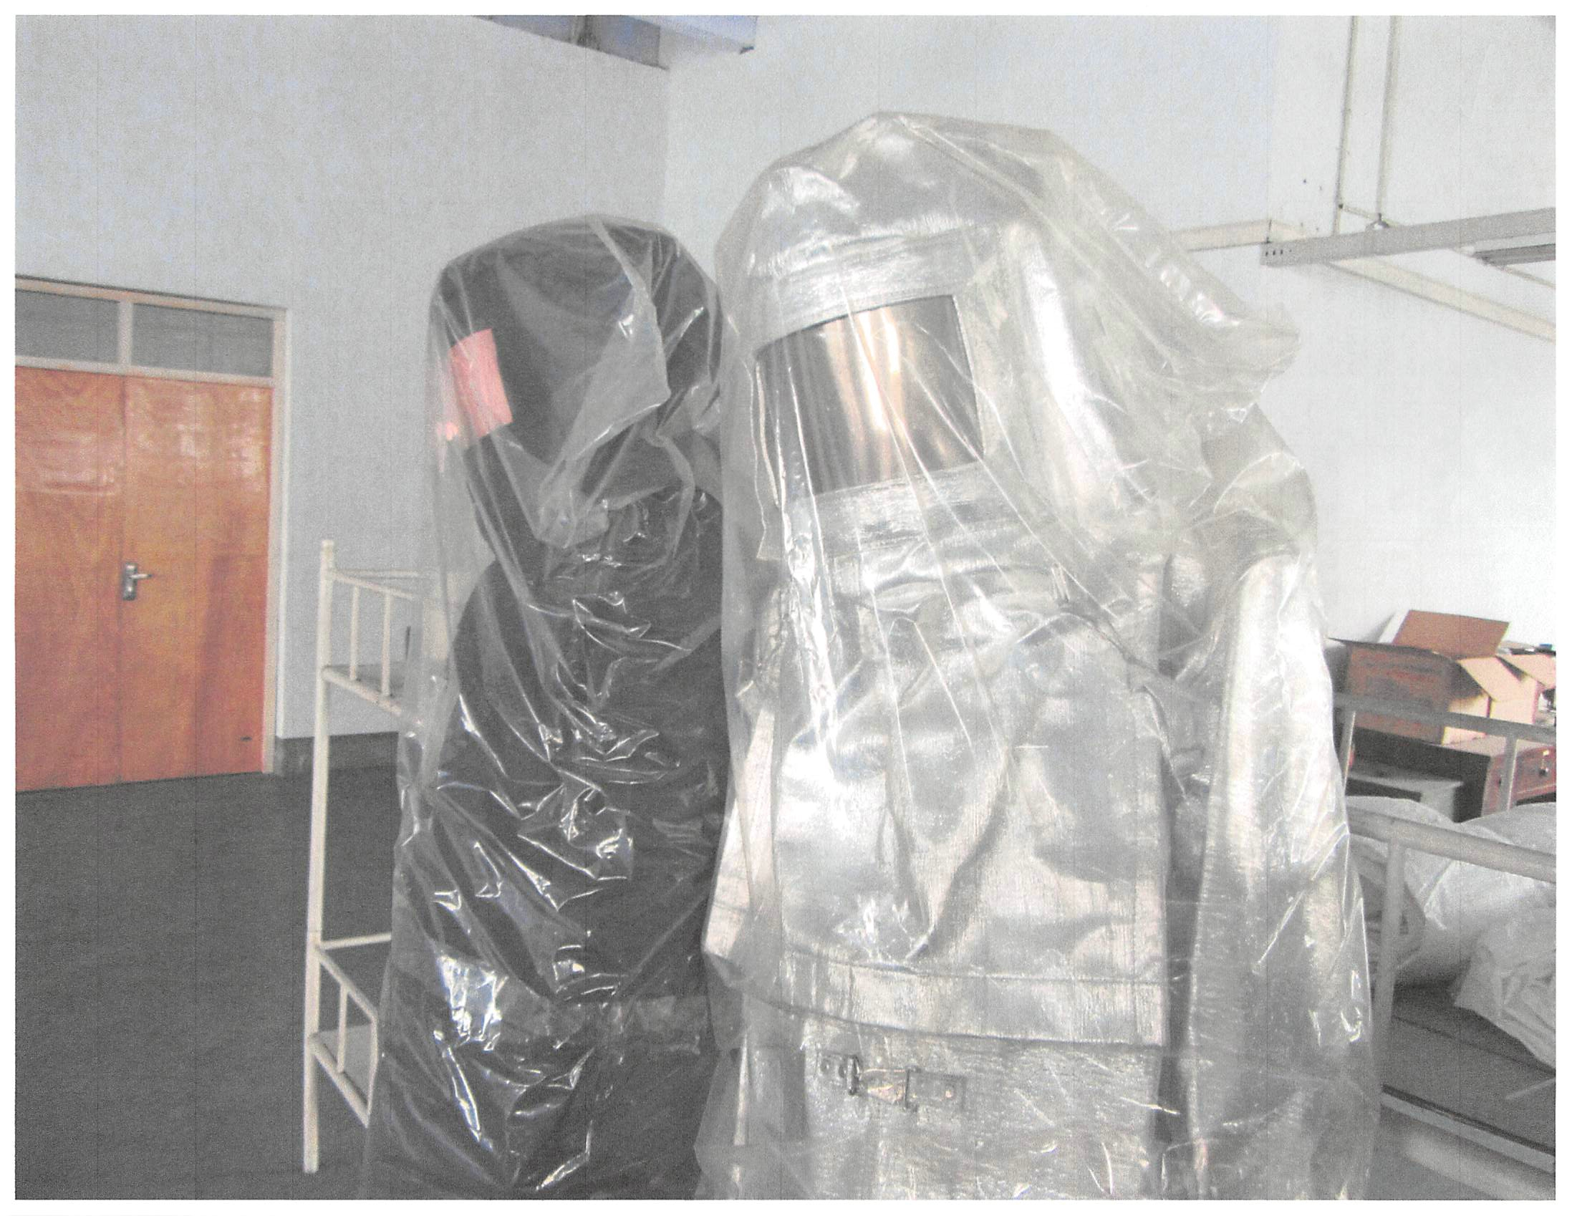

Slide 68
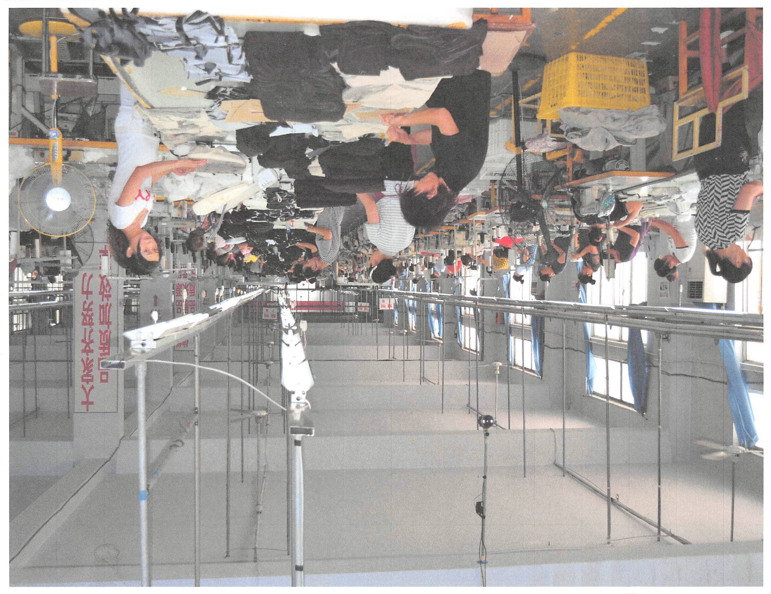

Slide 69
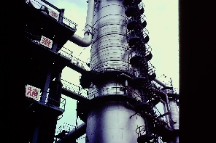

Slide 70
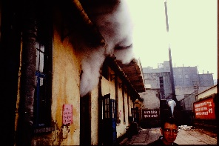

Slide 71
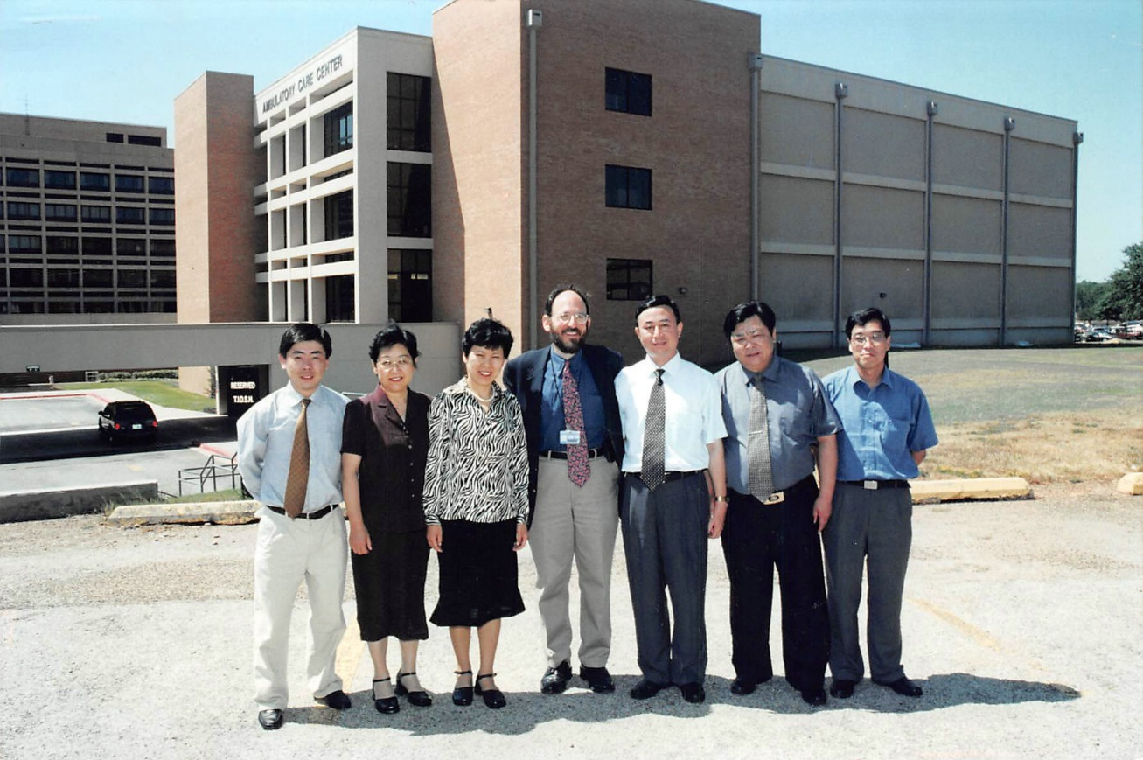

Slide 72
The Southeast Asian Connection:
India and Sri Lanka

Slide 73
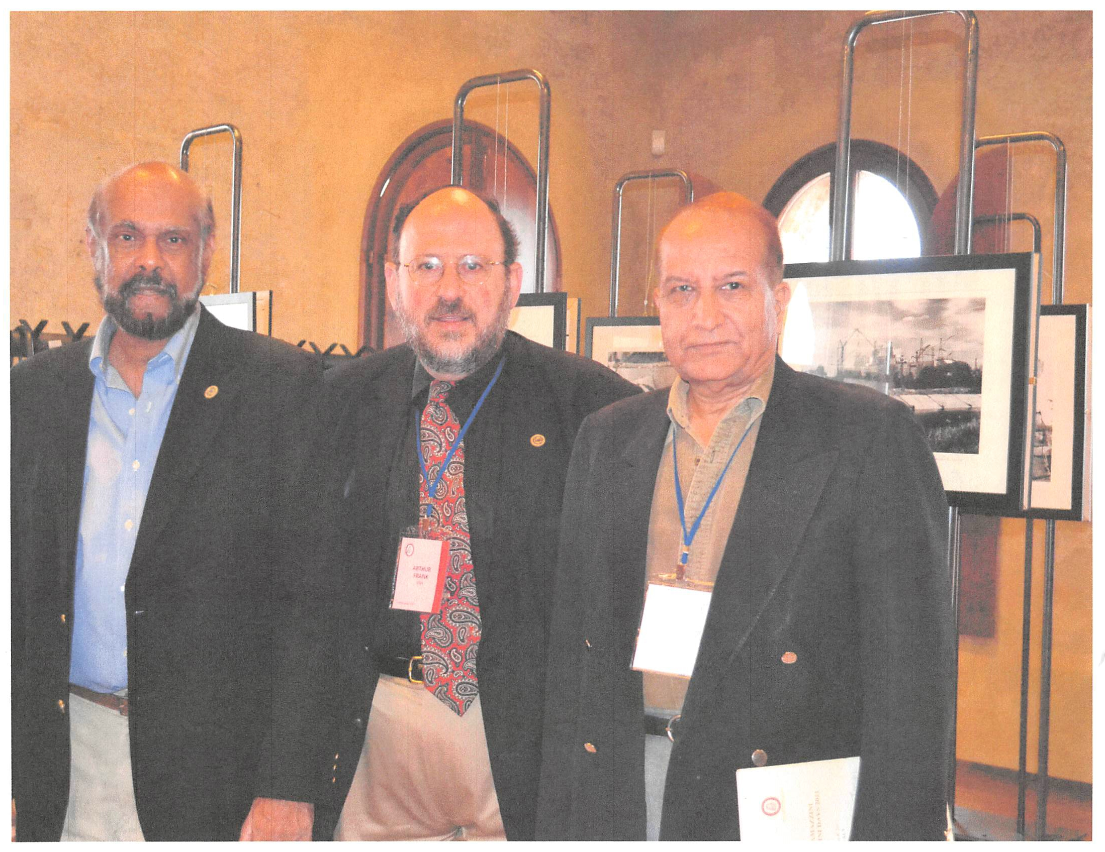

Slide 74
With Hemantha I worked in Sri Lanka, Brunei, and Malaysia

Slide 75
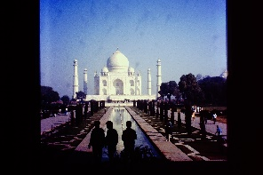

Slide 76
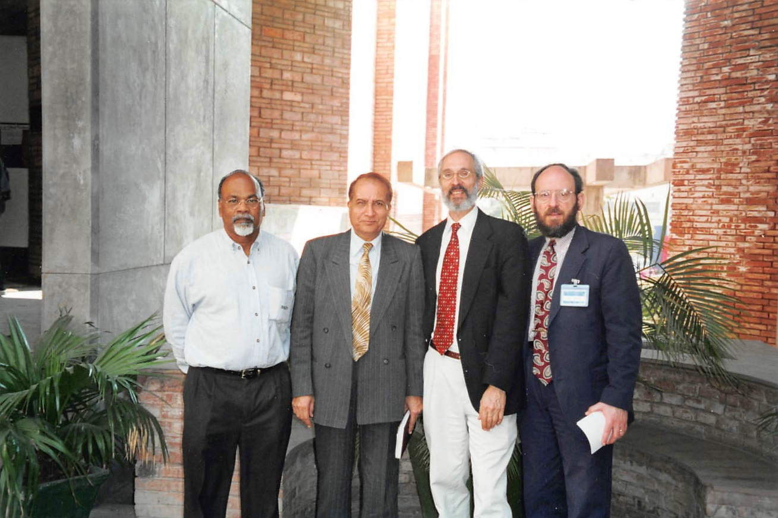

Slide 77
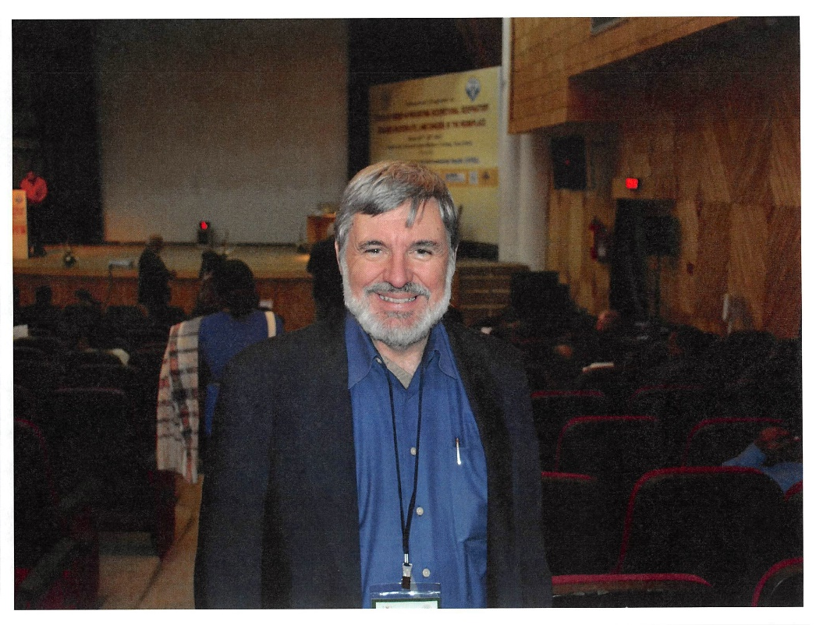

Slide 78
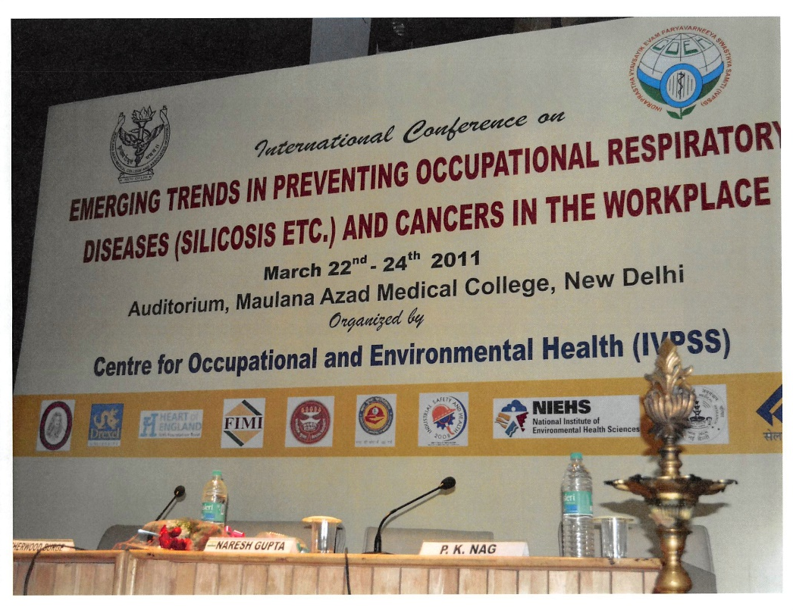

Slide 79
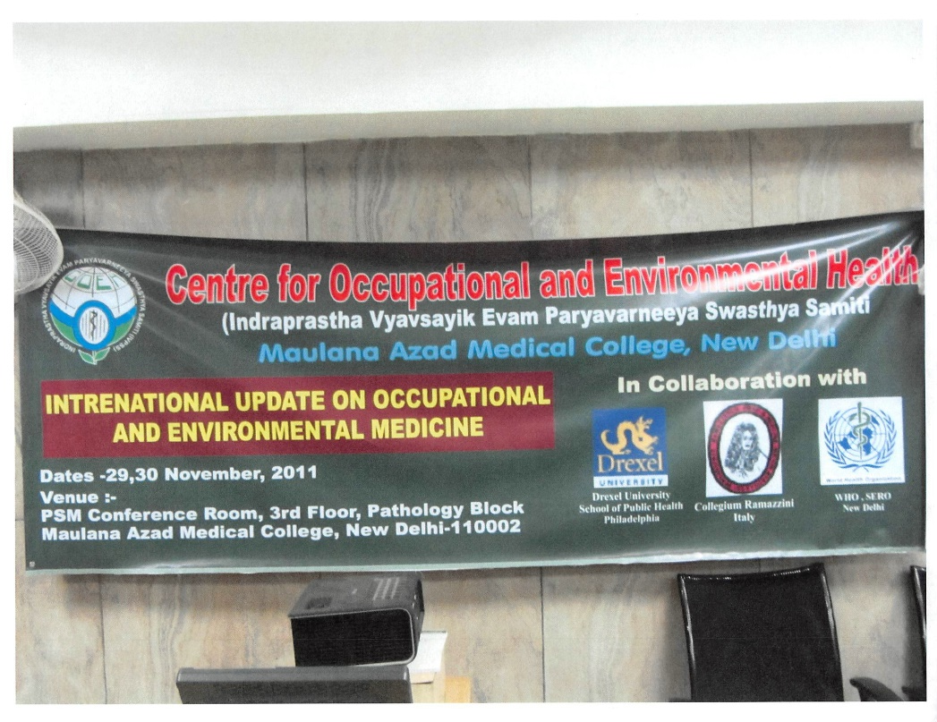

Slide 80


Slide 81


Slide 82


Slide 83


Slide 84


Slide 85


Slide 86


Slide 87


Slide 88


Slide 89


Slide 90


Slide 91


Slide 92
Thailand – CR Meeting
With Dr. Robson

Slide 93


Slide 94


Slide 95


Slide 96


Slide 97


Slide 98


Slide 99
Work in South America:
Brazil
Colombia
Argentina
Venezuela

Slide 100
Brazil is considering banning asbestos.

Slide 101


Slide 102


Slide 103


Slide 104


Slide 105


Slide 106
Columbia

Slide 107


Slide 108


Slide 109
Argentina

Slide 110


Slide 111


Slide 112
Why I Do Medical/Legal Work
Justice for workers
35+ years
5000+ cases (asbestos, silica, CWP, benzene, etc.)
> $5 billion
Funds to Universities where I have worked

Slide 113
Some Interesting Issues
DOJ
Jackson Township (medical monitoring)
Welding rods
International cases (Canada, Australia, India)

Slide 114
As many colleagues here know, things can get nasty in the legal arena.

Slide 115


Slide 116
“The purpose is to be that of a bridge between the world of scientific discovery and those social and political centers which must act on these discoveries to conserve life and prevent disease.”

Slide 117


