Slide 1
Use of All Available Data in Chemicals Assessment
John Bucher, Kristina Thayer
Division of the National Toxicology Program, National Institute of Environmental Health Sciences, National Institutes of Health
Notes:
Report on the National Toxicology Program’s year long research program into the toxicity of chemicals spilled into the Elk River in Charleston West Virginia on January 9, 2014.

Slide 2
Diverse data for public health decisions
Epidemiology
Traditional animal and genetic toxicology studies
Structure Activity Relationships (SAR)
Tox 21 high throughput screening
Alternative models (zebrafish, C. elegans)
Toxicogenomics
Read across
Systematic review methods to evaluate and integrate findings
Notes:
Outline of this presentation.

Slide 3

January 9, 2014- A data poor emergency situation
Charleston WV residents notice a “sweet smell” (like licorice) in the air.
Notes:
Background on the Elk River chemical spill.

Slide 4
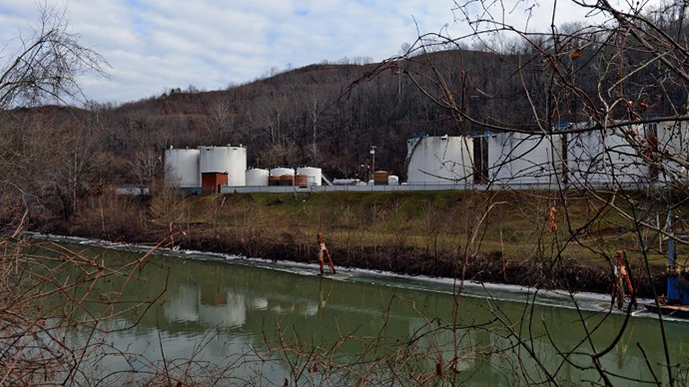
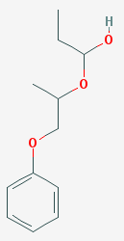
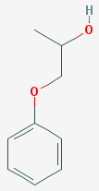
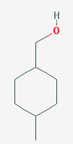
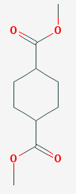
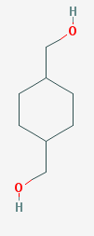
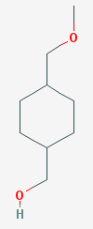
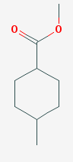
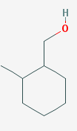
Elk River, West Virginia-January 9, 2014
Phenyl Ethers PPH
Crude Methylcyclohexanemethanol (MCHM)
*
A liquid used to wash coal was spilled from a leaking tank into the Elk River approximately 1.5 miles upstream of the water intake facility serving 300,000 people.
Notes:
Crude MCHM refers to a mixture of chemicals of similar structure shown here. MCHM or 4-methylcyclohexane methanol is the primary chemical in the spilled liquid and is indicated with an *.

Slide 5
Elk River spill
~10,000 gallons spilled
MCHM in the distributed treated water reached 3-4 ppm and then quickly dropped below 1 ppm
Nausea, skin and eye irritation, and headaches reported
CDC issued drinking water advisory level (DWAL) of 1 ppm for MCHM based on manufacturer’s unpublished toxicology studies
NTP initial assessment suggested little concern for lasting health effects given transient low exposure
Notes:
An advisory to not drink the water was issued on the afternoon of the spill. The spilled material overwhelmed the charcoal filtration system of the local water utility and entered the water distribution system. The Centers for Disease Control and Prevention (CDC) set an initial drinking water advisory level of 1 part per million (ppm) for MCHM based on information reported on a Material Safety Data Sheet issued by the manufacturer Eastman Chemical Company. The 1 ppm level was reaffirmed later following release by the manufacturer of a more extensive 28-day, repeated-dose, rat toxicology study. A Drinking Water Advisory Level (DWAL) for another chemical propylene glycol phenyl ether (PPH), present in much lower quantities, was established based on a more complete database of toxicology information made available by the manufacturer, Dow Chemical Company.
Based on initial evaluation of the structures of the spilled chemicals, the transient nature of the spill, and the irritating qualities of the spilled materials, the NTP predicted that there was low concern for any lasting health effects.
The advisory against drinking the water was lifted by the water company on Jan 18. CDC determined the water to be safe for drinking on Jan 21, but retained a caution for pregnant women.

Slide 6
Elk River chemical toxicology data
Uncertainties
Few toxicology studies to support the MCHM DWAL
No studies of MCHM in developing animals
Very limited data on the minor components of the spill
Notes:
At the time of the spill there were few toxicology studies available on which to base a drinking water advisory level. Because developing animals and humans are typically considered more susceptible than adults to toxic effects of environmental chemicals, the lack of any studies in developing organisms was a concern, as was the absence of information on many of the minor spilled chemicals.

Slide 7
Types of studies selected
Rapid predictive screens
Structure Activity Relationships
High throughput screens (Tox21)
C. elegans (roundworm) toxicity
Zebrafish embryo toxicity
Genetic toxicity
Notes:
The spilled chemicals were studied in five types of toxicity screening assays in human cells in vitro and in lower life forms. Computerized structure activity relationship screens were performed to extend those performed in the months immediately following the spill.

Slide 8
Types of studies selected
Studies using rodents
5-Day toxicogenomic study
Mouse dermal irritation and hypersensitivity studies
Rat prenatal toxicity studies
Notes:
There were three types of studies performed in rodents. These involved measurements of the irritant and potential sensitizing effects on mouse skin, studies of the development of rat fetuses after dosing pregnant females, and very sensitive studies of changes in the expression of genes involved in toxic responses in the livers and kidneys of rats following repeated oral exposures.

Slide 9
Structure Activity Relationship (SAR)
Findings (six software platforms, 199 models)
Toxicity Predictions
  MCHM chemicals class
    Developmental toxicity and irritancy
  Phenyl Ethers
    None
Notes:
Findings from a comprehensive battery of SAR models suggested that MCHM would likely be an irritant and may produce toxicity to developing organisms. It’s important to note that the models do not take into account the doses required to produce effects, and that many of the models have a number of limitations that reduce confidence in the predictions.

Slide 10
High throughput screening
Description (Tox21 platform)
Evaluate effects of chemicals on signaling pathways of toxicological concern in human cells in vitro
Used 27 different human cell-based automated screening assays
Tested concentrations from 5 nM to 92 µM
Notes:
The studies with the Elk River spill chemicals are part of a larger high throughput screening effort where over 8000 chemicals in commerce are being evaluated for their ability to activate biological targets related to toxicity in human cells and cell lines.

Slide 11
High throughput screening
Findings
Tested chemicals, were inactive at concentrations up to 92 µM (~10-20 ppm)
Chemical | Call
4-Methylcyclohexanemethanol [MCHM] | Inactive
Propylene glycol phenyl ether [PPH] | Inactive
1,4-Cyclohexanedimethanol [CHDM] | Inactive
Dimethyl 1,4-cyclohexanedicarboxylate [DMCHDC] | Inactive
Notes:
All chemicals were inactive in the assays performed to date. Verification of the actual concentrations of chemicals in these assays is ongoing.

Slide 12
C. elegans toxicity
Findings
All tested chemicals were inactive up to 100 µM (~10- 20 ppm)
Chemical | Call
4-Methylcyclohexanemethanol [MCHM] | Inactive
Technical product [crude MCHM] | Inactive
Dipropylene glycol phenyl ether [DiPPH] | Inactive
Propylene glycol phenyl ether [PPH] | Inactive
1,4-Cyclohexanedimethanol [CHDM] | Inactive
4-(Methoxymethyl)cyclohexanemethanol [MMCHM] | Inactive
Dimethyl 1,4-cyclohexanedicarboxylate [DMCHDC] | Inactive
Commercial product [Dowanol DiPPh glycol ether] | Inactive
Notes:
All chemicals tested were inactive in this assay.

Slide 13
Zebrafish developmental toxicity
Findings
No effects at concentrations up to 100 µM (~10 - 20 ppm)
Minor spill component (<1%) produced developmental abnormalities at ~ 13 ppm
Chemical | Call
4-Methylcyclohexanemethanol [MCHM] | Inactive
Technical product [crude MCHM] | Inactive
Propylene glycol phenyl ether [PPH] | Inactive
1,4-Cyclohexanedimethanol [CHDM] | Inactive
Dimethyl 1,4-cyclohexanedicarboxylate [DMCHDC] | Active
Notes:
The spilled chemicals were inactive in causing structural malformations or mortality in the Zebrafish embryo assay with one exception. The minor spill component 1,4-cyclohexanedicarboxylate was active in this assay, causing several common structural malformations at a concentration of 13 ppm and above, and mortality at approximately 17 ppm. Although one might wish to compare the water concentrations in these assays with the DWAL of 1 ppm, it’s important to remember that both the nematode and Zebrafish embryo assays are screening level assays intended to reveal the potential for developmental effects. Comparisons of doses or concentrations that might cause heath effects in the exposed human population are more appropriately derived from the rodent prenatal dosing study and the 5-day toxicogenomic study.

Slide 14
Bacterial mutagenesis
Findings
  Minor component (Dimethyl 1,4-cyclohexanedicarboxylate, <1%) caused DNA mutations in bacteria
Chemical Name | Call
4-Methylcyclohexanemethanol [MCHM] | Inactive
Technical product [crude MCHM] | Inactive
Propylene glycol phenyl ether [PPH] | Inactive
Dipropylene glycol phenyl ether [DiPPH] | Inactive
Commercial Product [Dowanol DiPPh glycol ether] | Inactive
Methyl 4-methylcyclohexanecarboxylate [MMCHC] | Inactive
4-(Methoxymethyl)cyclohexanemethanol [MMCHM] | Inactive
2-Methylcyclohexanemethanol [2MCHM] | Inactive
Notes:
None of the chemicals were found to cause mutations in these studies.

Slide 15

5-Day toxicogenomics
Description
Chemical orally administered to rats for 5 days- (0.1 to 500 mg/kg; 6 dose levels)
Global gene expression measured (liver, kidney)
Determine the most sensitive Molecular Biological Process (group of genes that function together to control a cellular process)
Run Bench Mark Dose software
Identify a biological “no effect level”, which typically occurs at a dose within a factor of 10 below that required for overt toxicity
Notes:
In this study the chemicals were given orally, once a day, for 5 days to rats. At the end of the study the animals were humanely killed, and the liver and kidneys were evaluated at a molecular level for evidence that the animals sensed and responded to the chemical treatment.

Slide 16
5-Day rat toxicogenomics
Findings
Liver
  MCHM
    22 Molecular Biological Processes active and had calculated BMD values
    Minimum biological effect benchmark dose: 13 mg/kg/day- fatty acid metabolism
  Crude MCMH mixture
    28 Molecular Biological Processes active
    Minimum biological effect benchmark dose: 10 mg/kg/day- ribosome biogenesis

Slide 17
Dermal irritancy and hypersensitivity
Findings
MCHM
  Mild irritation at concentrations > 20%
  No allergic response
Crude MCHM
  Mild irritation at a concentration of 75%-80%
  Weak allergenic response at concentrations > 40%
Notes:
This study found that pure MCHM was a mild skin irritant, and that crude MCHM was both an irritant and sensitizer. However, the concentrations of the chemicals applied to the skin required to produce these effects were quite high.

Slide 18
Rat prenatal developmental toxicity
Findings for MCHM
Minimal toxicity observed in pregnant rats
No effects on fetal survival
Lower birth weights observed at >150 mg/kg/day
Developmental defects observed at 400 mg/kg/day
Notes:
The findings from this study showed minimal evidence of toxicity to the pregnant rats. At the higher doses in the study (200 and 400 mg/kg/day) the rat fetuses were found to be of lower weight than expected, and some malformations in the fetuses were seen at the very highest dose (400 mg/kg/day). As can be seen in the slide, these doses were thousands of times higher than a pregnant woman could have been exposed to by ingesting the water containing MCHM at the DWAL.
Assumptions for margin of exposure of 6000
- Water levels of MCHM were 1 ppm (1 mg/L)
Pregnant woman drinks 2.5 L (0.66 gallons) of water per day
Pregnant woman weighs 75 kg (165 lbs)
Dose in a pregnant woman drinking 2.5 L of water containing 1 ppm MCHM (1 mg/L) is 0.033 mg/kg/day
Lowest effect level on rat fetus is 200 mg/kg/day
200 mg/kg/day / 0.033 mg/kg/day = a margin of exposure of 6060

Slide 19
Results in context of study goals
Strengthen the science base
  SAR predictions of developmental toxicity and irritancy confirmed
  Rat prenatal toxicity study confirms prior NOEL (no observed effect level) of ~ 100 mg/kg/day (or ~ 1000 ppm in drinking water) for MCHM
  5-Day toxicogenomics studies show Molecular Biological Process activations at ~ 10 fold lower dose than phenotypic changes
  Concentrations of MCHM and crude MCHM required to produce skin irritation and sensitization were much higher than expected
  Low genotoxic potential minimizes concern for long-term health effects
Notes:
The lowest doses at which there was evidence for toxicity in the collected NTP studies were similar to those in the studies used by CDC to establish the DWAL at the time of the spill.

Slide 20
Results in context of study goals
Determine if there are hazards for sensitive life stages
  Major components of spill did not affect C.elegans or zebrafish development
  The fetus is more sensitive to toxicity than the pregnant adult rat (reduced fetal weights)
  Toxicity occurred far above the drinking water advisory level that was derived by CDC
  Subsequent State of WV birth weight survey was negative
Notes:
The rat prenatal toxicity study found that one of the more sensitive responses to MCHM was a decreased weight of the fetuses in pregnant rats given the chemicals during gestation. However, this effect was observed at doses many thousands of time higher than any expected exposures of pregnant women following the Elk River Spill.

Slide 21
Results in context of study goals
Screen minor components of the mixture to determine if any are more toxic than MCHM
  Minimal differences between the minor constituents and MCHM
  One minor component (DMCHDC) was more toxic to developing zebrafish than MCHM, and was mutagenic
Notes:
DMCHDC, a minor spill component, has been found to be of low toxicity in a rat reproductive toxicity study suggesting the findings in Zebrafish are of minimal concern. An unknown component of the spill may have the capacity to cause skin sensitization, but at very high concentrations.

Slide 22
The collected findings supported the adequacy of the drinking water advisory level established at the time of the spill

Slide 23
Lessons learned
Confidence enhanced by few findings of concern in bacteria, nematodes, fish, rodents and human cells, and considering the limited human exposure
5-day transcriptomics studies provide sensitive data to predict a low probability of hazard
Possible use of similar battery of studies for priority setting under new TSCA
Systematic review methods can help in problem formulation, literature analysis and data integration across multiple evidence streams to use all available data

Slide 24
Acknowledgements
Office of Health Assessment and Translation
  Abee Boyles
  Andy Rooney (Deputy Director)
  Kembra Howdeshell
  Beruk Kiros
  Kristina Thayer (Director)
  Kyla Taylor
  Vickie Walker
Office of Scientific Information Management
  Stephanie Holmgren
ICF International
  Cara Henning
  Jessica Wignall
  Pam Ross
  Robyn Blain
  Ali Goldstone
Sciome
  Dan Svoboda
ILS
  Jon Hamm
External Collaborators
  Caroline Baier-Anderson (US EPA)
  Lisa Truong (Oregon State University)
  Nathalie Pham (Cal-EPA OEHHA)
  Patrick Allard (University of California – Los Angeles)
  Robert Tanguay (Oregon State University)
  Shoba Iyer (Cal-EPA OEHHA)
NTP Associate Director’s Office
  Nigel Walker
  Scott Masten
Biomolecular Screening Branch
    Alex Merrick
    Fred Parham
    Jui-Hua Hsieh
    Ray Tice
    Scott Auerbach
    Steve Ferguson
    Tina Teng
NTP Labs
  Julie Rice
  Mike DeVito
  Paul Dunlap
  Sreenivasa Ramaiahgari
  Sue Fenton
Programs Operation Branch
  Andy Shapiro
  Brad Collins
  Joshua Addington
  Suramya Waidyanath
Laboratory of Reproductive & Developmental Biology
    Ken Korach
    Yin Li
  Toxicology Branch
    Vicki Sutherland

Slide 25
Thank You

Slide 26
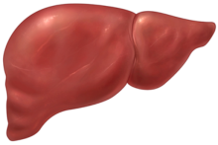
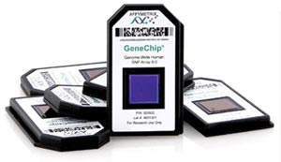


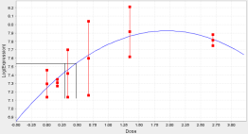
5-Day rat toxicogenomics
Molecular Biological Process BMD
Liver RNA (6 dose levels, 4-5 animals/group)
RNA Expression
Levels~20000
genes
Identify “Active” genes:
ANOVA(P<0.05) &
Fold change >|1.5|
Identify “Active” MBPs:
P<0.05 Fisher Exact test &
≥5% populated &
≥ 5 genes
Genes sorted
into Molecular
Biological
Processes (MBP)
Identify Gene-level BMDs:
“Active” genes are fit to 5 models.
A BMD is derived from best
fit model.
Report Median MBP BMDs
(median BMD of gene in pathway or BP)

Slide 27
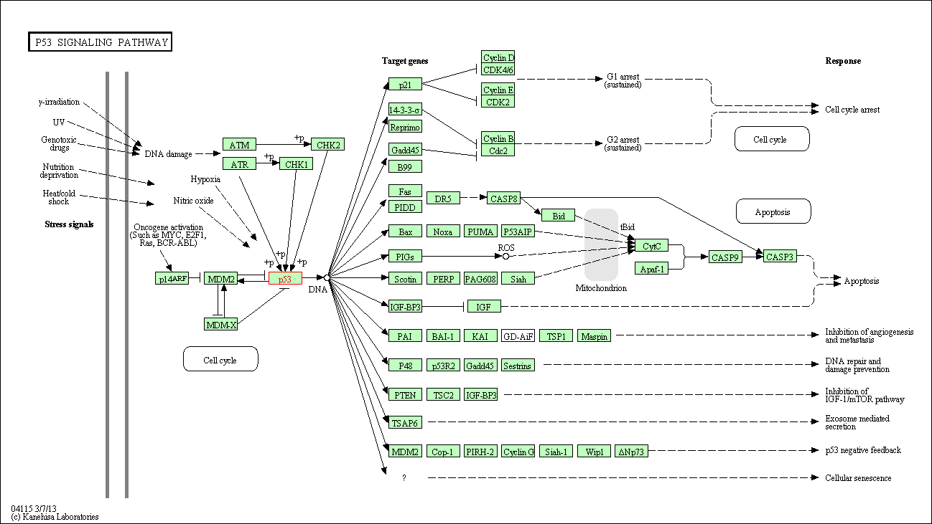
5-Day Rat Toxicogenomics
Molecular Biological Process
A group of genes that function together to control a cellular process (e.g., P53 signaling pathway, lipid metabolism)
  Different types of Molecular Biological Processes
    KEGG Pathways
    GO Biological Processes

