Slide 1
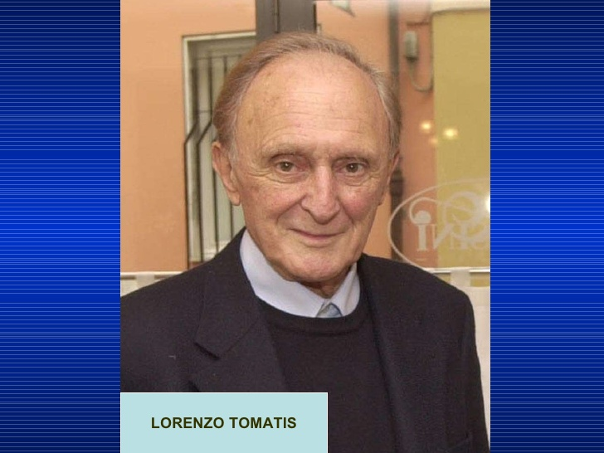
Challenges and progress in regulating chemicals
Session dedicated to Lorenzo Tomatis
Moderators: Ludwine Casteleyn & Philippe Grandjean
Towards a non toxic future Philippe Grandjean
Evaluation of TSCA reform bill Ellen Silbergeld
Use of available data in chemicals assessment John Bucher & Kristina Thayer
Comparative Hazard Assessment - a pragmatic tool for decision-makers
Vyvyan Howard International trade agreements - current discussions and future perspectives Daniele Mandrioli An overview of the IARC Monographs programme's evaluations of risk factors for childhood cancer and a perspective on ongoing research - Kurt Straif

Slide 2
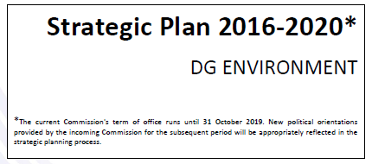



Slide 3
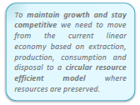

Slide 4
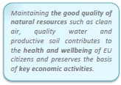

Slide 5

Current emphasis is on building the strategy for a nontoxic environment
The precautionary principle is one of the four basic principles (together with the principles of prevention, polluter pays, rectifying pollution at source)
The PP may be applied if three conditions are met:
identification of potentially adverse effects;
evaluation of the scientific data available; and
the extent of scientific uncertainty
DG ENV is currently evaluating the use of the PP

Slide 6
Nontoxic time line
Target 2050
The initiative is based on the overall vision of the 7th environmental action programme (EAP)
EAP's non-toxic environment strategy aims at substituting hazardous substances by non-hazardous substances or non-chemical alternatives by 2050.

