Slide 1
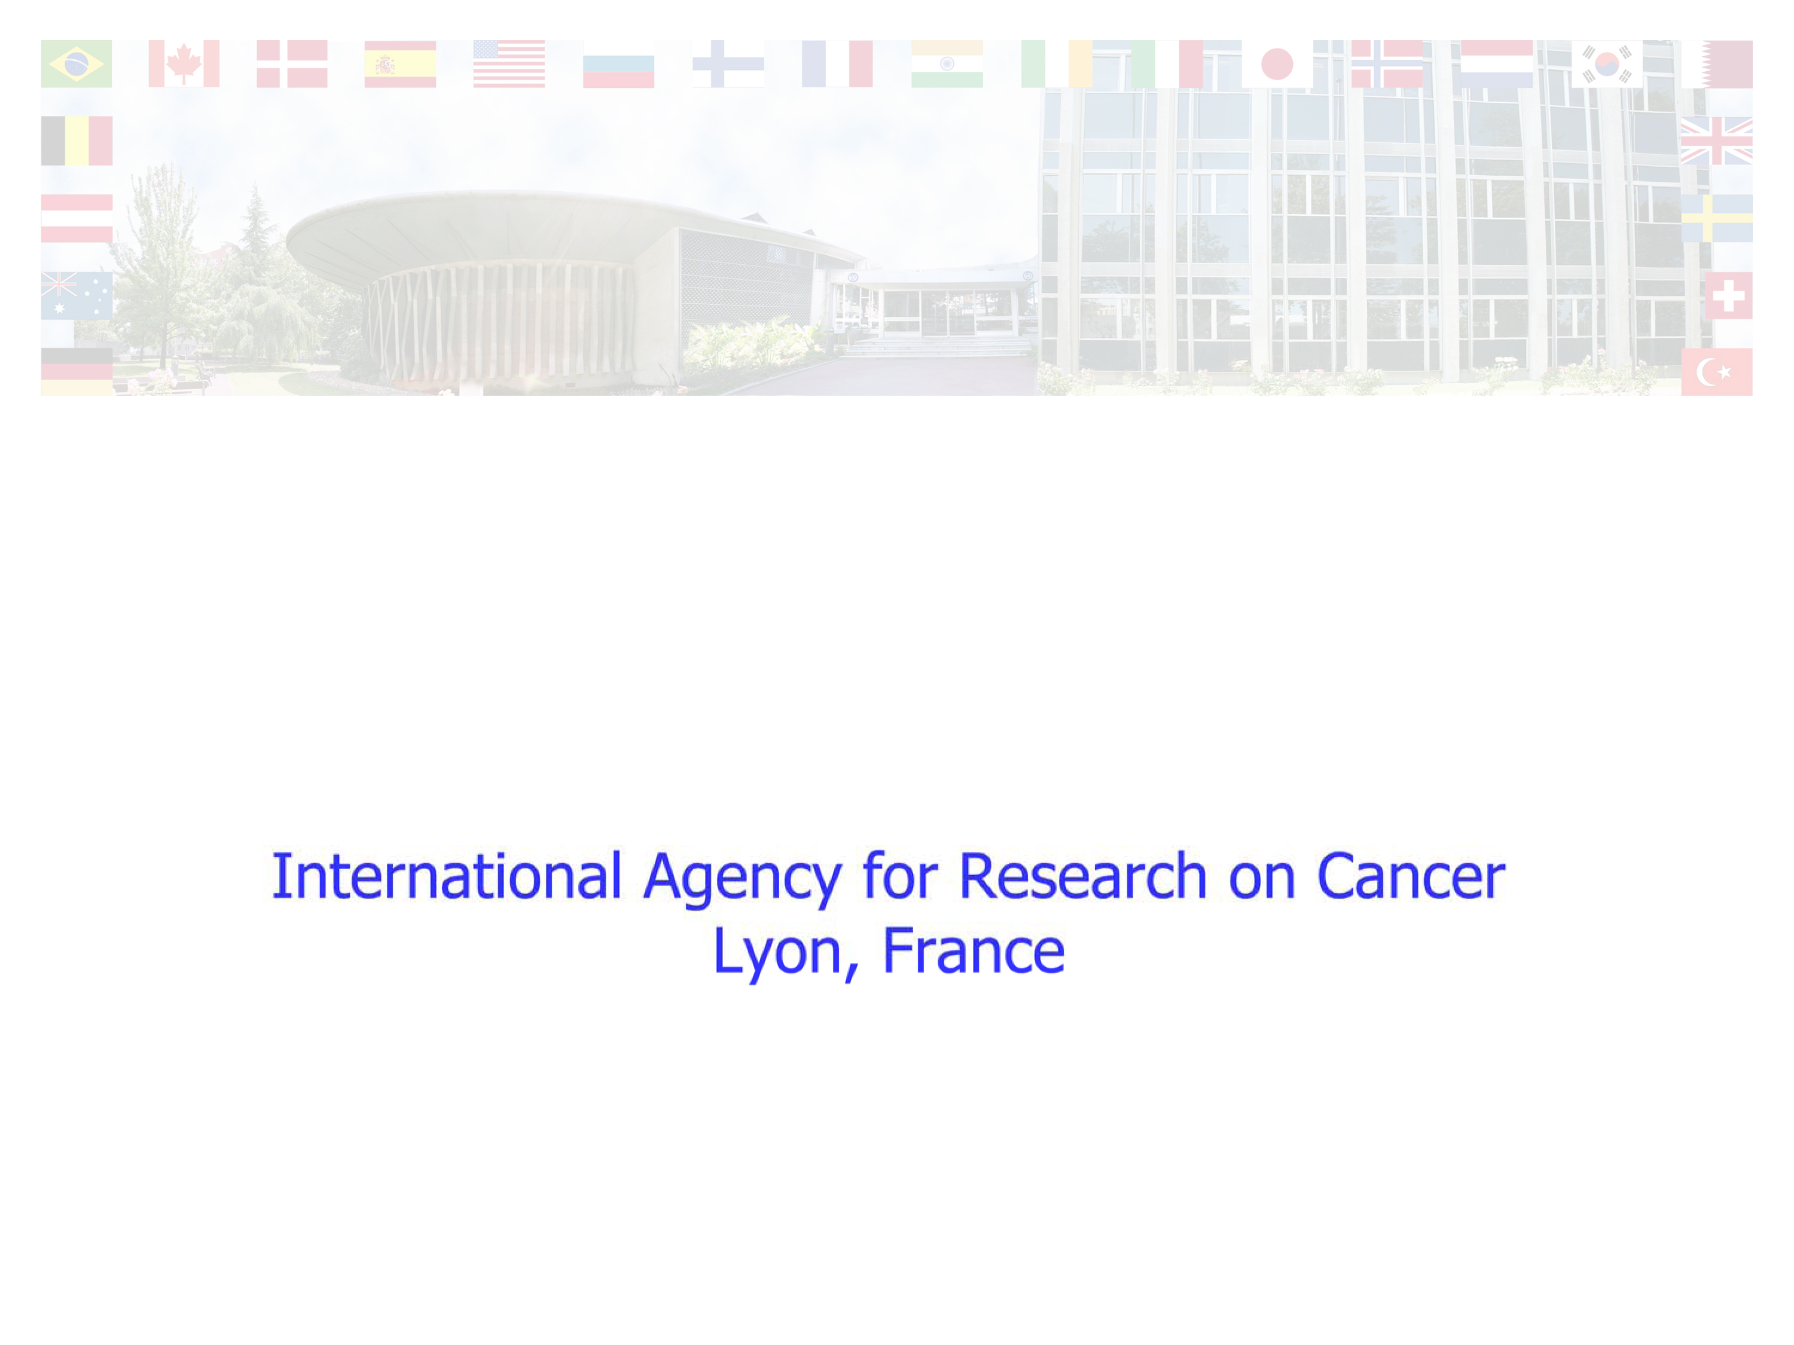
An overview of the IARC Monographs programme's evaluations of risk factors for childhood cancer and a perspective on ongoing research
Kurt Straif MD PhD MPH

Slide 2
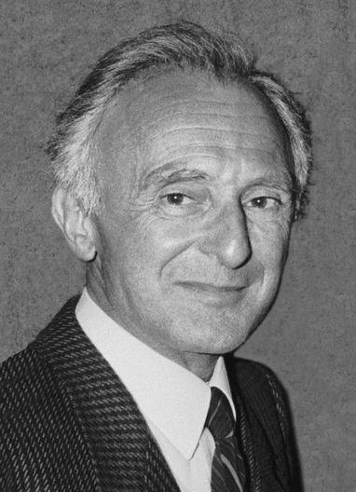
“The encyclopaedia of carcinogens”
The IARC Monographs evaluate
  Chemicals
  Complex mixtures
  Occupational exposures
  Physical and biological agents
  Personal habits
Almost 1000 agents have been evaluated
  119 are carcinogenic to humans (Group 1)
  81 are probably carcinogenic to humans (Group 2A)
  292 are possibly carcinogenic to humans (Group 2B)
National and international health agencies use the Monographs
  As a source of scientific information on known or suspected carcinogens
  As scientific support for their actions to prevent exposure to known or suspected carcinogens
Lorenzo Tomatis
1929-2007

Slide 3
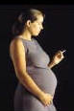
Vol 100E, Parental smoking
Increased risk of cancer in children born of parents who smoke preconception, during pregnancy and/or perinatally
Hepatoblastoma
4 recent studies with significantly increased risk
  United Kingdom Childhood Cancer study
    Father only: 1.86 (0.5-7.6)
    Mother only: 2.01 (0.4-10.2)
    Both parents: 4.74 (1.68-13.4)
Sufficient evidence of carcinogenicity
Leukaemia (in particular ALL)
Meta-analysis of 11 studies
Meta-RR for paternal smoking = 1.12 (1.04-1.21)
Limited evidence of carcinogenicity
Newborns of smoking mothers have increased frequencies of HPRT mutations, chromosomal translocations, and DNA strand breaks.
Sperm of smokers has increased frequencies of aneuploidy, DNA adducts, strand breaks, and oxidative damage.
Cigarette smoke also causes germ-cell mutations in mice
Notes:
Hepatoblastoma: tumour of fetal origin, derived from pluripotent liver stem cells.
Somebody may ask why the significant meta-analysis provided only limited evidence: recall bias, no dose response, other confounding in light of small risk increase?

Slide 4
Vol 100D, Ionizing radiation
        Radioiodines
        Chernobyl accident: sharp increase in the risk of thyroid cancer associated with exposure to radioiodines, particularly iodine-131, during childhood and adolescence. This might be due to
        a higher milk intake per unit of body weight among children;
        a higher thyroid dose per unit of iodine-131 intake from milk;
        a higher susceptibility per unit of thyroid dose;
        or a combination of these.
        Sufficient evidence in humans for the carcinogenicity of exposure during childhood and adolescence to short-lived radioisotopes of iodine, including iodine-131. Short-lived radioisotopes of iodine, including iodine-131, cause thyroid cancer.
        X and gamma radiation
        There is sufficient evidence in humans for the carcinogenicity of in utero X and gamma radiation for childhood cancers.
Notes:
Pearce2012? Use of CT scans in children to deliver cumulative doses of about 50 mGy might almost triple the risk of
leukaemia and doses of about 60 mGy might triple the risk of brain cancer. Because these cancers are relatively rare,
the cumulative absolute risks are small

Slide 5
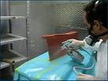
Vol 98, 100F, Occupational exposure as a painter
Maternal exposure to paints and childhood leukemia
Nine case-control studies (2 on acute leukemias, 5 on ALL, 3 on AML)
5 studies with significant positive associations for maternal paint exposure either before or during pregnancy adjusted for age and/or sex, race, social class or other variables.
3 studies with borderline significant positive associations and non- significantly elevated ORs
Significant exposure-response relationships, according to duration of maternal paint exposure, in 2 studies
Evaluation
Limited evidence of an association between maternal exposure to painting – before and during pregnancy – and an increased risk of childhood leukaemia in the offspring

Slide 6

Vol 80 (2002), Non-ionizing radiation
        Extremely low-frequency (ELF) electric and magnetic fields
        Residential ELF magnetic fields and childhood leukaemia
        Pooled analysis of nine well conducted studies (Ahlbom et al, 2000)
        RR=2.0(95%CI 1.3-3.1) for exposure > 0.4 µT.
        Pooled analysis of 15 studies - less restrictive inclusion criteria (Greenland et al, 2000)
        RR=1.7 (95%CI 1.2-2.3) for exposure > 0.3 µT
        Evaluation
        There is limited evidence in humans for ELF magnetic fields and childhood leukaemia and inadequate evidence for electric fields and childhood leukaemia
Notes:
RF-EMF brain cancer? Cerenat, new NTP studies
Mobikids, 10-24yrs, results soon

Slide 7
Epstein-Barr virus & malaria, V100&104
In 1962, Denis Burkitt noted a strong geographical association between holoendemic malaria and the most frequent paediatric cancer in sub-Saharan Africa, later called endemic Burkitt lymphoma (eBL).
Epstein-Barr virus (EBV), a ubiquitous oncogenic herpes virus, is a necessary agent for the pathogenesis of eBL.
African children are infected by EBV early in life (<3 years of age), and the timing of EBV and Plasmodium coinfection and the intensity of malarial infections at an individual level seem to influence EBV dysregulation, which may lead to eBL.
Infection with P falciparum in holoendemic areas is “probably carcinogenic to humans” (Group 2A).
Notes:
Epstein–Barr virus (EBV) infects almost everyone and causes several types of cancer, including naso-pharyngeal carcinoma, one of the most common cancers in southeastern Asia,
Two case–control studies among children in holoendemic areas reported sig nifi cantly increased risks for eBL with high titres of total IgG antibodies specifi c to whole schizont extracts in the presence of high EBV antibody titres.

Slide 8
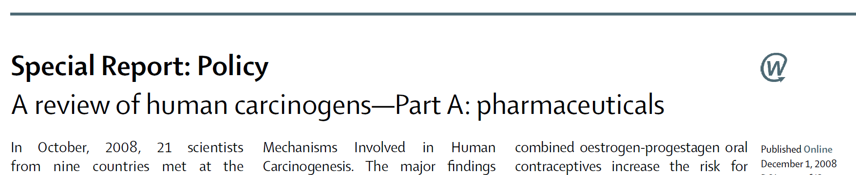
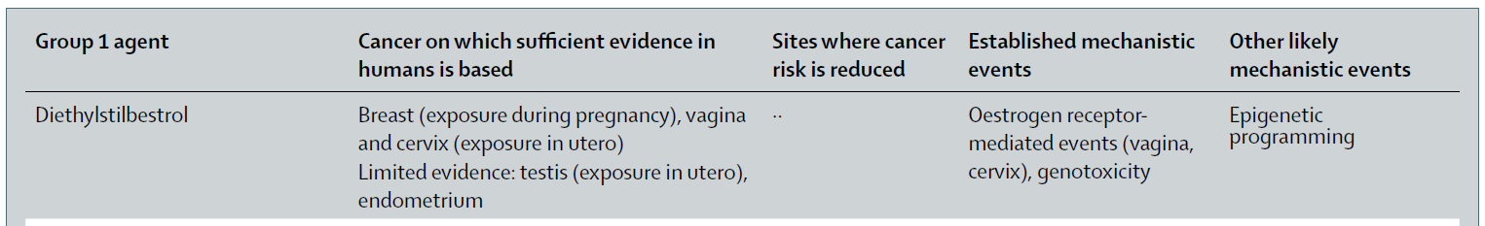
Vol 100, Diethylstilbestrol
Adenocarcinoma of the vagina is an extremely rare tumour, especially in young women. In 1971, however, Herbst et al. described 8 patients aged 15-22 years with this condition.
The administration of diethylstilboestrol to women during pregnancy is associated with an increased risk of vaginal or cervical adenocarcinoma in their exposed female offspring (IARC Monographs Vol 6, 1974)

Slide 9
Challenges in the causal inference for childhood cancer
Occupational cohorts: important role in identification of environmental carcinogens (chimney sweeps, radon, benzene) with clearly defined study population, prospective exposure assessment, strong exposure contrast
Childhood Cancer very rare disease -> Case-control studies,
- often all childhood cancer cases combined,
- questionnaire-based exposure information, Recall bias?
(coffee drinking and childhood leukemia?)
Conceptionally different exposure metrics are often highly correlated -> difficult to disentangle preconceptional, gestational by trimester, postnatal, maternal/paternal exposures
Notes:
(total number of incident cases among children less than number of incident diagnoses of cancer for all but the rarest of individual adult sites)total number of incident cases among children is less than the number of incident diagnoses of cancer for all but the rarest of individual adult sites.
In the year 2000, malignant neoplasms comprised about 8% of deaths among l~ year olds, 15% among 5-9 year olds, 12% among 10--14 year olds, and 6% among 15-19 year olds, with ranking as the third, second, second, and fourth leading causes of death, respectively (Accidents are the leading cause of d~ in children and comprise between 40%-50% of mortality)

Slide 10
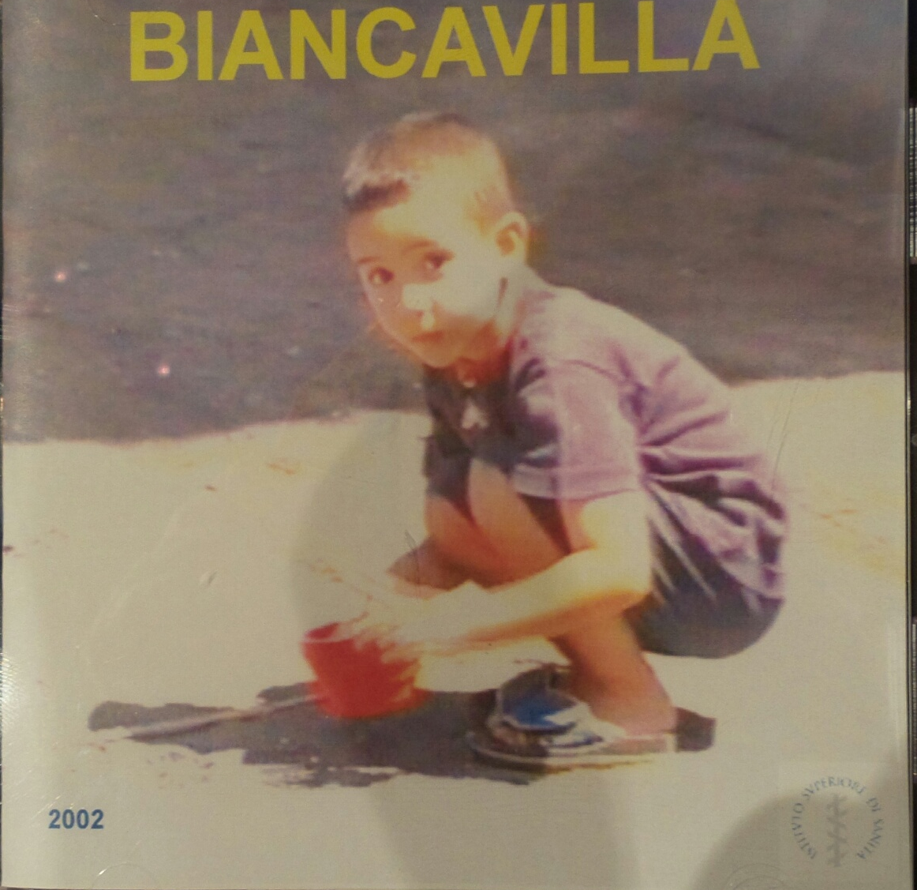
Challenges in the causal inference for childhood cancer
Long latency period of some cancers
- sentinel events, asbestos and mesothelioma,
DES and vaginal cancer -> critical exposure
period in childhood (vs childhood cancer)
Higher target exposure (eg RF-EMF to the brain) or
increased susceptibility due to developing organ systems (DDT and breast cancer?)
Obesity in childhood, adolescence, and young adulthood
(≤25 years of age) linked with cancer in adult life, with the notable exception of postmenopausal breast cancer.
Notes:
- Latency for radiation & childhood leukemia could be shorter, no increased risk shortly after cessation
- 110 million children and adolescents in 2013 (an increase by a factor of 2 since 1980) were obese.- shouldn’t become prisoners o fthe proximate (Tony McMichaels), but consider interventions that prevent obesity all the way to healthy cities

Slide 11
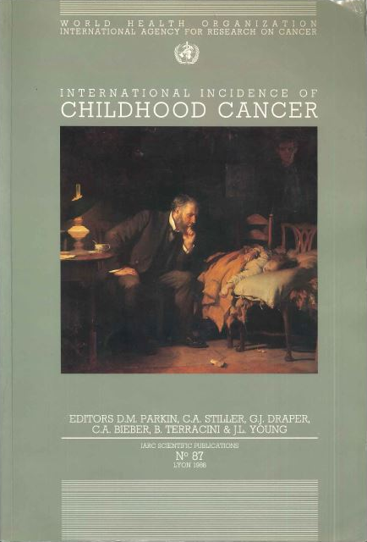
Childhood cancer registries, Vol 1, 1988
The study of geographical and ethnic variation in the risk of childhood cancer is of great value in formulating hypotheses concerning the relative contribution of genetic susceptibility and environmental exposure to etiology.
This volume is the most extensive collection of data on the incidence of cancer in childhood that has ever been published.
        Lorenzo Tomatis, 1988

Slide 12
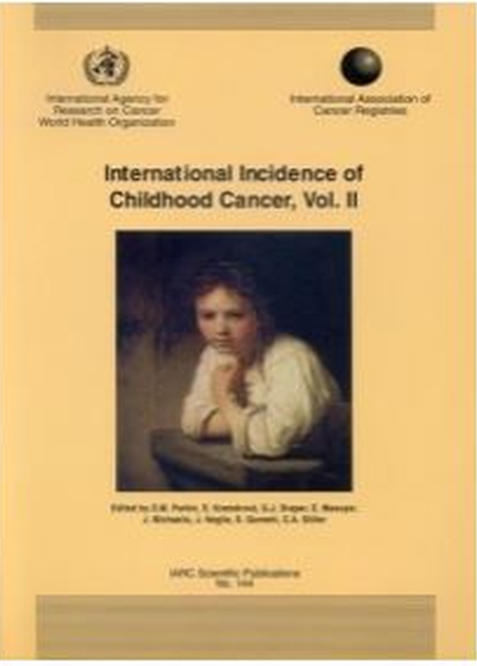
Childhood cancer registries, Vol 2, 1998
Cover the age range 0-14 years
Classified by histology rather than by the site of the tumour.
Number of specialized children's tumour registries, data from these are not published in Cancer Incidence in Five Continents.
The incidence is only about 1 % of that in adults,
The most common adult cancers hardly
ever occur in children.

Slide 13
International Incidence of Childhood Cancer (IICC-3) 2001-2010
Incidence rate across all selected registries was 140/million at 0-14yrs
Leading cancer types were leukaemias, followed by CNS tumours in most world regions.
Highest leukaemia rates among US white Hispanics,
Highest lymphoma rates in the Mediterranean (Northern Africa, Western Asia and Southern Europe
Notes:
The highest leukaemia rates were observed among US white Hispanics (Fig.9), while the highest lymphoma rates were seen in the Mediterranean (Northern Africa, Western Asia and Southern Europe,

Slide 14
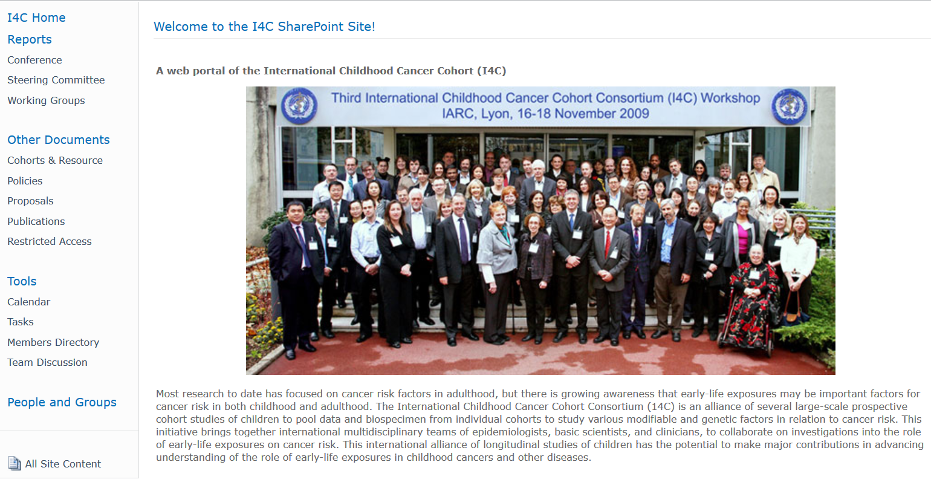
Consortia of prospective cohort studies, I4C
Notes:
https://communities.nci.nih.gov/i4c/default.aspx

Slide 15
Agricultural pesticide exposures and risk of childhood cancers
- Evaluate risk of childhood cancers in relation to residential proximity to agriculture and associated pesticide use during pregnancy and early life
- Evaluate the risk of childhood cancers associated with parental work in agriculture and pesticide related occupations
- Evaluate combined effects of residential and occupational exposures to agriculture and pesticides

Slide 16
Exposure Assessment
Data Sources
Agricultural records
  Pesticide use registries
  Land use records/maps
Remote Sensing
  E.g. Landsat satellite images
Exposure Measure
Distance from residence to fields
Density surrounding residence
  Crop land/total land
By crop type
  General agriculture
  Corn, soybean, etc.
Parental occupational Exposure
Harmonize different classification systems for occupational codes to ISCO-88
Notes:
Exposure data

Slide 17
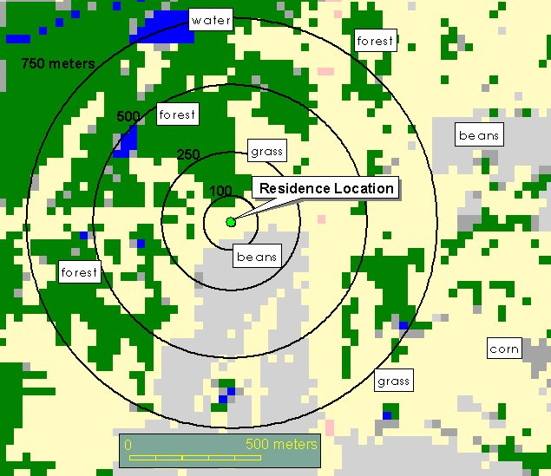
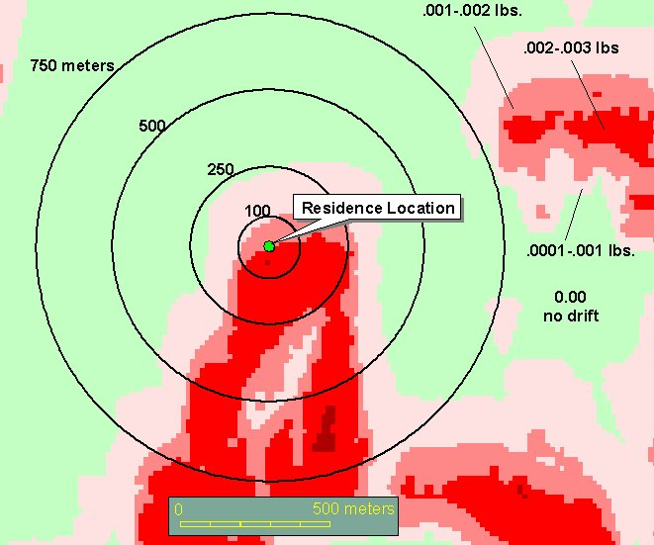
Exposure Modeling
Residence with circular buffers overlaid on crop map
Results from pesticide drift model, soybeans sprayed with 2,4-D with a south wind direction

Slide 18
I4C Cohorts & Cancer Cases
Cohort | Total number live births | Birth years | Total number of cancer cases | Number of ALL
ALSPAC (UK –Avon area) | 14 062 | 1991-1992 | 24 | 3
THIS (Australia) | 10 628 | 1987-1995 | 31 | 3
JPS (Jerusalem Perinatal Study) | 92 408 | 1964-1976 | 125 | 40
CPP (Collaborative Perinatal Project) | 58 000 | 1960-1965 | 48 | 12
MoBa (Norway - nationwide) | 108 487 | 1999-2007 | ? | ~44
DNBC (Denmark - nationwide) | 96840 | 1996-2002 | 200 | 41
TOTAL | 380 425 |  | 228 | 102
All 6 cohorts will be examined for parental occupational exposures
ALSPAC, MoBa and DNBC will be examined for residential pesticide exposure
Notes:
This slide is from the 2011 I4C presentation. Cancer counts may not reflect current state of cohorts.
The ALOHA JEM developed by Kromhout and Vermeulen is linked to ISCO-88, and estimate exposure to pesticides (herbicides, insecticides and fungicides), biological dust, mineral dust, solvents, and metals.
ALSPAC is from the UK (Not yet approval to transfer data to NCI)
DNCB is from Denmark (Not yet approval to transfer data to NCI)
JPS is from Israel (sent to Ben)
MoBA is from Norway (sent to Ben)
TIHS is from Australia (will soon be sent to Ben)

Slide 19
Ways forward
Established risk factors in adults for leukemia,
mother-child cohorts linked with drug prescription registries or biobanking data,
Clearly (genetically) defined subsets of childhood cancer
Systematic review of cancers in offsprings in cancer bioassays (e.g. nitrosamines)
Use of mechanistic information to evaluate
- placental transfer,
- exposures reaching sperm cells or ovaries,
- exposures classified as reproductive hazards
- periods of susceptibility by period of organ development
Notes:
EPIC IARC, Ambatipudi-paper, Tobacco smoking-associated genome-wide DNA methylation changes in the EPIC study

Slide 20
Ways forward
Mendelian randomization (eg coffee drinking and childhood leukemia)
Biomarkers of exposure, intermediate effects or genetic susceptibility to complement questionnaires, however these could be affected by disease status (cord blood)
Meta-analysis of methylation data identified numerous loci involved in response to maternal smoking in pregnancy with persistence into later childhood (Joubert et al, 2016)
Large and growing number of childhood cancer survivors; compared with the general population, childhood cancer survivors have an increased risk of second malignancies
Notes:
EPIC IARC, Ambatipudi-paper, Tobacco smoking-associated genome-wide DNA methylation changes in the EPIC study

Slide 21
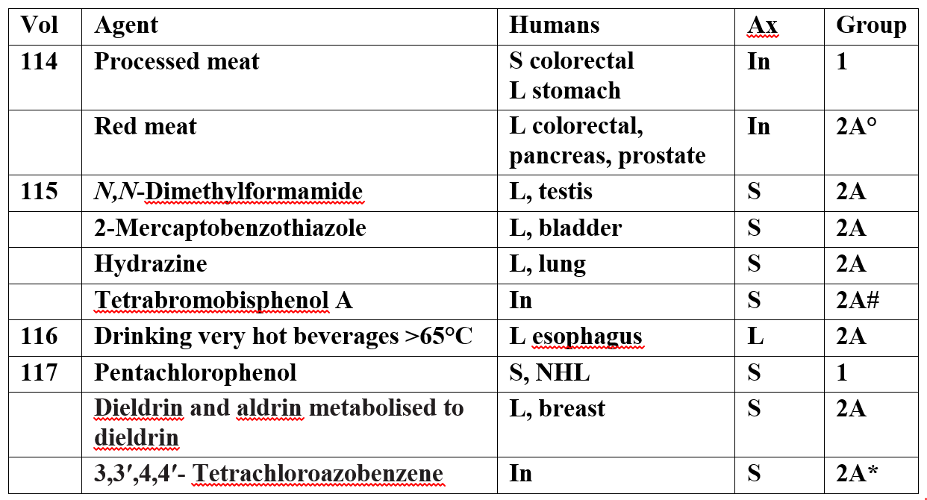
Annual update from the Monographs
Notes:
V114 PR the day after last year’s CR days
Coffee The combination of evidence suggesting lack of carcinogenicity for cancers of the female breast, pancreas, prostate, uterine endometrium, and liver, with inverse associations for the latter two and inadequate evidence for all the other sites reviewed
° meta-analysis reported modest but statistically significant association between consumption
of red or processed meat and adenomas (preneoplastic lesions). Substantial supporting mechanistic evidence was available for multiple meat components (NOC, haem iron, HAA).
# Tetrabromobisphenol A interacts with human nuclear receptors, including thyroid-hormone receptor and PPAR-γ, modulates enzymes relevant to the endocrine system, including
aromatase, and is a potent inhibitor of oestrogen sulfotransferase, induces oxidative stress in human cells in vitro and in multiple species in vivo, has immunosuppressive effects in human natural killer cells in vitro and in mice in vivo.
* belongs, on the basis of mechanistic considerations, to a class of agents that activate AhR, some members of this class have previously been evaluated as Group 1 or Group 2A carcinogens

Slide 22
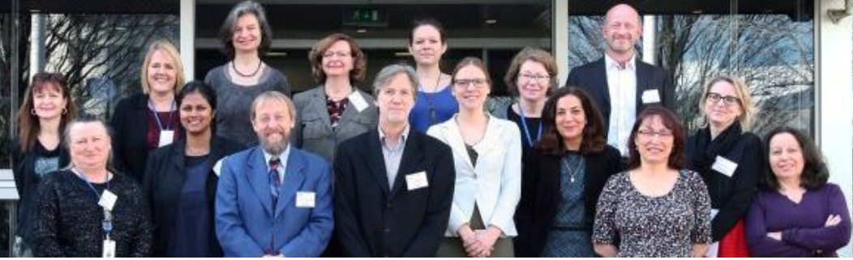
Acknowledgements
The IARC Monographs and Handbooks are supported by grants from
  U.S. National Cancer Institute (since 1982)
  European Commission, DG Employment, Social Affairs and Inclusion (since 1986)
  U.S. National Institute of Environmental Health Sciences (since 1992)
Thank you!
Notes:
Coffee – good news

Slide 23
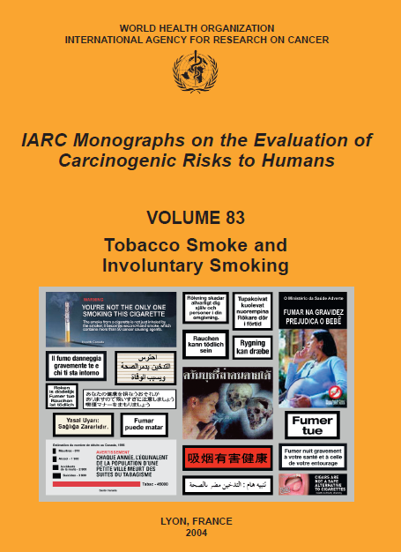
Global burden and control of cancer
Rising burden of cancer: estimates
by 2025 19.3 million new cases/a
compared to 14.1 million in 2012
Majority of the increase in cancer
burden expected in low- and
middle-income countries (LMIC)
Prevention probably the single most effective response to these challenges, particularly in LMIC where health services are least able to meet the impending challenge.
The first step in cancer prevention is to identify the causes of human cancer http://monographs.iarc.fr/ and what works in cancer prevention http://handbooks.iarc.fr/
Notes:
Mention research gap
If the cancer-specific and sex-specific trends estimated in this study continue, we predict an increase in the incidence of all-cancer cases from 12·7 million new cases in 2008 to 22·2 million by 2030. Bray TLO 2012
We used four levels (low, medium, high, and very high) of the Human Development Index (HDI), a composite indicator of life expectancy, education, and gross domestic product per head, to highlight cancer-specific patterns in 2008 (on the basis of GLOBOCAN estimates) and trends 1988–2002 (on the basis of the series in Cancer Incidence in Five Continents), and to produce future burden scenario for 2030 according to projected demographic changes alone and trends-based changes for selected cancer sites.

Slide 24

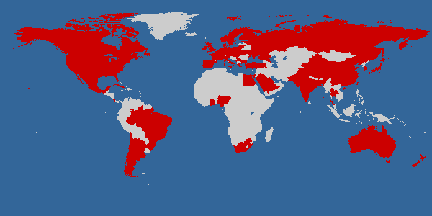
































The IARC Monographs, a worldwide endeavour that since 1971 has involved over 1000 scientists from over 50 countries
Notes:
Uniqueness of Monographs

Slide 25
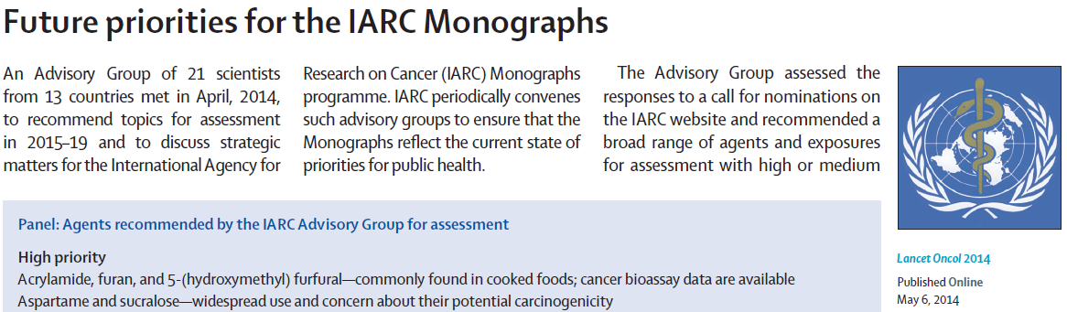

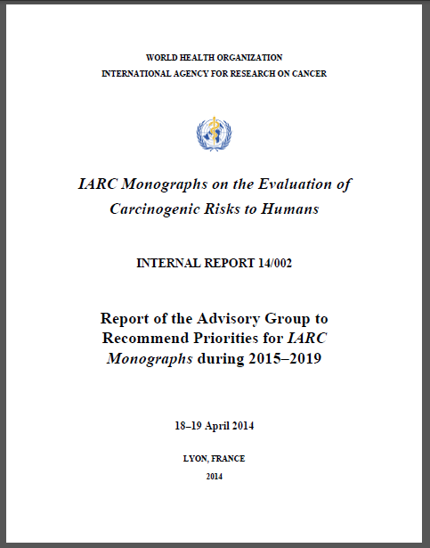
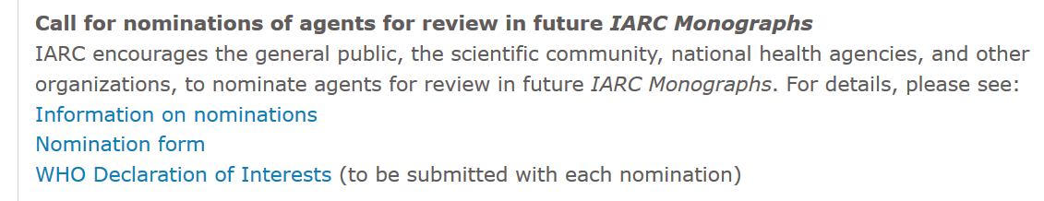
Advisory Group, Priorities 2015-2019
Bisphenol A
Disinfected water
Iron, dietary
Maté & coffee drinking
Nicotine
Opium
H Cytomegalie Virus
Beta-carotene
Dimethylformamide
Carbon nanotubes
Sedentory work
Tin compounds
Pesticides
Shift work
Styrene
Welding
Coal dust
Notes:
Very long and rich list of high priorities from 2014 AG
Including environmental exposures in broadest sense,
HCMV human cytomegalie virus
Coal dust medium
BPA EDC

Slide 26


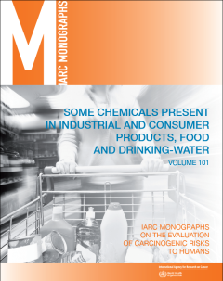
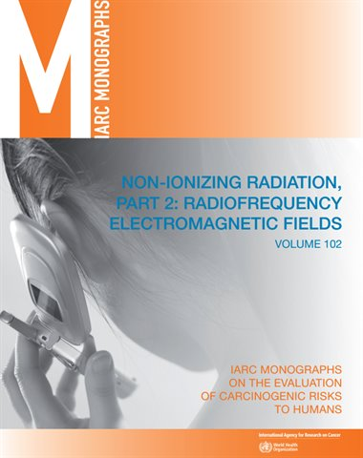
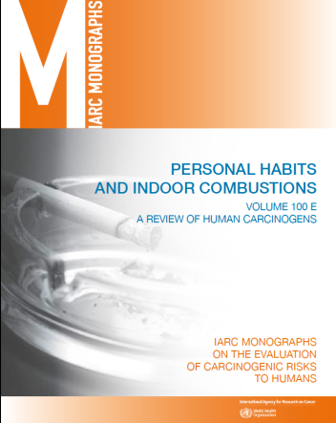
How are Evaluations Conducted?
Published guidelines for participant selection, conflict of interest & stakeholder involvement
Criteria for data eligibility
Guidelines for review of human, animal and mechanistic evidence
Decision process for overall evaluations
??
http://monographs.iarc.fr/ENG/Preamble/index.php
Notes:
Public guidance document
Procedural guidelines for participant selection, conflict of interest, stakeholder involvement & meeting conduct
Separate criteria for review of human, animal and mechanistic evidence
Decision process for overall evaluations

Slide 27
WHO Declaration of Interests
To ensure public confidence that interested parties do not have links to the WG, IARC strives to identify and avoid real or apparent conflicts of interests
  Before official invitation WG have to declare employment, research, and financial interests
  At the opening of the meeting they are asked to update their Declaration
Pertinent interests are disclosed
  To meeting participants
  To the public ((http://monographs.iarc.fr/)
  In the published volume of Monographs
They are asked also to complete the conflict-of-interest form required by The Lancet Oncology
  IARC sends TLO’s form — not WHO’s form — to TLO;
  TLO summarizes this information alongside IARC’s summary

Slide 28
Subgroup work
Cancer in
humans
 Sufficient evidence
 Limited evidence
 Inadequate evidence
 Evidence suggesting lack of carcinogenicity
Cancer in
experimental animals
 Sufficient evidence
 Limited evidence
 Inadequate evidence
 Evidence suggesting lack of carcinogenicity
Mechanistic and
other relevant data
• Mechanistic data “weak,” “moderate,” or “strong”?
• Mechanism likely to be operative in humans?
Overall evaluation
 Group 1 Carcinogenic to humans
 Group 2A Probably carcinogenic to humans
 Group 2B Possibly carcinogenic to humans
 Group 3 Not classifiable as to its carcinogenicity to humans
 Group 4 Probably not carcinogenic to humans

Slide 29
Evaluating human data
(Subgroup 2)
Cancer in
humans
— Preamble Part B, Section 6(a)
Cancer in
experimental animals
Mechanistic and
other relevant data
 Sufficient evidence
Causal relationship has been established
Chance, bias, and confounding could be ruled out with reasonable confidence
 Limited evidence
Causal interpretation is credible
Chance, bias, or confounding could not be ruled out
 Inadequate evidence
Studies permit no conclusion about a causal association
 Evidence suggesting lack of carcinogenicity
Several adequate studies covering the full range of exposure levels are mutually consistent in not showing a positive association at any observed level of exposure
Conclusion is limited to cancer sites and conditions studied

Slide 30
Evaluating experimental animal data
(Subgroup 3)
Cancer in
humans
Cancer in
experimental animals
— Preamble Part B, Section 6(b)
Mechanistic and
other relevant data
 Sufficient evidence
Causal relationship has been established through either:
- Multiple positive results (2 species, studies, sexes of GLP)
- Single unusual result (incidence, site/type, age, multi-site)
 Limited evidence
Data suggest a carcinogenic effect but: (e.g.) single study, benign tumours only, promoting activity only
 Inadequate evidence
Studies permit no conclusion about a carcinogenic effect
 Evidence suggesting lack of carcinogenicity
Adequate studies in at least two species show that the agent is not carcinogenic
Conclusion is limited to the species, tumour sites, age at exposure, and conditions and levels of exposure studied

Slide 31
Evaluating mechanistic and other data
(Subgroup 4)
Cancer in
humans
Cancer in
experimental animals
Mechanistic and
other relevant data
— Preamble Part B, Section 6(c)
• Are the mechanistic data “weak,” “moderate,” or “strong”?
Have the mechanistic events been established? Are there consistent results in different experimental systems? Is the overall database coherent?
Has each mechanism been challenged experimentally? Do studies demonstrate that suppression of key mechanistic processes leads to suppression of tumour development?
• Is the mechanism likely to be operative in humans?
Are there alternative explanations? Could different mechanisms operate in different dose ranges, in humans and experimental animals, or in a susceptible group?
Note: an uneven level of support for different mechanisms may reflect only the resources focused on each one

Slide 32
The plenary sessions will combine the human and experimental evaluations
EVIDENCE IN EXPERIMENTAL ANIMALS
Sufficient
Limited
Inadequate
ESLC
EVIDENCE IN HUMANS
Sufficient
Group 1 (carcinogenic to humans)
Limited
Group 2A
(probably carcinogenic)
Group 2B (possibly carcinogenic)
(exceptionally, Group 2A)
Inadequate
Group 2B
(possibly carcinogenic)
Group 3 (not classifiable)
ESLC
Group 4

Slide 33
Mechanistic data can be pivotal when the human data are not conclusive
EVIDENCE IN EXPERIMENTAL ANIMALS
Sufficient
Limited
Inadequate
ESLC
EVIDENCE IN HUMANS
Sufficient
Group 1
Limited
⬆1 strong evidence in exposed humans
Group 2A
⬆2A belongs to a mechanistic class where other members are classified in Groups 1 or 2A
Group 2B (exceptionally, Group 2A)
Inadequate
⬆1 strong evidence in exposed humans
⬆2A strong evidence … mechanism also operates in humans
Group 2B
⬇3 strong evidence … mechanism does not operate in humans
⬆2A belongs to a mechanistic class
⬆2B with supporting evidence from mechanistic and other relevant data
Group 3
⬆2A belongs to a mechanistic class
⬆2B with strong evidence from mechanistic and other relevant data
Group 3
Group 3
⬇4 consistently and strongly supported by a broad range of mechanistic and other relevant data
ESLC
Group 3
Group 4

Slide 34

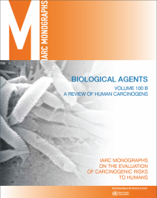
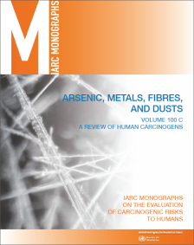

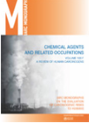
IARC Monographs, Volume 100
A Review of Human Carcinogens
Scope of volume 100
  Update the critical review for each carcinogen in Group 1
  Identify tumour sites and plausible mechanisms
  Compile information for subsequent scientific publications
The volume was developed over the course of 6 meetings
  A. Pharmaceuticals (23 agents, Oct 2008)
  B. Biological agents (11 agents, Feb 2009)
  C. Metals, particles and fibres (14 agents, Mar 2009)
  D. Radiation (14 agents, June 2009)
  E. Lifestyle factors (11 agents, Sept 2009)
  F. Chemicals and related occupations (34 agents, Oct 2009)

Slide 35
The IARC Monographs, Volume 100
  Update the critical review for each Group-1 carcinogen
  Identify tumour sites and plausible mechanisms
Vol. 100 will also provide data for subsequent scientific publications
Tumour Site Concordance between Humans and Animals
  Increase understanding of the correspondence across species
  Identify human cancer sites without good animal models
Mechanisms Involved in Human Carcinogenesis
  Organized by mechanism to facilitate joint consideration of agents that act through similar mechanisms
  Identify biomarkers that could be influential in future studies
  Identify susceptible populations and developmental stages
  Promote research that will lead to more confident evaluations

Slide 36
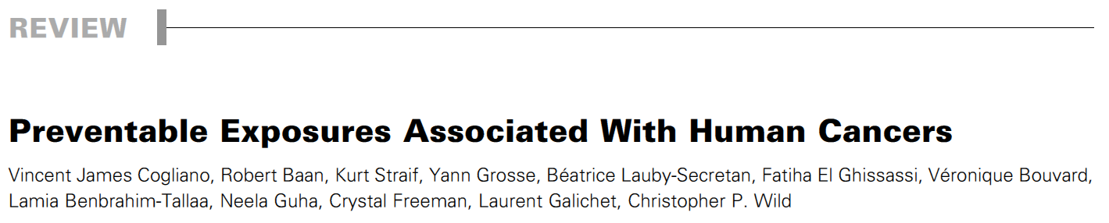
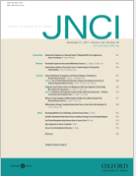
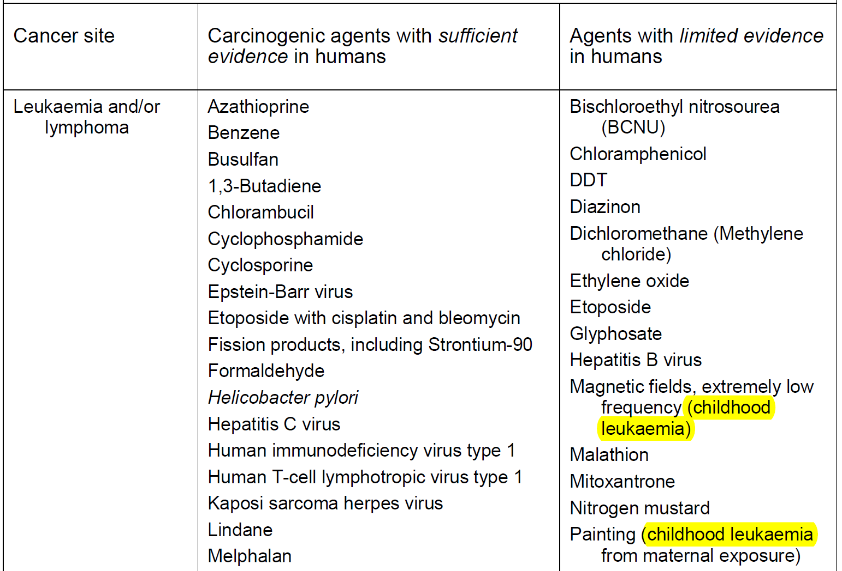
Known and suspected causes of cancer
Notes:
With the V100 and additional review of all other agents for the JNCI publication systematic sufficient, limited evidence for all agents ever evaluated by the Monographs
In addition to traditional prespective from agent, now also allows to search Monograph evaluations by cancer site
This list of classification updated after each meeting
This captures the cover page and the header of the Vol 100 review article published in JNCI almost coinciding with the 40 years anniversary of the first day of the first IARC Monographs meeting on 13 Dec 1971

Slide 37
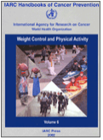
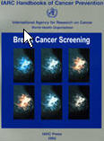
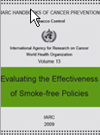
History of IARC Cancer Prevention Handbooks
IARC Sc Pub #139 Principles of Chemoprevention (Nov 1995)
Preventive Agents
Vol 1 NSAIDs
Vol 2 Carotenoids
Vol 3 Vitamin A
Vol 4 Retinoids
Vol 5 Sunscreens
Vol 6 Weight Control & Physical Activity
Vol 8 Fruit and Vegetables
Vol 9 Cruciferous Vegetables,Isothiocyanates and Indoles
Screening
Vol 7 Breast Cancer Screening (Working procedures)
Vol 10 Cervix Cancer Screening
Vol 15 Breast Cancer Screening
Tobacco Control
Vol 11 Reversal of Risk after Quitting Smoking
Vol 12 Methods for Evaluating Tobacco Control Policies
Vol 13 Evaluating the Effectiveness of Smoke-free Policies
Vol 14 Effectiveness of Price and Tax Policies for Control of Tobacco

Slide 38
particular challenges in the causal inference for childhood cancer
Childhood Cancer methodologically very rare disease
In the year 2000, malignant neoplasms comprised about 8% of deaths among l~ year olds, 15% among 5-9 year olds, 12% among 10--14 year olds, and 6% among 15-19 year olds, with ranking as the third, second, second, and fourth leading causes of death, respectively (Accidents are the leading cause of d~ in children and comprise between 40%-50% of mortality)
Notes:
total number of incident cases among children is less than the number of incident diagnoses of cancer for all but the rarest of individual adult sites.
In the year 2000, malignant neoplasms comprised about 8% of deaths among l~ year olds, 15% among 5-9 year olds, 12% among 10--14 year olds, and 6% among 15-19 year olds, with ranking as the third, second, second, and fourth leading causes of death, respectively (Accidents are the leading cause of d~ in children and comprise between 40%-50% of mortality)
a large and growing number
of childhood cancer survivors. fu the United States in 2000, there were
estimated to be nearly 195,000 people who had survived up to 25 years
past a diagnosis of cancer between the ages of 0 and 19 years (Ries et
al., 2003). Compared with the general population, childhood cancer
survivors have an increased risk of second malignancies

Slide 39
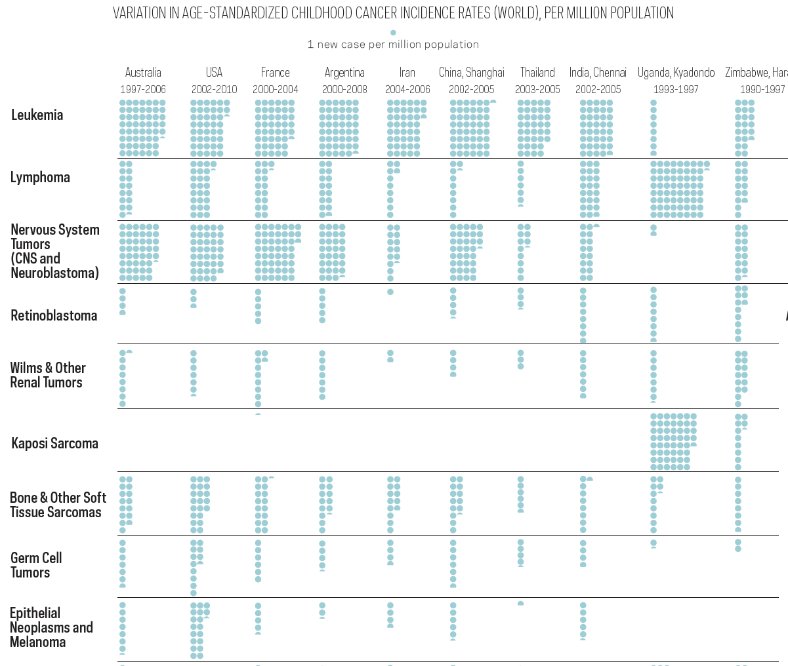
Childhood cancer registries
        ACS Cancer Atlas, high-quality Eva
        Poster Eva

Slide 40
Investigators
Lead investigators:
  Mary Ward (NCI) Ann Olsson (IARC)
  Leslie Stayner (UIC) Joachim Schüz (IARC)
  Benjamin Booth (UIC) Kurt Straif (IARC)
Co-investigators
  Martine Vrijheid (CREAL)
  Gabriella Tikellis (MCRI)
  Martha Linet (NCI)
  Mike Dellarco (NICHD/NCS)

Slide 41
Exposure Approaches in Childhood Cancer Research
Study design: exposure level
Pesticide purchase/use records
  Reynolds et al. (2002)
  Reynolds et al. (2005)
  Rull et al. (2009)
Land use records
  Carozza et al. (2008)
  Walker et al. (2008)
  Thompson et al. (2008)
Aerial imagery
  Carozza et al. (2009)
Ecologic: block group
Case-control: ½ mile
(804.7 m) buffer
Ecologic: county
Case-control: 1,000 m buffer
Notes:
Extension of previous slide to show the approaches that were used.
Previous studies have not utilized cohort based subjects.
Block groups are subdivisions of census tracts (which are subdivisions of counties) and are the lowest level of census information that can be obtained without going to the individual or household level.
Block groups tend to range from 600-3000 people.

Slide 42
Application to I4C
Geocode addresses at birth
Utilize land use maps and crop-specific pesticide use data
Circular buffer around birth address to derive exposure
  Sensitivity analysis to explore most appropriate buffer
    750 m & 1000 m buffers have been used in previous studies

Slide 43
Study Design
Case-cohort study, 10 controls per case
  Cohorts with birth addresses for geocoding
    - DNBC, MoBa, ALSPAC
  Land cover maps and crop-specific pesticide use data
    - Obtained from each country for birth year
    - Changes in pesticide regulation by country & time
  Adjust for exposures from agricultural and pesticide related occupations

Slide 44
Occupational Exposure Assessment
Harmonize the different classification systems to ISCO-88.
Evaluate the risk of childhood cancer (primarily leukaemia, lymphomas and brain cancer) associated with parental occupation in different types of farming;
Estimate the relative risk of childhood cancer associated with duration and low and high levels of parental occupational exposure to pesticides (insecticides & herbicides);
.
Notes:
This slide is from the 2011 I4C presentation. Cancer counts may not reflect current state of cohorts.
The ALOHA JEM developed by Kromhout and Vermeulen is linked to ISCO-88, and estimate exposure to pesticides (herbicides, insecticides and fungicides), biological dust, mineral dust, solvents, and metals.
ALSPAC is from the UK (Not yet approval to transfer data to NCI)
DNCB is from Denmark (Not yet approval to transfer data to NCI)
JPS is from Israel (sent to Ben)
MoBA is from Norway (sent to Ben)
TIHS is from Australia (will soon be sent to Ben)

Slide 45
Strengths & Limitations
Strengths
Limitations
First to evaluate crop density and childhood cancer in a cohort study
Ability to compare results across countries
Ability to pool data across studies for additional power
May be underpowered to detect associations in specific cancer types
Crop rotation can lead to complications in exposure measure where pesticide use information is not available
Rare crop/pesticide exposures not feasible to study

Slide 46
Occupational Exposure Assessment
Apply the ‘ALOHA+’ job exposure matrix made available from IRAS at Utrecht University to estimate no, low and high exposure to herbicides, insecticides and fungicides, based on ISCO-88.
This project will also prepare the ground for studying other parental occupational exposures in relation to childhood cancer by harmonizing all occupational histories of the individual studies to ISCO-88, eg from ALOHA+ mineral dust, solvents, and metals
.
Notes:
This slide is from the 2011 I4C presentation. Cancer counts may not reflect current state of cohorts.
The ALOHA JEM developed by Kromhout and Vermeulen is linked to ISCO-88, and estimate exposure to pesticides (herbicides, insecticides and fungicides), biological dust, mineral dust, solvents, and metals.
ALSPAC is from the UK (Not yet approval to transfer data to NCI)
DNCB is from Denmark (Not yet approval to transfer data to NCI)
JPS is from Israel (sent to Ben)
MoBA is from Norway (sent to Ben)
TIHS is from Australia (will soon be sent to Ben)

Slide 47
Booth, biological dust
See abstract, parental exposures (AGRICOH?)
Maternal occupational exposure to organic dust was associated with increased risk of any cancer (HR=1.33, 95% CI=1.04-1.70) and non-leukemia cancers (HR=1.38, 95% CI=1.02-1.86), but not with leukemia
Notes:
Radon limited evidence for leukemia (adults)

Slide 48
Discussion after presentation
Possibility to take into account moving of parents (MoBa) for sensitivity analysis
Availability of covariates as advantage of cohort studies
Future analyses by combination of pesticides by mechanism of action, 2nd step after first results
DNBC, use of biospecimen for validation of exposure assessment, as a 2nd step
Data from Israel cohort post 1973 (?) could be included
Notes:
100e parental smoking childhood leukemia limited

Slide 49
Environmental Group
Detailed descriptive analyses of childhood cancers and trends by subtypes & country
Environm. and occupational pesticides: private application, dietary intake (FFQ), seasonal spraying (Dengue);
validation of exposure assessment in biospecimen (blood, breast milk, fat tissue); by mechanism o fpesticides
Occupational coding available for other cohorts for application of JEMs
Air pollution and childhood leukemia: benzene, distance from roads, gas filling stations – also potential links with ~omics proposal
Secondhand smoke and childhood leukemia
Notes:
100e parental smoking childhood leukemia limited

Slide 50
Environmental Group
Natural radiation, indoor radon and childhood leukemia: need to explore possibilities of exposure assessment
Arsenic in drinking water, exposure assessment?
Endocrine disruptors incl estrogene in drinking water
EMF/ELF, medical (diagnostic) radiation: currently studied in dedicated cohorts
Testicular cancer, as of now:
Outcome too old for childhood cancer cohorts,
too young (in terms of exposures) for adult cohorts
Notes:
Radon limited evidence for leukemia (adults)

Slide 51
Environmental Group, plenary
Air pollution, outdoor
What can be learned beyond ESCAPE? Cohorts beyond Europe, developing countries (China)
Air pollution, indoor
Norway has data on wood burning, gas cooking, use of candles
Japan has data on VOC, aldehydes, pm2.5, NOx, SOx, ozone
Radon – would an ecologic exposure assessment be accurate enough??
Diagnostic radiation, perhaps some interesting perspectives for I4C, check with Ausra Kesimiene/IARC
Notes:
Radon limited evidence for leukemia (adults)

