Slide 1

ANNUAL RAMAZZINI DAYS
Environmental health in contaminated sites: recent findings and clues for international cooperation
Pietro Comba
Environmental and Social Epidemiology Unit
Department of Environment and Health
^{Istituto Superiore di Sanità}
Carpi, Italy
26-29 October 2017

Slide 2
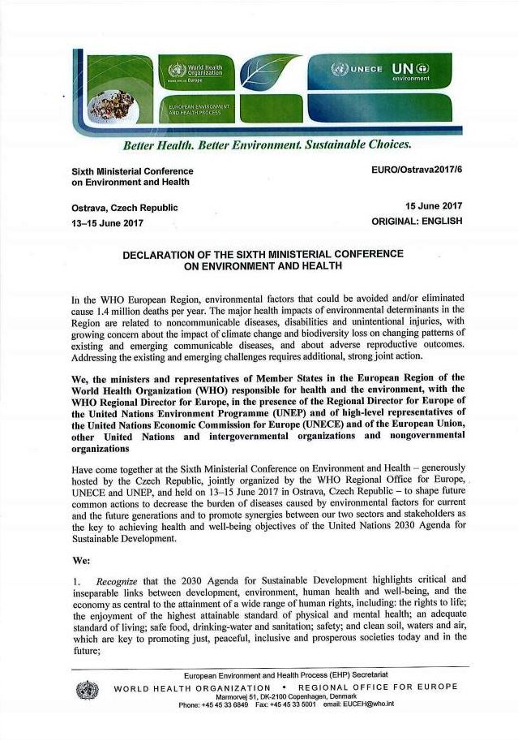

Slide 3


Slide 4


Slide 5
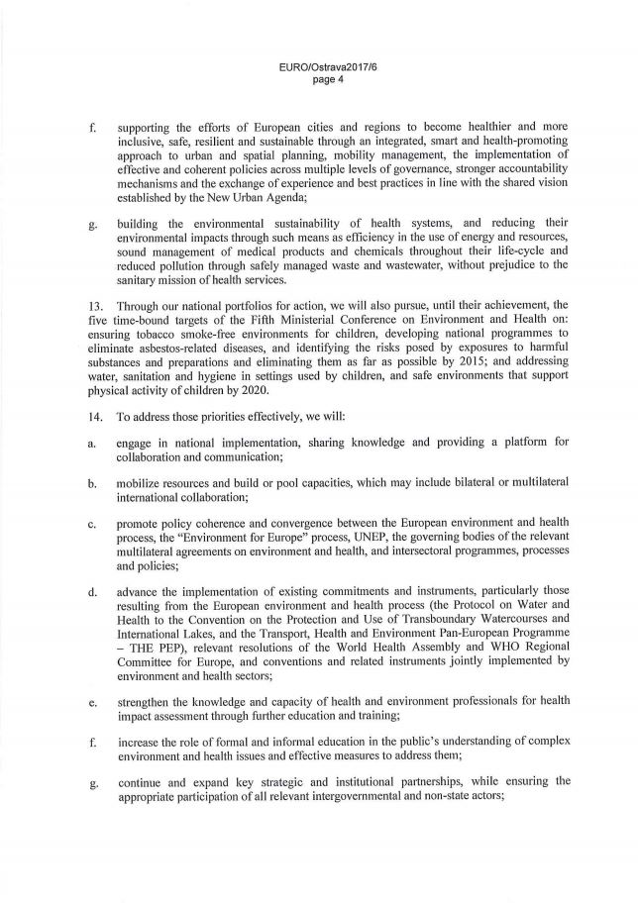

Slide 6
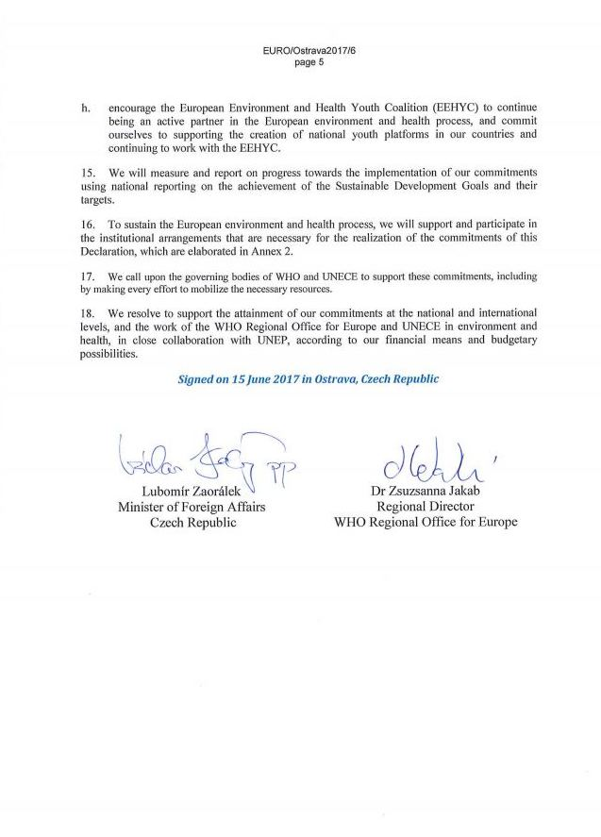

Slide 7
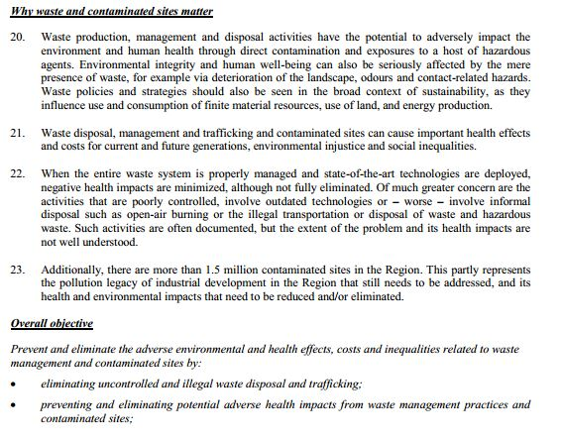

Slide 8


Slide 9

Prequel
SENTIERI Project: aims and methods
SENTIERI Project: findings
SENTIERI Project: perspectives
Concluding remarks

Slide 10
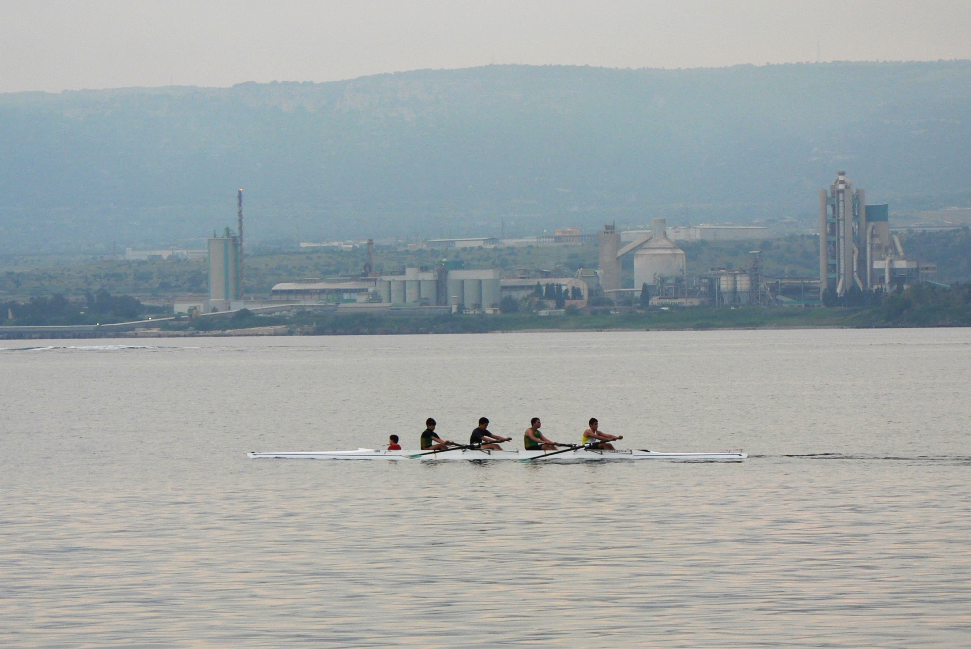
Prequel

Slide 11

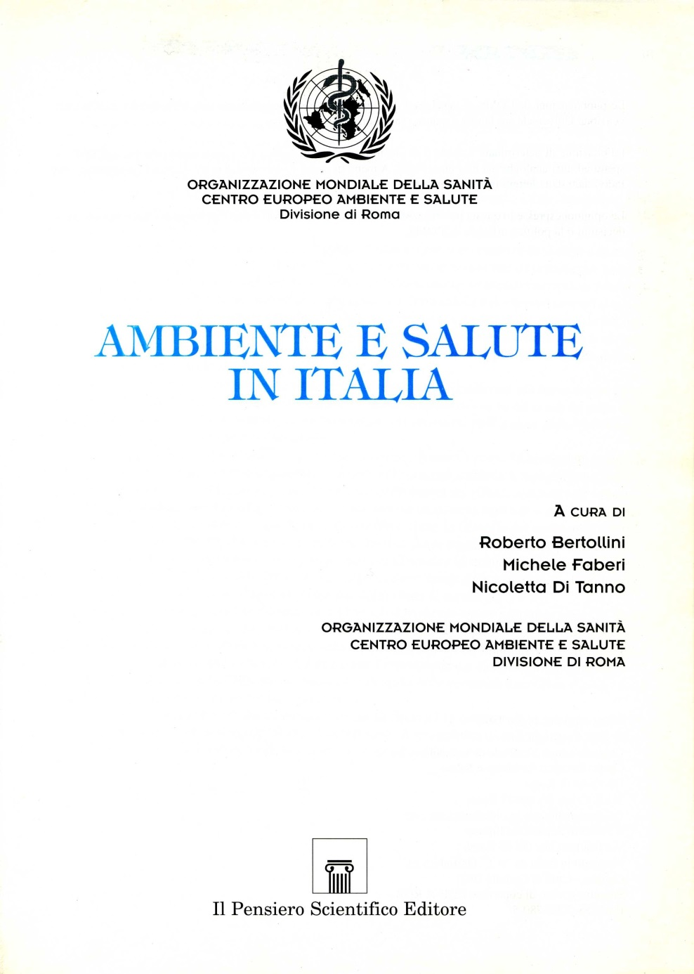

Slide 12

Epidemiological studies in sites of national interest for environmental remediation in Italian regions funded
by European Union structural funds
Edited by Liliana Cori, Manuela Cocchi
and Pietro Comba
http://www.iss.it/binary/publ/publi/05-1.1114595447.pdf

Slide 13

Epidemiologic studies in polluted sites: scientific background, methodology, management, and aspects of equity
Edited by Fabrizio Bianchi
and Pietro Comba
http://www.iss.it/binary/publ/cont/06-19.1162907147.pdf

Slide 14

Health impact in contaminated sites: methods and instruments
for research and evaluation
Edited by Pietro Comba, Fabrizio Bianchi, Ivano Iavarone and Roberta Pirastu
http://www.iss.it/binary/publ/cont/07-50.1204799444.pdf

Slide 15
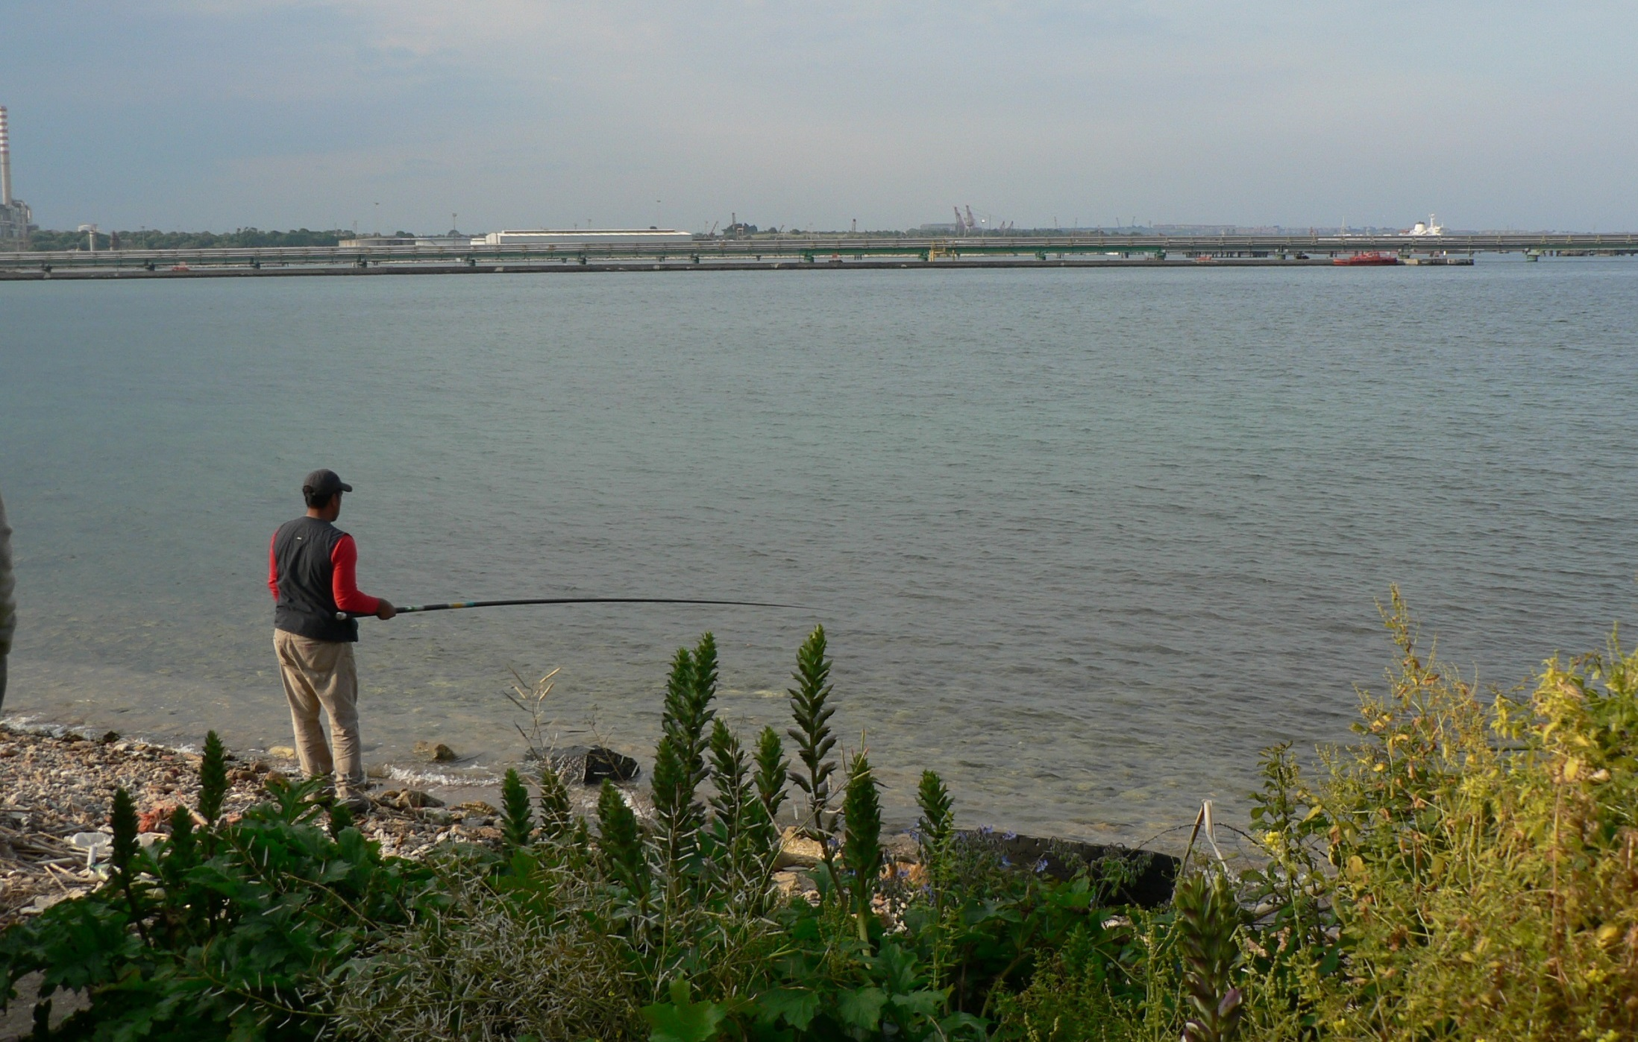
SENTIERI Project: aims and methods

Slide 16

SENTIERI is for surveillance of health status
of residents in contaminated sites
Notes:
16

Slide 17
Aims of SENTIERI Project
To collect, store and interpret data
on the health status of populations
resident in National Priority Contaminated
Sites (NPCS) recognized by the
Ministry of Environment based
on soil and groundwater contamination
Notes:
17

Slide 18
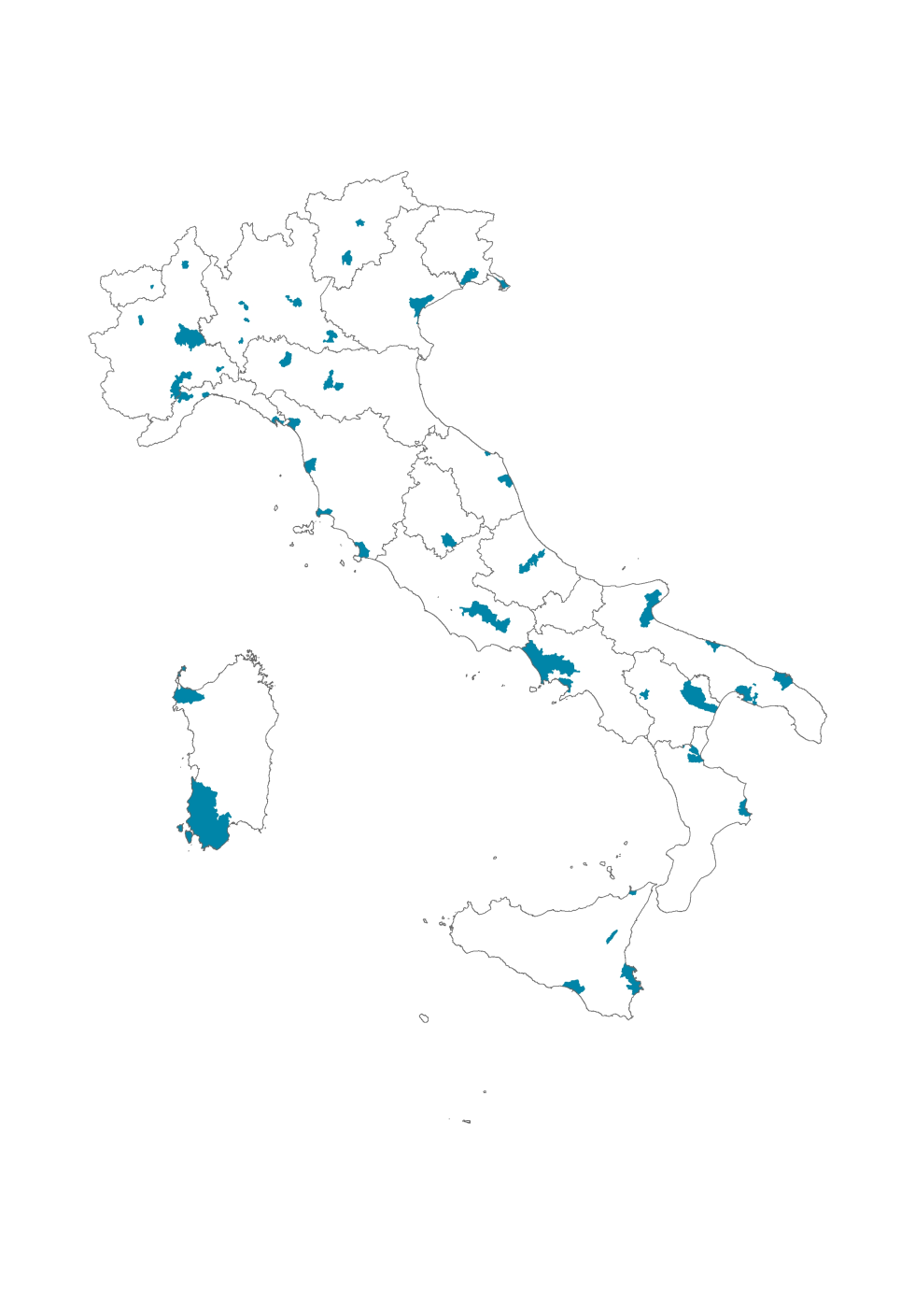








CONTAMINATED SITES (45)
STEEL INDUSTRY
ASBESTOS/OTHER MINERAL FIBRES
LANDFILL/WASTE DUMP
OIL INDUSTRY
HARBOUR
ELECTRIC POWER PLANT
MINE/QUARRY
CHEMICAL PLANTS
ESTIMATED NUMBER
of CHILDREN and ADOLESCENTS
1 million (0-19 years old)

Slide 19
Main features of SENTIERI Project
Multidisciplinary working group
Area based study - municipality level
A priori evaluation of scientific evidence in order
to define specific etiological hypotheses
Categorization of environmental exposures based
on the sources of contaminant agents explicitely
mentioned in the decrees of NPCS institution
Notes:
19

Slide 20

A priori evaluation of the epidemiological evidence of the causal association of 63 causes of death with the
environmental exposures in National Priority Contaminated Sites – NPCSs
NPCSs are defined on the basis of health, environmental and social criteria (Decree 152/06)
http://www.epiprev.it/pubblicazione/
epidemiol-prev-2010-34-5-6-suppl-3
Notes:
20
20

Slide 21
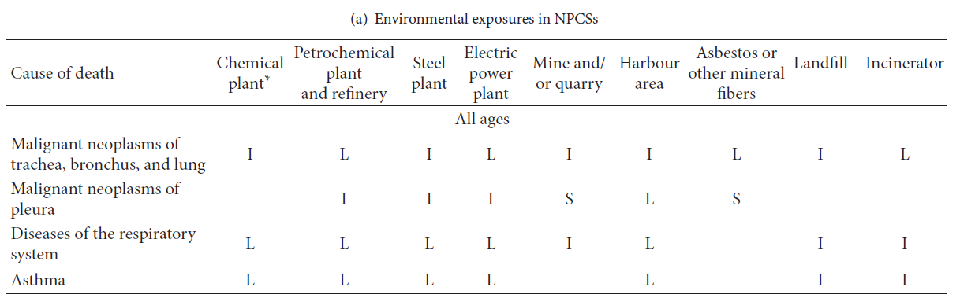
S: sufficient to infer the presence of a causal association
L: limited but not sufficient to infer the presence of a causal association
I: Inadequate to infer the presence of a causal association

Slide 22
NPCSs’ municipalities distribution by quintile of deprivation index
113
36
MOST DEPRIVED
LESS DEPRIVED

Slide 23
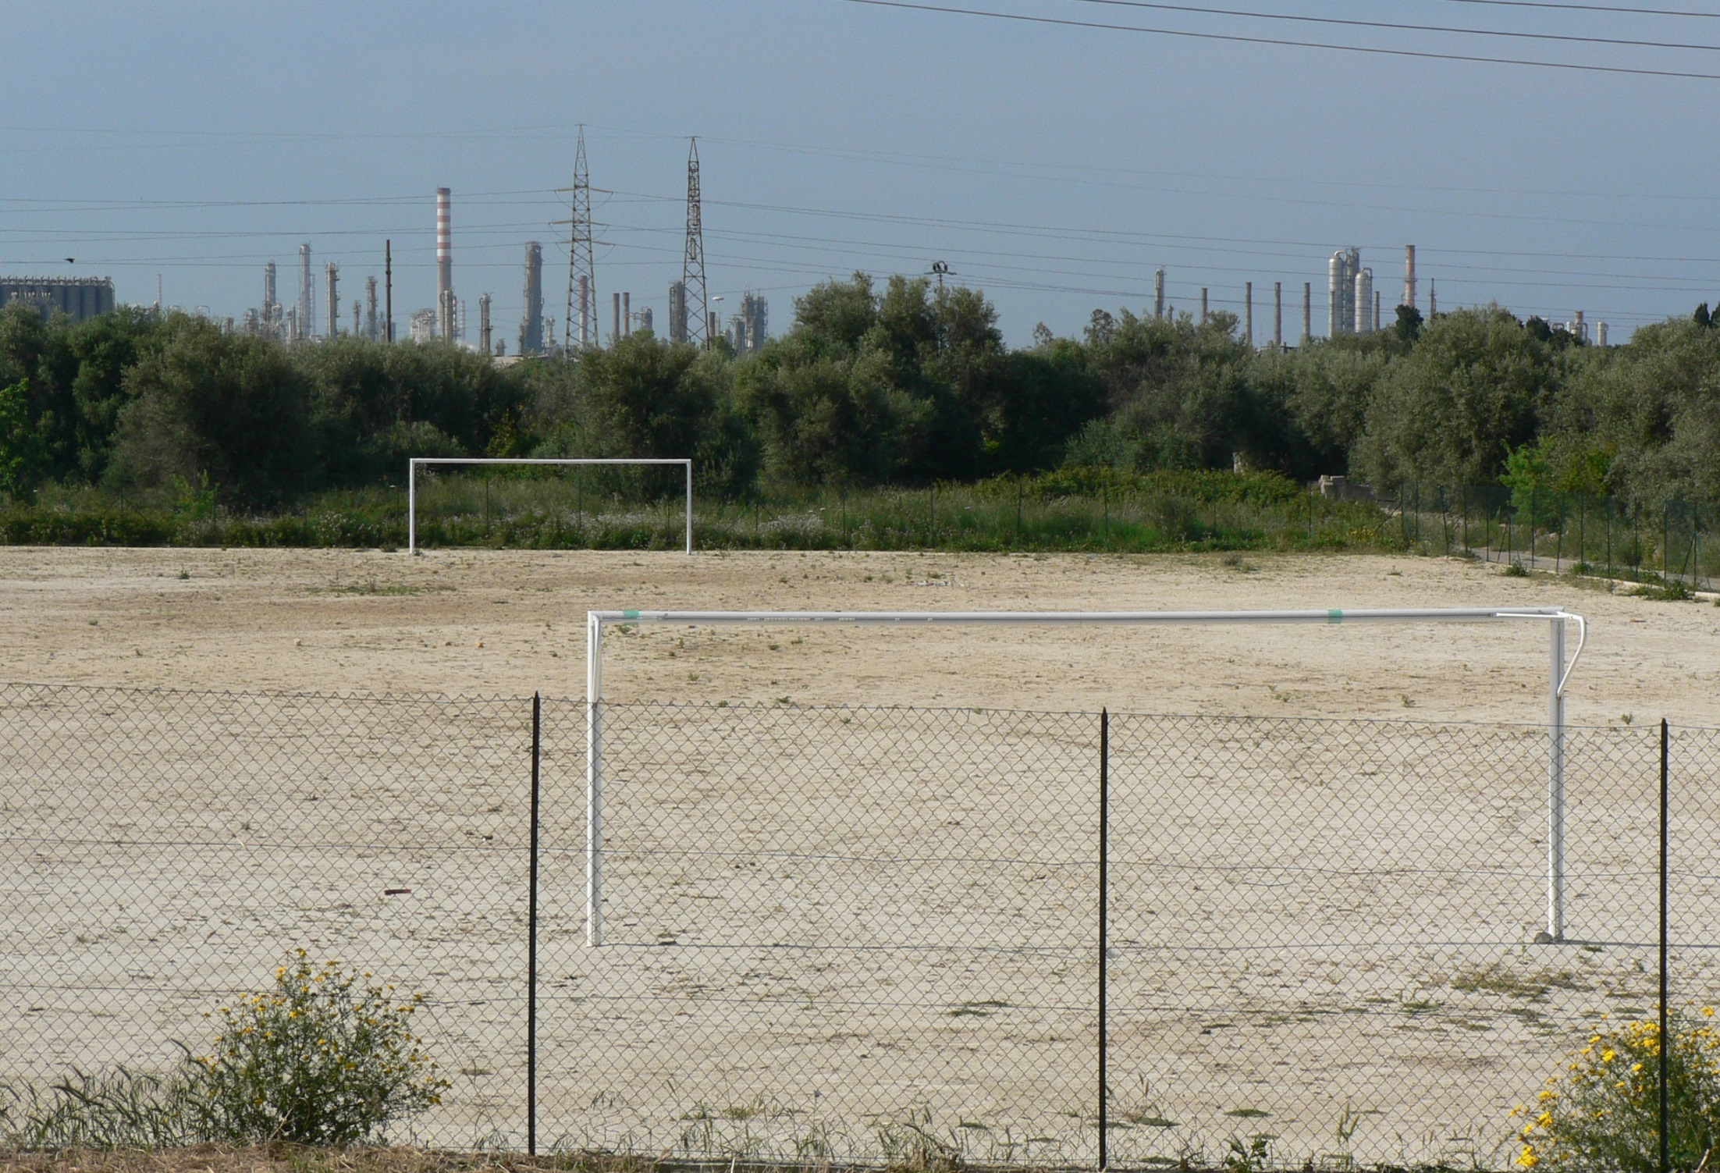
SENTIERI Project: Findings

Slide 24
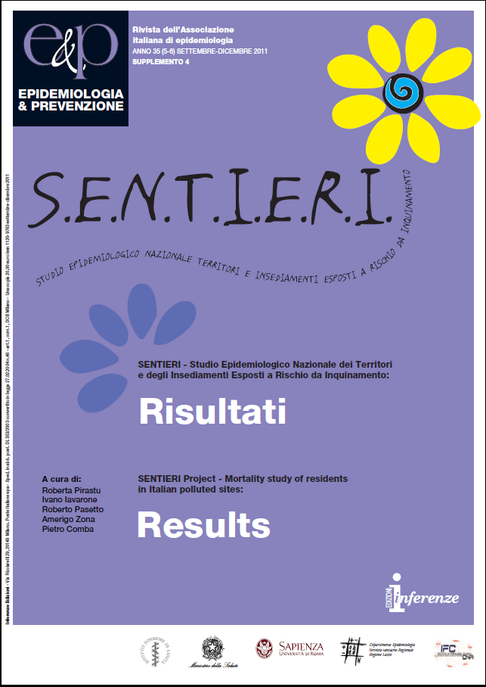
Mortality study (63 causes of death, 1995-2002), males and females
Standardized Mortality Ratio
regional reference population
SMR: crude and adjusted for an ad hoc deprivation index
http://www.epiprev.it/pubblicazione/
epidemiol-prev-2011-35-5-6-suppl-4
Notes:
24

Slide 25
Global burden of mortality in NPCSs
Mortality 1995-2002
Cause of death | Oberved | Expected | SMR | Obs-Exp
Overall mortality | 403,692 | 393,723 | 102.5 | 9,969
All neoplasms | 116,075 | 111,766 | 103.8 | 4,309
Diseases of the circulatory system | 169,750 | 167,863 | 101.1 | 1,887
Diseases of the respiratory system | 25,785 | 25,158 | 102.4 | 627
Diseases of the digestive system | 21,452 | 19,845 | 108.0 | 1,607
Diseases of the genitourinary system | 5,698 | 5,506 | 103.4 | 192

Slide 26
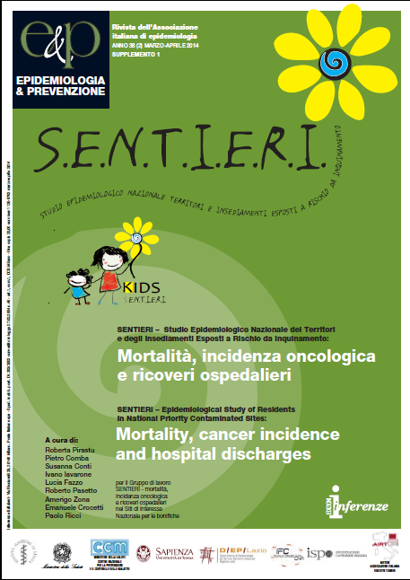
18 NPCSs
Mortality update (63 causes of death ICD-10, 2003-2010), males and females, regional reference rates, SMR
Cancer incidence (35 cancer sites, ICD-10,1996-2005), males and females, macro-area reference rates, SIR
Hospital discharge records (46 discharge diagnoses, ICD-9-CM, 2005-2010) males and females, regional reference rates, SHR
SMR, SIR and SHR adjusted for an ad hoc deprivation index
http://www.epiprev.it/pubblicazione/
epidemiol-prev-2014-38-2-suppl-1

Slide 27
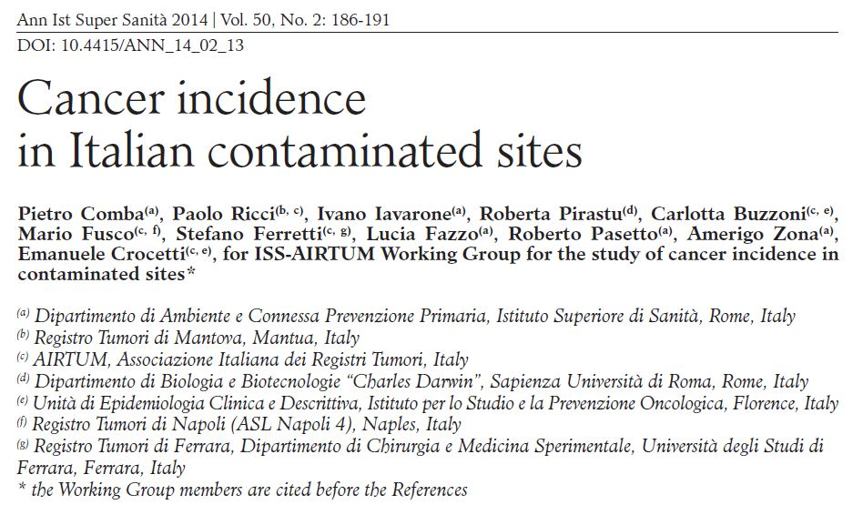

Slide 28
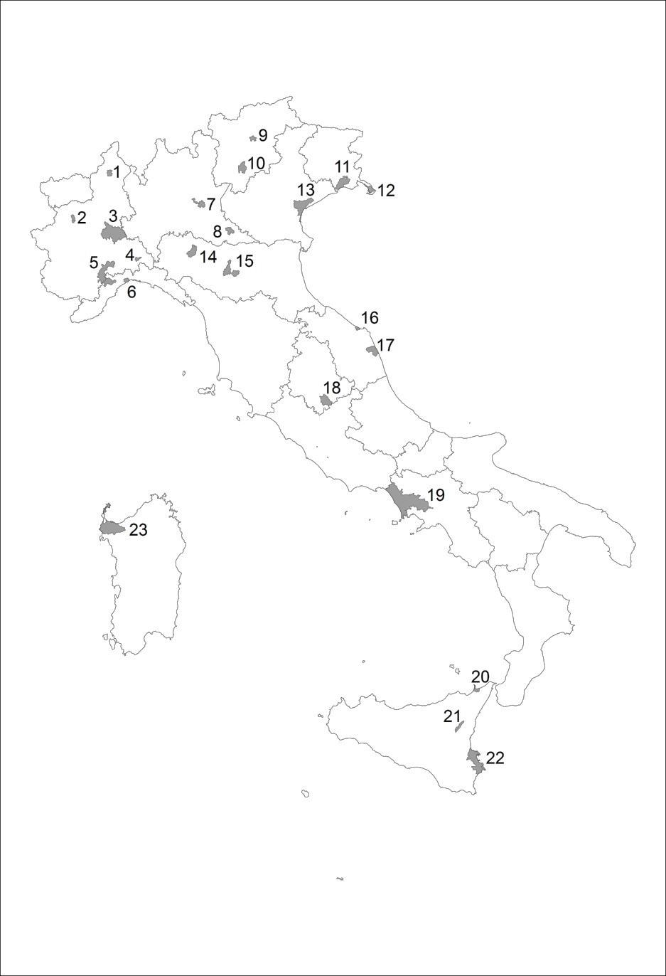
Figure 1.
Italian National Priority
Contaminated Sites:
Geographical distribution
Ann Ist Super Sanità 2014 | Vol. 50, No. 2: 186-191

Slide 29
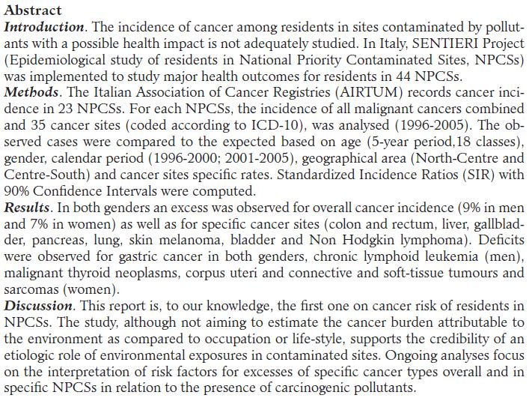
Ann Ist Super Sanità 2014 | Vol. 50, No. 2: 186-191

Slide 30
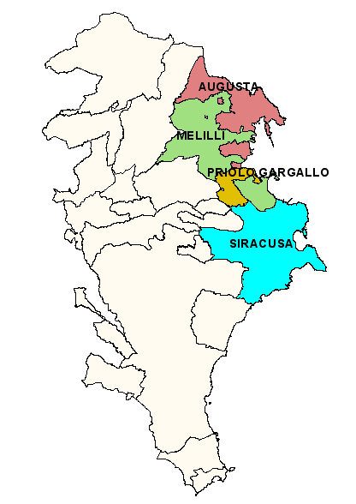
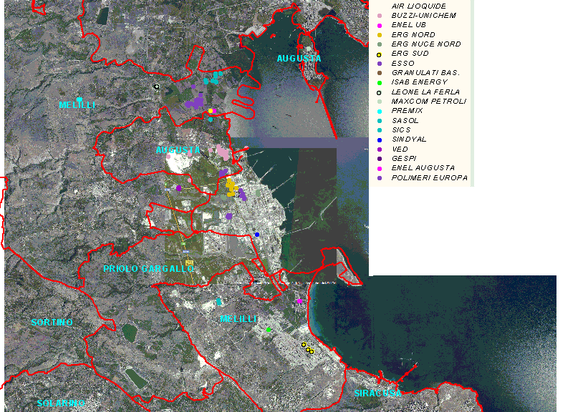
PRIOLO
The industrial area of Priolo was included in the Italian National Priorities List of Contaminated Sites in 2000
The area includes the territory of 4 municipalities
Industrial and polluting activities: Chemical product plants, refineries, harbour areas, landfills of hazardous wastes, former asbestos-cement plant (in Syracuse)

Slide 31
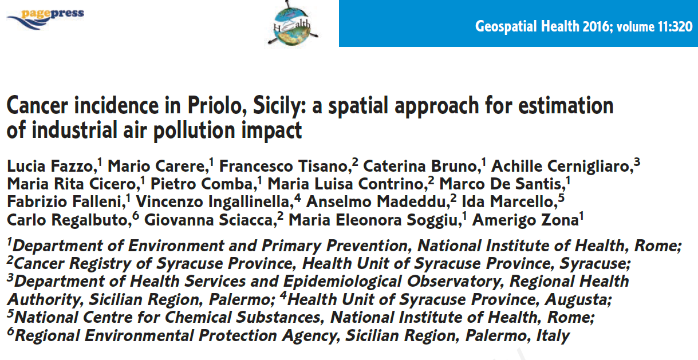

Slide 32
Contaminants in “Priolo” CS with concentrations above regulatory threshold values
 | Industrial Soil | Groundwater | Pine Trees needles* | Lichens* | Sediment (marine coastal area) | Fish products (2007)**
Arsenic | × | × | x | x | ×
Cadmium | × |  |  |  |  | ×
Chromium tot | × | × | x | x | ×
Chromium VI | × | ×
Mercury | × | × |  | x | × | ×
Lead | × | × | × | x | × | ×
Nickel |  | x | x
Vanadium | × | × | x |  | ×
1,2 Dichloroethane | × | ×
Benzene | × | ×
Vinyl Chloride | × | ×
Hexachlorobenzene | × | × |  |  | × | ×
Tetrachloroethylene | × | x
Xylenes | × | ×
Trichloroethylene |  | ×
Hydrocarbons C<12 | ×
Hydrocarbons C>12 | ×
Hydrocarbons tot |  | ×
* No regulatory values for pine tree needles and lichens
** For fish products a declining trend has been detected in the recent years
In addition, occupational exposure to asbestos was documented both in Syracuse (former asbestos-cement plant) and in Augusta (refineries, chemical industries)

Slide 33
Priolo CS’s environmental contaminants and IARC evaluations
1,2-Dichloroethane | 2B
As | 1
Benzene | 1
Cd | 1
Cr | 1 (Cr VI compounds), 3 (metallic chromium, and Cr III compounds)
Hexachlorobenzene | 2B
Hg | 3, 2B (Methylmercury compounds as a group)
Ni | 1 (Nickel compounds), 2B (metallic nickel)
Pb | 2B (lead), 2A (lead compounds, inorganic), 3 (lead compounds, organic)
Tetrachloroethylene | 2A
V | 2B (vanadium pentoxide)
Vinyl chloride | 1
Xylenes | 3
PCBs* | 1
*: PCB’s were included taking into account the predictable emissions of industrial activities within the CS, and the findings of a biomonitoring investigation.

Slide 34
Malignant neoplasms and environmental contaminants Epidemiologic evidence evaluation – References used
IARC monographs and publications
ATSDR Toxicological profiles
Fourth National Report on Human Exposure to Environmental Chemicals 2009 Department of Health and Human Services Centers for Disease Control and Prevention
Report on Carcinogens Twelfth Edition 2011
U.S. Department of Health and Human Services
Public Health Service
National Toxicology Program

Slide 35
Malignant neoplasms and environmental contaminants Epidemiologic evidence evaluation
Sufficient evidence*
Limited evidence*
Conflicting or scarce results, few studies, confounding suspected etc
No information
*Levels of evidence were based on IARC’s evaluation

Slide 36
Malignant neoplasms | 1,2-Dichl | As | Ben | Cd | Cr | Hexachl | Ni | Pb | PCBs | Tetrachl | Vinyl
Oesophagus
Stomach
Colon-rectum
Liver
Trachea, bronchus and lung
Melanoma of skin
Connective and soft tissue
Breast
Cervix uteri
Prostate
Kidney and other urinary organs
Bladder
CNS
Thyroid gland
Lymphohematopoietic system
Hodgkin lymphoma
Non Hodgkin lymphomas
Leukaemias
Lymphoid leukaemia
Chronic lymphocytic leukaemia
Myeloid leukemia
Acute myeloblastic leukaemia
Chronic myeloid leukaemia

Slide 37
PRIOLO STUDY:CONCLUDING REMARKS. 1
The available environmental data, collected from official sources, were not produced for research purpose. A proper exposure assessment is thus not feasible.
Very high levels of some toxic and hazardous agents have been found in the soil and groundwater in the industrial area of the CS.
A widespread chemical contamination has been found in different environmental matrices of the CS, and it has spread far from the point of origin, involving the food chain, namely fishery products.

Slide 38
PRIOLO STUDY:CONCLUDING REMARKS. 2
“Priolo” CS shows a higher incidence of all cancers and of some specific cancer sites, with respect to the Province of Syracuse.
The excesses of pancreas, lung, breast and bladder cancers, of pleural mesothelioma and melanoma were found in both genders.
The review of the scientific literature found sufficient / limited evidence of an association between some contaminants present in “Priolo” CS, and some malignant neoplasms increased in the area: lung cancer and As, Cd, Cr (VI), Ni (sufficient),
melanoma of skin and PCBs (sufficient),
breast cancer and PCBs (limited),
bladder cancer and As (sufficient) and tetrachloroethylene (limited).

Slide 39
PRIOLO STUDY:CONCLUDING REMARKS. 3
The present study contributed to the assessment of the cancer burden in the population resident in Priolo CS. Etiological hypotheses on the links between the occurrence of a number of carcinogenic agents and the observed excess incidence of some cancer sites were generated.
The population has probably been co-exposed to a mixture of pollutants by a variety of routes; appropriate exposure modelling and risk-assessment procedures should be implemented in order to assess their relative contribution.
In this frame, further epidemiological study will require a spatial analysis
of cancer incidence in CS, with respect to the estimated impact of industrial activities, taking into account the residential history of the cases.

Slide 40
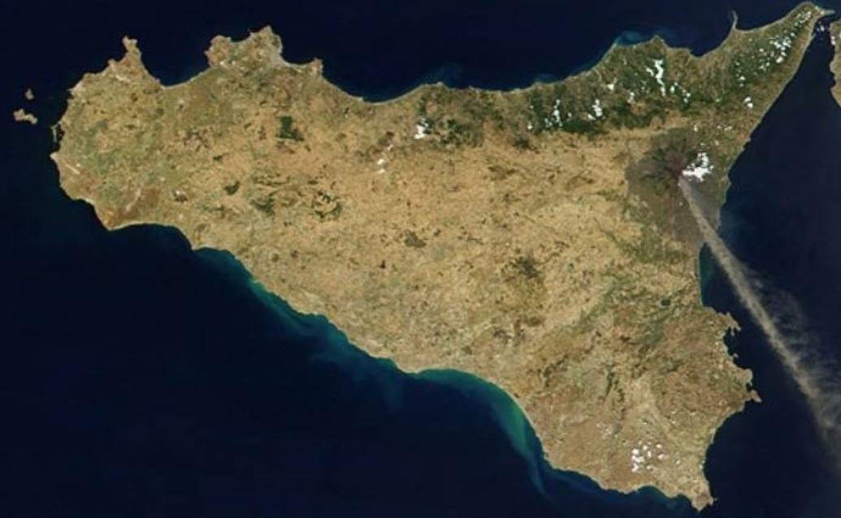
BIANCAVILLA

Slide 41
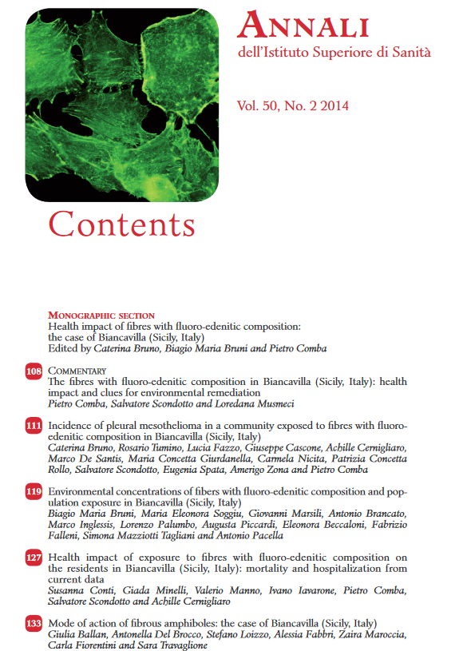
http://www.iss.it/binary/pres/cont/ANNALI_ISS_50_2__2014.pdf

Slide 42
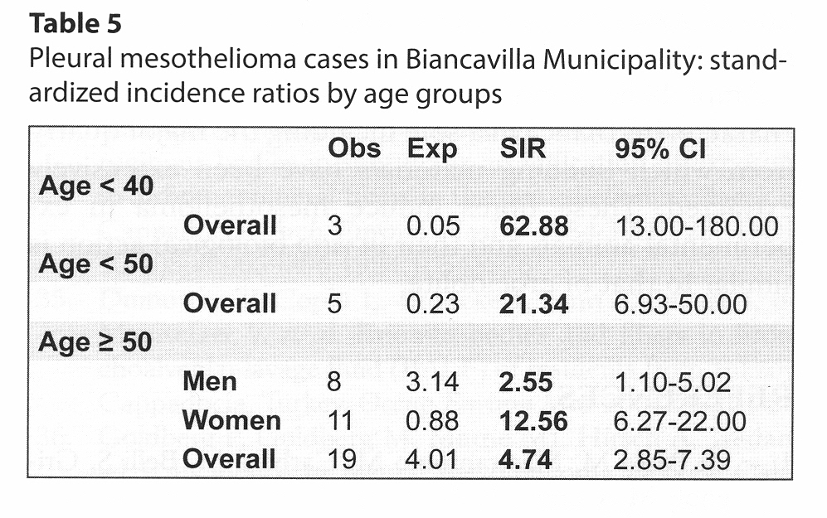
Ann Ist Super Sanità 2014/ Vol. 50, No.2:111-118

Slide 43
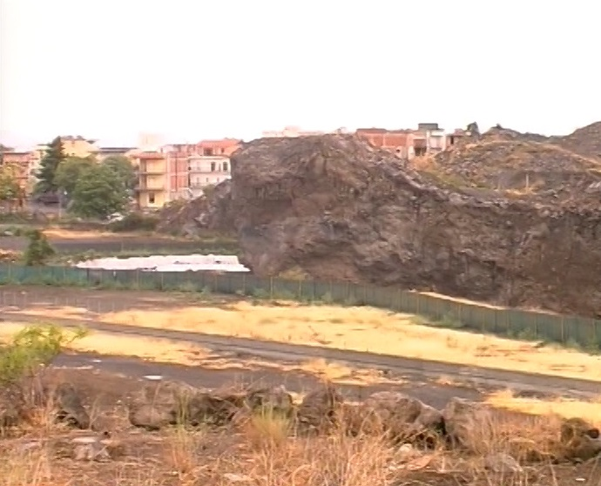

Slide 44
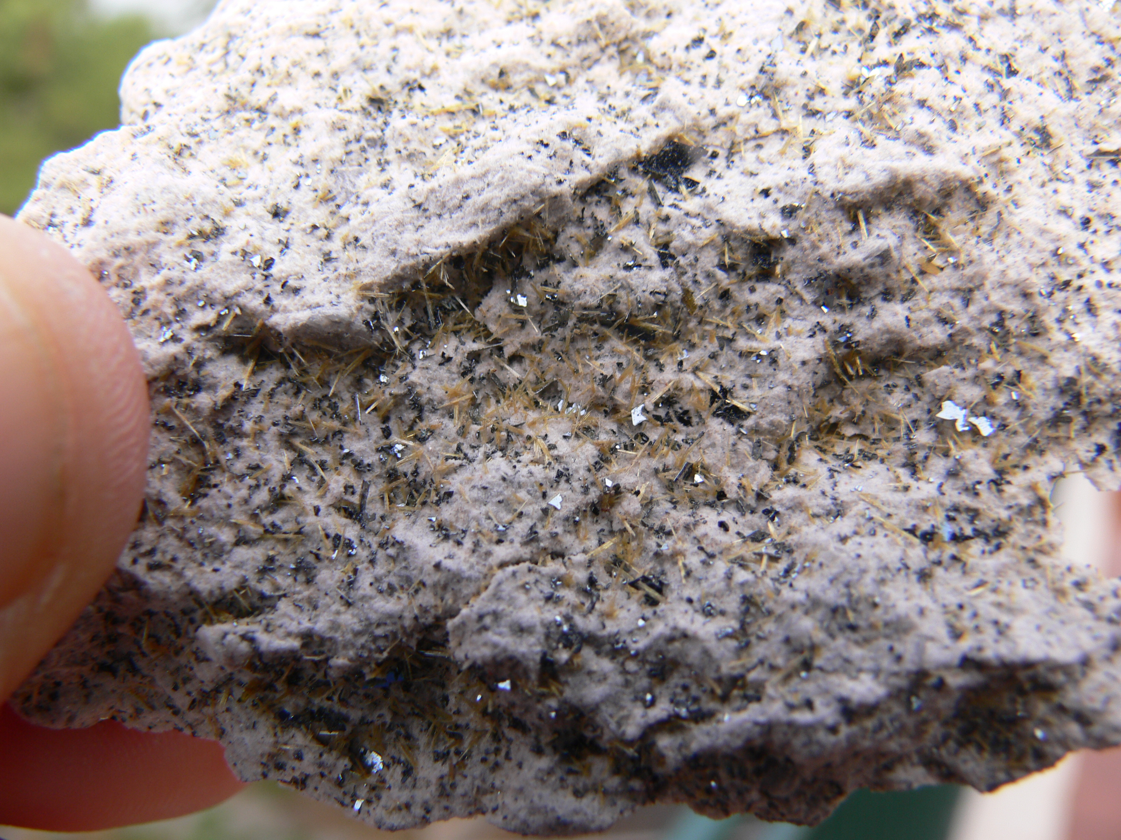

Slide 45
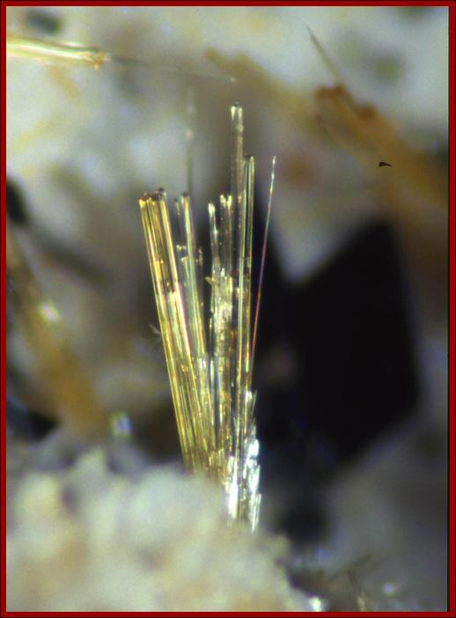
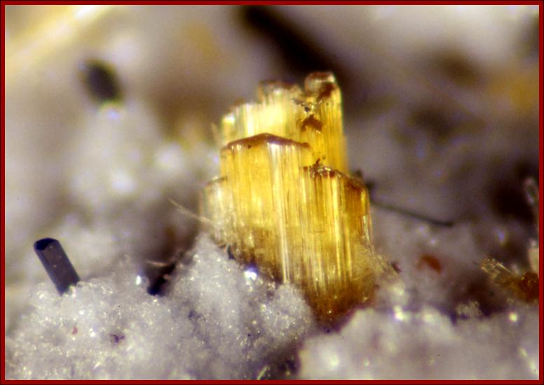

Slide 46
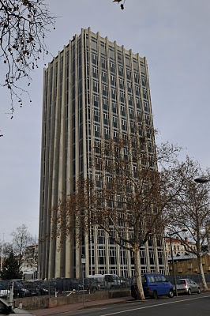
IARC EVALUATION:
fluoro-edenite
is carcinogenic to humans (group 1)
IARC Monographs on the Evaluation of Carcinogenic Risks to Humans
Volume 111: Some Nanomaterials and Some Fibres
Lyon, 30 September – 7 October 2014

Slide 47
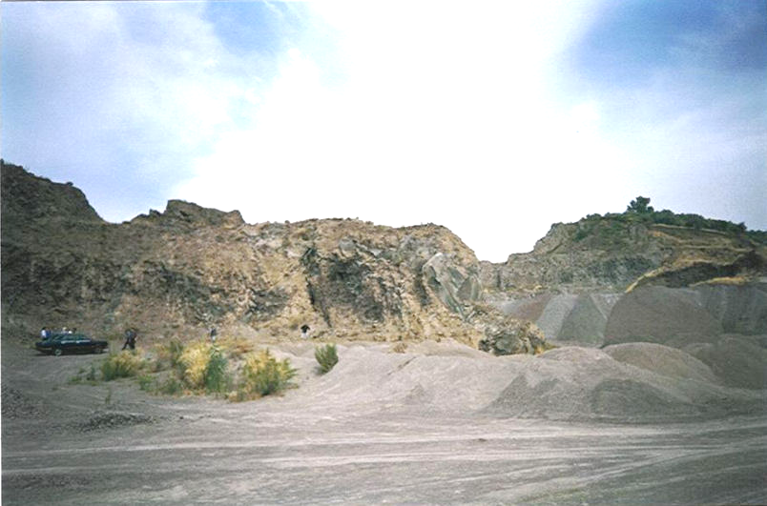
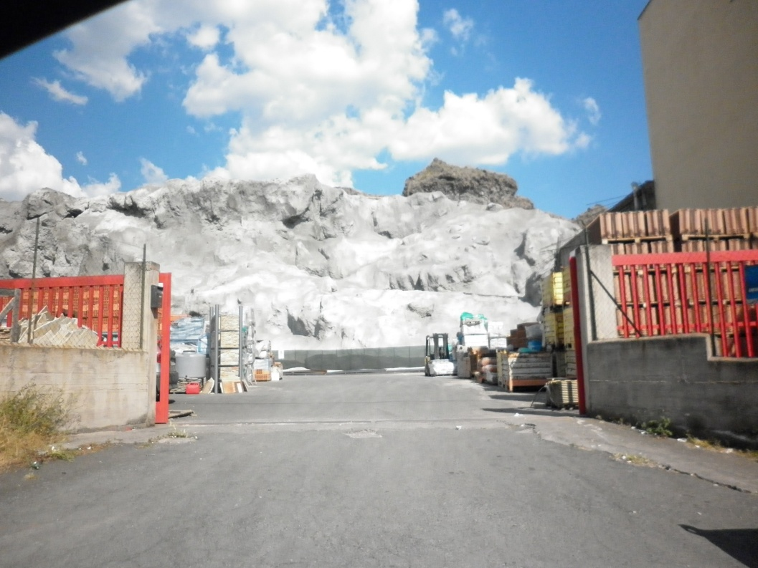
Biancavilla – Monte Calvario quarry 1997
The quarry in 2012

Slide 48
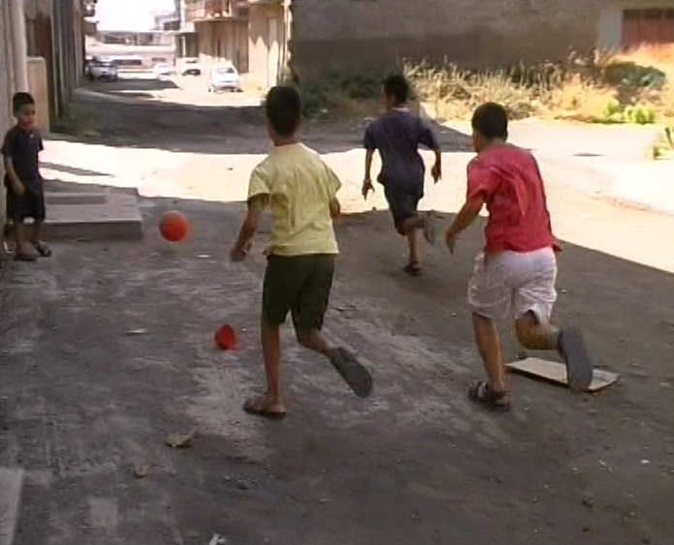

Slide 49
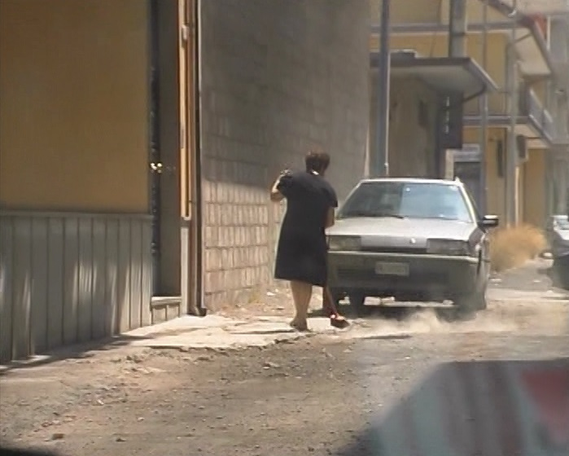

Slide 50
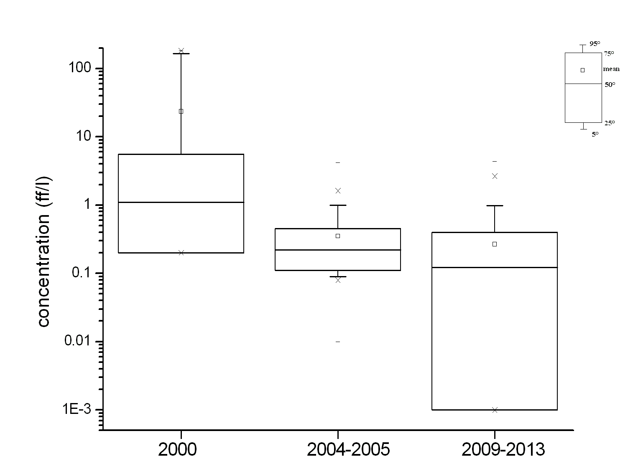
Figure 4: Distributions of air fibres concentrations acquired during the different surveys
Da: Environmental concentrations of fibers of fluoro-edenitic composition and population exposure in Biancavilla
B.M. Bruni, M.E. Soggiu, G. Marsili, A. Brancato, M. Inglessis, L. Palumbo, A. Piccardi, E. Beccaloni, F. Falleni, S. Mazziotti Tagliani and A. Pacella
Ann Ist Super Sanità 2014/ Vol. 50, No.2:119-126

Slide 51

Biancavilla: communication with the population
http://www.iss.it/binary/publ/cont/ONLINEBiancavilla.pdf

Slide 52
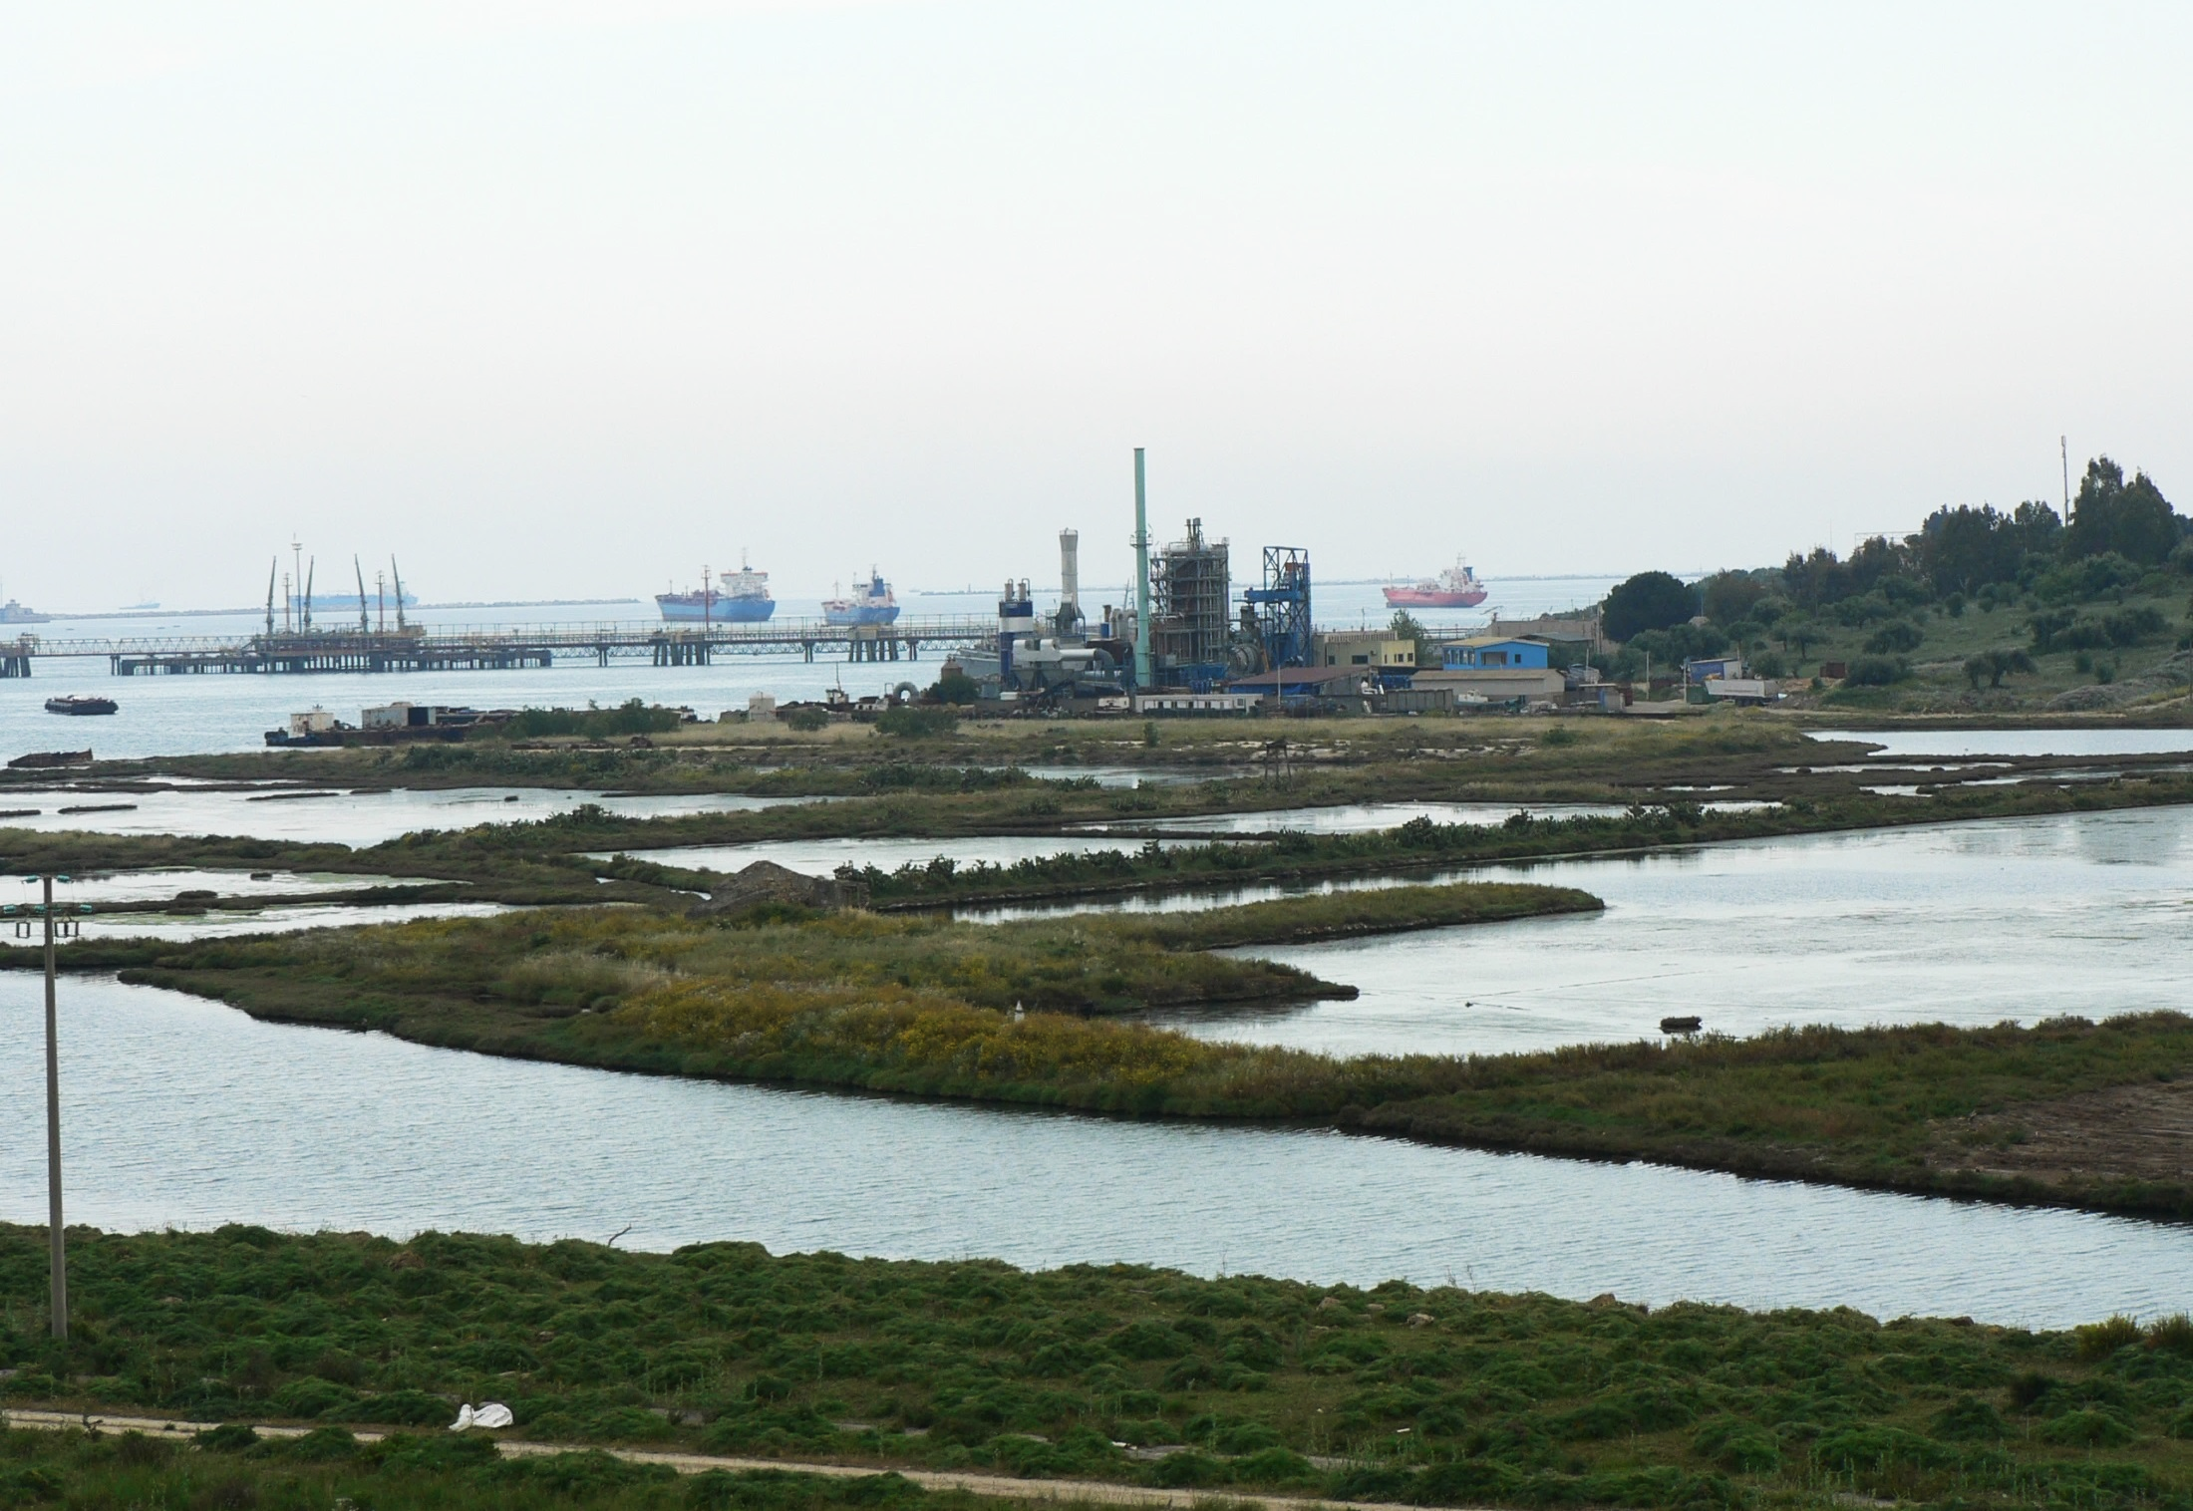
SENTIERI Project: perspectives

Slide 53
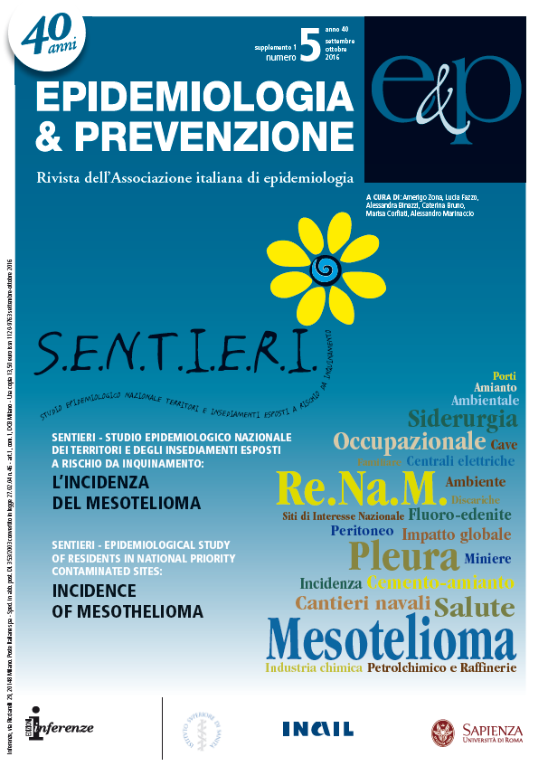
The purpose of SENTIERI-ReNaM Study is to describe mesothelioma incidence in the Italian National Priority Contaminated Sites
Epidemiol Prev 2016 Sep-Oct;40(5 Suppl 1). Italian

Slide 54
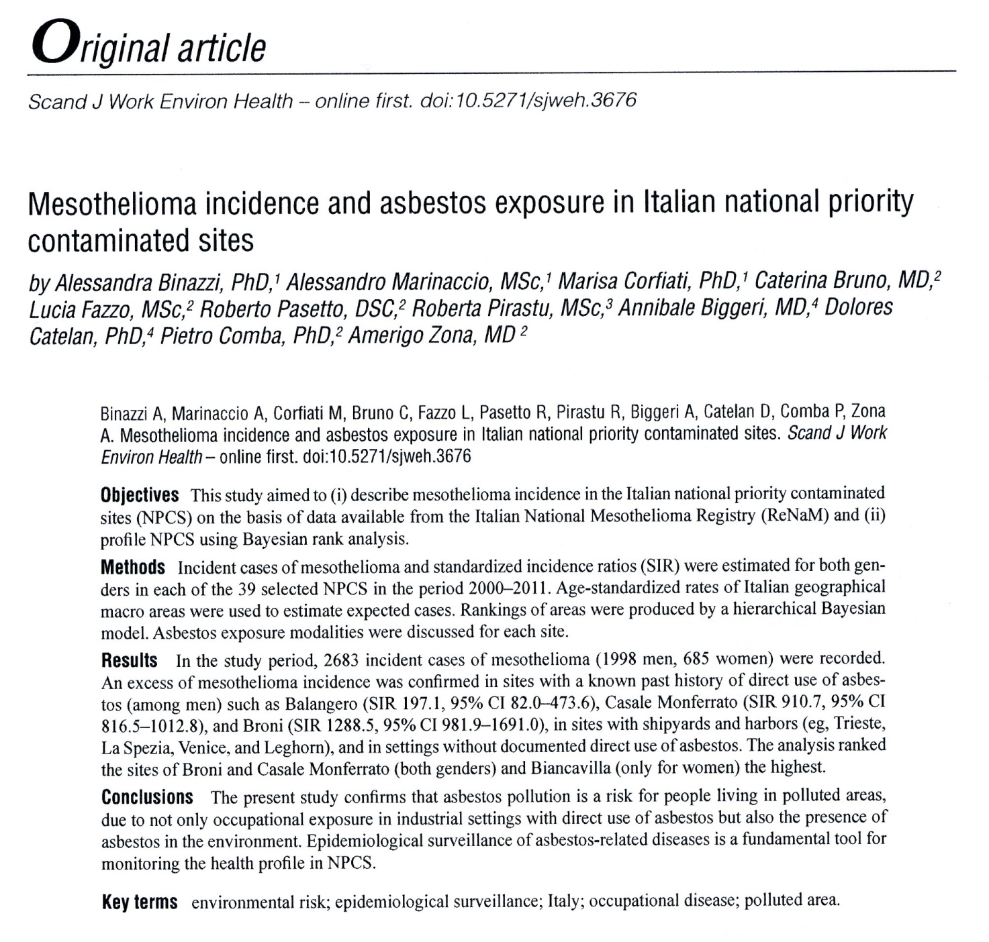

Slide 55
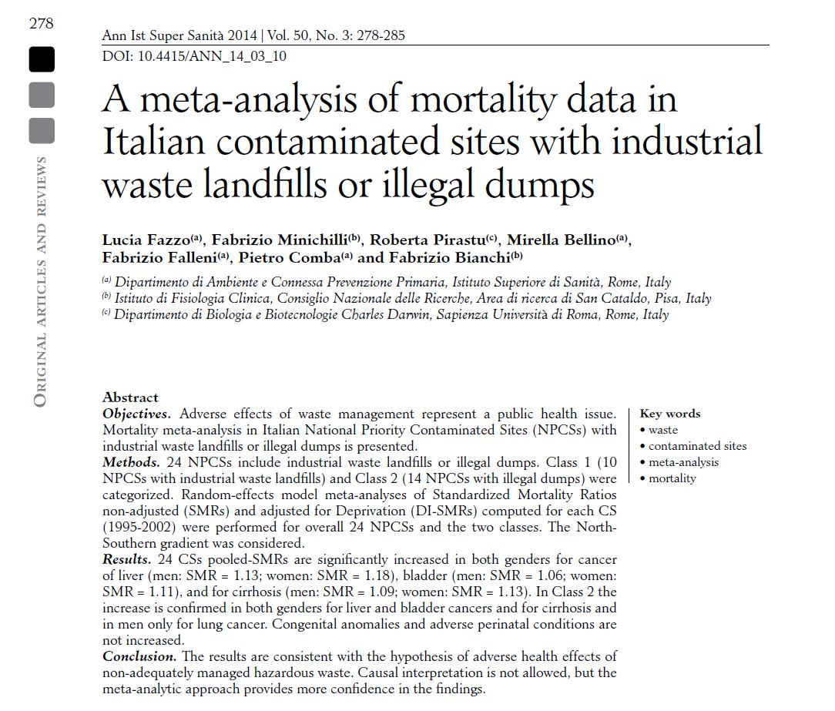

Slide 56
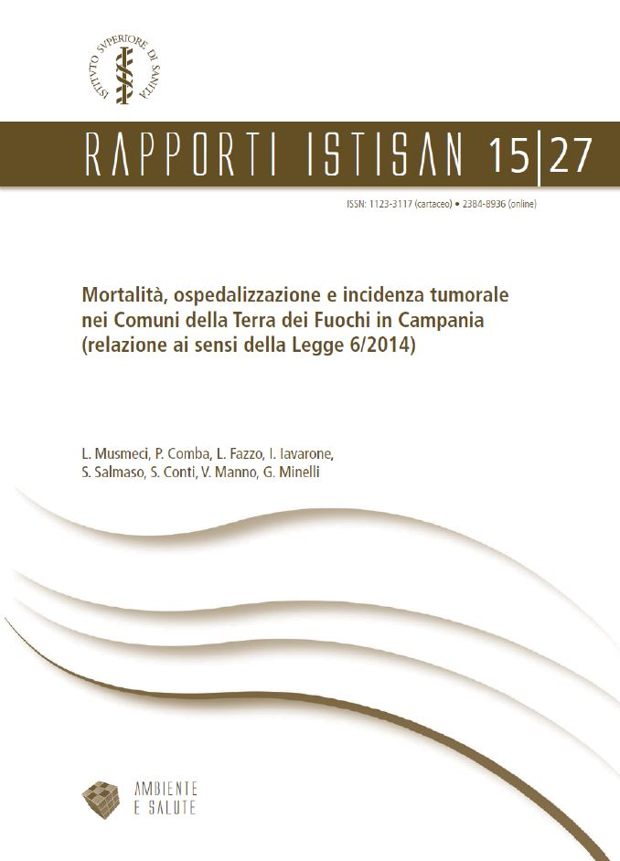
Mortality, hospitalization and cancer incidence in the “Land of Fires” in Campania (report required by the Law 6/2014).
Loredana Musmeci, Pietro Comba,
Lucia Fazzo, Ivano Iavarone,
Stefania Salmaso, Susanna Conti,
Valerio Manno, Giada Minelli
http://www.iss.it/binary/publ/cont/15_27_web.pdf

Slide 57
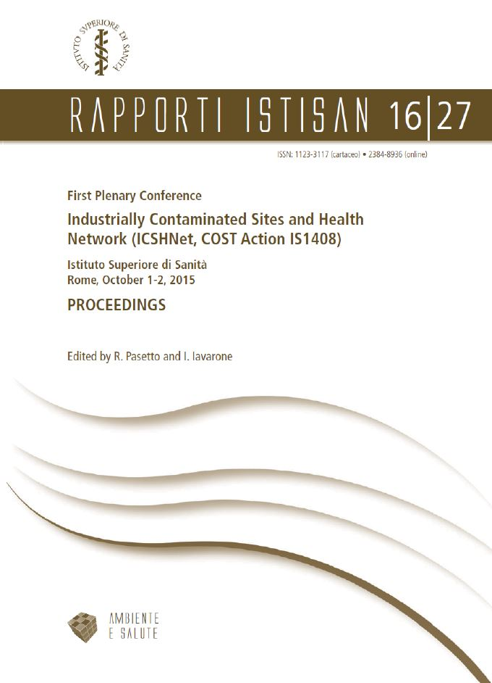
http://www.iss.it/binary/publ/cont/16_27_web.pdf

Slide 58
This volume reports the contributions to the First Plenary Conference of the COST Action IS1408 (Industrially Contaminated Sites and Health Network, ICSHNet), held in Rome at the Istituto Superiore di Sanità (the National
Institute of Health in Italy) on 1-2 October, 2015. The first section focuses
on the Action’s framework, objectives, tasks and goals, the principal
challenges for science and policy posed by Industrially Contaminated
Sites (ICSs), and the progress in the management of ICSs in Europe.
The second section concerns methodological issues related to the
impact of ICSs, including exposure assessment, environmental burden
of disease, integrated environmental health impact, ecological public
health, residential cohorts and geographic epidemiological studies based
on a priori evaluation of the scientific evidence. The third section includes
17 European case studies from participating countries, describing environmental health assessments, human biomonitoring surveys, risk
management and remediation activities related to ICSs.

Slide 59
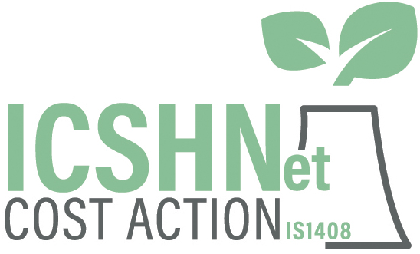

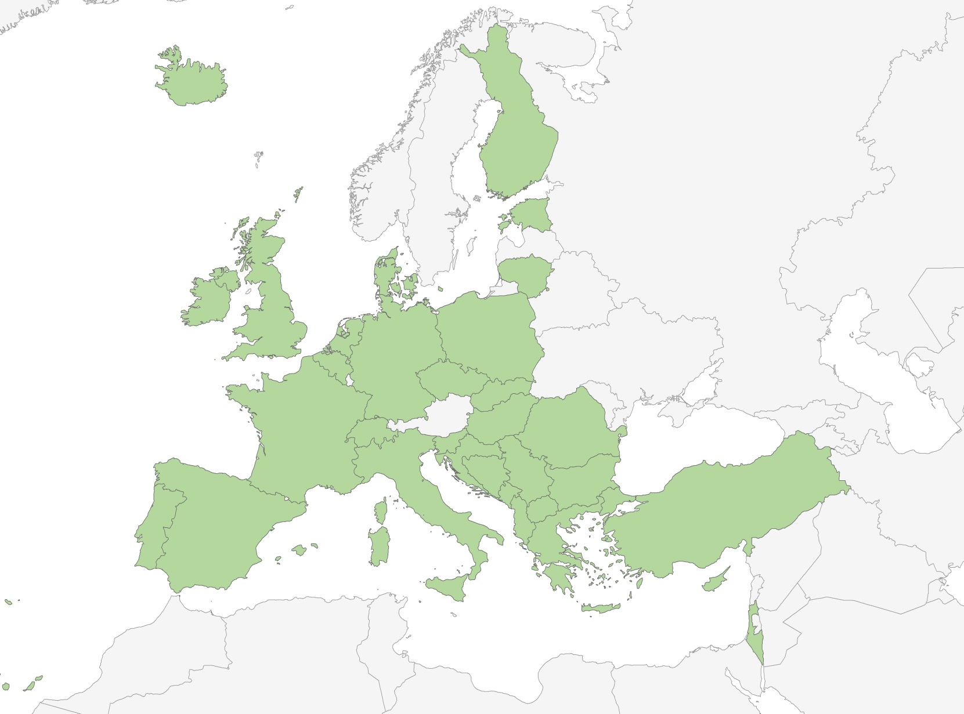
http://www.icshnet.eu/
The Action Network
140 Participants
33 Countries
WHO
EC DG JRC and
DG Environ
http://www.cost.eu/COST_Actions/isch/IS1408

Slide 60
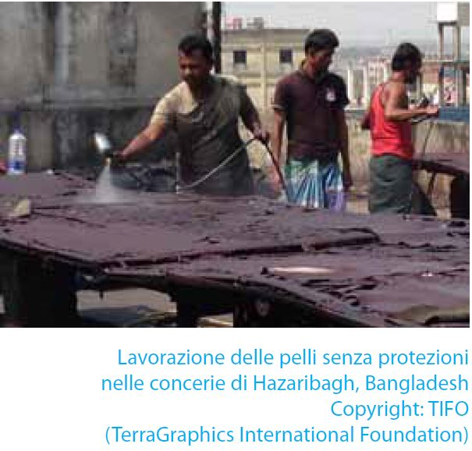

Slide 61
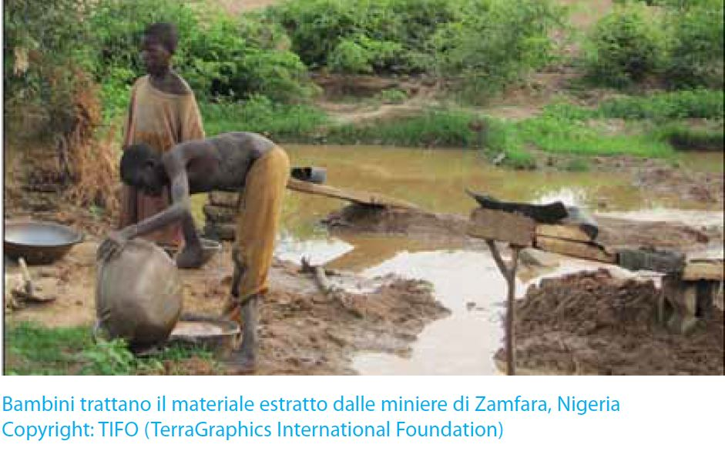

Slide 62
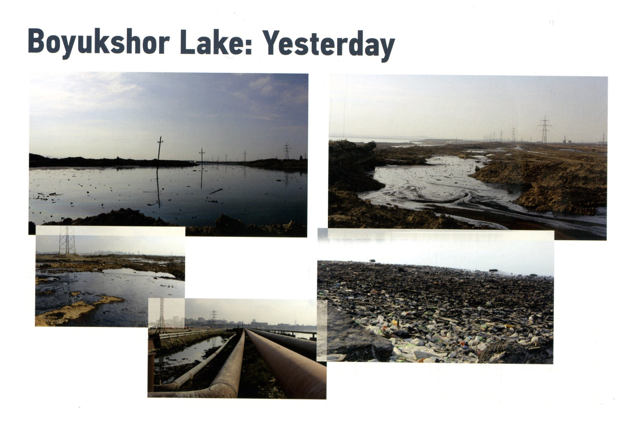

Slide 63
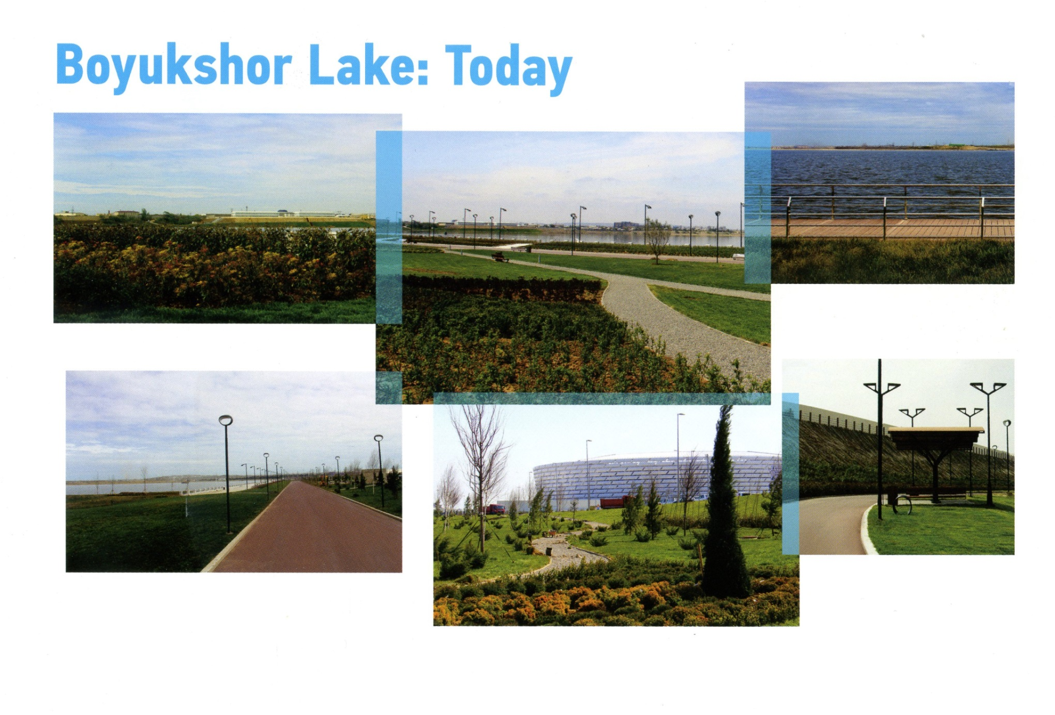

Slide 64
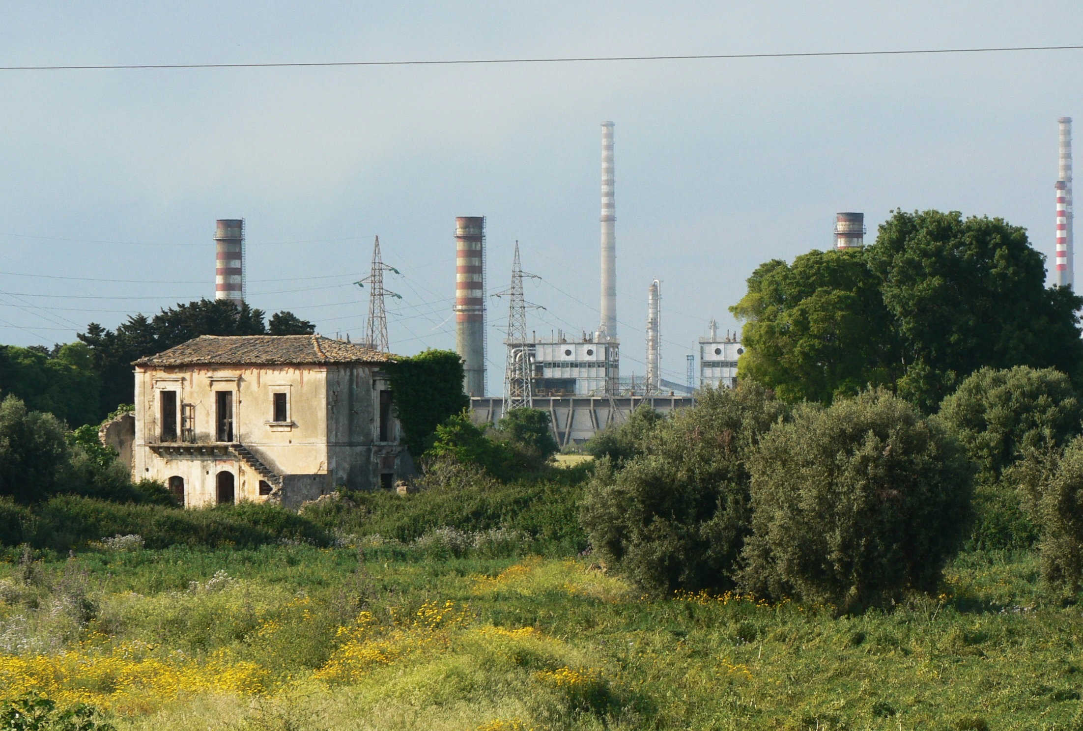
Concluding remarks

Slide 65
Need to integrate scientific research and public health.
Need to integrate environmental and health
administrations at national, regional and local level.
Need to create communication strategies involving
affected populations, local administrations,
general practitioners, school teachers, citizens’
committees and associations and the media.
Need to adopt a global environmental health approach
and foster international scientific cooperation.

Slide 66
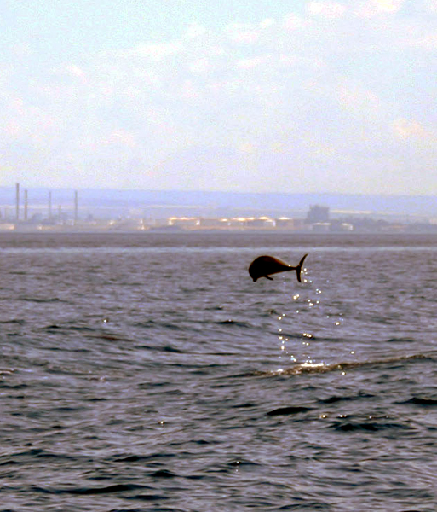
Thanks
I acknoweledge
the helpful support of
Massimo Corbo
for graphic processing

