Slide 1
Drinking water contaminants
and health effects:
the example of exposure to lithium
Florencia Harari, MD PhD
Institute of Environmental Medicine,
Karolinska Institutet, Sweden
Department of Occupational and Environmental Medicine,
University of Gothenburg, Sweden

Slide 2
Drinking water contaminants: a public health problem
More than 2 billion people worldwide still don’t have access to safe drinking water sources. UN 2015
Metals such as arsenic and lead are well-known water contaminants with reported health effects even at low levels of exposure. Moon et al 2017, Milton et al 2017, NTP 2012
Less is known about other metals contaminating drinking water sources such as lithium.

Slide 3
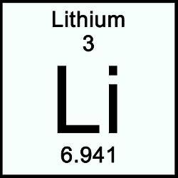
Lithium
Light non-essential metal.
Occurs naturally in rocks, soil and groundwater.
Increasing extraction and use worldwide.
Zimbabwe
U.S. Geological Survey, 2012, 2015

Slide 4
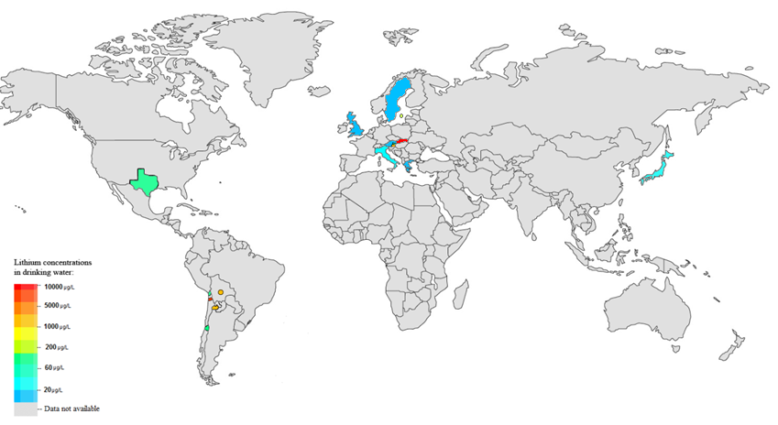
Lithium in drinking water: a problem?
Lithium may occur in drinking water at varying concentrations (1-5,000 µg/L).
Unknown how many people are exposed to lithium worldwide.
Guideline values only in Ukraine and Russia (30 µg/L).
(Lithium therapy from ~300,000 µg/dag)

Slide 5
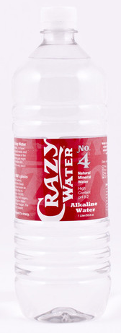
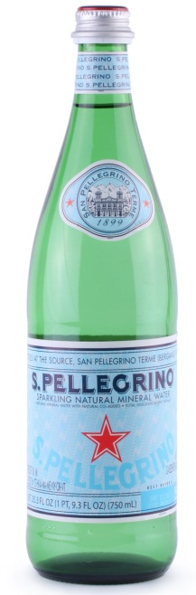
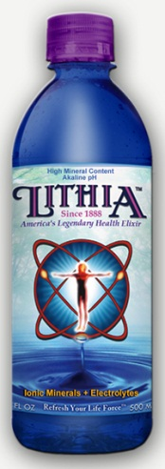
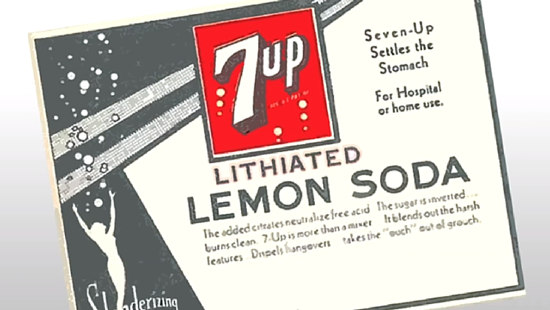
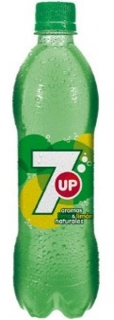
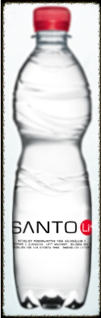

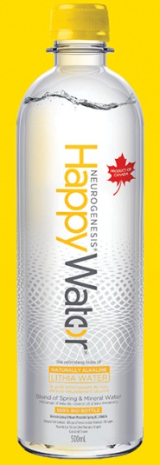
Lithium occurs also at highly varying concentrations (10-10,000 μg/L) in bottled water.
And even historically…..

Slide 6
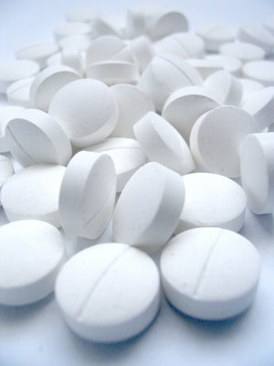
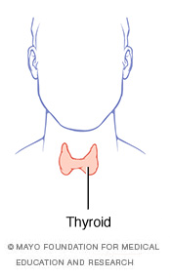
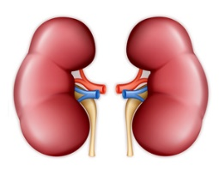
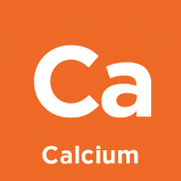
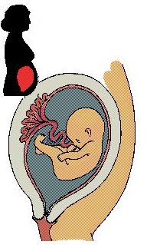
Lithium is used to treat bipolar disease:
The main adverse effects are:
Kidney impairment and polyuria.
Hypothyroidism and goiter.
Hyperparathyroidism
Li
Li
Li
Li
Li
Li
Li
Li
Li
Li
Li
Li
Li
Adverse effects during pregnancy are:
Malformations
Fetal hypothyroidism and goiter
Prematurity
Grandjean et al, 2013

Slide 7
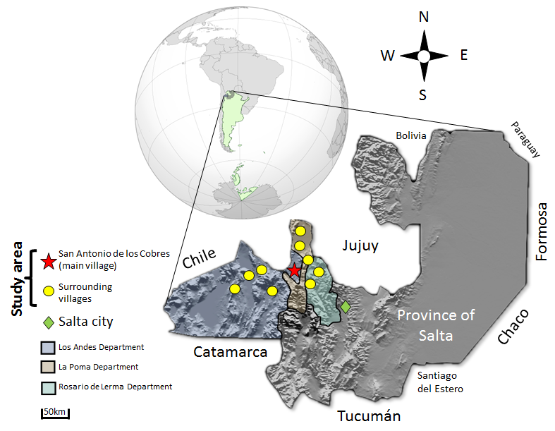
Aim: to investigate the association between environmental lithium exposure with
maternal and infant health.
Drinking water*:
Lithium: 5 - 850 µg/L
Boron: 300 - 7,000 µg/L
Arsenic: 1 - 250 µg/L
Cesium: 1 - 400 µg/L
*Vahter et al 1995,
Concha et al. 2010,
Harari 2015,
Igra et al. 2016

Slide 8
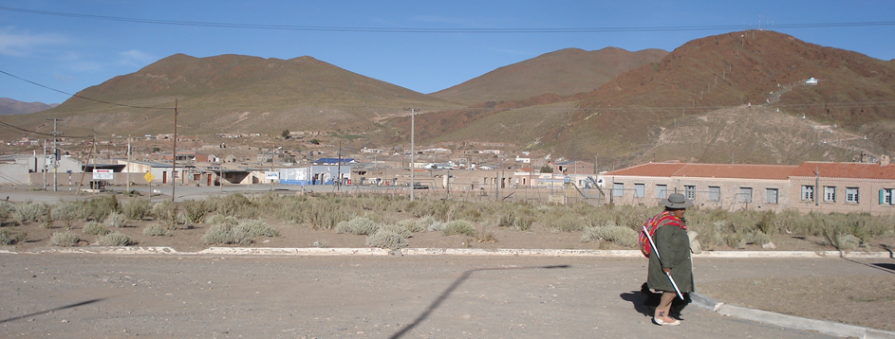
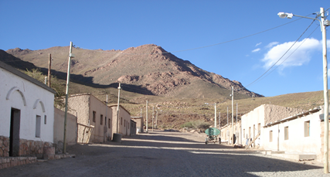
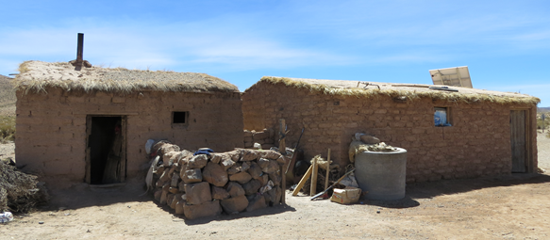
Study area
~8,000 inhabitants
Mostly indigenous
3,200-4,000 masl
Sparsely populated
~200 births/year

Slide 9
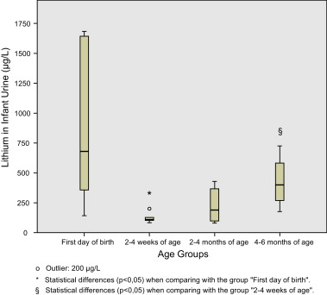
Pilot study (n=10 pregnant women)
The lithium concentrations in the first urine in life were about half of those in maternal urine.
High correlation between maternal and cord blood
Lithium in cord blood (µg/L)
Lithium in infant urine (µg/L)
r_{s}=0.82
First day
of birth
2-4
weeks
2-4
months
4-6
months
Lithium in maternal blood (µg/L)
Harari et al. Rep Tox. 2012
Thus, lithium crosses the placenta.

Slide 10
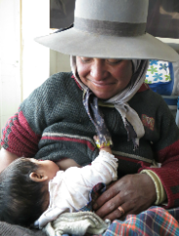
Mother-child cohort in Argentina (N=194; 88% participation rate)
October 2012 to December 2013
Non-smokers
No alcohol
43% coca chewing.
Age 13 to 41 years
Blood, urine, water, ultrasound, anthropometry, questionnaire.
Pregnancy
trimesters
1st
2nd
3rd
Birth
3 months
6 months
Infant age
Cord blood, placenta, anthropometry.
Urine, breast milk, anthropometry, questionnaire
Blood, urine, mouth cells, anthropometry, questionnaire

Slide 11
Lithium in drinking water and maternal health:
Lithium exposure from drinking water during pregnancy has been associated with: impaired maternal thyroid function (higher TSH and lower fT3 and T3). Harari et al. Thyroid. 2015.
TSH
fT3

Slide 12
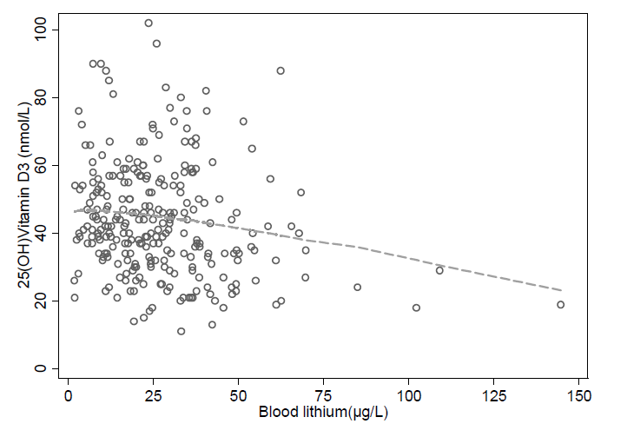
Lithium in drinking water and maternal health (cont).:
Lithium exposure from drinking water during pregnancy has been associated with: altered maternal calcium homeostasis (a 5-times increased risk of vitamin D3 deficiency). Harari et al. Env Res. 2016
-6.1 nmol/L (95%CI -9.5; -2.6)
for a 25 μg/L increase in blood lithium.

Slide 13
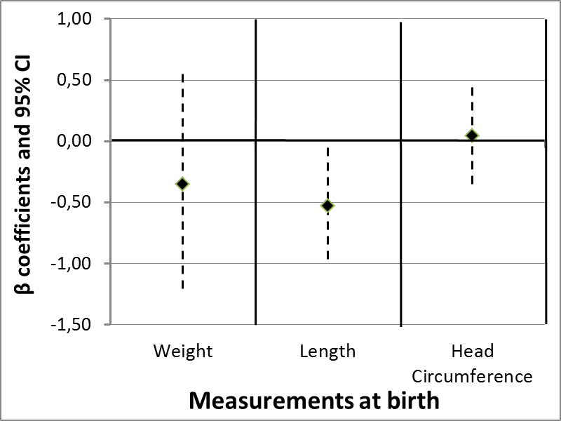
Lithium in drinking water and infant health:
Lithium exposure during pregnancy was associated with impaired fetal size: newborns of mothers in the highest tertile of exposure were 0.8 cm shorter compared to those in the lowest tertile. Harari et al. Env Int. 2015

Slide 14
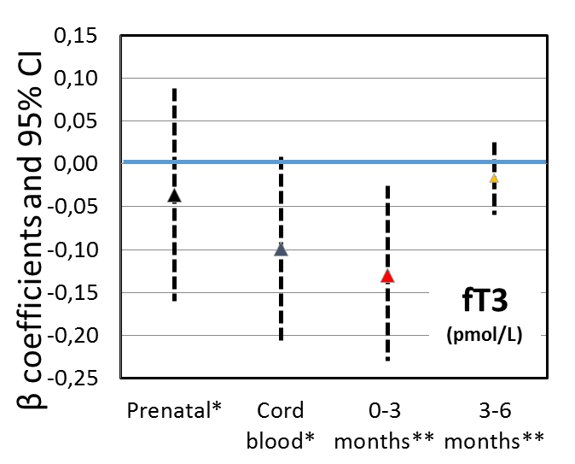
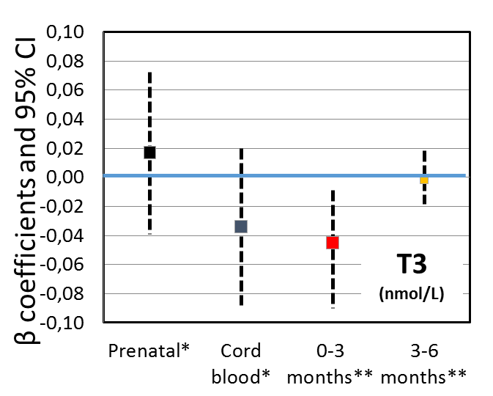
Lithium in drinking water and infant health:
Inverse associations between infant urinary lithium (0-3m) and fT3 and T3
Borderline inverse associations between cord blood lithium and fT3 and T3.
Lithium (μg/L) in: | Median (range)
Maternal blood | 25 (1.9-145)
Cord blood | 47 (11-147)
Infant urine (0-3m) | 70 (3.0-864)
Infant urine (3-6m) | 200 (21-1995)
Models adjusted for age, U-iodine and selenium, infant sex, excl. breastfeeding.
*Change per 10 μg/L increase in maternal or cord blood lithium.
**Change per 50 μg/L increase in infant urinary lithium.

Slide 15
General conclusions
Elevated exposure to lithium through drinking water during pregnancy may adversely affect prenatal development, possibly through disruption of the thyroid and calcium systems.
Lithium seems to have endocrine disruption properties.
If confirmed in other and larger studies, the findings have implications for the public health.
Reinforce the need for thorough screening of lithium concentrations in drinking and bottled water and further evaluation of the health effects.

Slide 16
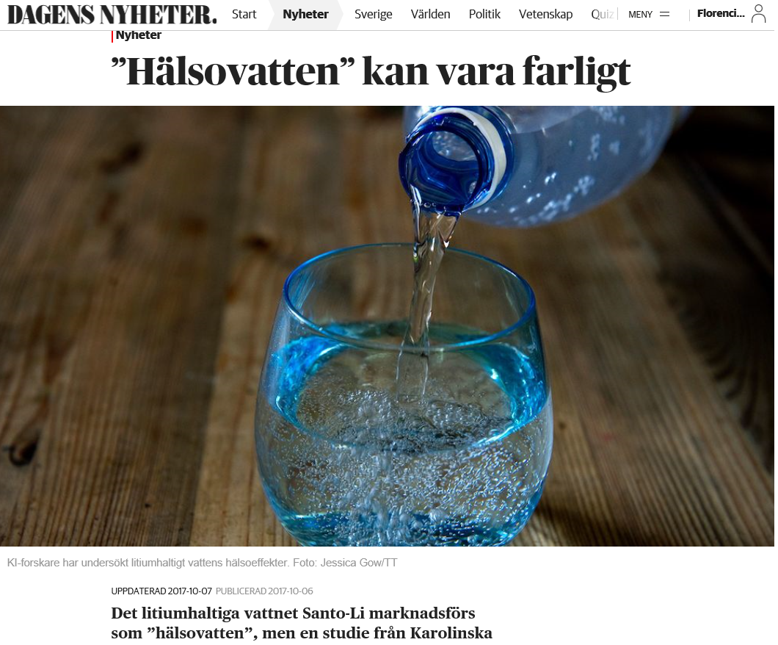
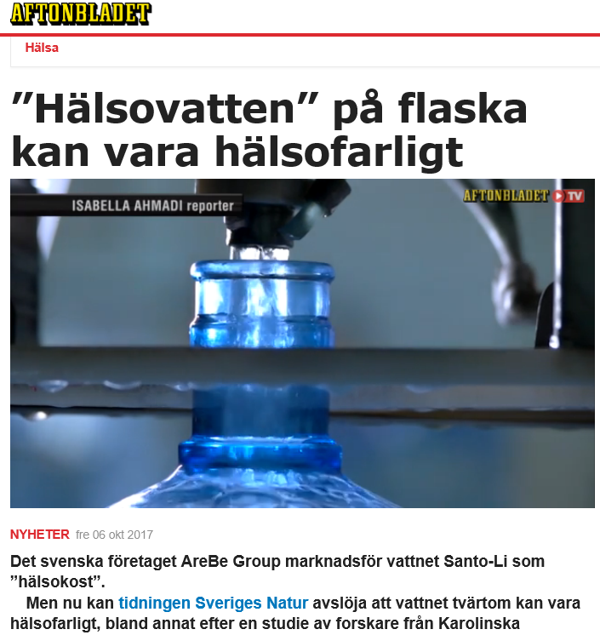
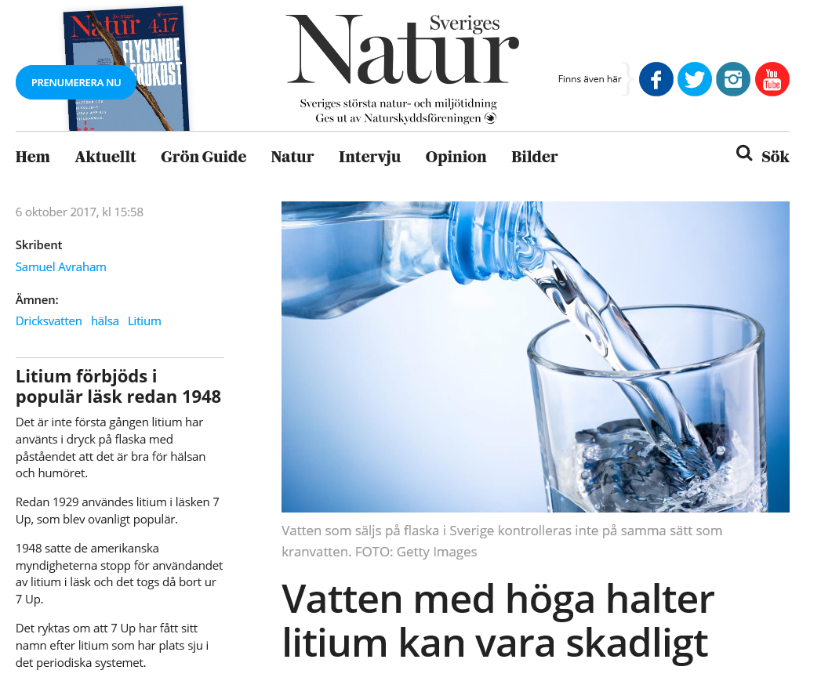
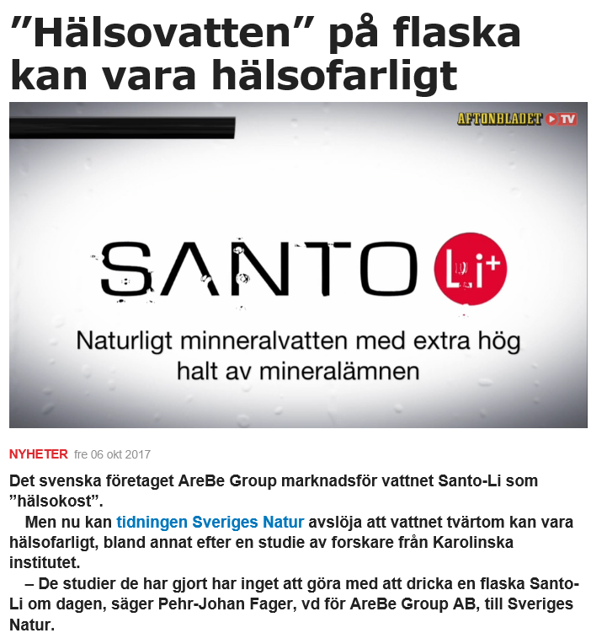
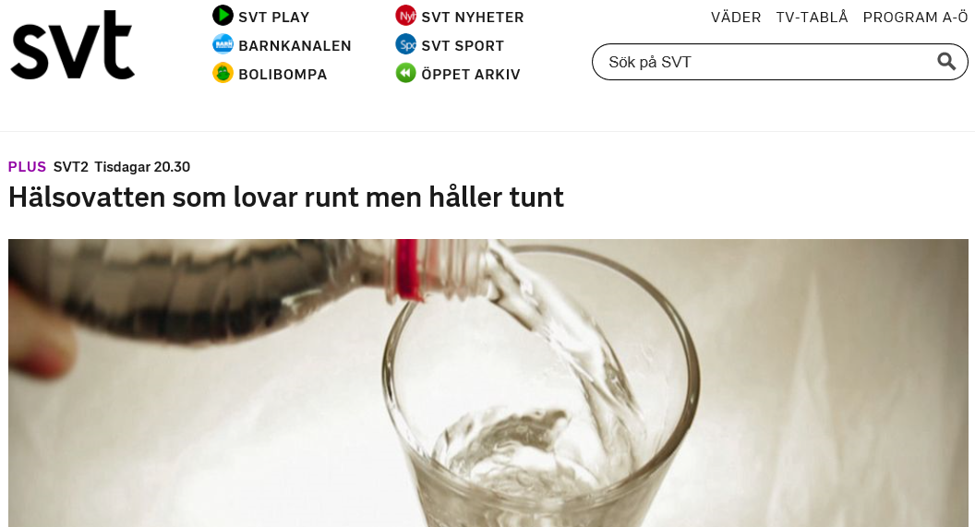

Slide 17
Consequences of the findings:
Attacks from a company commercializing lithium-containing bottled water to stop the dissemination of results and to ask for removal of the articles in the newspapers.
Ministry of Health in Salta, Argentina and local municipality:
Have received continuous reports of the results.
We have measured lithium and other metals in alternative water sources.
Swedish Food Agency:
Review of the available data on lithium in drinking water.
Safe/harmful level? Benefitial level?

Slide 18


Acknowledgments
THANK YOU!
Participating mothers and infants
Hospital Dr. Nicolás Cayetano Pagano, San Antonio de los Cobres, Argentina
Esperanza Casimiro
Graciela Colque
Alicia Soriano
Luis Lima
Wilfredo Medrano
Primary health care workers
Ministry of Health in Salta, Argentina
Alberto Gentile
University of Salta, Argentina
Analía Boemo
INTA institute, Chile
Ana María Ronco
Miguel Llanos
Francisca Castro
Funding agencies:
Institute of Environmental Medicine, Karolinska Institutet, Sweden
Unit of Metals and Health, Nutritional Epidemiology, and Biostatistics
Marie Vahter
Agneta Åkesson
Karin Broberg
Brita Palm
Margaretha Grandér
Helena Nordqvist
Ying Lu
Barbro Nermell
Matteo Bottai
Margareta Langeén
Anna Karin Bernhardsson
National Food Agency, Sweden
Gabriela Concha

Slide 19
Thank you!
Florencia.Harari@amm.gu.se

Slide 21
Thank you!
Florencia.Harari@amm.gu.se

