Slide 1
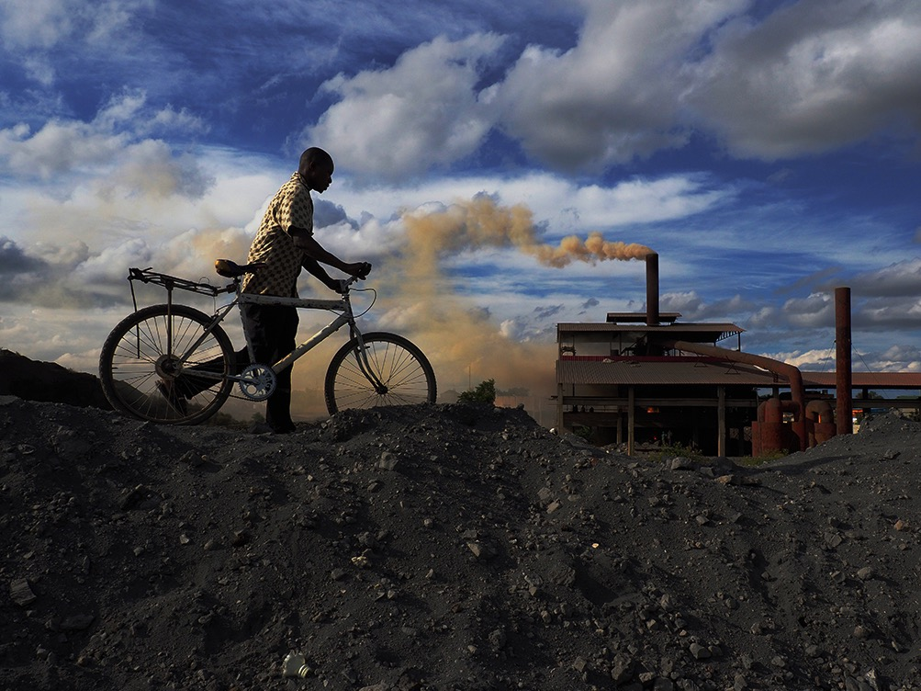

COMMISSION ON POLLUTION AND HEALTH
Notes:
Burden of disease, economic costs, enormous. Solutions are doable. Google can play a big part, using technology

Slide 2
POLLUTION DEFINED
Any material introduced
into the environment
by human activity
that endangers human health or harms living resources and ecosystems.

Slide 3
MAJOR TYPES OF POLLUTION
Household Air Pollution
Soil Pollution
Ambient Air Pollution
Occupational toxins
Water Pollution
Lead
Notes:
Household air pollution;
Ambient air pollution - fine particulate (PM 2.5) pollution and low-level ozone pollution;
Water pollution – unsafe water source and inadequate sanitation;
Soil pollution at active and abandoned industrial and mining sites;
Occupational exposures to toxic chemicals and pesticides; and
Lead

Slide 4
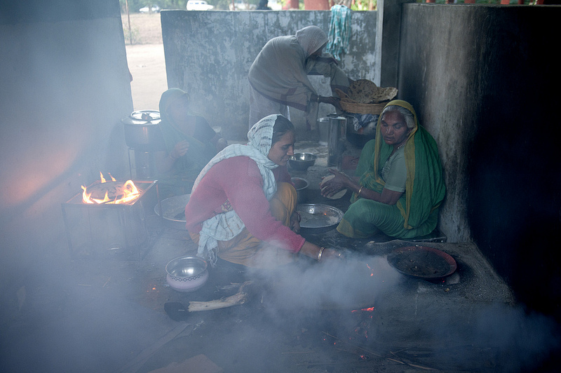
HOUSEHOLD AIR POLLUTION
KILLS ALMOST 3 MILLION PER YEAR

Slide 5
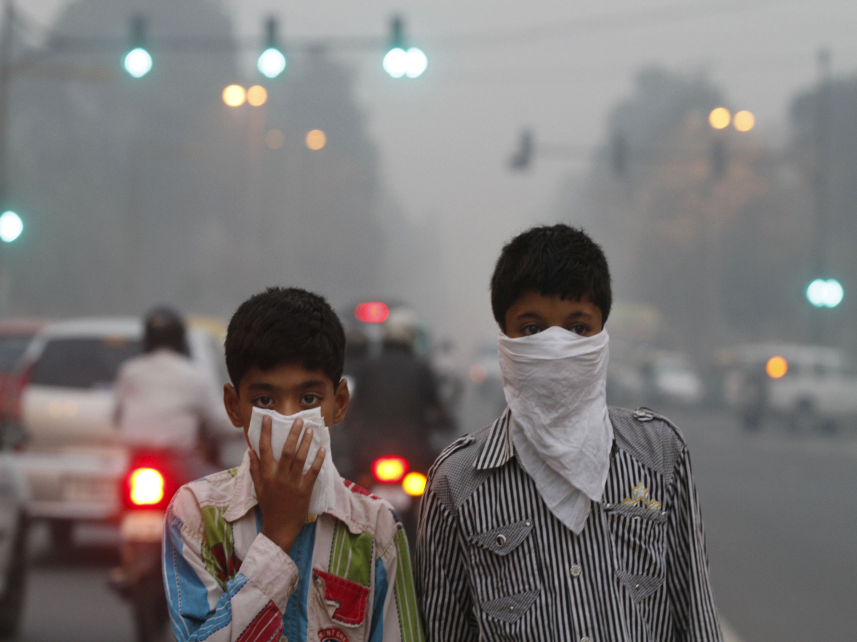
AMBIENT AIR POLLUTION
KILLS ABOUT 4 MILLION PER YEAR
Beijing air pollution in 2012
Delhi is now worse
Notes:
Rich

Slide 6
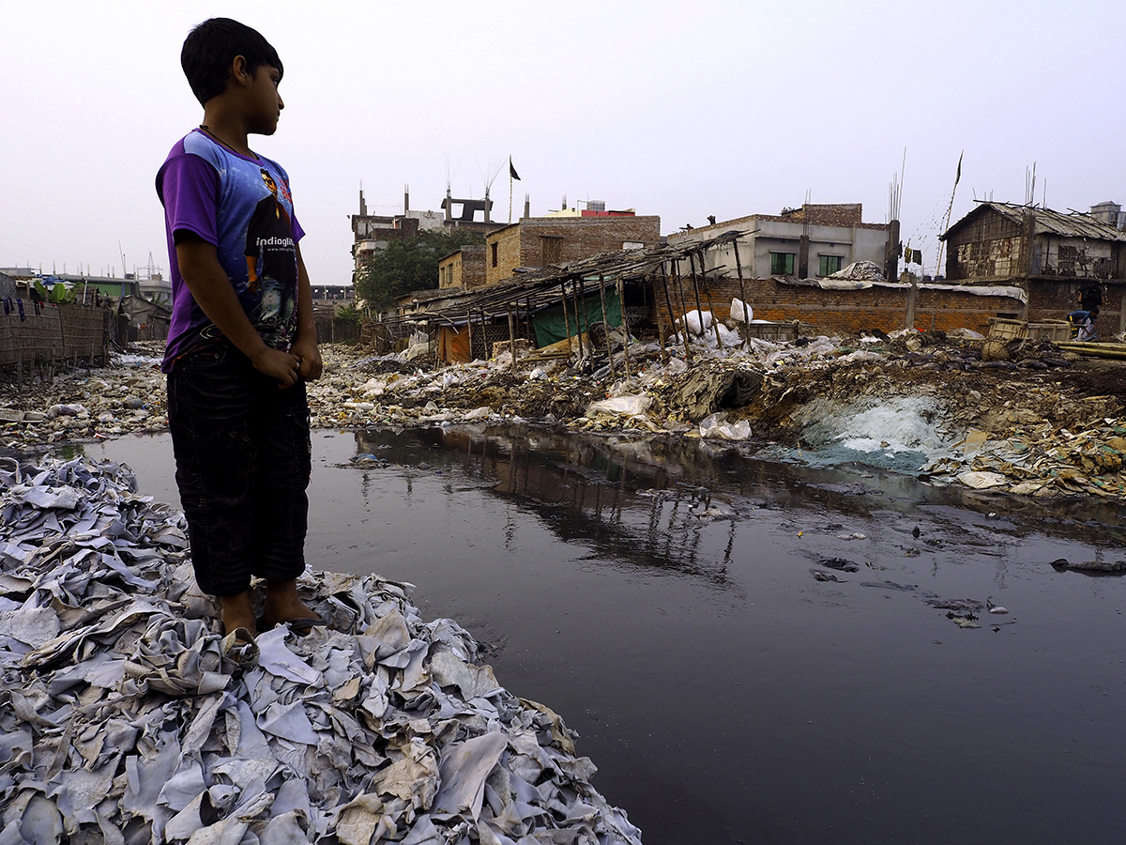
POLLUTED WATER & POOR SANITATION
KILL ABOUT 1.7 MILLION PER YEAR

Slide 7
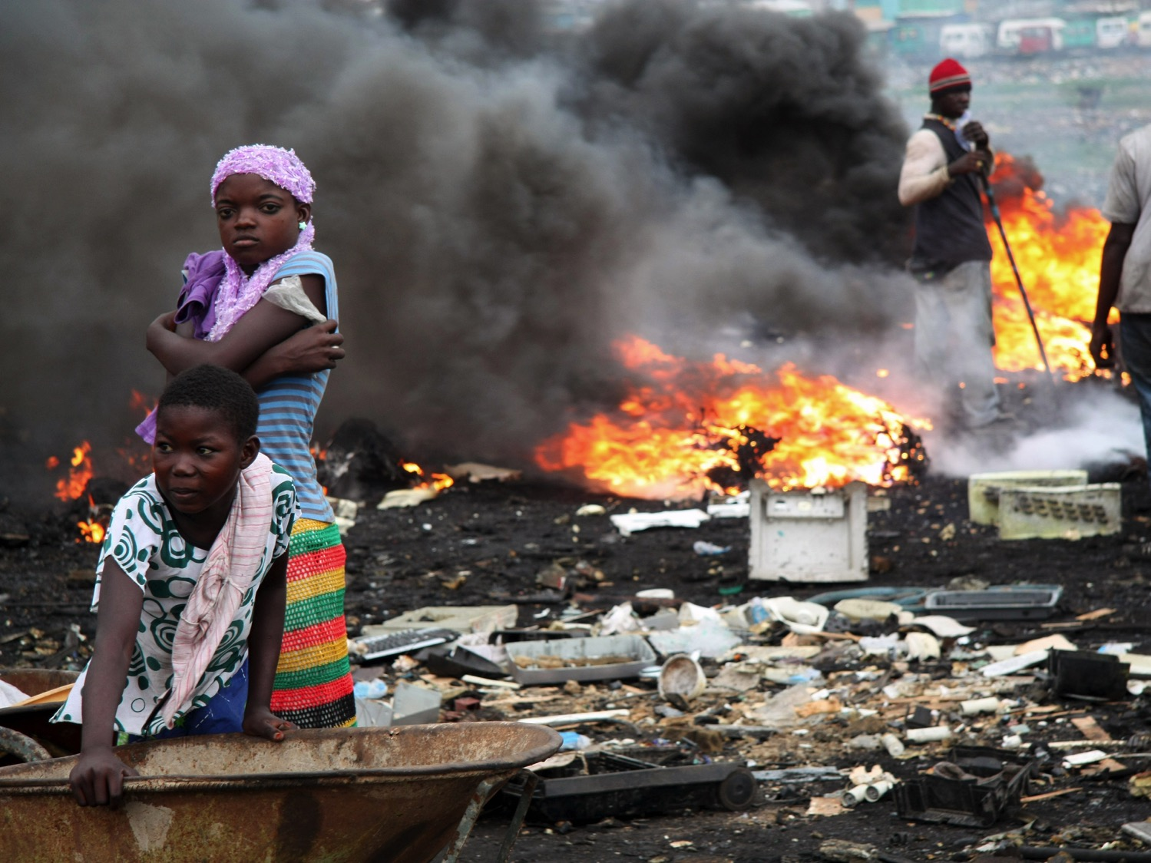
POLLUTED SOIL, CHEMICALS, HEAVY METALS
KILL OVER 1.1 MILLION PER YEAR

Slide 8
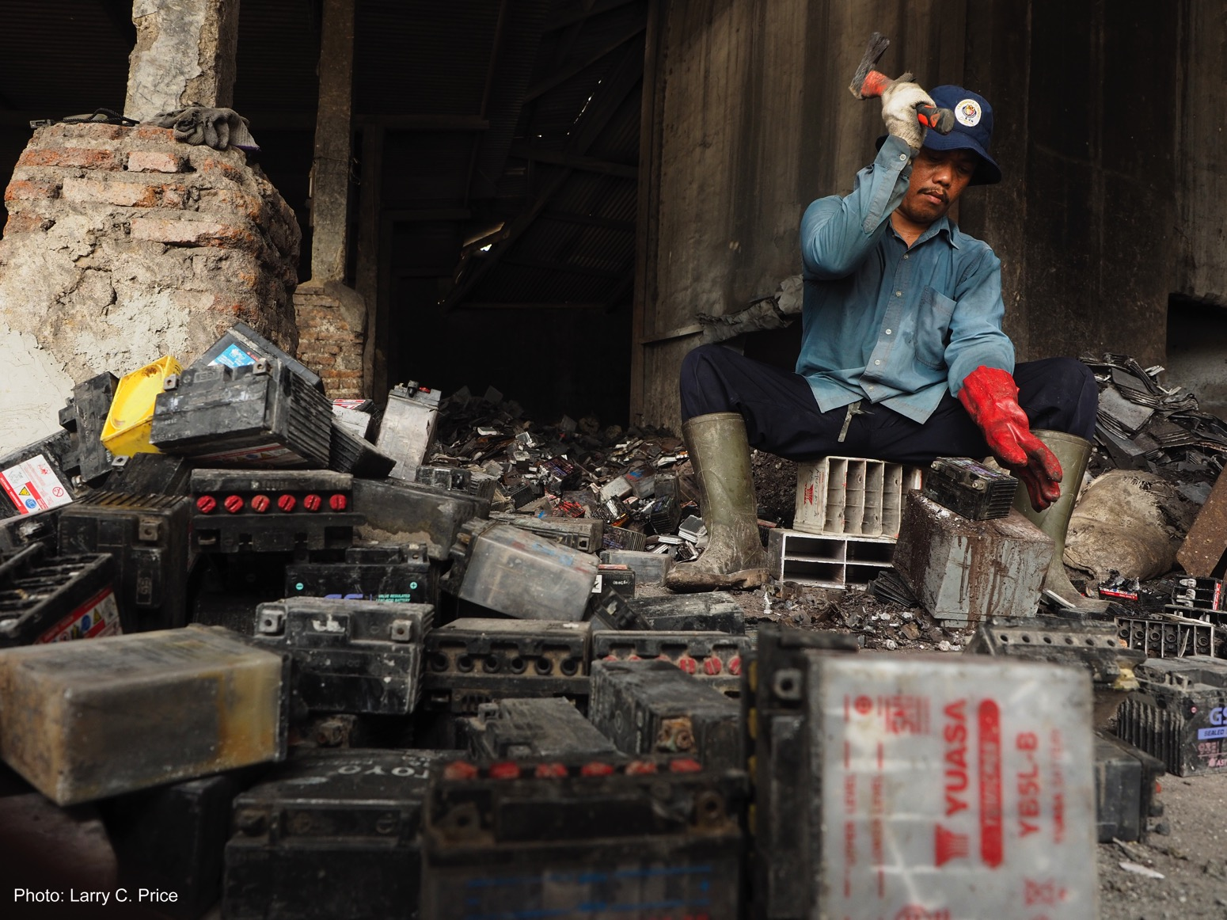
LEAD POISONING
KILLS MORE THAN 500,000 PER YEAR
Notes:
Lead acid batteries are used in cars, solar panels,

Slide 9
COMMISSION’S MAIN HEALTH FINDINGS
Pollution killed an estimated 9 MILLION people in 2015…
3 TIMES MORE than AIDS, tuberculosis and malaria combined.
Notes:
Pollution was responsible in 2015 for 268 million DALYs—254 million years of life lost and 14 million years lived with disability.
Air pollution – 6.5 million deaths
Water pollution 1.8 million deaths
Soil pollution – 0.5 million deaths
Occupational pollution 0.8 million deaths
Lead – 0.5 million deaths

Slide 10
DEATHS FROM POLLUTION VERSUS OTHER MAJOR RISK FACTORS
Notes:
Pollution – The Largest Causes of Premature Death
There are two other combined risk factors that are also about 10 million. All dietary risks, and hypertension. These are (somewhat) self-inflicted requiring behavioral solutions. Pollution is (mostly) imposed on others

Slide 11
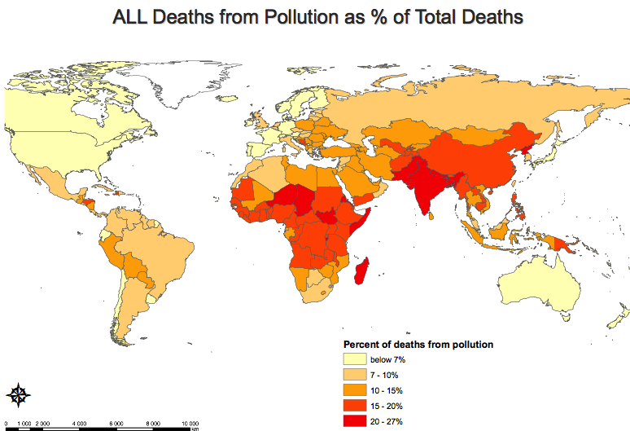
POLLUTION-RELATED DISEASE FALLS MOST HEAVILY ON LOW- AND MIDDLE-INCOME COUNTRIES

Slide 12
DEATHS DUE TO AIR, SOIL AND CHEMICAL POLLUTION ARE RISING
Main Drivers:
Urbanization
Globalization
Motor vehicles
Source GBD study, 2016

Slide 13
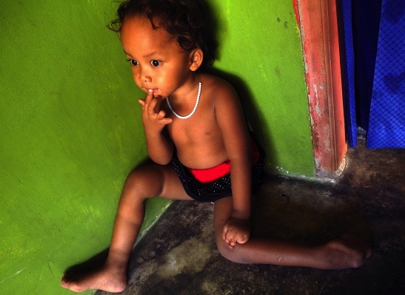
CHILDREN ARE EXQUISITELY SENSITIVE
Greater exposure proportionate to body mass
7 times more water per Kg per day; Hand-to-mouth activity
Diminished ability to detoxify many chemicals
Heightened biological vulnerability—e.g. thalidomide, DES, fetal alcohol syndrome, lead
More years of future life
Notes:
Modern pollution not well researched:
Burden of Disease underestimated
Soil and chemicals—very limited coverage: only lead exposures from gasoline phase-out
Other toxins NOT included in estimates
Mercury, arsenic, chromium, asbestos
Pesticides
Endocrine disruptors

Slide 14
70 PERCENT OF POLLUTION-RELATED DISEASE IS NON-COMMUNICABLE DISEASE
Communicable vs. Non-communicable Disease and Pollution
12,000,000
10,000,000
8,000,000
6,000,000
4,000,000
2,000,000
0
Notes:
Note - not in Lancet report

Slide 15
THE POLLUTOME: WHAT WE KNOW AND DON’T KNOW ABOUT POLLUTION
Numbers of pollution-related deaths currently included in GBD
ESTIMATES BY ZONE
Well characterized health effects of well-studied pollutants. Data included in GBD estimates and in Commission report.
Zone 1: 9 MILLION
Zone 2: NONE
Emerging, but still unquantified health effects of known pollutants. Data not included in GBD estimates or in Commission report.
Zone 3: NONE
Inadequately characterized health effects of emerging pollutants. Data not included in GBD estimates or in Commission report.

Slide 16
EMERGING CHEMICAL POLLUTANTS
Developmental neurotoxicants
Endocrine disruptors
Novel classes of insecticides such as the neonicotinoids
Chemical herbicides
Pharmaceutical wastes
Notes:
Far too little is known about the global distribution of these chemicals, patterns of exposure, and disease burden

Slide 17
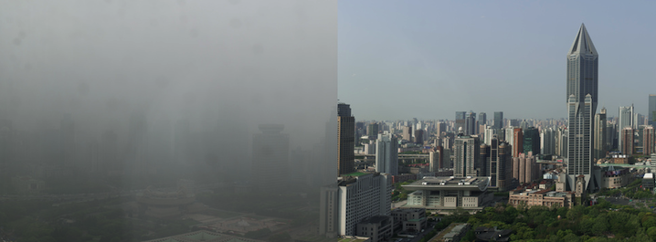
CLIMATE CHANGE & POLLUTION INEXTRICABLY LINKED
Tackling pollution benefits long-term climate goals and short-term health goals
Notes:
Some greenhouse gases (carbon black/soot/PM2.5) are toxic
High carbon intensity industries are often highly toxic as well
Electricity generation, especially coal
Transportation – mobile sources of particulates
Mining and deforestation
Chemical manufacture

Slide 18
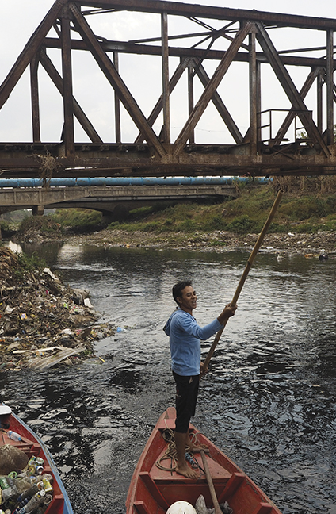
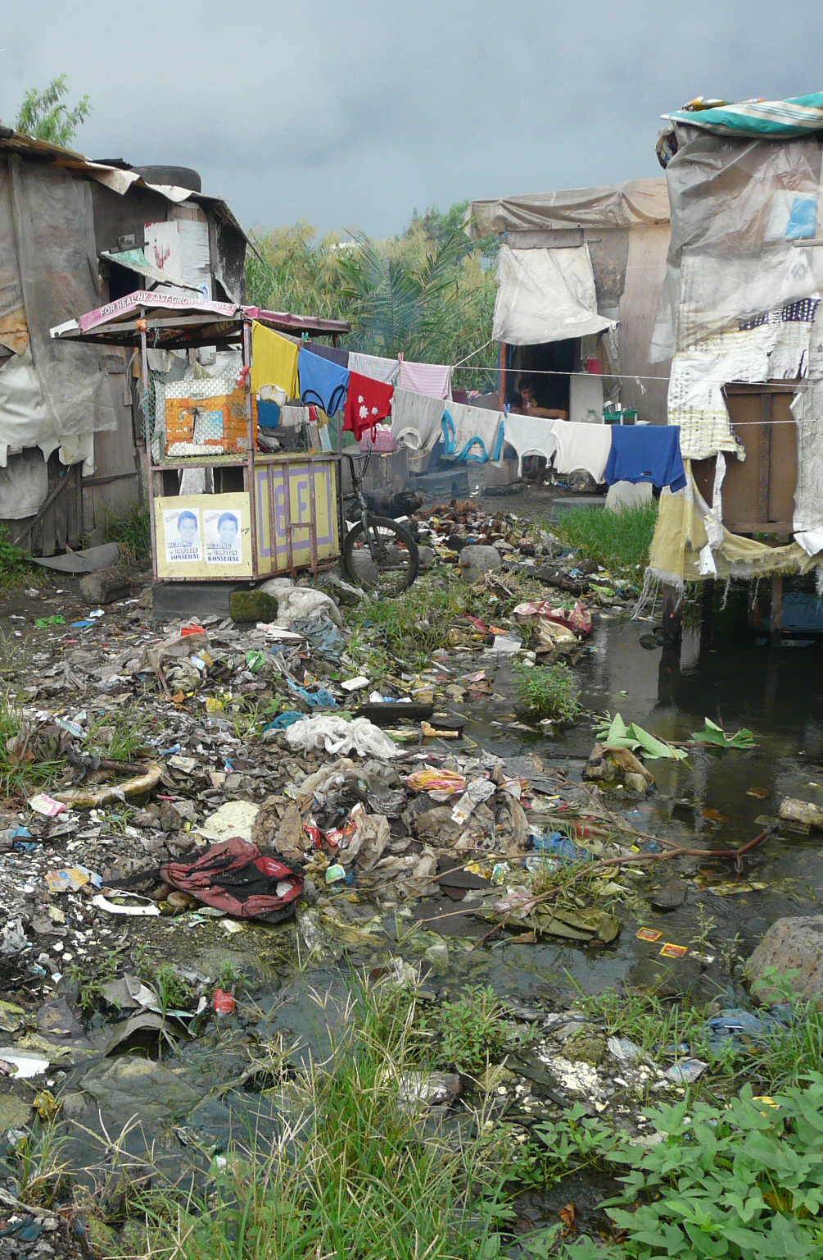
SECTION II Economic Impact of Pollution

Slide 19
COMMISSION’S MAIN ECONOMIC FINDINGS
Up to 2% of GDP in low- and middle-income countries from loss of productivity. A drain on growth that can undercut national development.
Health care costs. 1.7% of health care spending in high-income countries; up to 7% in rapidly industrializing, heavily polluted countries
These are costs associated with premature mortality and exclude costs of morbidity
Additional costs resulting from environmental degradation not counted in this analysis

Slide 20
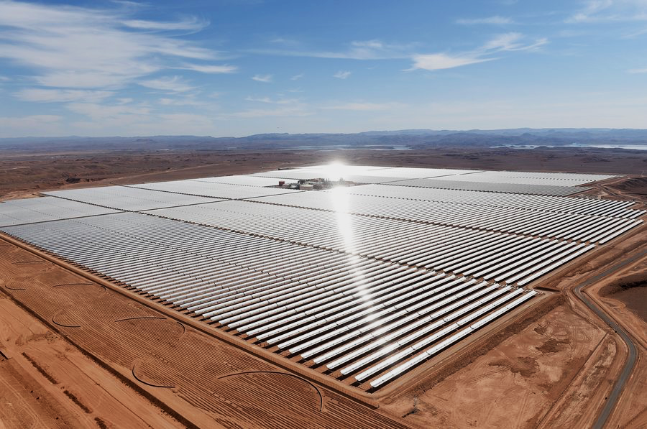
POLLUTION IS NOT INEVITABLE
Kuznets Curve Hypothesis does not hold for toxic pollution
Notes:
Kuznets curve hypothesis (you must go through a polluting phase to grow) does not hold for toxic pollution

Slide 21
SECTION III Pollution, Poverty and Injustice

Slide 22
POLLUTION IS A HUMAN RIGHTS ISSUE
In countries at all income levels, pollution disproportionately affects the poor and marginalized
Notes:
92% of deaths from pollution-related disease occur in low- and middle-income countries
In countries at all income levels, pollution disproportionately affects the poor and marginalized
Women, children, the elderly and minorities are the main victims
Contrast these sad realities with Pope Francis’ visionary social and environmental teaching in his encyclical, Laudato Si’

Slide 23
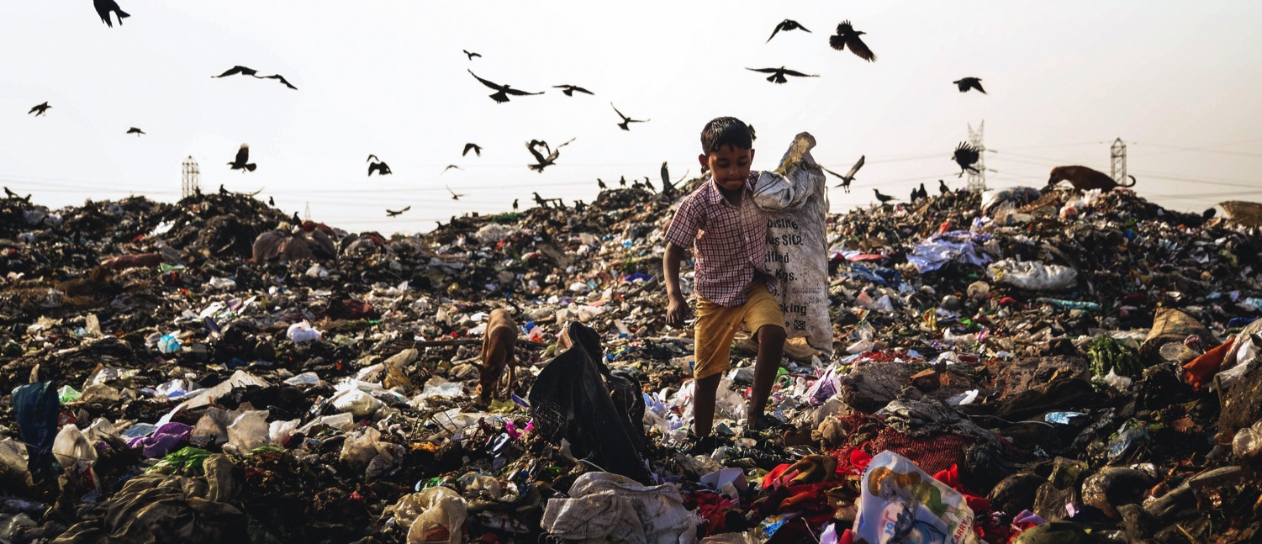
POLLUTION, HUMAN RIGHTS AND ENVIRONMENTAL INJUSTICE
Pollution affects the rights of the child, the right to safe work, and protection of the most vulnerable
Notes:
Pollution threatens the human right to life, health and well-being
It affects the rights of the child, the right to safe work, and protection of the most vulnerable
Many countries recognize the right to a healthy environment
Violating these rights often reflects environmental injustice

Slide 24

POLLUTION IS A HUMAN RIGHTS ISSUE
Contrast the tragic realities of pollution with Pope Francis’ visionary social and environmental teaching in his encyclical, Laudato Si’

Slide 25






GOAL 3.9
“By 2030, substantially reduce the number of deaths and illness from hazardous chemicals and air, water and soil pollution and contamination.”
Notes:
Progress on pollution advances all SDGs, especially
Goal 1: end poverty
Goal 6: clean water
Goal 11: sustainable cities
Goal 12: responsible production and consumption
Goal 13: slow climate change – Progress toward SDG 13 will help to control pollution

Slide 26
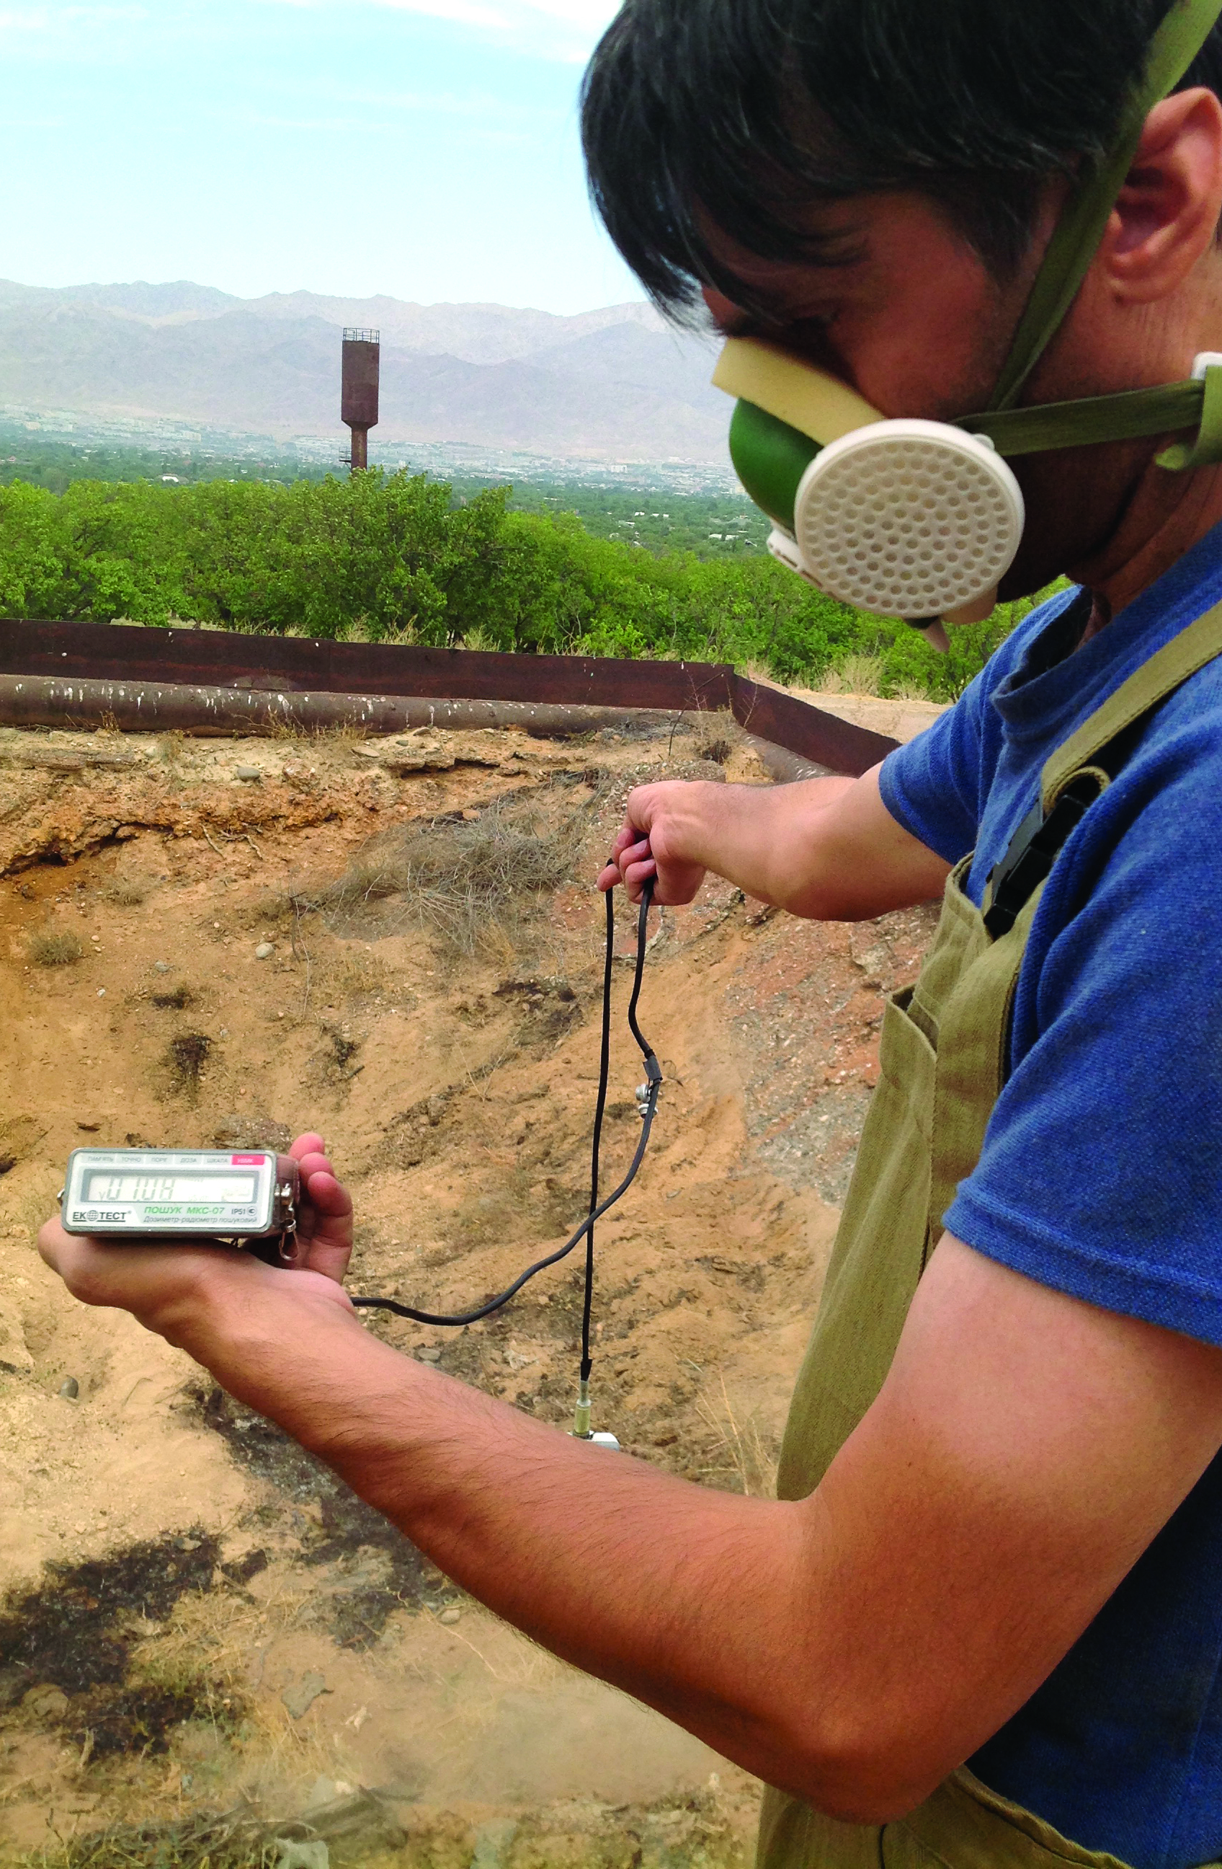
SECTION IV Effective Interventions

Slide 27
IMPACTS ARE UNDERCOUNTED, SOLUTIONS ARE UNDERFUNDED
Deaths (millions)
US$ (millions)
Notes:
Urban air pollution – just beginning as a focal area
Soil - only some chemicals partially funded (pesticides, mercury, others)
GBD studies don’t include most diseases from toxins in soil and water
LMICs lack national data, demand is low

Slide 28
POLLUTION CONTROL AND GDP, UNITED STATES, 1970-2015
GDP GREW BY 250%, WHILE AIR POLLUTION FELL BY 70%

Slide 29
POLLUTION CAN BE CONTROLLED AND PREVENTED
High-income and some mid-income countries are making good progress against pollution
These countries have implemented science-based control strategies based on law, policy and technology backed by effective regulation
The long-term solution is transition toward a more sustainable, less wasteful economic paradigm – renewable energy, public and active transport, clean technology, green chemistry
Notes:
Modern pollution is the product of a ‘take-make-use-dispose’ economic paradigm that Pope Francis has termed a “throwaway culture”.
Pollution can be sharply reduced by transition toward a more sustainable, less wasteful economic paradigm.
High-income and some mid-income countries are making good progress against pollution and have developed and implemented cost-effective control strategies based on law, policy and technology.
These strategies are ready to be exported globally

Slide 30
POLLUTION CONTROL YIELDS GREAT ECONOMIC BENEFITS
Control of ambient air pollution in the United States yields about $30 in benefits for every $1 invested
An aggregate benefit of $1.5 trillion against an investment since 1970 of $65 billion
Removal of lead from gasoline has added billions of dollars to economies around the world
Notes:
Control of ambient air pollution in the United States yields about $30 in benefits for every dollar invested (95% CI $4 - $88).
An aggregate benefit of $1.5 trillion against an investment since 1970 of $65 billion
Removal of lead from gasoline has added billions of dollars to economies around the world through the increased intelligence and economic productivity of lead-free generations

Slide 31
PROJECTS TO ACHIEVE HEALTH OUTCOMES
AIR Indoor air— move to cleaner fuels, clean cooking.
WATER Sanitation investments, full WASH
WORKPLACE Bring in international good practices
AMBIENT AIR control large point source, establish clean fuels, etc.
SOIL, CHEMICALS, METALS Identify priorities, clean up urgent hotspots
Notes:
Photos of projects

Slide 32
WHY HAS PROGRESS AGAINST POLLUTION BEEN SO SLOW?
Few have been aware of pollution’s huge impacts
Pollution's diseases and costs are invisible – hidden in plain sight
Fragmentation of the pollution control agenda
Political will often lacking
Push-back by powerful vested interests – merchants of doubt
Insufficient financial resources
Notes:
Civil society a critical role

Slide 33
RESEARCH
1
Quantify the global burden of disease associated with chemical pollutants of known toxicity— lead, mercury, chromium, arsenic, asbestos, and benzene.
2
Discover diseases caused by new and emerging chemical pollutants
.
3
Economic research
4
Country-specific/local research
Notes:
Phil

Slide 34
TRACKING FUTURE PROGRESS
Pollution and Health—follow up on Lancet report
Metrics related to interventions
Burden of Disease
Exposure
Investments undertaken
Regulatory structures and implementation
Efficacy of solutions, knowledge transfer
Aggregating data from others (SDG’s, etc.) relevant to pollution

Slide 35

THANK YOU!

Slide 36
DATA SOURCES
Institute for Health Metrics and Evaluation 2015 Global Burden of Disease analysis
World Health Organization 2012 Burden of Disease analysis
Pure Earth/GAHP Toxic Sites Inventory Soil pollution at contaminated sites

