Slide 1
Scientific integrity in journal publication practice for Occupational and Environmental Health
L London, School of Public Health and Family Medicine, University of Cape Town
K Ruff, RightOnCanada
B Castleman, Environmental Consultant, USA
A Watterson, Centre for Public Health and Population Health Research, University of Stirling

Slide 2
Background
Journal publication + rigorous peer-review critical to disseminating new scientific findings
→ Evidence for appropriate public health action.
Therefore, publication integrity essential
Health policies should be free of vested interests
However, increasing pressure on journals from third parties, particularly corporate interests

Slide 3
Research into journal publication bias
Friedman and Friedman, 2015:
Review of 373 OEH papers in 17 journals
17.2% had a financial COI
Articles with financial COI more likely to report null results:
If COI involved processing of industrial and commercial products: OR = 4.3 (95% CI (2.5–7.4)
If COI with military employers: OR = 9.2 (CI 2.7- 30.7)
Resnik reviewed 224 EOH journals in 2017:
96% require COI disclosure
76% defined COI
69% included non-financial disclosure
34% applied COI to editors and reviewers
32% mandated discussion of funding source role
2% enforcement

Slide 4
Where is the firewall?
https://www.elsevier.com/__data/assets/pdf_file/0010/92476/ETHICS_COI02.pdf

Slide 5
Committee on Publication Ethics (COPE)
Established to provide guidance for editors, journals, publishers
Guidelines to New Editors
Code of Conduct for Publishers
Guideline for Ethical Editing
Transparency
Guideline on Retraction
Relationship of Journal to Research Institutions
Journal membership of COPE gives credibility
Forum for members to discuss individual cases
Receive and deal with complaints

Slide 6
COPE Code of Conduct
Duties and responsibilities of editors include:
Maintain the integrity of the academic record;
Preclude business needs from compromising intellectual and ethical standards;

Slide 7

The International Journal of Occupational and Environmental Health (IJOEH)
Long history of peer-reviewed articles critical of industry bias in research
Taylor and Francis take over journal in 2015
Existing editor’s contract ends Dec 2016
Journal appoints corporate consultant as new editor sans consulting editorial board
New Editor associated with Toxicology Excellence for Risk Assessment (TERA)
In Feb, Editorial Board wrote to publisher, asked for reasons; pointed to Maier’s record on diacetyl

Slide 8
T&F claim
Jukka Takala was consulted over direction of journal and new editor
Repositioning of journal a result of discussion with Maier “… how we might position the journal to cover the multiple perspectives of this diverse area with an impartial and evidence-based approach. We felt satisfied that he had the right experience and vision for this role…”
Comment on Retraction Watch:
“[Yes], The publisher is concerned that the perspective of industrial polluters has been previously neglected…”
T&F note that they retracted previous article (on Bakelite) because it was “inadvertently published before the review process was completed, and was subsequently decided to be unsuitable for publication.” Three further accepted articles flagged up as “raising potential concerns.”

Slide 9
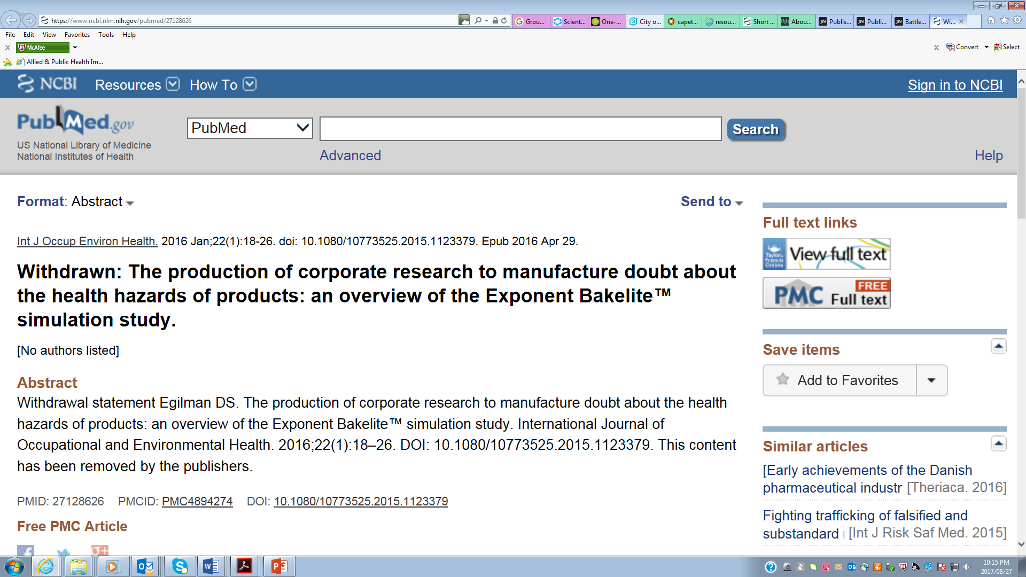
What is the article that was ‘unsuitable?’
Egilman D. The production of corporate research to manufacture doubt about the health hazards of products: an overview of the Exponent Bakelite™ simulation study. IJOEH 2016 22:18-26.
New editor denies any involvement in retraction
“This content has been removed by the publishers…”

Slide 10
COPE Guideline | What took place?
New Editors should honour previous publication decision unless ‘serious problems’ | Previous publication withdrawn; 3 more? No reasons given; no evidence ‘serious problems’
Decide without interferences from publisher | Publisher made decision – editor claimed no part in decision
Relationship editor to publisher independent | Editor unable to exercise independence
Retraction only if serious: | No evidence of any misconduct, serious error, redundancy, plagiarism, unethical
Retraction only last resort | No discussion with author at all
Editors should champion freedom of expression | Implied legal/libel issues at stake
Preclude business needs from compromising intel standards | Implied legal/libel issues at stake
Keep editorial board members ‘updated on new policies’ | T&F repositioned journal as less critical of industry without informing editorial board

Slide 11
Progress?
Complaint lodged with COPE June 2nd
Follow up inquiries … “Thank you for your email, I confirm the case has been reviewed by the COPE Complaints subcommittee, the subcommittee is considering the next steps and intends to discuss the matter with the publisher. I will be in touch as the evaluation of the case progresses…”
October 2017 – no response T&F

Slide 12
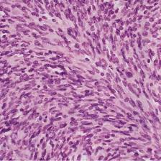
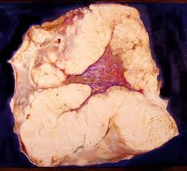
Asbestos and disinfomation in clinical journals

Slide 13
European Journal of Cancer Prevention
In May 2012 the European Journal of Cancer Prevention (EJCP) published an article* denying harm caused by continuing exposure to asbestos
The authors stated they had no COI and that the article had been funded by the Italian Cancer Research Association
Both statements were untrue:
Both authors were paid consultants for a company facing criminal charges for continuing asbestos exposure of workers.
The Italian Cancer Research Association had not funded the article.
Complaint to EJCP (a COPE member) - violated COPE's Code of Conduct
Editors responded – see no COI; authors reaffirmed no COI
March 2014: complaint submitted to COPE for several violations of COPE's Code of Conduct
October 2014: COPE upheld the complaint stating that the authors had a COI which should have been declared
*La Vecchia C, Boffetta B. Role of stopping exposure and recent exposure to asbestos in the risk of mesothelioma

Slide 14
COPE does not enforce its Code of Conduct
COPE recommended that the EJCP publish a Correction to disclose the authors' COI
COPE stated that they knew the publisher could ignore the recommendation and there would be no consequences
COPE makes recommendations in response to complaints but does not require COPE members to comply
In this case, the EJCP published the Correction

Slide 15
The practice of publishing in E&OH …
PubMed search on “occupational”, “hazards” and “pesticides” to general journal sample.
Published ≥1997; English-language
Yield 222 articles from 114 journals
Dropped journals with only 1 paper; not English lang
Ended with 34 journals (137 articles)
Analysis for:
COPE membership
Editorial independence
CoI process
Enforcement

Slide 16
COPE adherence | Enforcement
Membership of COPE: 74% | Any specific enforcement measures 15%
Editorial independence made explicit: 0% | Erratum:12%
Provide for CoI 88% | Retraction: 12%
CoI defined financial 88% | Intervene with employer 6%
CoI defined non-financial 56% | ‘ban’ repeat offender 3%
 | Rely on COPE guideline for enforcement 38%
Caveats: a) review of websites only – limited info; b) website review not contemporaneous with journal article publication

Slide 17
Discussion
A set of Failures:
failure of conflict of interest processes;
failure to enforce corrective action once problems were identified
pervasive influence of third parties over editorial decisions
non-transparency
failure of oversight mechanisms
COPE too slow, too weak, no enforcement
Yet, usually most journals rely on COPE as members and to take care of ‘enforcement’!!

Slide 18
Conclusion
Corporate interests continue to threaten the integrity of scientific publication.
Failure to keep at bay corporate intrusion into journal publication is a threat to the unbiased dissemination of evidence
Threatens the rights of people to enjoy the benefits of scientific progress.

