Slide 1



Italian pool of asbestos workers cohorts:
mortality trends of asbestos related neoplasms
D.Ferrante (1), E.Chellini (2), E.Merler (3), V.Pavone (4), S.Silvestri (5), L.Miligi (2), G.Gorini (2), V.Bressan (3), P.Girardi (3), L.Ancona (6), E.Romeo (6), F.Luberto (7), O.Sala (8), C.Scarnato (4), S.Menegozzo (9), E.Oddone (10), S.Tunesi (1,11), P.Perticaroli (12), A.Pettinari (12), F.Cuccaro (13), S.Mattioli (14), A.Baldassarre (15), F.Barone-Adesi (16), T.Cena (1), P.Legittimo (14), A.Marinaccio (17), D.Mirabelli (11), M.Musti (15), R.Pirastu (18), A.Ranucci (1), C.Magnani (1, £), and the working group

Slide 2
¹ Unit of Medical Statistics and Epidemiology, Dept Translational Medicine, Univ. Eastern Piedmont, and CPO-Piemonte, Novara.
² Occupational & Environmental Epidemiology Unit - Cancer Prevention and Research Institute (ISPO), Florence.
³ Mesothelioma Register of the Veneto Region, Local Health Unit. Padua
⁴ Department of Public Health, Prevention and Security Area Work Environments, Local Health Authority, Bologna.
⁵ Cancer Prevention and Research Institute (ISPO), Florence.
⁶ Department of Epidemiology, Lazio Regional Health Service, Rome.
⁷ Inter-institutional Epidemiology Unit, AUSL Reggio Emilia and Arcispedale Santa Maria Nuova, IRCCS, Reggio Emilia.
⁸ ARPAE Emilia Romagna, Sezione Provinciale di Reggio Emilia, Reggio Emilia.
⁹ National Cancer Institute IRCCS Fondazione Pascale, Napoli.
¹⁰ Department of Public Health, Experimental and Forensic Medicine, University of Pavia, Pavia.
¹¹ Unit of Cancer Epidemiology, CPO Piemonte and University of Turin, Turin.
¹² Prevention Department, ASUR Marche, Senigallia.
¹³ Unit of Epidemiology and Statistics -Local Health Unit of Barletta-Andria-Trani , Barletta.
¹⁴ Dept Medical and Surgical Sciences, University of Bologna, and Unit of Occupational Medicine, …. , Bologna.
¹⁵ Interdisciplinary Department of Medicine, Occupational Medicine “B. Ramazzini”, University of Bari, Bari.
¹⁶ Department of Pharmaceutical Sciences, University of Eastern Piedmont, Novara.
¹⁷ INAIL, Department of Occupational and Environmental Medicine, …., Italian Mesothelioma Register, Rome.
¹⁸ Department of Biology and Biotechnologies “Charles Darwin”, Sapienza Rome University, Rome
¹⁹ Cancer Institute IRCCS Giovanni XXIII, Bari.
²⁰ Regional Health Agency of Puglia, Bari

Slide 3

U.O.2, UPO: Studi sull’evoluzione nel tempo del rischio di patologia da amianto tra gli ex-esposti

Slide 4
AIMS:
Pool existing cohorts of asbestos workers with long period of observation, in different sectors
Update and analyze asbestos related risks
Interest on time related trends, in particular cumulative exp. and latency
Risks in women

Slide 6
 | Men |  | Women |  | Total
 | n | % | n | % | p-y*
Asbestos-cement | 10,714 | 23.3 | 2,362 | 41.1 | 388,915
Rolling stock constr. maint. | 23,099 | 50.1 | 711 | 12.4 | 755,034
Shipyards | 5,099 | 11.1 | 21 | 0.4 | 172,583
Glassworks | 2,966 | 6.4 | 761 | 13.2 | 105,446
Insulation | 205 | 0.4 | - | - | 6,482
Ship furniture | 1,150 | 2.5 | 20 | 0.3 | 36,957
Dockyards and harbours | 1,938 | 4.2 | 1 | 0.02 | 62,102
Asphalt rolls production | 341 | 0.7 | 72 | 1.2 | 14,429
Industrial ovens const. | 202 | 0.4 | 15 | 0.3 | 7,107
Crocidolite miners | 299 | 0.6 | 1 | 0.02 | 9,314
Domestic exposure | - | - | 1,777 | 30.9 | 55,658
Wks in multiple sectors | 47 | 0.1 |  |  | 1,626
TOTAL | 46,600 |  | 5,741 |  | 1,615,653

Slide 7
Study Data
List of workers in each cohort, with f-u updated to 31.12.2013.
  Sex
  Birthdate
  Date of F-U
  Status at f-u
  Cause of death
  Work periods (date start and end)

Slide 8
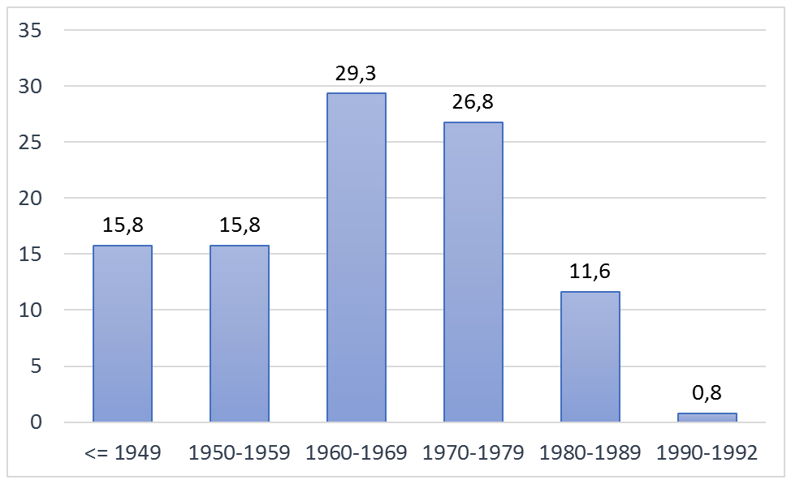
Year of first employment in the cohort (%)

Slide 9
Status at follow up (%)
5% of causes of death were unknown

Slide 10
Mortality
 | Men | SMR (IC95%) | Women | SMR (IC95%)
All causes | 18370 | 1.05 (1.03-1.06) | 2503 | 1.17 (1.12-1.22)
Malignant Neopl. | 7361 | 1.17 (1.14-1.20) | 818 | 1.33 (1.24-1.43)
M.N.pleura | 611 | 13.28 (12.24-14.37) | 134 | 28.44 (23.83-33.69)
M.N.peritoneum | 136 | 4.77 (4.00-5.64) | 35 | 6.75 (4.70-9.39)
M.N. lung | 2415 | 1.26 (1.21-1.31) | 78 | 1.43 (1.13-1.78)
Asbestosis | 366 | 300.72 (270.7-333.2) | 51 | 389.6 (290.1-512.3)
M.N.ovary |  |  | 43 | 1.38§ (1.00-1.87)
*All p<0.01, except § p<0.05

Slide 11
Mortalità nella coorte
 | Men | SMR (IC95%) | Women | SMR (IC95%)
M.N. oral cavity and pharynx | 149 | 0.78** (0.66-0.91) | 9 | 1.37 (0.62-2.59)
M.N. stomach | 523 | 0.91* (0.83-0.99) | 44 | 0.92 (0.67-1.23)
M.N.colon | 408 | 0.99 (0.89-1.09) | 62 | 1.17 (0.90-1.50)
M.N.rectum | 173 | 0.96 (0.82-1.11) | 22 | 1.08 (0.68-1.64)
M.N.larynx | 141 | 0.87 (0.73-1.02) | 2 | 1.24 (0.15-4.48)
Cardiovasc. dis. | 5452 | 0.88** (0.85-0.90) | 909 | 1.00 (0.93-1.06)
*p<0.05 **p<0.01

Slide 13
Mesothelioma and latency
The ‘traditional model’, based on relatively short foIlow-up (Newhouse & Berry -1976) forecasts a monotonic exponential increase
I_{t} = c · (t-w)^{k}
Mortality Rates
0
10
20
30
40
50
60
Time since first exposure (years)

Slide 14
Mesothelioma and latency
The model was evaluated on studies with long follow- up. Results suggested a reduction of the increase after 40 years approx. Berry (1991) suggested a new term, biologically corresponding to the effect of clearance
I(T)= C(T- w)^{K} exp(-λT)
Mortality rates
λ: tasso di eliminazione
0
10
20
30
40
50
60
Time since first exposure (years)

Slide 15
Mortality by latency
Pleural Neoplasm
trend: p<0.01

Slide 16
SMRs by year of first employment
 | <=1949 | 1950-1959 | 1960-1969 | 1970-1979 | 1980-1989
MN. peritoneum | 4.98** | 8.95** | 4.08** | 1.93 | -
MN. lung | 1.40** | 1.32** | 1.18** | 1.17** | 1.14
MN.pleura | 9.85** | 17.91** | 14.84** | 9.48** | 8.60**
Asbestosis | 434.3** | 389.8** | 237.3** | 75.4** | 35.64 (1 sogg)
MEN
MN. peritoneum | 10.22** | 6.94** | 2.50 | 2.90 | -
MN Lung | 1.20 | 1.79** | 1.59* | 0.19 | 2.37
MN.pleura | 26.99** | 28.90** | 31.24** | 22.98** | 25.81**
Asbestosis | 782.3** | 322.1** | 81.8** | 137.1* | -
WOMEN
**p<0.01; *p<0.05

Slide 17
Conclusions
Risk of death for pleural malignant neoplasm increases until 40 years of latency and then remains stable for men and decreases for women
Risk of death for peritoneal malignant neoplasm steadily increases with latency, in both sexes
Mortality from asbestosis, and malignant tumour of the pleura and the peritoneum increases with duration of employment

Slide 18















Thank you to collaborators, regions (Piemonte, Lombardia, Emilia Romagna, Veneto, Marche, Toscana,
Lazio, Campania, Puglia) and ISS for the support
D Mirabelli
V Pavone, C Scarnato
C Magnani, F Barone-Adesi,
T Cena, D Ferrante, S Tunesi
F Luberto
E Oddone
V Bressan, P Girardi, E Merler
F Cuccaro
P Legittimo, S Mattioli
P Perticaroli, A Pettinari
O Sala
A Baldassarre, M Musti
E Chellini, G Gorini, L Miligi,
S Silvestri
L Ancona, E Romeo
R Pirastu
S Menegozzo
A Marinaccio

