Slide 1
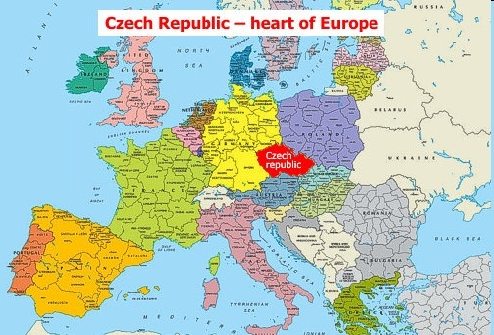
2,3,7,8-TCDD BODY BURDEN AND HEATH IMPACTS
IN PATIENTS 50 YEARS AFTER THE INTOXICATION
Daniela Pelclova
Department of Occupational Medicine, First Medical Faculty,
Charles University and General University Hospital, Prague, Czech Republic

Slide 2
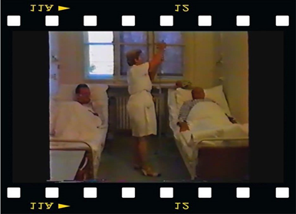
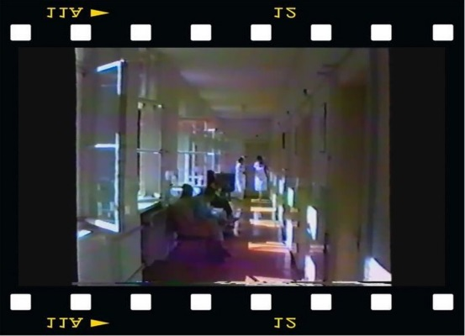
Czech workers exposed in 1965-1968
76 men developed „chloracne“ during the production of herbicide 2,4,5-trichlorophenol acetic acid (2,4,5-T)
formation of 2,3,7,8-tetrachlorodibenzo-p-dioxin (TCDD) occurred accidentally by wrong technical conditions as contaminant
Only toxicological analysis of the dust from the workplace was available
1991 film about the Department of Occupat. Medicine
in Prague, Czech Rep

Slide 3
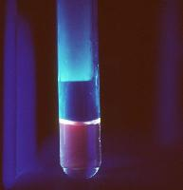
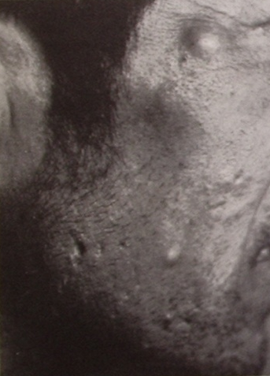
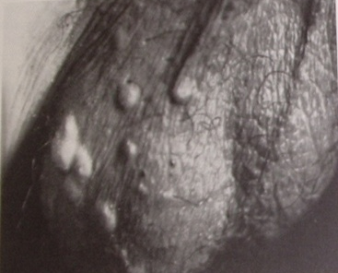
Czech Republic 1965-1968
80 men exposed in 2,4,5-T production
55 men examined in 1974
Mean age 36 years
Mean exposure 16 months
100 % „chloracne“ – face, genitals
97 % neuropsychological disturbances
50 % hyperlipidemia
20 % porphyria, hypertrichosis, dark skin
JIRÁSEK L et al.: Hautartzt 1976
First TCDD analysis was performed in 1996 (Prof. Rappe, Umeå, Sweden)

Slide 4
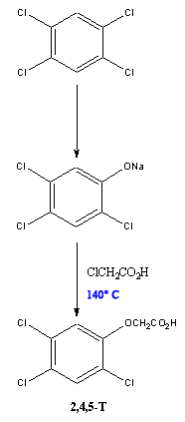
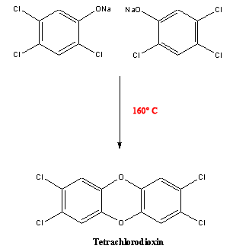


Herbicide production (Arborocid E) to control weeds and as a defoliant during the Vietnam war.
2,4,5-T
TCDD
Pazderova-Vejlupkova J, et al. The development and prognosis of chronic intoxication by tetrachlordibenzo-p-dioxin in men. Arch Environ Health 1981

Slide 5
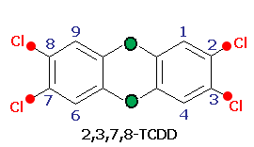
2,3,7,8-tetrachlorodibenzo-p-dioxin
(TCDD)
Colorless to white crystalline solid –
Insoluble in water; slightly soluble in organic solvents,
accumulates in the fat, half-life 7 years
IARC Carcinogen Group 1 (all cancers combined)
Guinea-pig LD₅₀ p.o. 1 μg/kg b.w.
Animals die during 2-3 weeks due to „wasting syndrom“
NO ANTIDOTE FOR TREATMENT
No known commercial applications,
but ubiquitous in the environment, soil, formed during burning,
higher in the top of the food chain

Slide 6
Mechanism of effect of TCDD
AhR- arylhydrocarbon receptor
Arnt- arylhydrocarbon nuclear transport protein
XRE- xenobiotics responsive elements
INCREASE OF ENZYMES OF PHASE 1 AND 2 OF XENOBIOTICS BIOTRANSFORMATION
TCDD
nucleus
diffusion
      cytosol
TCDD
AhR
Arnt
TCDD
Arnt
AhR
XRE (DRE) in DNA
mRNA
Alteration of expression of genes (CYP1A1, CYP1A2,CYP1B1, GST, UGT..)
Elevation of enzymes activities

Slide 7
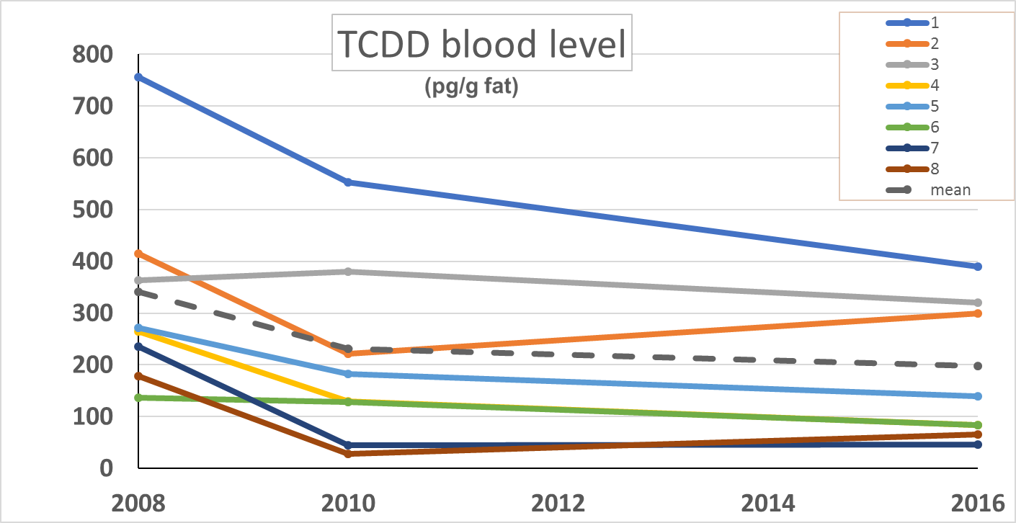
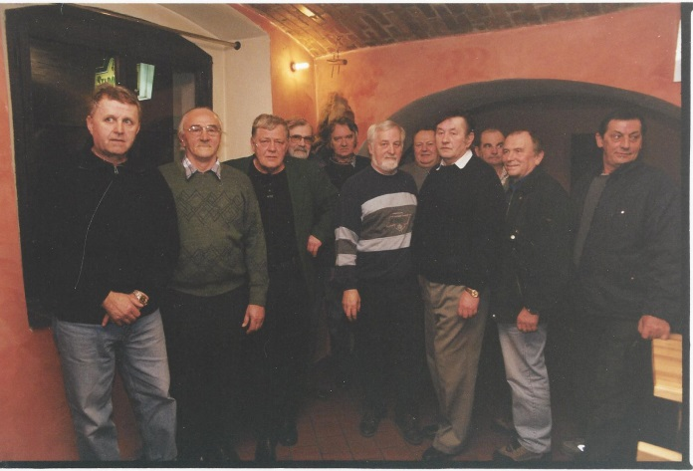
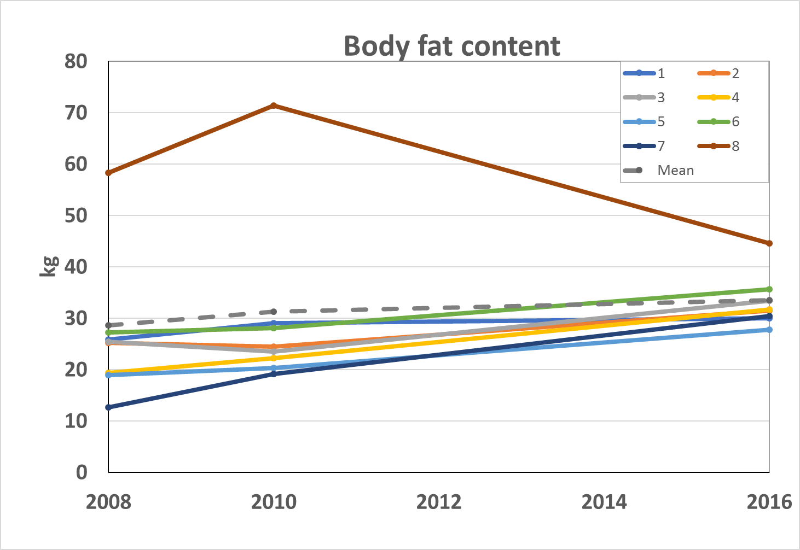
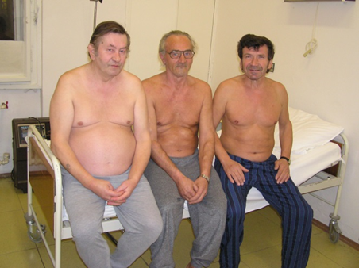
TCDD patients have been followed in 1996, 2001, 2004, 2010, 2016
15 TCDD patients in 2002
3 from 11 TCDD patients in 2010

Slide 8
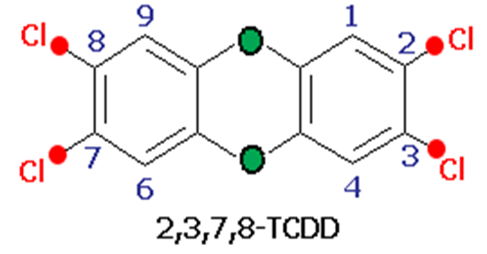

Examination in 2016
last 8 TCDD-exposed patients (out of 76 in 1965)
age 72.1 ± 1.5 years
Densitometry to estimate body fat (%, kg)
Neurological examination
Visual evoked potentials (VEP)
Nerve conduction study (EMG)
Single photon emission computer tomography (SPECT) of the brain
CDT – carbohydrate-deficient transferin (3-6 weeks´ alcohol exposure)
EG – ethylglucuronide in urine (recent alcohol exposure)

Slide 9

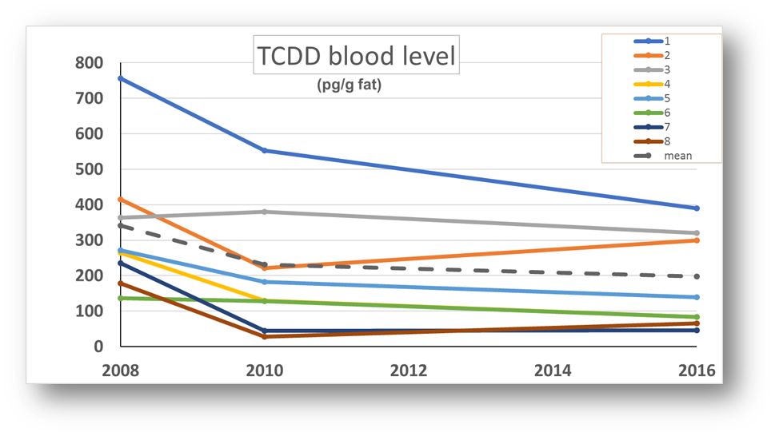
MEDIAN TCDD in blood 112 (46-390) pg/g blood lipids controls: 12 (0.10-22.2) pg/g blood lipids
MEDIAN TEQ in blood 146 (74-418) pg/g blood lipids
TCDD Half-life
1996-2006: 8.5 years 2010-2016: 10.2 years
MEAN

Slide 10
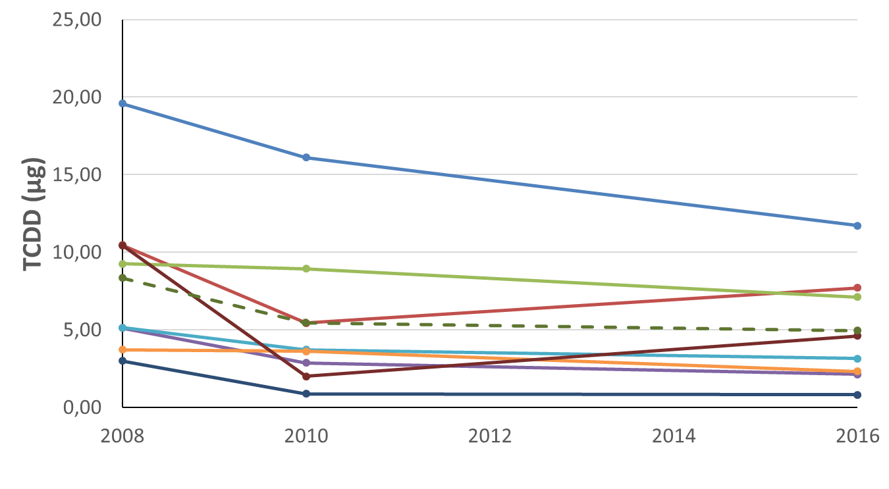
Total TCDD body deposit median 3.9 (0.8-11.7) µg
Mean TCDD body deposit

Slide 11

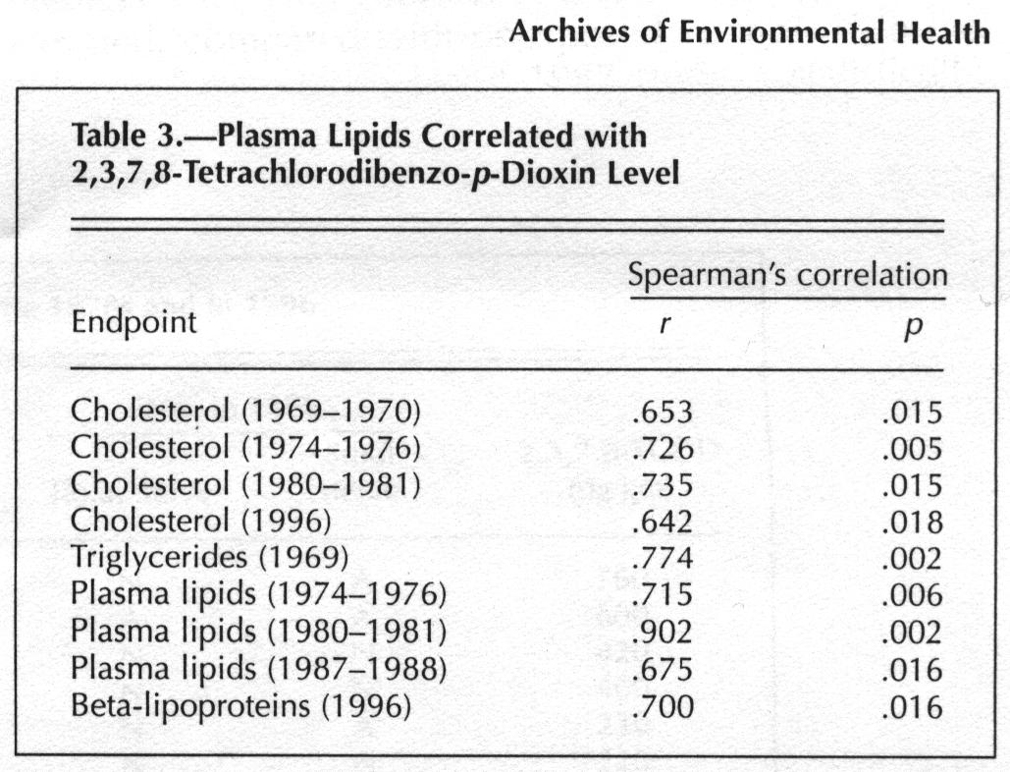
In 1996 first TCDD blood analysis hyperlipidemia correlated with TCDD
r=0.74, p=0.01
PELCLOVÁ D, et al. Biochemical, neuropsychological and neurological abnormalities following 2,3,7,8-TCDD exposure. Arch Environ Health, 2001
PELCLOVÁ D, FENCLOVÁ Z, PREISS, J et al. Lipid metabolism and neuropsychological follow-up study of workers exposed to 2,3,7,8-TCDD. Int Arch Occup Environ Health 2002

Slide 12
In 1996 first TCDD blood analysis - Neuropsychological impairment correlated with TCDD level
TCDD level
and neuropsychological
impairment
r=-0.76, p< 0.05
PELCLOVÁ D, FENCLOVÁ Z, PREISS, J et al. Lipid metabolism and neuropsychological follow-up study of workers exposed to 2,3,7,8-TCDD. Int Arch Occup Environ Health 2002
Notes:
Memory Quotient (MQ WMS)
Full Scale IQ WAIS-R test
Impairment Index HRNB
Category Test HRNB (2004)
Highest cholesterol (1996)
and neuropsychological impairment
Full Scale IQ WAIS-R test
Impairment Index HRNB
Category Test HRNB
Poruchy kognitivních funkcí prokázané v psychologických testech v řadě případů korelovaly s koncentrací dioxinu v krvi.
Index oslabení HRNB
(norma 0,0-0,40)
1996……… 0,45
2001……….0,58
2004……… 0,58
PREISS J: Experience with the Czech version of Wechsler Memory Scale-Revised (WMS-R) in neurological and psychiatrical patients p < 0,01
Normální výsledky byly zjištěny jen u osob pod 94 ppg (osoby 9 a 11)
Index oslabení HRNB 0,45 současně významné korelace s koncentrací cholesterolu v krvi
USA veteráni –u nejvíce exponovaných náznak poruchy kognit. funkcí
Barrett et al. 2001Serum dioxin and cognitive functioning among veterans of Operation Ranch Hand.Neurotoxicology. 2001 Aug;22(4):491-502.
Michalek et al. Serum dioxin and psychological functioning in U.S. Air Force veterans of the Vietnam War. Mil Med. 2003 Feb;168(2):153-9.

Slide 13
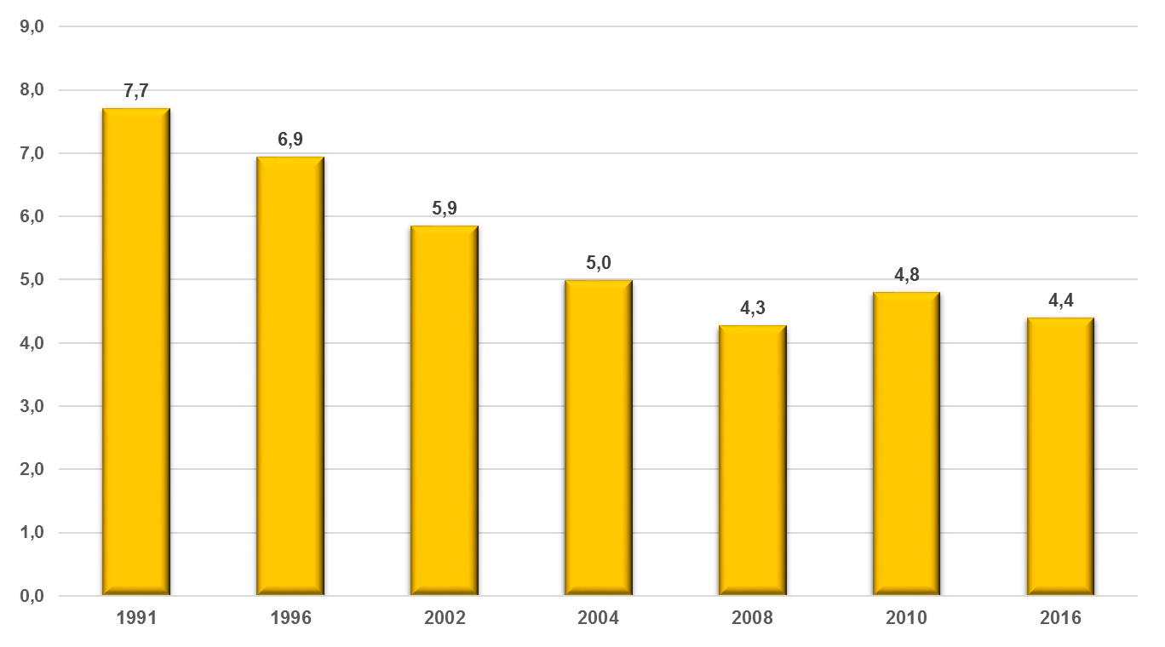
Lowering serum cholesterol with statins
(N 3.83-5.80 mmol/l)

Slide 14
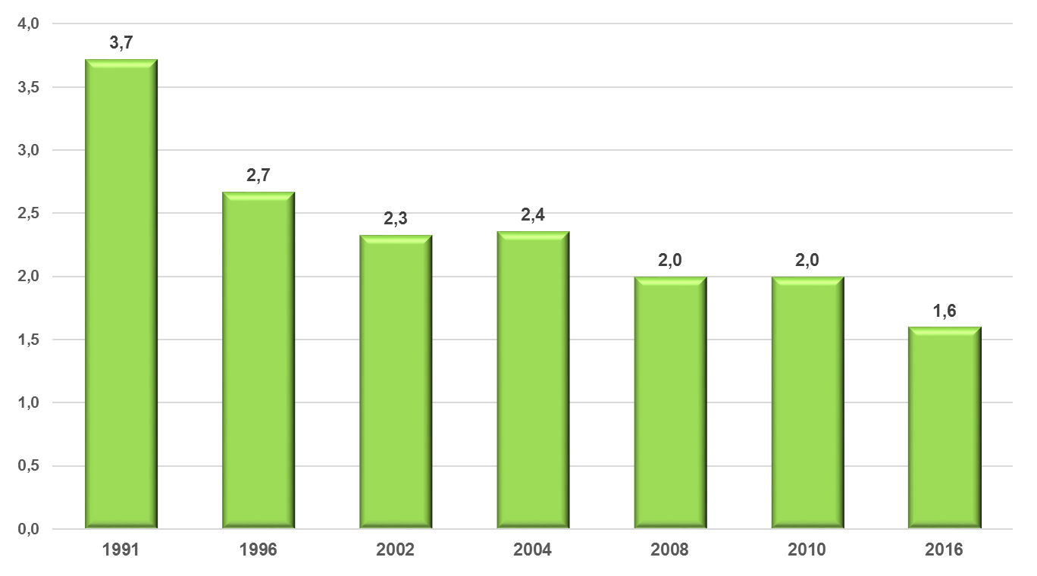
Lowering serum triglycerides with fibrates
(N 0.68-1.69 mmol/l)

Slide 15
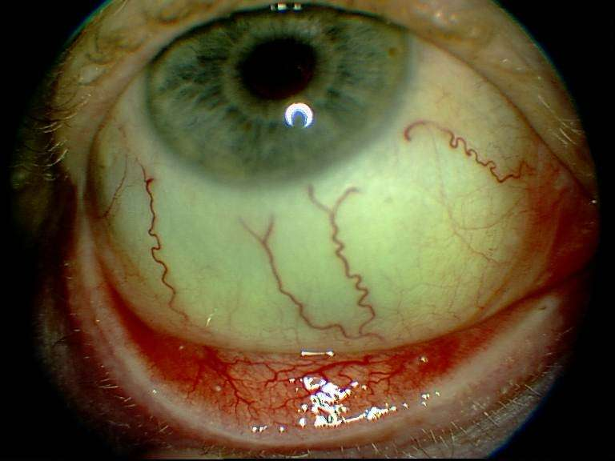
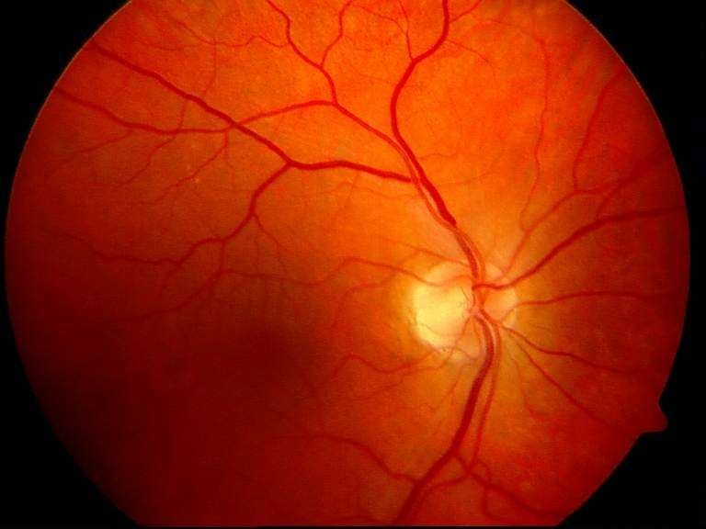
Eye vascular findings
(100% patients)
Chronic coniunctivitis Angiosclerosis at the eye fundus

Slide 16
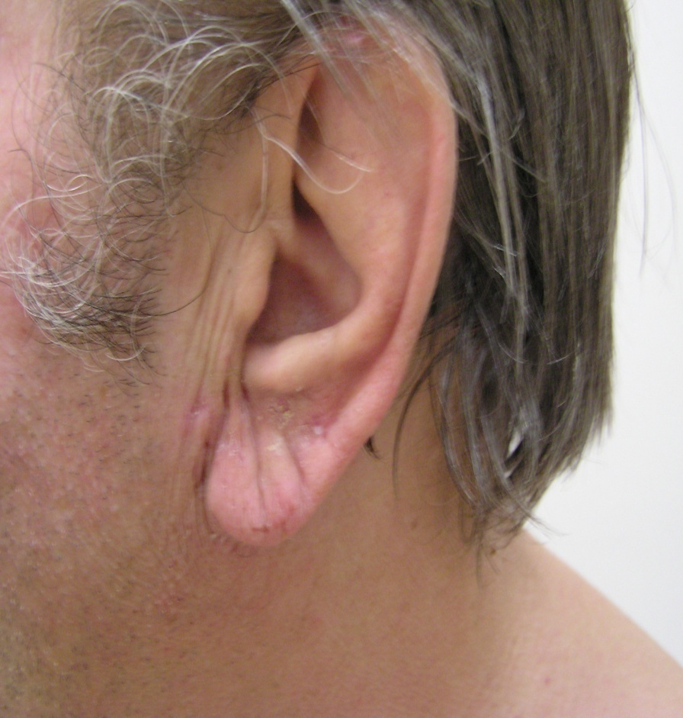
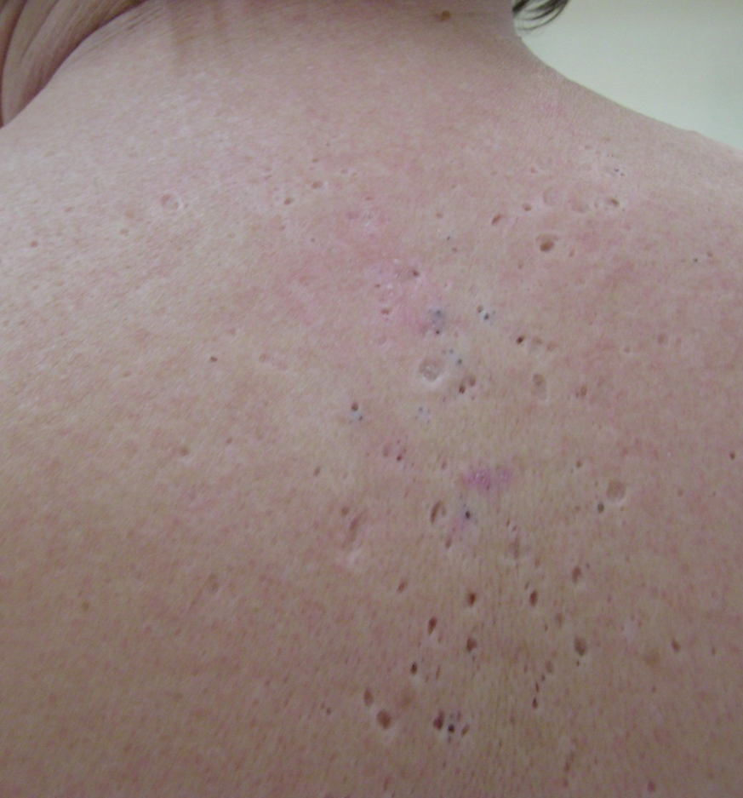
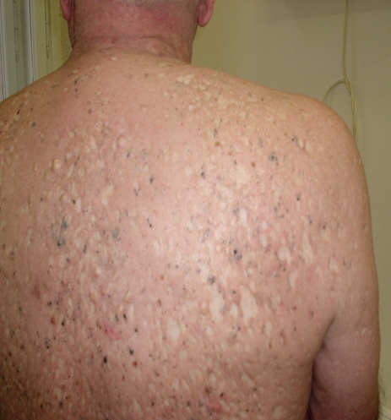
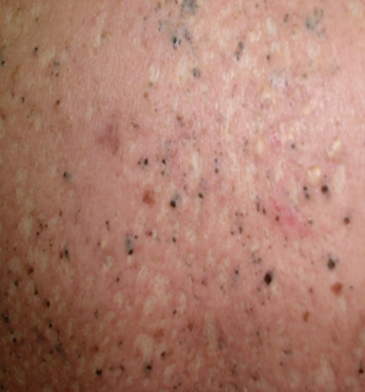
In 2016 all patients had residues of „chloracne“ –
MADISH - Metabolising Aquired Dioxin Induced Skin Hamartomas (cysts, no sebaceous glands, Saurat et al. 2012)
Pelclová D, et al. Adverse health effects in humans exposed to 2,3,7,8- TCDD.
Rev Environ Health 2006

Slide 17
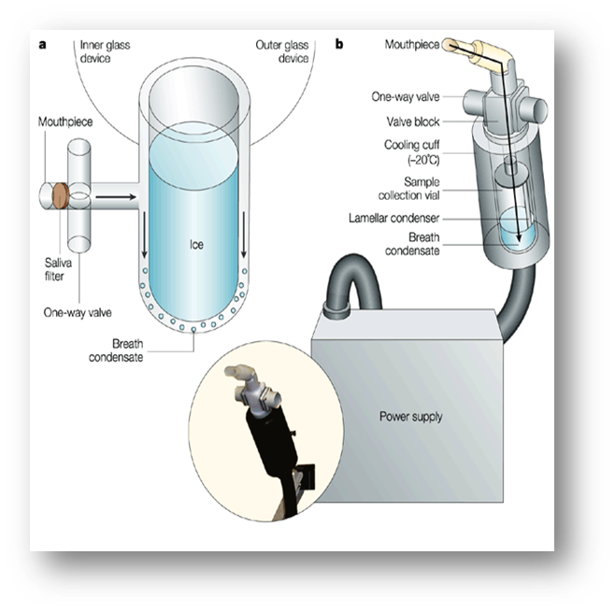


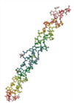
Markers in exhaled breath condensate (EBC)
LC-ESI-MS/MS analysis
malondialdehyde (MDA)
4-hydroxy-trans-nonenal (HNE) oxidation of lipids
8-isoProstaglandin F_{2α} (8-isoprostane)
8-hydroxy-2-deoxyguanosine (8-OHdG)
8-hydroxyguanosine (8-OHG) oxidation of nucleic acids
5-hydroxymethyl uracil (5-OHMeU)
o-tyrosine (o-Tyr)
3-chloro-tyrosine (3-Cl-Tyr) oxidation of proteins
nitrotyrosine (NO-Tyr)
leukotrienes LTB₄, LTC₄, LTD₄, LTE₄ markers of inflammation

Slide 18
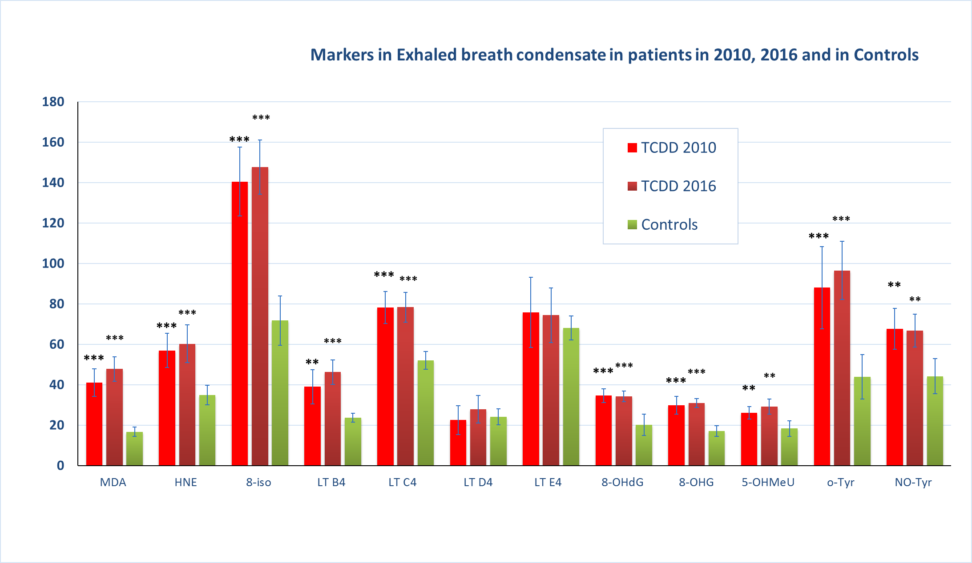
Oxidative Stress and Inflammation Markers 2010 and 2016 in TCDD-exposed patients and controls in exhaled breath condensate (malondialdehyde, 4-hydroxy-trans-nonenal, 8-isoprostane, leukotrienes B4, C4, D4, E4,
8-hydroxy-2-deoxyguanosine, 8-hydroxyguanosine, 5-hydroxymethyl uracil, o-tyrosine, 3-chloro-tyrosine, nitrotyrosine)
**p<0.01, ***p<0.001
Pelclova D, et al. Increased oxidative/nitrosative stress markers measured non- invasively in patients with high 2,3,7,8-TCDD plasma level. Neuro Endocrinol Lett. 2011.
MDA and HNE are expressed in ng/ml, all other markers in pg/ml

Slide 19
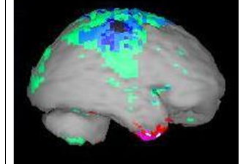
Neurological abnormalities
A- abnormal, N – normal
Patient No. | TCDD (pg/g fat) | TCDD body deposit (µg) | NCS (EMG) | Acquired dyschro- matopsia | SPECT | No of abnor-malities
1 | 390 | 11.7 | A | A | A | 5
2 | 320 | 7.1 | A | A | A | 4
3 | 300 | 7.7 | A | A | A | 5
4 | 140 | 3.2 | A | A | A | 5
5 | 84 | 2.1 | A | A | A | 5
6 | 83 | 2.3 | A | N | A | 4
7 | 66 | 4.6 | N | N | A | 4
8 | 46 | 0.8 | N | A | A | 4
Median/% | 112 | 3.9 | 75% | 63% | 100% | 4.5
Pelclova D et al. Basic & Clinical Pharmacology & Toxicology, 2017

Slide 20
Perfusion SPECT Imaging of the Brain
(Single-Photon Emission Computer Tomography)
DISTRIBUTION OF THE REGIONAL CEREBRAL BLOOD FLOW
SPECT showed focal reduction of perfusion in various brain locations in all 8 (100% patients)
worsening since 2010 in 4 (50%) patients
Patient No 5 - development of the perfusion pathology in area parietalis superior right hemisphere since 2010
^{99m}Tc-HMPAO SPECT - Neurogam Segami
2010
2016
HYPOPERFUSION - statistical subtraction:
SD -2.0 = green; SD -3.0 = iris-blue; SD -4.0 = blue;
HYPERACCUMULATION („hyperperfusion”) SD+2.0=red; SD+3.0=pink; SD+4.0=white.

Slide 21
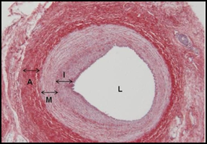

Metabolic, vascular abnormalities
Patient No. | TCDD (pg/g fat) | Diabetes | Carotid patho logy | Athero AMI, IS, CHD | Dyslipi daemia | Hyper tension | No of abnor-malities
1 | 390 | A | A | A | A | A | 5
2 | 320 | N | A | N | A | A | 3
3 | 300 | N | A | A | A | A | 4
4 | 140 | A | A | A | A | A | 5
5 | 84 | A | A | N | A | A | 4
6 | 83 | A | A | A | A | A | 5
7 | 66 | A | A | A | A | A | 5
8 | 46 | N | A | N | N | N | 1
Median/% | 112 | 63% | 100% | 63% | 88% | 88% | 4

Slide 22
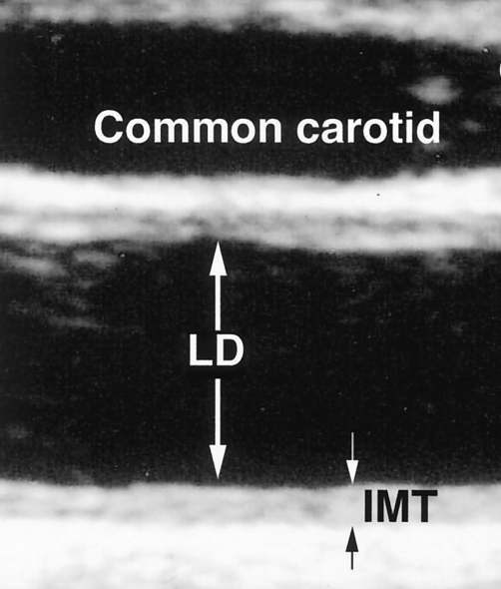
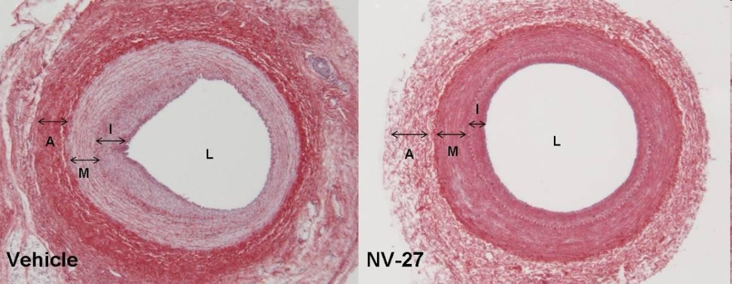
Ultrasonography of carotid arteries
100% had plaques in carotid arteries
2 patients had surgery of carotid artery
Patient 1: 2001+2009,
Patient 4: 2007, 2016 progression
62.5% patients has increased intima-media thickness (IMT)
direct toxic effect of TCDD
chronic hyperlipidemia and endothelial dysfunction.
Pelclová D, et al. 2,3,7,8-TCDD exposure, endothelial dysfunction and impaired microvascular reactivity. Hum Exp Toxicol. 2007

Slide 23
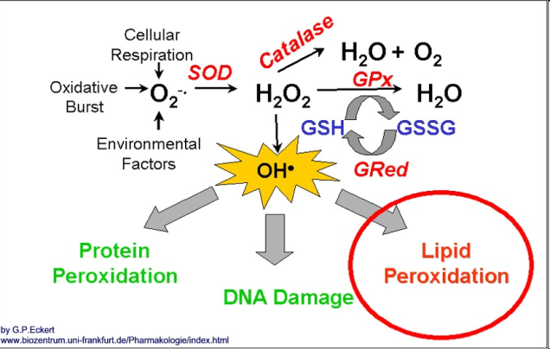
Experimental studies
BIRNBAUM 1985: The role of structure in the disposition of halogenated aromatic xenobiotics.
DALTON PT, et al. 2001: Dioxin exposure is an environmental risk factor for ischemic heart disease.
VOGEL 2004: Activation of inflammatory mediators and potential role of AhR in foam cell formation.
HAWS, BIRNBAUM 2006: Development of a refined database of mammalian relative potency estimates for dioxin-like compounds.
KOPF AND WALKER 2009: 2,3,7,8-TCDD increases ROS production in human endothelial cells via induction of cytochrome P4501A1
WU et al. 2012: Activation of Ah receptor induces vascular inflammation and promotes atherosclerosis

Slide 24

Human studies
BERTAZZI 2001, MOCARELLI 2008 Increased risk for type 2 diabetes, adverse cardiovascular effects, altered endocrine function – after Seveso 1976
MICHALEK and PAVUK 2008 Diabetes and cancer in veterans of Ranch Hand in Vietnam
FINGERHUT 1991 Cancer mortality in workers
WHITE AND BIRNBAUM 2009 Effects on vertebrates
TAYLOR, ..BIRNBAUM 2013 Question of environmental exposure to persistent organic pollutants (POPs) and diabetes in epidemiological studies

Slide 25
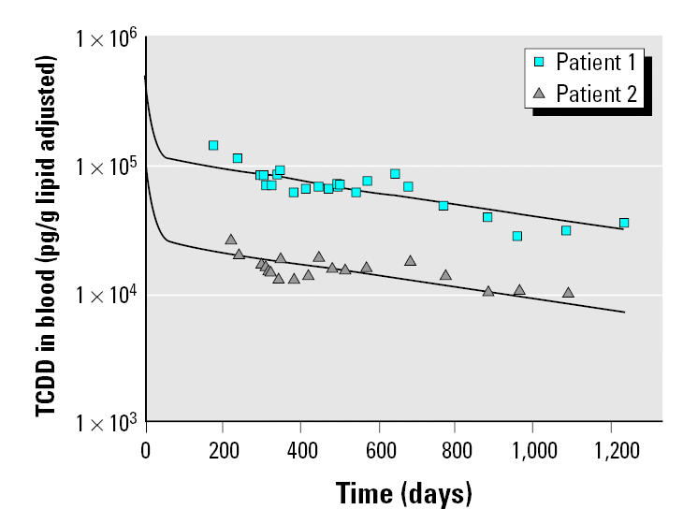
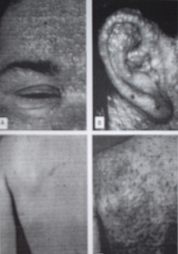
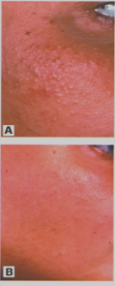
Elimination half-life is shorter initially
One volunteer single oral dose 1.14 ng TCDD/kg followed for 40 days (POIGER, SCHLATTER 1086): Pharmacokinetics of 2,3,7,8-TCDD in man.
Physiologically based model incorporates an inducible elimination of TCDD in high levels - above 1 250 pg/g fat (EMOND et BIRNBAUM 2004, 2005) –
induction of P450 1A1, P450 1A2, and P450 1B1 and increased enzymatic activity and increased ROS production in human cells (KOPF, WALKER 2010)
Half-life 1.5 and 3 years during 3 years period
AUSTRIA 1998
144 000 pg/g fat
26 000 pg/g fat
(GEUSAU 2002)

Slide 26
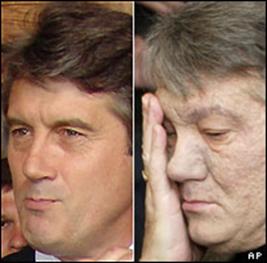
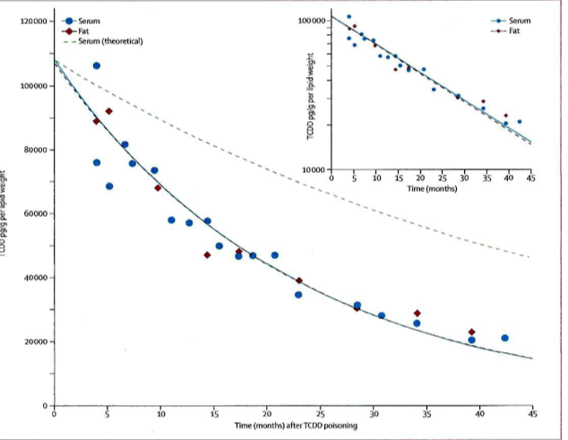
Ukraine 2004
Candidate for president V. Y.
Dinner in Kiev on September 5, 2004
Diagnosis on December 2004
blood level 4.5 months later: 108 000 pg/g fat
Initial half-life 1 ¼ year
V. Yuschenko
(SORG 2009)

Slide 27
Occupational or Environmental Exposure | Years | Acute back-calculated 2,3,7,8-TCDD (pg/g plasma fat) of the group using physiologically based model (Emond et al. 2005)
USA, Veterans | 1962-1971 | <35 000* (Emond 2005)
Seveso, Italy | 1976 | <56 000 zone A** (Landi 2003)
Workers, Czech Republic | 1965-68 | 35 000 - 355 000
Population level | now | 2-25

Slide 28
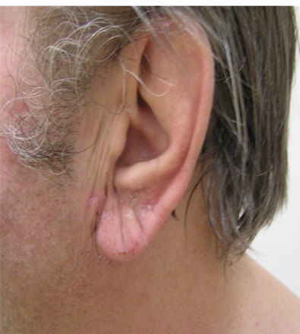
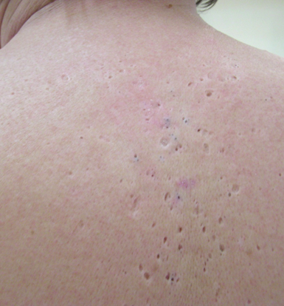
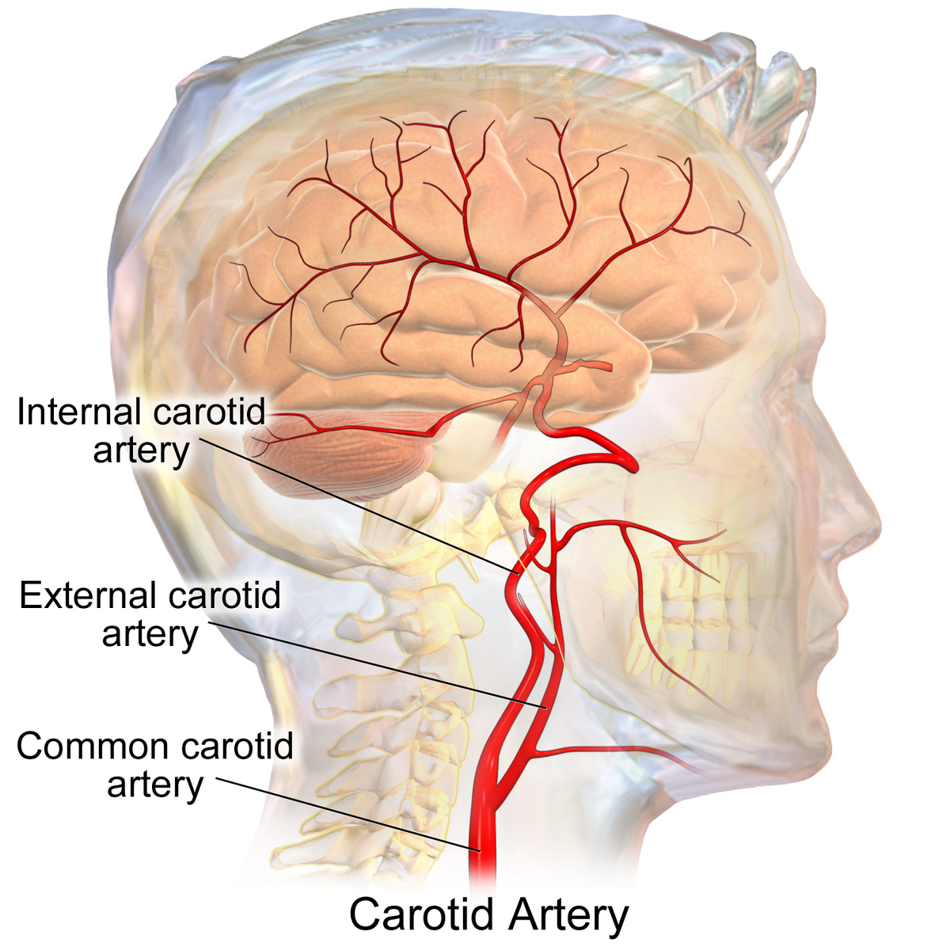
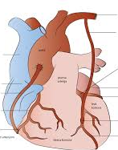
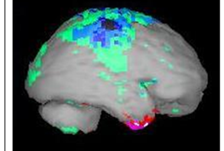
Patient No. 1, born 1945
Exposed for 9 months in 1968 as chemical worker in 2,4,5-T production and for 3 months he cleaned the building
1968 „acne“ appeared
1969 whole year disabled for „whole body acne“ with surgical interventions
1996 hypertension, type 2 diabetes
1998 mixed hyperlipoproteinaemia
2001 hypothyreoidism
2001 bilateral stent in the common carotid artery, 80% stenosis
2010 MI, 2011 Bypass aortocoronarius triplex
2016 SPECT impaired in both hemispheres, impairment since 2010
Psychol: cognitive deficits, impaired memory, low mental
flexibility,…
We use all that data when we suggest compensation for impaired
life capacity of the patients by the accident insurance

Slide 29
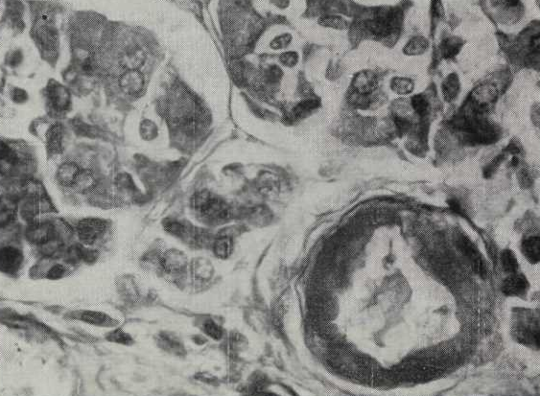
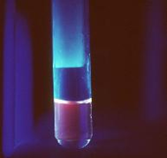
Lethal Intoxication with dioxin (?)
55-y old healthy worker (born 1913, died 1970)
9 months exposed as chemical worker in 2,4,5-T production
Died in the course of 2 years: cachexia (164 cm/48 kg), dementia, porphyria, chloracne, hyperpigmentation, hypertrichosis, hypertension, diabetes, neuropathy
Family received compensation for his occupational intoxication in 1970
Pathological anatomy findings:
Generalized arteriosclerosis (brain, liver, kidneys, pancreas)
Cardiac hypertrophy
Porphyria (fluorescence in UV light - liver, kidney, bone marrow)
Peripheral neuropathy
Immediate cause of death:
Bronchopneumonia
PAZDEROVÁ-VEJLUPKOVÁ J, LUKÁŠ E, NĚMCOVÁ M, et al.: Arch Environ Health 1981
Atheroma

Slide 30
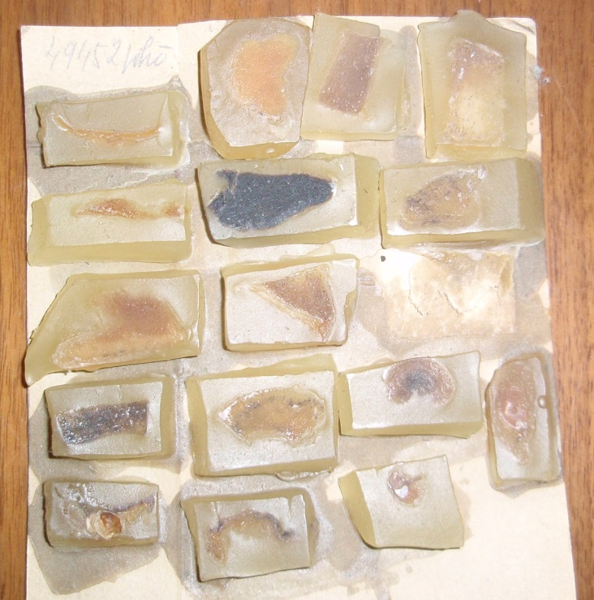
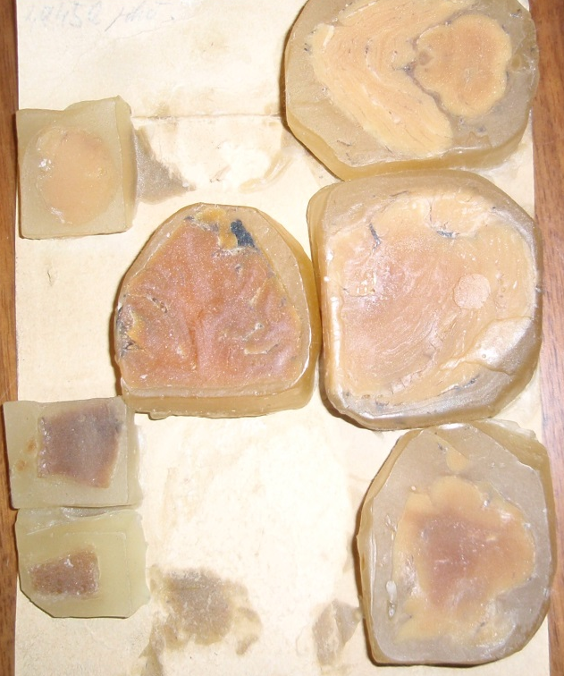
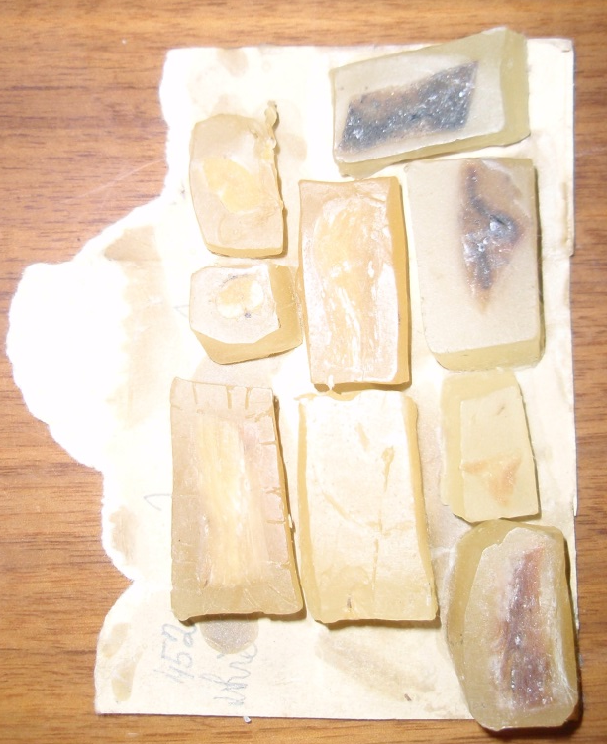
Histology samples of the patient (1913-1970)
        Thank you

Slide 32
Other congeners
WHO Toxic Equivalency Factor (TEF) 2005
2,3,4,7,8-PeCDF (TEF 0.3) in patient No.1 and patient No. 4 the level increased by factor 1.5-2.
Median 2,3,7,8-TCDF (TEF 0.1) was 9fold higher comparing with 1996.
Median 1,2,3,6,7,8-HxCDF (TEF 0.1) in patient No. 1 increased 11fold from 3.1 pg/g lipids in 1996.

Slide 33
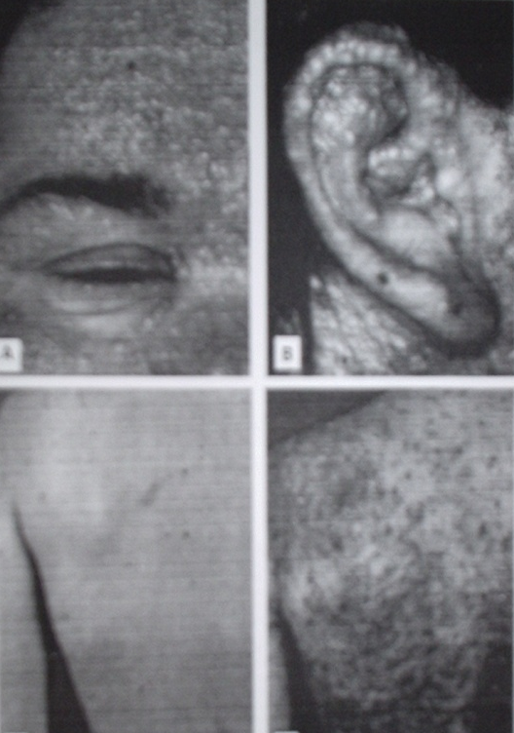
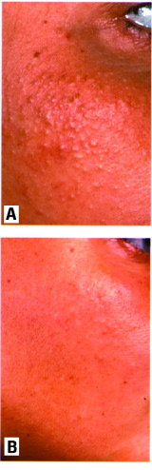
Austria 1998
Severe intoxication of two young women
144 000 pg/g fat = 25 μg/kg b.w. 26 000 pg/g fat = 6 μg/kg
Elimination half-life during a 3-year period
1.5 years 2.9 years
Maximum back-calculated initial levels (after acne appearance)
507 000 pg/g fat 87 000 pg/g fat
GEUSAU et al.: Severe 2,3,7,8-TCDD intoxication: kinetics and trials to enhance elimination in two patients. Arch Toxicol 2002
Patient 1
Patient 2

Slide 34

CONCLUSIONS
The longest follow-up - 50 years and first clinical study to find:
The last survivors have severe findings
TCDD levels slowly decrease to lower levels
Elevation of markers of oxidative stress
Endothelial dysfunction, vascular impairment
– carotid arteries, eye fundus
Impaired brain vascular supply (SPECT)
Oxidative stress markers elevated
No effect of ethanol consumption

