Slide 1
Gulf War Illness Etiologies and mechanisms: Implications for patients with non-military occupational illnesses
Roberta F White, PhD, ABPP
Collegium Ramazzini Annual Meeting
October 28, 2017
Notes:
--GWI, a disorder that has been extensively studied in relation to military participation in the 1991 Gulf War and that may have implications for other occ and env populations

Slide 2
1990-1991 Gulf War: Operations Desert Shield/Desert Storm
Aug 2, 1990 - Iraq invaded Kuwait
Jan 16, 1991 - Air strikes began
Feb 24, 1991 - Ground combat began
Feb 28, 1991 - Cease fire declared
________________
- 6 weeks air strikes, 4 day ground war
- 37 countries in Allied Coalition
~ 700,000 U.S. troops
- Relatively few Allied casualties
Notes:
--As a reminder, the conflict began with the invasion of Kuwait by Iraq in August of 1990 and ended after 6 weeks of airstrikes and 4 days of ground combat
--over 37 countries were involved

Slide 3
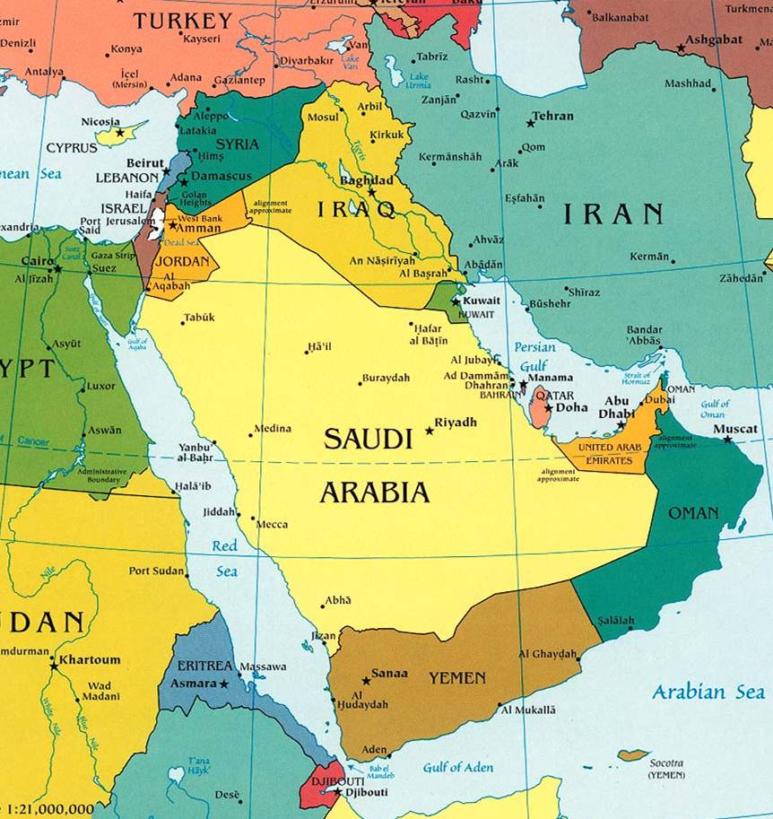
1990-1991 Gulf War
Notes:
--Theater of war

Slide 4
Gulf War Illness Case Definitions:
Based on Symptoms in Multiple Domains that Affect Gulf War Veterans at Significantly Excess Rates
PAIN
SYMPTOMS
Joint Pain
Muscle Pain
NEUROLOGICAL
SYMPTOMS
Memory Problems
Headaches
Dizziness
Mood Changes
FATIGUE
SYMPTOMS
Fatigue
Sleep Problems
RESPIRATORY
SYMPTOMS
Persistent Cough
Wheezing
GASTROINTESTINAL
SYMPTOMS
Diarrhea
Nausea
SKIN
PROBLEMS
Rashes
Other Problems
At least 10 different approaches to case definition have been used; some studies use no case definition
Notes:
--Within a few months of return from the war, it became apparent that a substantial subset of US GW veterans were ill with symptoms involving multiple body systems that were difficult to diagnose
--These sx include pain, neurological complaints, fatigue, GI sx (esp IBS), respiratory sx and skin rashes
--The exact sx varied among veterans but combinations of these sx affected about 1/3 of US troops or 250,000 people—also identified in UK< Danish, Australian and other troop cohorts

Slide 5
Large number of Gulf War-related experiences and exposures of potential concern
Combat stress
Chemical weapons*
Oil well fires
Munitions containing depleted uranium
Heavy use of insecticides/repellants*
PB pills (pyridostigmine bromide)*
Vaccines
Infectious diseases
Tent heaters
Particulates
Fuel exposures
Solvents, CARC paint
Notes:
--the 1991 GW was considered to be a “chemical war” in the US—but did this have anything to do with sx of GW veterans?
--Starred exposures are Op or Op-like chemicals

Slide 6
Early Research
  1991: Ft Devens Survey
    Focus: PTSD, psychiatric symptoms, health symptoms (HS36, short version) (N about 2000)
  1993: VA OPH clinical funding (Boston)*
    Foci: PTSD, multiple chemical sensitivity, chronic fatigue syndrome, chemical exposures
  1994-1999: VA Environmental Hazards Centers, Haley syndrome studies
    Three centers
      New Jersey (CFS/MCS)
      Portland (case definition)
      Boston (high symptom reporters, exposure-outcome)*
Notes:
--Doing research into this situation has been one of the greatest challenges of my career and I became involved in 1993—and that involvement has continued to date—
dozens of collaborators and investigators including fellow Ramazzian David Ozonoff

Slide 7
What Gulf War illness isn’t
Early findings from Devens cohort that have been repeatedly confirmed
Gulf War illness is not:
  Multiple chemical sensitivity
  Chronic fatigue syndrome
  Fibromyalgia
  Post-traumatic stress disorder
  Psychiatric disorders
Rates of these disorders 1-6% in Devens cohort, <10% in later cohorts
Notes:
--It immediately became evident that the veterans’ sx were not attributable to “stress” or PTSD: more vets had GWI than these disorders, having PTSD dn predict having GWI
--Despite overlapping sx, most of the ill GW vets did not meet criteria for MCS, CFS or FM

Slide 8
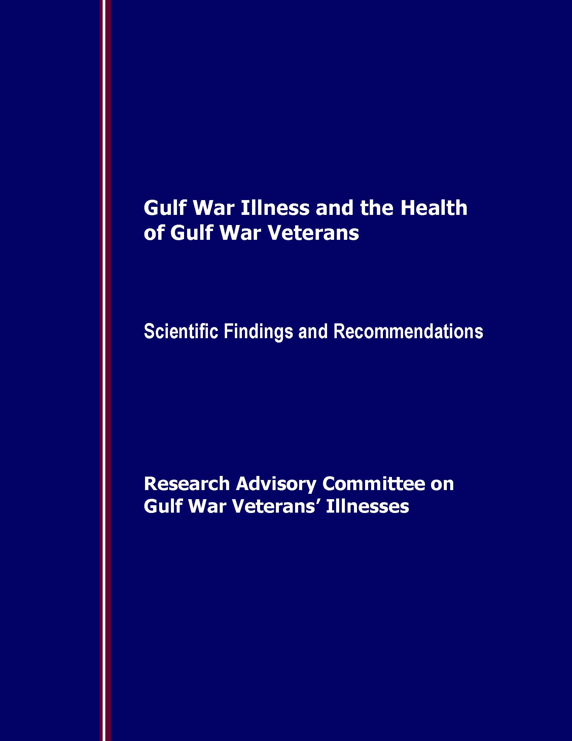
2008 Report (2004-2008)
Notes:
--What GWI is and how it relates to exposures in theater have been summarized in a series o f3 reports from the US Research Advisory Committee on GWI

Slide 9
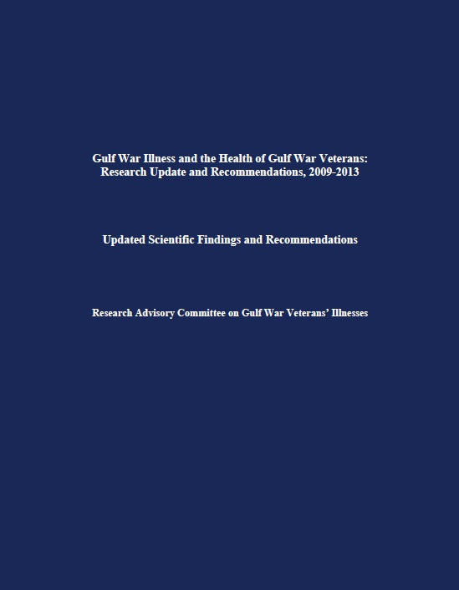
2014 Report (2008-2013)
Notes:
Basis for recent outcome update slides

Slide 10
White RF et al. Recent Research on Gulf War illness and other health problems in veterans of the 1991 Gulf War: Effects of toxicant exposures during deployment (Massachusetts, USA). Cortex. 15 September 2015; DOI: 10.1016/j.cortex.2015.08.022
Notes:
--and the 2014 RAC report was summarized in this paper

Slide 11
Etiologic Factors for Gulf War Illness
Summary of Epidemiologic Studies of Gulf War Veterans
- Psychological stress | Evidence indicates no association
- Pyridostigmine bromide (PB) - Pesticides | Evidence consistently indicates a significant association
- Low-level nerve agents Sustained oil well smoke - Large number of vaccines - Combinations of exposures | Association cannot be ruled out; evidence is inconsistent or limited in important ways
- Depleted uranium - Anthrax vaccine - Fuels, solvents - Sand, particulates - Other | Unlikely to have caused Gulf War illness for the majority of affected veterans
Notes:
--Multiple studies implicate exposure to pesticides and to pyridostigmine bromide (given to US troops experimentally as anti-nerve gas agents) as being associated with developing GWI
--Several studies also implicate sarin gas exposure and a few suggest that oil well fire smoke exposure may have been a factor for some troops
--Some of these exposures are also related other ilnesses such as ALS and brain tumors

Slide 12
What is Gulf War illness??
(My opinion)
GWI is an occupational disease caused by exposures to OP-like substances and pesticides in the 1991 Gulf War theater and characterized by chronic neuroimmune dysfunction affecting multiple body systems in genetically vulnerable individuals
It is a form of chronic intoxication.

Slide 13
Research Studies on Gulf War Illness Using Animal Models:
Take Home Message from OP-like Exposure Studies
  As in ill veterans, multiple organ systems implicated
  Multiple combined exposures consistent with in-theater exposures are implicated
  CNS and Autonomic nervous system function/structure affected
  Neuroendocrine and neuroimmune measures preferentially affected
  No defined pathobiological “mechanism” but neuroinflammatory/ mitochondrial dysfunction represent key possibilities now under more extensive investigation.
  Genomic and proteomic profiling underway to identify novel targets for therapeutic interventions
Notes:
--The epi and human clinical work led to animal models of GWI that replicated GW-relevant exposures and investigated chronic and delayed outcomes
--The animal models have confirmed CNS,ANS, neuroimflammatory findings in the human work and are being used to drive mechanistically based pre-clinical trx trials

Slide 14
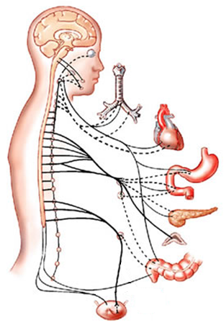
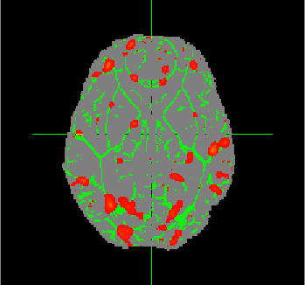
What physical changes in the body led to Gulf War illness?
Notes:
CNS/neuroimmune dysfunction

Slide 15
Do repeated low-dose exposures to OPs cause neurotoxicity in humans: occupational research
Weight of evidence
  (19 of 24 studies) suggests that occupational exposures to OPs are associated with decrements in neurobehavioral function
Review of 24 studies indicate decrements in exposed vs. controls for scores in several functional domain outcomes:
Motor Speed/Coordination (10 studies)
Information Processing Speed (8 studies)
Complex Visual Motor/Executive Function (12 studies)
Attention/Short-term Memory (9 studies)
Memory (6 studies)
Rohlman et al., 2011, Neurotoxicology
Notes:
--the evidence on CNS effects of OP exposures in the occupational and env health literature is strikingly similar to that for GWI for ag workers and their families, pest applicators, sheep dippers and other groups, including airline workers, some of who have a syndrome similar to GWI

Slide 16
Implications beyond Gulf War illness
Occupational populations with OP exposures
Environmental exposures
Mixtures
Complex immunological/multi-system responses to exposures
Gene-environment interactions
Effective treatments
Notes:
--This work has implications for env and occ health,
--And we might add sarin exposure to the list for env exposures given recent chemical attacks in Syria
--in addition to exposed populations, the literature on GWI considers: mixtures, complex immunological/neur, gene-

Slide 17
Treatments
Improve well-being, pain, energy
  Tai Chi, yoga, acupuncture
  Brain stimulation, O2
Treat oxidative stress, mitochondrial dysfunction, neuroimmune responses
  Co-enzyme Q10
  Low-dose naltrexone/avoid opiods
Reverse damage/cure??
Notes:
--When looking to treat pts with env or occ exposure to OPs or OP-like substances, we might look to this evolving research, which is funded annually through the US DoD GWIRP
--go through slide on levels of trx
--I don’t know of other systematically funded research programs for TREATMENT of pesticide-related illnessesa and would like to hear of any that are known—but I suggest that this is a place to start

Slide 18
Thanks for listening and for your thoughts!

